Slide 1
LAB 5
Write code to simulate rolling three six-sided dice
Print Triple, Double
srand(), rand()
srand(8987)
int a = rand()
Ask user first enter a "seed" value
Demo
void roll_three(int* one, int* two, int* three)

Slide 2
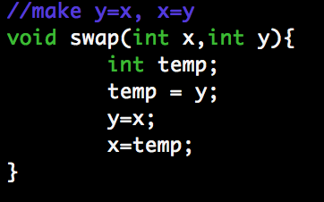
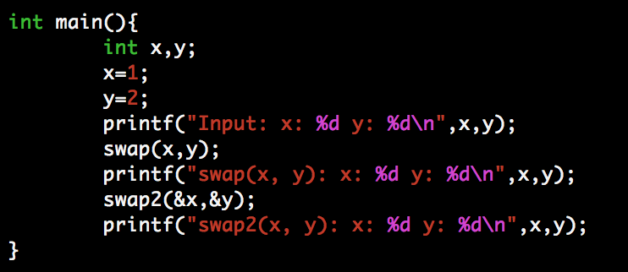
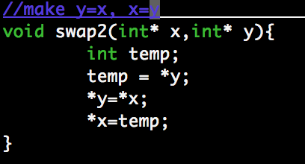
Pointer
Swap example
What is the output value?

Slide 3
MP 5
Code breaker (Guess the four hidden string solutions)
Perfect matches: number of the guess that appear in the same place in the solution code (1000pts)
Misplaced matches: number of values that appear somewhere in the solution but in a different place (100pts)

Slide 4

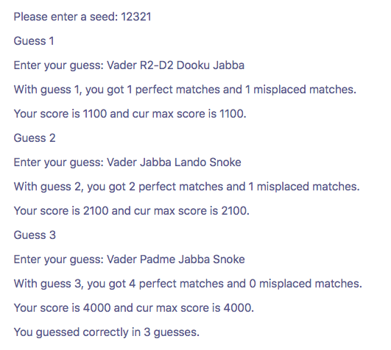

Slide 5
set_seed
int set_seed (const char seed_str[]);
If input is valid, set seed and return 1
Else print "set_seed: invalid seed\n” return 0
‘123’ - valid
‘123vvv’ -invalid
‘123 34’ –invalid
‘hello’ – invalid
int sscanf (seed_str, "%d%1s", &seed, post))

Slide 6
sscanf <stdio.h>
int seed;
char post[2];
int sscanf (seed_str, "%d%1s", &seed, post))
seed_str: C string that the function processes as its source to retrieve the data
"%d%1s”: one int, one string
seed: store the integer
post: store the string
return: number of items were read
seed_str = “123abc“
seed_str = ”123“

Slide 7
start_game
void start_game (int* one, int* two, int* three, int* four)
Generate a solution of 4 random terms
idx = rand() % 8
Init max_score = -1, guess_number = 1
"Vader", "Padme", "R2-D2", "C3PO", "Jabba", "Dooku", "Lando", "Snoke"

Slide 8
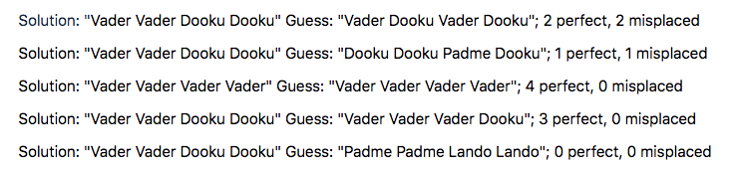
make_guess
int make_guess (const char guess_str[], int* one, int* two, int* three, int* four);
Check valid guess, store guess to one, two, three, four
If invalid print "make_guess: invalid guess\n” return 0
Compute the number of perfect and misplaced matches.
Calculate the score and update max_score if the current score is larger than the max_score.

Slide 9
Compile and Test
gcc -g -std=c99 -Wall -Werror test.c prog5.c -o test5
./test5 0
./test5 1
./test5 2

Slide 10
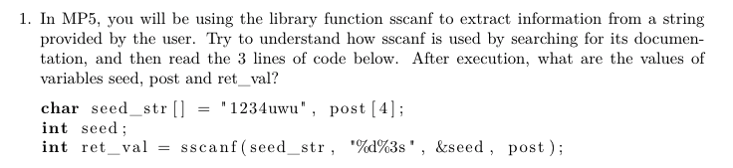

Slide 11
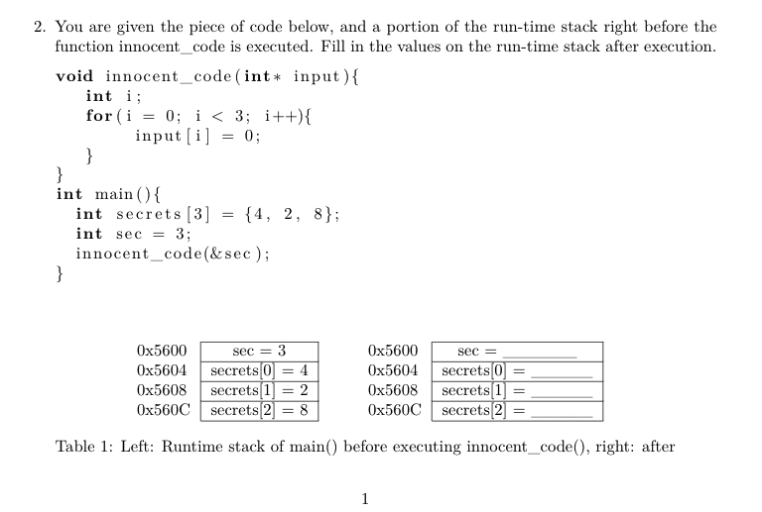
0
0
0
8

