Slide 1
ECE220 LAB6

Slide 2
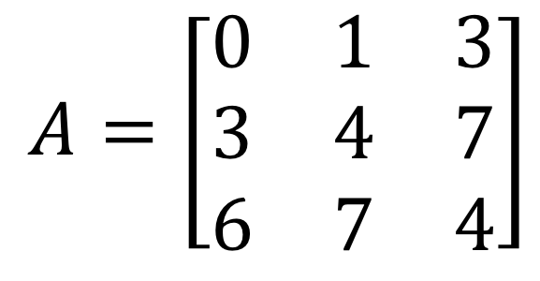
Lab 6 Matrix Multiplication
Represent an m x n matrix using 1-D array
Col(j) 0 1 2
Row (i)
0
1
2
A[5] -> 7
A[1][2] x
$$A=\left[\begin{matrix}0 & 1 & 3 \\ 3 & 4 & 7 \\ 6 & 7 & 4\end{matrix}\right]$$
A = [0 1 3 3 4 7 6 7 4]
Array index 0 1 2 3 4 5 6 7 8
(i, j) (0,0) (0,1) (0,2) (1,0) (1,1) (1,2) (2,0) (2,1) (2,2)

Slide 3
Linear(i, j) = i x n + j , n: # of columns
Linear(1, 2) = 1 x 3 + 2
Linear(2, 1) = 2 x 3 + 1
Col(j) 0 1 2
Row (i)
0
1
2
$$A=\left[\begin{matrix}0 & 1 & 3 \\ 3 & 4 & 7 \\ 6 & 7 & 4\end{matrix}\right]$$

Slide 4
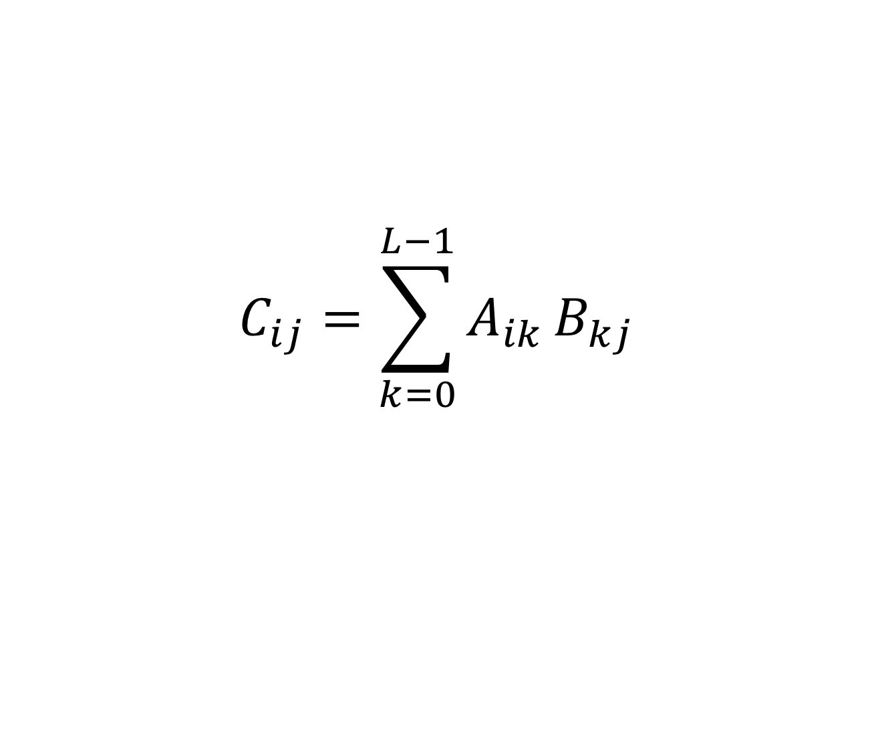
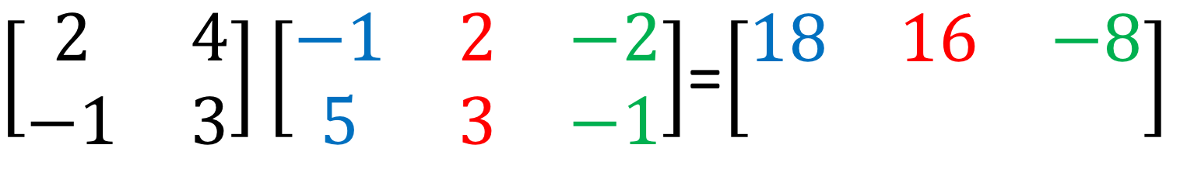
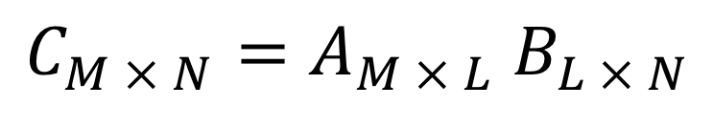
Matrix multiplication
$\left[\begin{matrix}2 & 4 \\ −1 & 3\end{matrix}\right]\left[\begin{matrix}−1 & 2 & −2 \\ 5 & 3 & −1\end{matrix}\right]$=$\left[\begin{matrix}18 & 16 & −8 \\ & & \end{matrix}\right]$
2 x 2
2 x 3
2 x 3
$C_{M × N}=A_{M × L}$ $B_{L × N}$
$$C_{ij}=\sum_{k=0}^{L−1}{A_{ik}}B_{kj}$$

Slide 5
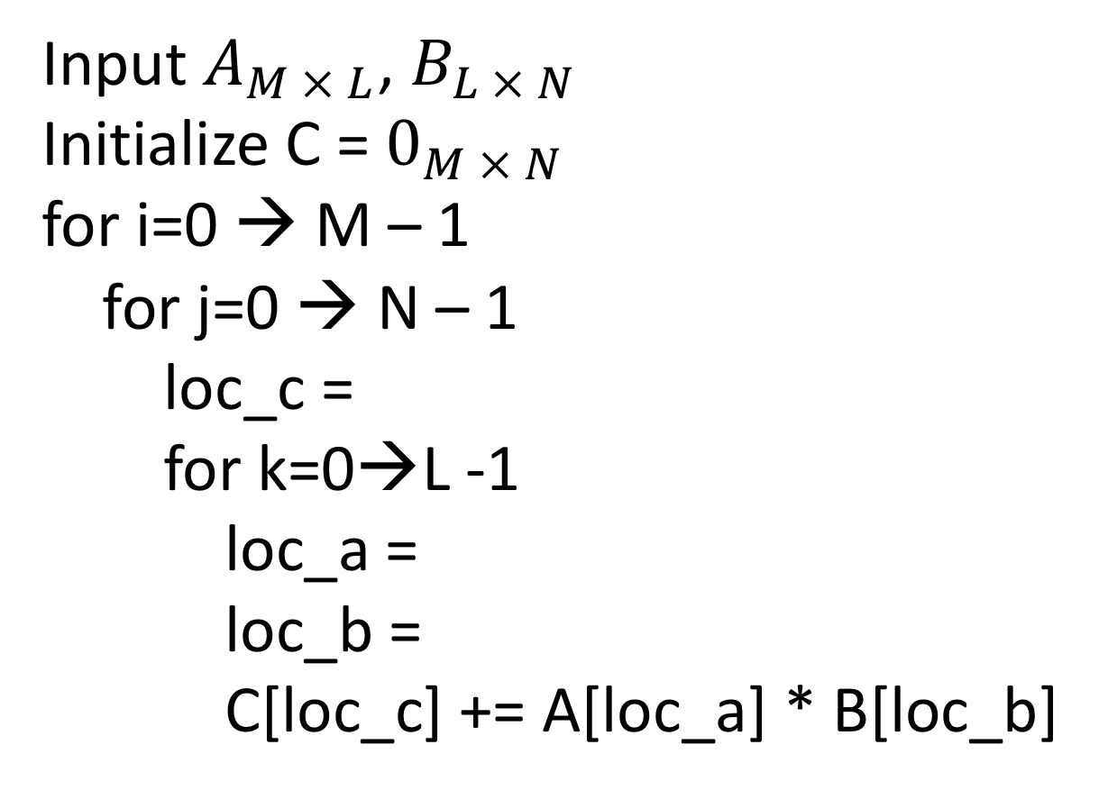
Matrix multiplication
Input $A_{M × L}$, $B_{L × N}$
Initialize C = $0_{M × N}$
for i=0 → M – 1
for j=0 → N – 1
loc_c =
for k=0→L -1
loc_a =
loc_b =
C[loc_c] += A[loc_a] * B[loc_b]

Slide 6
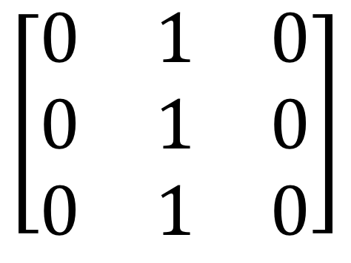
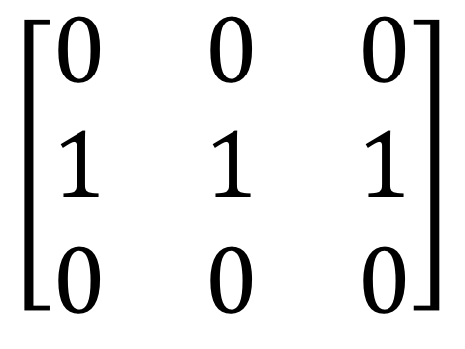
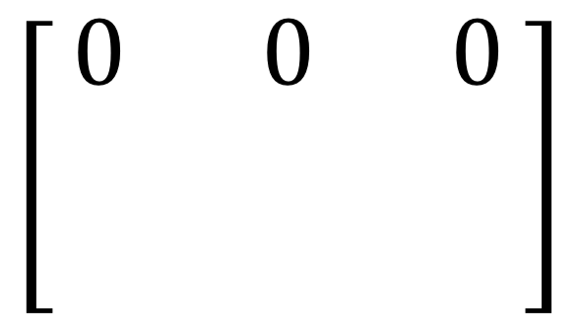
MP6 Game of Life
 | X
N x M grid, each cell is live/dead
Update rule
Live cell with < 2 live neighbors → dead
Live cell with 2 or 3 live neighbors → live
Live cell with > 3 live neighbors → dead
Dead cell with 3 live neighbors → live
$$\left[\begin{matrix}0 & 0 & 0 \\ 1 & 1 & 1 \\ 0 & 0 & 0\end{matrix}\right]$$
$$\left[\begin{matrix}0 & 1 & 0 \\ 0 & 1 & 0 \\ 0 & 1 & 0\end{matrix}\right]$$
$$\left[\begin{matrix}0 & 0 & 0 \\ & & \\ & & \end{matrix}\right]$$

Slide 7
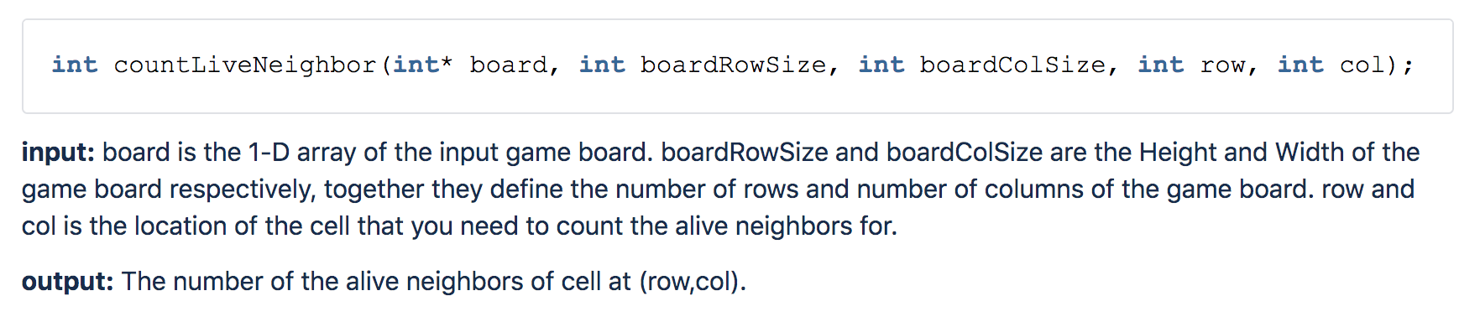
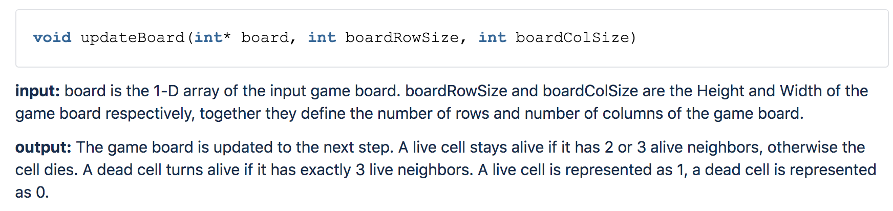
Functions

Slide 8
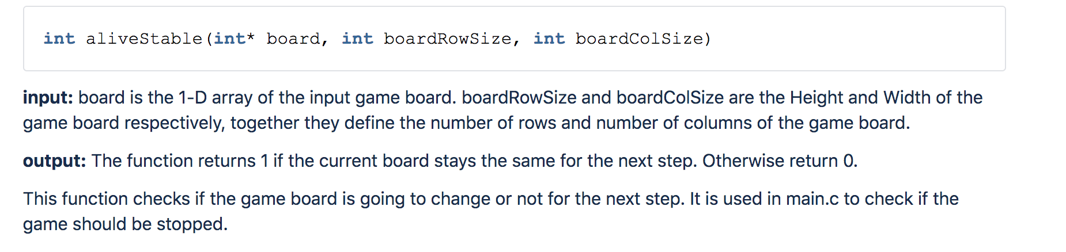
Functions

Slide 9
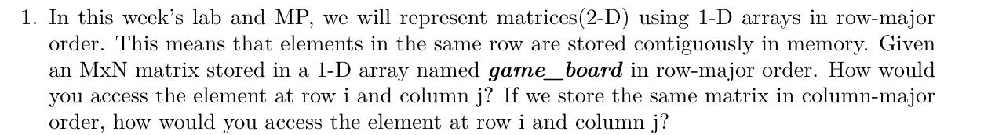
Worksheet
game_board[i * N + j]
game_board[j * M + i]

Slide 10
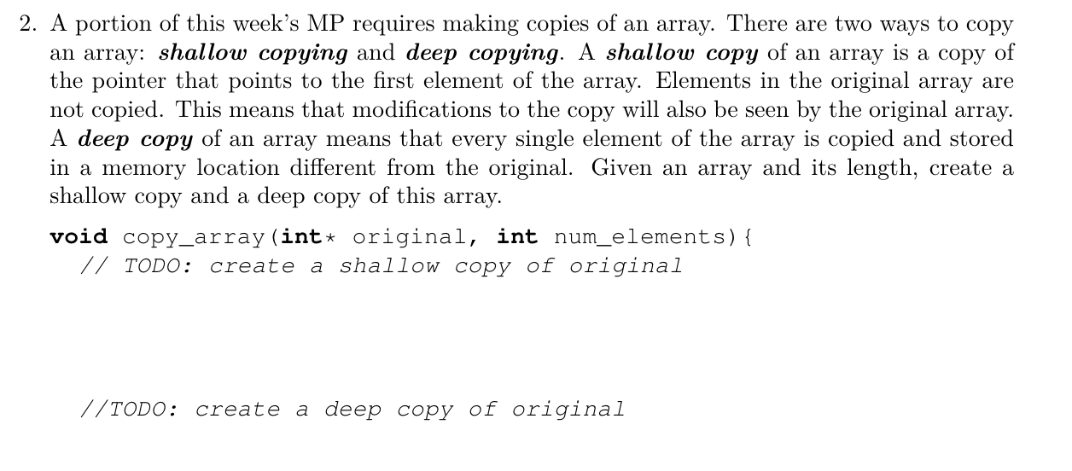
Worksheet
int * shallow_copy = original;
int deepcopy[num_elements];
For(int i = 0 ; i < num_elements; i ++){
deep_copy[i] = original[i];
}

