Slide 1
ECE220 Lab7

Slide 2
Lab 7 Mini Sudoku
Reads an input grid of size 5x5 from a file
Fills out the grid, such that each row has numbers 1-5 appear exactly once, and each column has numbers 1-5 appear exactly once.
0 | 0 | 0 | 0 | 1
3 | 0 | 0 | 0 | 0
0 | 2 | 0 | 0 | 0
0 | 0 | 0 | 0 | 0
5 | 0 | 0 | 0 | 0
2 | 3 | 4 | 5 | 1
3 | 1 | 2 | 4 | 5
1 | 2 | 5 | 3 | 4
4 | 5 | 1 | 2 | 3
5 | 4 | 3 | 2 | 1
Input
Output

Slide 3
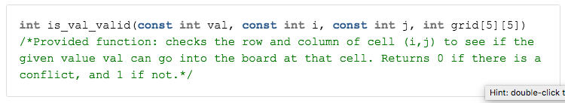
Given Functions
0 | 0 | 0 | 0 | 1
3 | 0 | 0 | 0 | 0
1 | 2 | 0 | 0 | 0
2 | 0 | 0 | 0 | 0
5 | 0 | 0 | 0 | 0
Is_val_valid(5, 0, 0, grid)
Is_val_valid(5, 1, 1, grid)

Slide 4
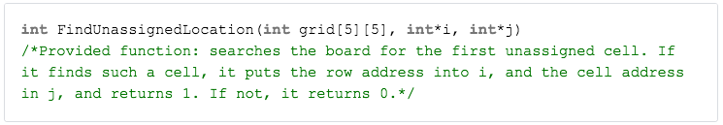
Given Function
2 | 3 | 4 | 5 | 1
3 | 1 | 2 | 4 | 5
1 | 2 | 5 | 3 | 4
4 | 5 | 1 | 2 | 3
5 | 4 | 3 | 2 | 1
int i;
int j;
FindUnassignedLocation(grid, &i, &j)

Slide 5
You need to implement
void parse_grid(const char fpath[], int grid[5][5]);
int solve_grid(int grid[5][5]);

Slide 6
You need to implement
void parse_grid(const char fpath[], int grid[5][5]);
open the file for reading
make sure the file is valid
for each row and column
scan the file to read the next int into the board
close the file
FILE *reader = fopen(fpath, "r");
assert(reader != NULL);
fscanf(reader, "%d", &sudoku[i][j]);
https://github-dev.cs.illinois.edu/ECE220FA20/_release/blob/regular/lab7/grid1.txt

Slide 7
You need to implement
int solve_grid(int grid[5][5]);
if all entries in the grid are filled
return 1
for each row
for each column
if the cell at (row, column) is empty
for each possible value
if that value is valid
place it there
if solve_grid solves the puzzle
return 1
zero the cell
return 0
FindUnassignedLocation()
What are all possible values?

Slide 8
2 x 2 example
2 | 1
1 | 2
1
 | 2
1
 | 2
 | 2
0
 | 2
2
 | 2
2 | 1
 | 2
2 | 1
1 | 2
2
 | 2

Slide 9
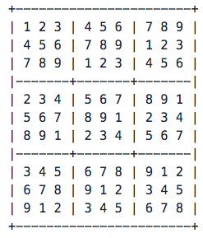
MP7 Sudoku
Each number can only occur once in each 3x3 zone, row, and column of the grid

Slide 10
