Slide 1
LAB 8
Sliding Up Values

Slide 2
1 | 1 | 2 | 1
 | 1
 |  | 1
1 | 2
1 | 1 | 2 | 1
1 | 1 | 1
 | 2
Slide up

Slide 3
 | 1
 |  | 2
1
1 | 1 | 2
Slide up

Slide 4
Idea: Slide one column at a time.
Find a non-empty cell and slide it up.

Slide 5
Slide one column
Target_i : point to the topmost empty cell
i: point to current cell. We use i as index to find a non-empty cell
1
1
target_i
i

Slide 6
Slide one column
Target_i : point to the topmost empty cell
i: point to current cell. We use i as index to find a non-empty cell
1
1
target_i
i

Slide 7
Slide one column
Target_i : point to the topmost empty cell
i: point to current cell. We use i as index to find a non-empty cell
1
1
target_i
i

Slide 8
Slide one column
Target_i : point to the topmost empty cell
i: point to current cell. We use i as index to find a non-empty cell
1
1
target_i
i

Slide 9
Slide one column
Target_i : point to the topmost empty cell
i: point to current cell. We use i as index to find a non-empty cell
1
1
target_i
i

Slide 10
Slide one column
Target_i : point to the topmost empty cell
i: point to current cell. We use i as index to find a non-empty cell
1
1

Slide 11
for j = 0 → n_col – 1
target_i ← 0
for i = 1 → n_row – 1
if grid ( i , j ) is not empty
while grid ( target_i , j ) not empty and target_i < i
+ + target_i
if target_i < i
grid ( target_i , j ) = grid ( i , j )
grid ( i , j ) ← empty

Slide 12
Slide one column
Target_i : point to the topmost empty cell
i: point to current cell. We use i as index to find a non-empty cell
1
1
target_i
i
for j = 0 → n_col – 1
target_i ← 0
for i = 1 → n_row – 1
if grid ( i , j ) is not empty
while grid ( target_i , j ) not empty and target_i < i
+ + target_i
if target_i < i
grid ( target_i , j ) = grid ( i , j )
grid ( i , j ) ← empty

Slide 13
Slide one column
Target_i : point to the topmost empty cell
i: point to current cell. We use i as index to find a non-empty cell
1
1
target_i
i
for j = 0 → n_col – 1
target_i ← 0
for i = 1 → n_row – 1
if grid ( i , j ) is not empty
while grid ( target_i , j ) not empty and target_i < i
+ + target_i
if target_i < i
grid ( target_i , j ) = grid ( i , j )
grid ( i , j ) ← empty

Slide 14
Slide one column
Target_i : point to the topmost empty cell
i: point to current cell. We use i as index to find a non-empty cell
1
1
target_i
i
for j = 0 → n_col – 1
target_i ← 0
for i = 1 → n_row – 1
if grid ( i , j ) is not empty
while grid ( target_i , j ) not empty and target_i < i
+ + target_i
if target_i < i
grid ( target_i , j ) = grid ( i , j )
grid ( i , j ) ← empty

Slide 15
Slide one column
Target_i : point to the topmost empty cell
i: point to current cell. We use i as index to find a non-empty cell
1
1
target_i
for j = 0 → n_col – 1
target_i ← 0
for i = 1 → n_row – 1
if grid ( i , j ) is not empty
while grid ( target_i , j ) not empty and target_i < i
+ + target_i
if target_i < i
grid ( target_i , j ) = grid ( i , j )
grid ( i , j ) ← empty
i

Slide 16
Slide one column
Target_i : point to the topmost empty cell
i: point to current cell. We use i as index to find a non-empty cell
1
1
target_i
for j = 0 → n_col – 1
target_i ← 0
for i = 1 → n_row – 1
if grid ( i , j ) is not empty
while grid ( target_i , j ) not empty and target_i < i
+ + target_i
if target_i < i
grid ( target_i , j ) = grid ( i , j )
grid ( i , j ) ← empty
i

Slide 17
Slide one column
Target_i : point to the topmost empty cell
i: point to current cell. We use i as index to find a non-empty cell
1
1
for j = 0 → n_col – 1
target_i ← 0
for i = 1 → n_row – 1
if grid ( i , j ) is not empty
while grid ( target_i , j ) not empty and target_i < i
+ + target_i
if target_i < i
grid ( target_i , j ) = grid ( i , j )
grid ( i , j ) ← empty

Slide 18
MP8 2048
2
2
4
4
4
① Slide a value as in lab.
② Check if the slided cell can be combined with the cell above it. If Yes, combine them.

Slide 19
2
2
4
2
2
4
4
4
4
4
target_i
i
?

Slide 20
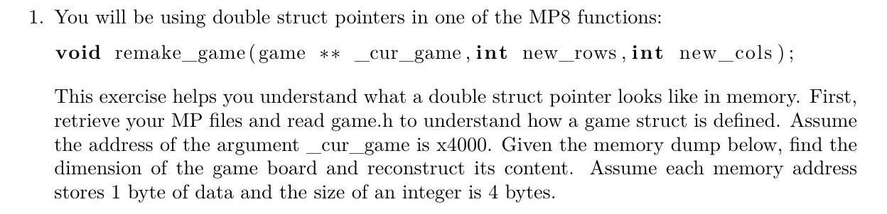
LAB 8 Worksheet

Slide 21
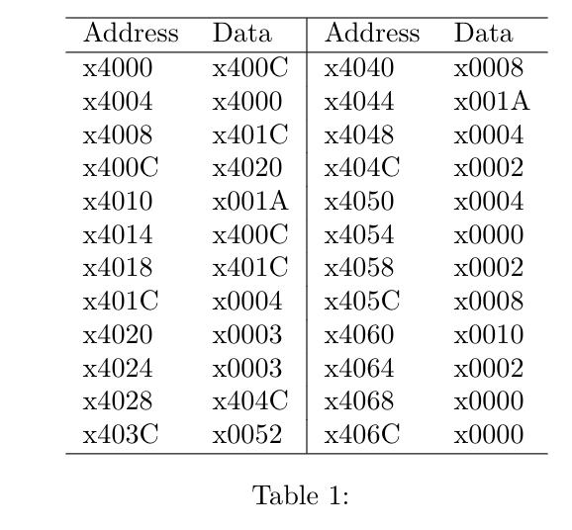
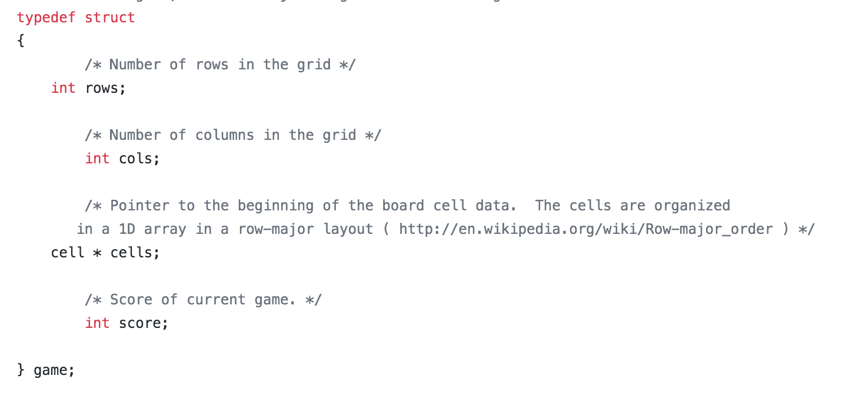
Variable | address | value
__cur_game | x4000 | x400c
(Pointer to struct) | x400c | x4020
rows | x4020 | x0003
cols | x4024 | x0003
2 4 0 2 8 x10 2 0 0

