Slide 1
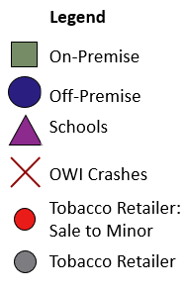
Legend
On-Premise
Off-Premise
Schools
OWI Crashes
Tobacco Retailer: Sale to Minor
Tobacco Retailer

Slide 2
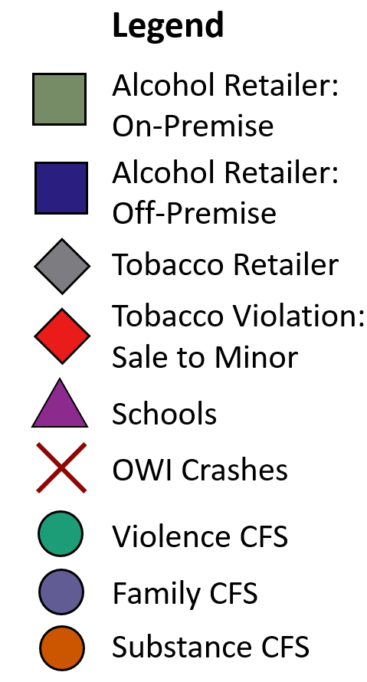
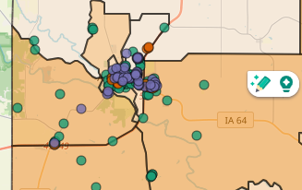
Jones Legend
Alcohol Retailer: On-Premise
Alcohol Retailer: Off-Premise
Schools
OWI Crashes
Tobacco Retailer: Sale to Minor
Tobacco Retailer Violence CFS Family CFS Substance CFS =
Legend
Alcohol Retailer:
On-Premise
Alcohol Retailer:
Off-Premise
Tobacco Retailer
Tobacco Violation:
Sale to Minor
Schools
OWI Crashes
Violence CFS
Family CFS
Substance CFS

Slide 3
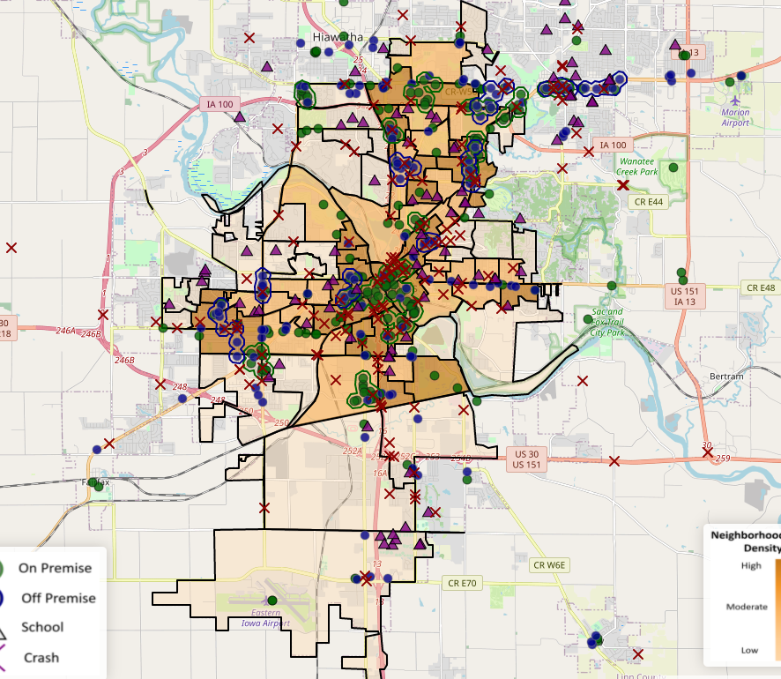
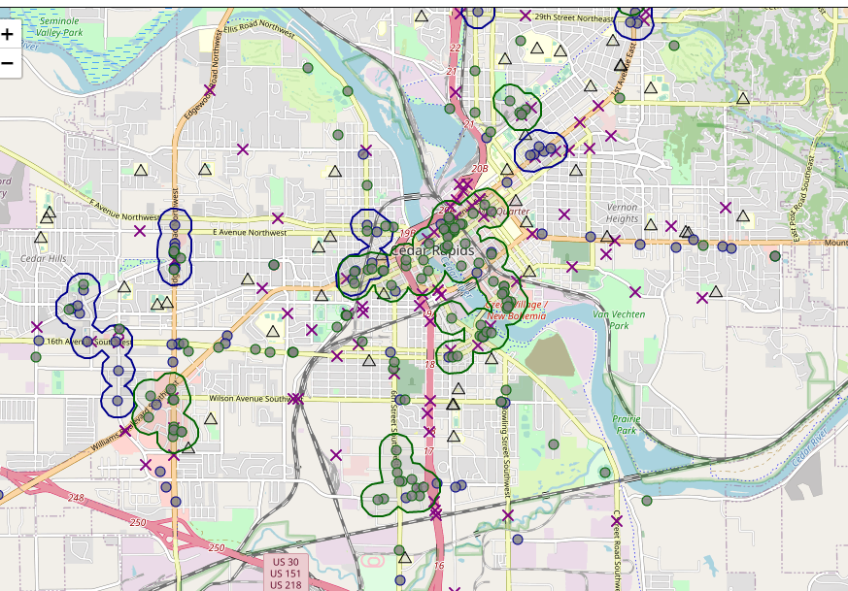
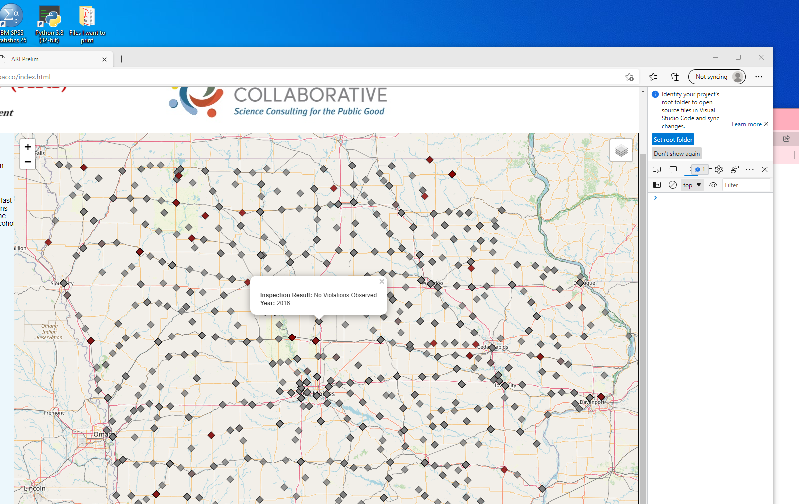
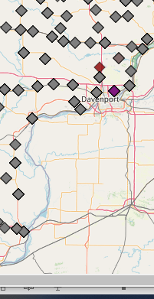

Legend
Sale to Minor Violation
Other Violation
Density Values
Inspection without Violation
High
On Premise Outlet
Off Premise Outlet
Alcohol Related
Legend
Schools
Moderate
On-Premise
Off-Premise
Schools
OWI Crashes
Low
X

Slide 4
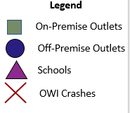
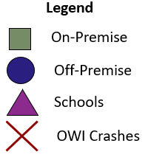
Neighborhood-Level Density
High
Moderate
Low

Slide 5
County-Level Population Size
Sales per 10,000 Gallons
High
Moderate
Low

Slide 6
Legend
On-Premise Clusters
Off-Premise Clusters
K-12 Schools
OWI Crashes
Density Values
Low
Moderate
High

