Slide 1
EventLang
By Derrick Lockwood

Slide 2
Definition
Event driven style of programming.
I.e. “Do something and call back when complete”
Programming flow
Events are thrown to other programs / processes
In algorithm:
Input (args, event_handlers):
Run algorithm
Call event_handlers(eargs)

Slide 3
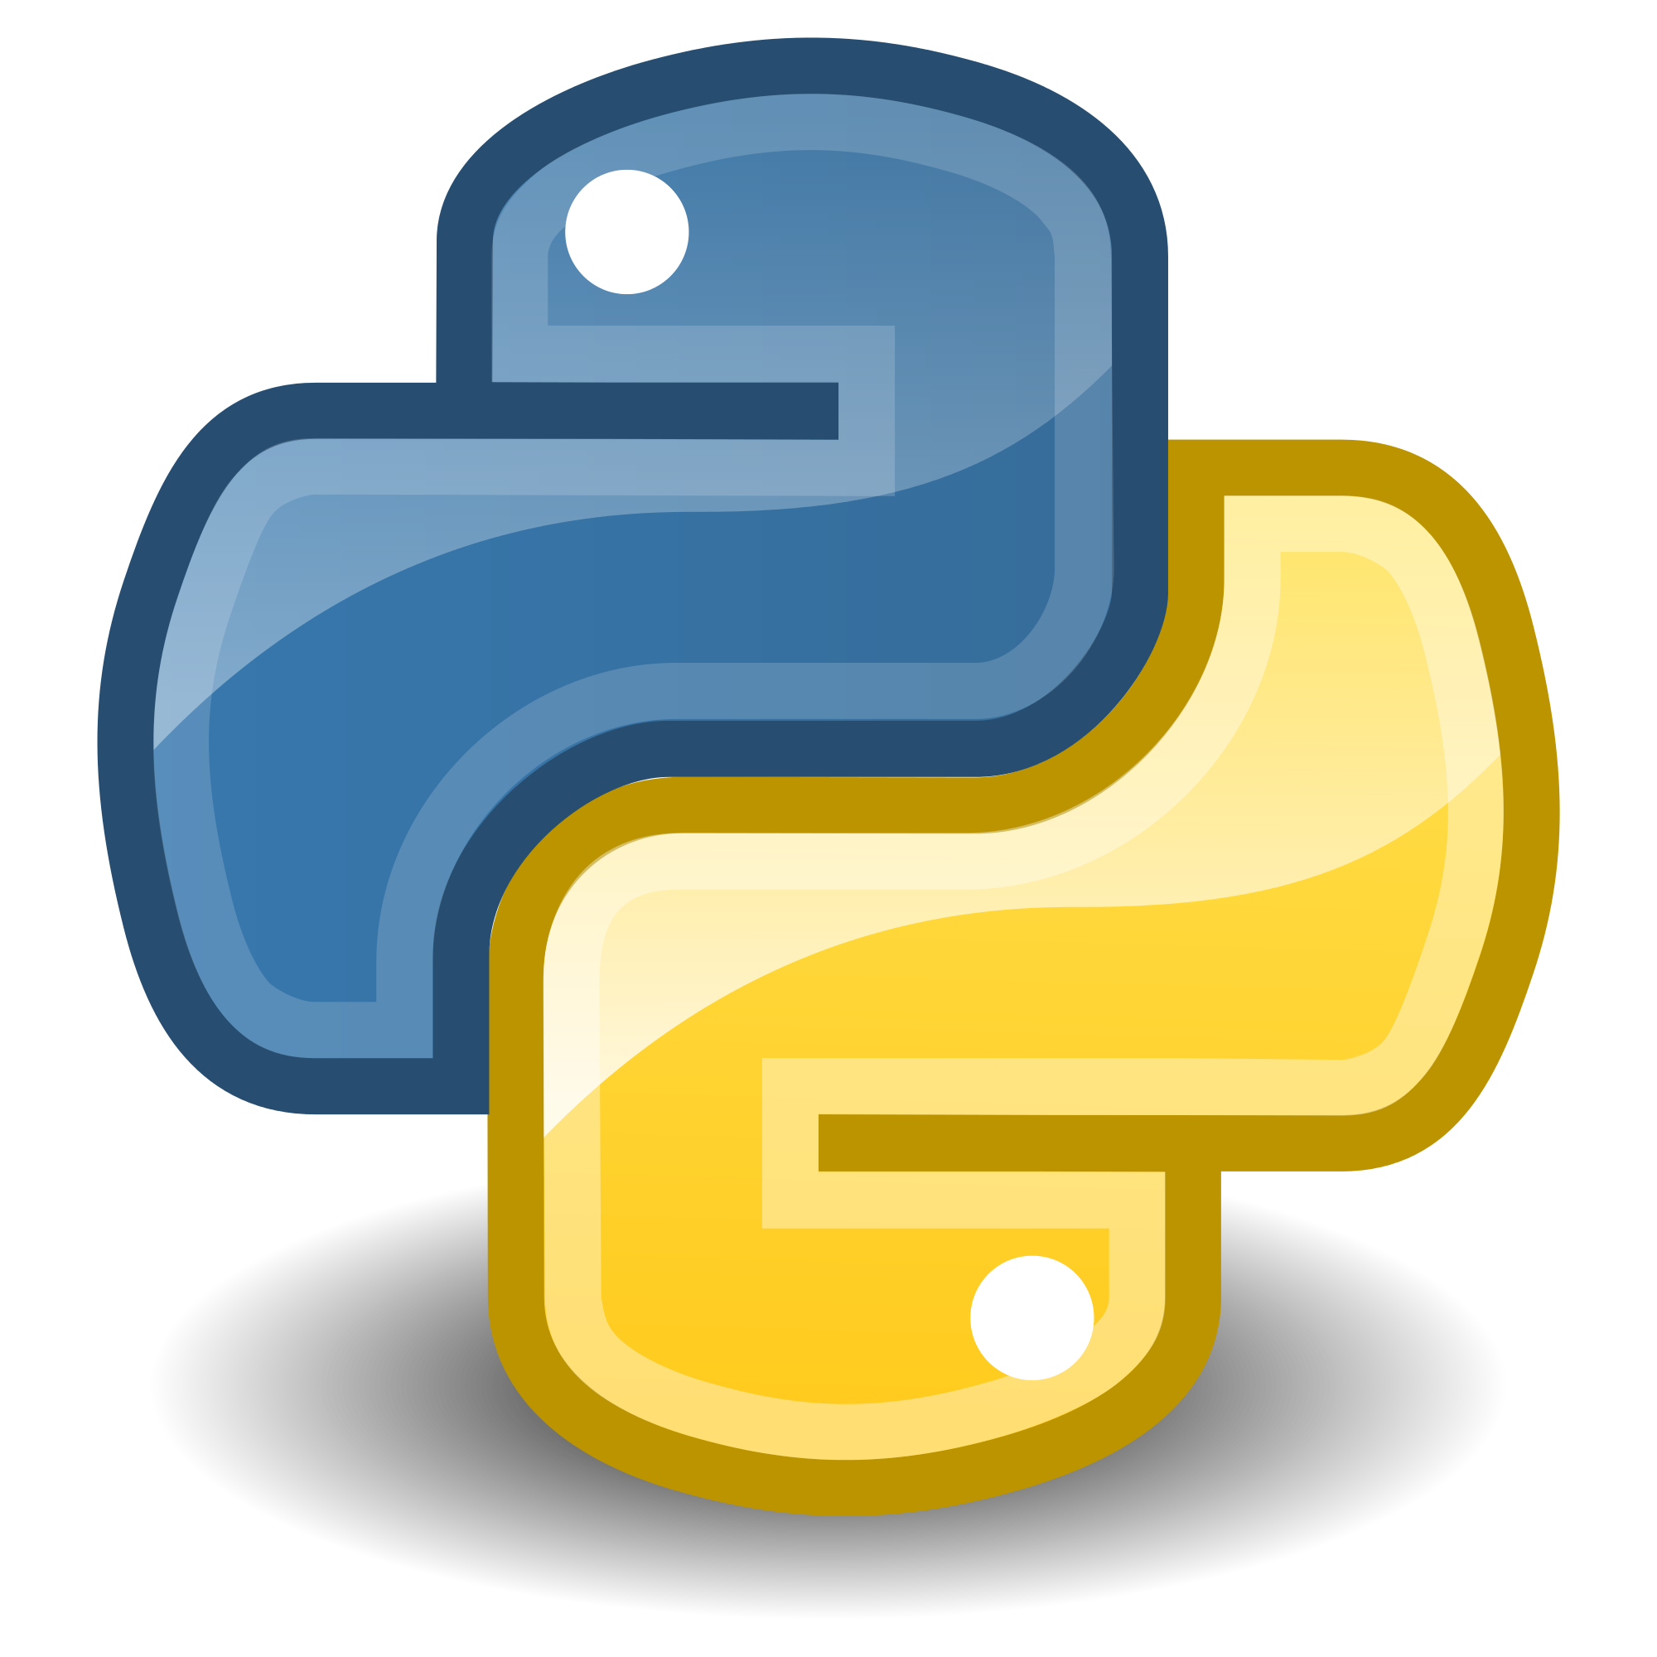

Usages
Usage
Mouse actions, Keyboard input (keypress)
Sensors
Multithreading and inter process communication
Reactive Programming (ReactiveX)

Slide 4
Invocation Types
Explicit Invocation
Caller invokes EXPLICIT (known) Callee(s)
I.e. (let ((x (fac 5))) (+ x 2))
The let expression (caller) invokes the expression (fac 5) which is supplied to the the let expression.
Implicit Invocation
Caller invokes IMPLICIT (unknown) Callee(s)
Observable vs Observer Pattern

Slide 5
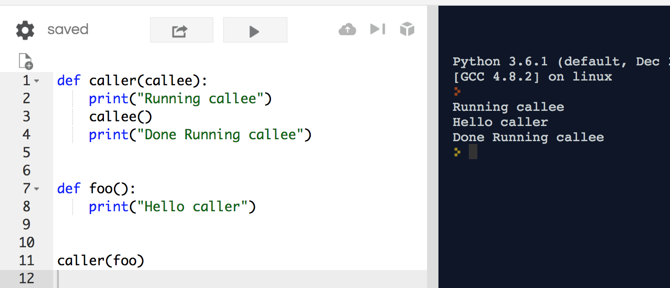
Explicit Invocation
Caller has to know about callee.
Python Example.

Slide 6
Explicit Invocation Diagram
Invokes
Invokes
Invokes
Caller is supplied a list of callee’s by which they are called and the Caller EXPLICITLY calls the Callees
Callee
Caller
Callee
Callee

Slide 7
Explicit Invocation (con’t)
In the python example, the method “caller” needed to be supplied an EXPLICIT “callee” to be called when executed in the program.
Explicit invocation mainly is used in functional programming languages.
One-to-one relation
Dependency of caller is on callee
You can have more than one callee supplied as parameters to the caller and the execution of the callee’s are dependent on when the caller executes them.

Slide 8
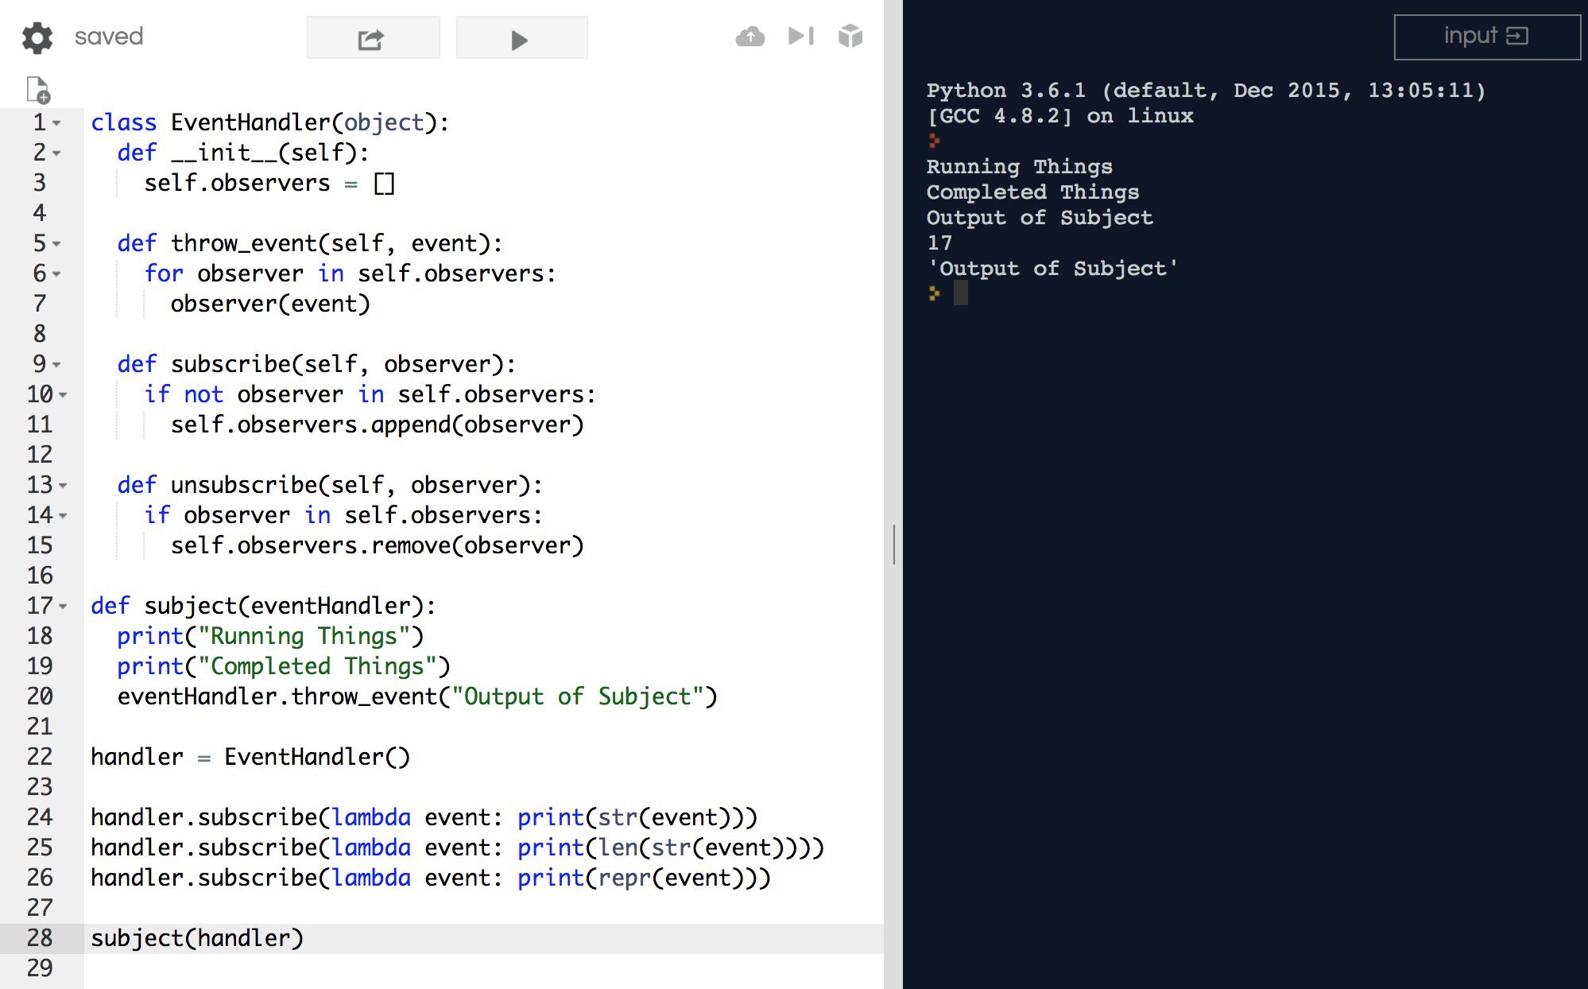
Implicit Invocation

Slide 9
Implicit Invocation Diagram
Subscribes
Announces
Subscribes
Subscribes
Whenever the subject is ready it announces an event implicitly not knowing about the observers
Observer
Subject
Event
Observer
Observer

Slide 10

Implicit Invocation
Founded on a Subject and Observer model.
The subject throws an event (completion, button press) and observers are watching for this event and react accordingly.
Normally this is done asynchronously so that the subject can continue with execution.
The communication between subjects and observers is through events (can be completed on an event bus)

Slide 11
Implicit Invocation (con’t)
In the example it doesn’t use multithreading.
Advantages of multithreading the observer implementation
To make this modification, the EventHandler (also known as a EventBus) will be used to create separate threads by which the observers execute.
Notes:
Multithreading will be useful to let the subject continue with its processing instead of blocking it.

Slide 12
EventLang (Implicit Invocation)
Expressions
Declaration of event
Announcement of event from subject
Subscription on event from observer

Slide 13
EventLang Syntax
Event declaration
‘(‘ event ‘(‘ Identifier* ‘)’ ‘)’
Event Definition
Declares an anonymous event supplied the parameters of the event as the identifiers
Evaluates to Unit Value
Context variable names are shared between subjects and observers

Slide 14
EventLang Syntax
When declaration
‘(‘ when eventexp do exp ‘)’
When definition
Subscribes observer to the event and evaluates exp with the shared context variables

Slide 15
EventLang Syntax
Announce declaration
‘(‘ announce eventexp ‘(‘ exp* ‘)’ ‘)’
Announce definition
Announces an event exp with the supplied values of the context variables as exp*
All observers evaluate with the context variables in the event
Evaluates to last observer value

Slide 16
EventLang Examples
$ (define ev (event (a b)))
$ (when ev do (+ a b))
$ (announce ev ( 2 3))
Notes:
Evaluates to Unit type
Evaluates to Unit type
Evaluates to last event i.e. 2 + 3

Slide 17
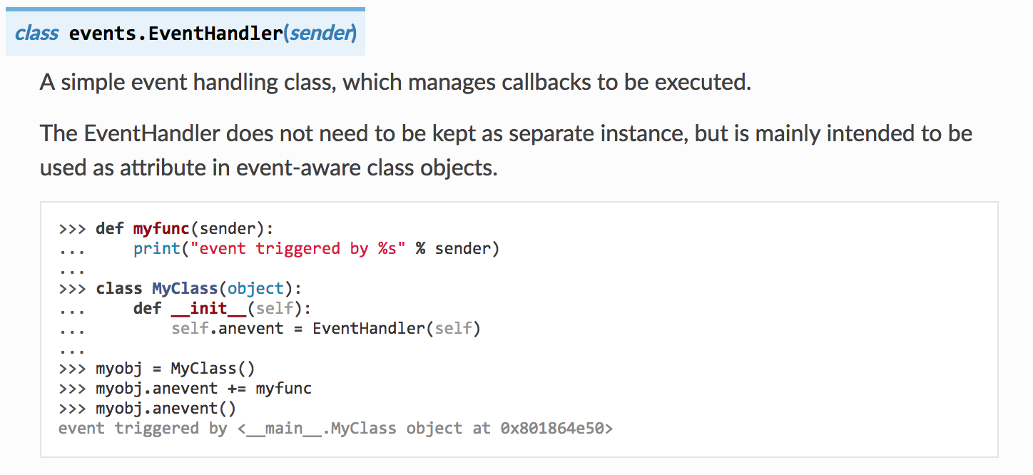
Inclass Exercise / Demo / Questions
Notes:
Inclass exercise
Sheet of paper write down a program with more than one observer. What happens when we call announce?
Demo - In Intellij or Pycharm

