Slide 1


Product Analysis İpek Tan

Slide 2

Information: This is the dataset from a small online store (E-Commerce products) with customer purchase data in November 2018
Objectives:
Determining which product sells the most
Importing and analyzing data from Kaggle. Finding the product that needs to be advertised.

Slide 3

Methodology
extracting unused data
getting the sales total for each product
grouping total clicks in site and total time on site by products

Slide 4
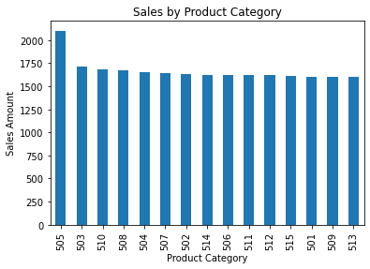
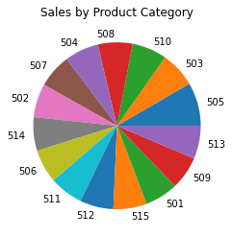
Best Selling Product

Slide 5
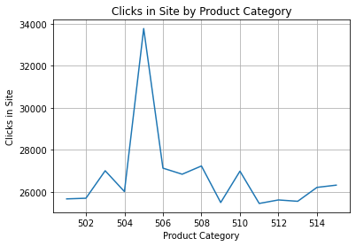

Slide 6
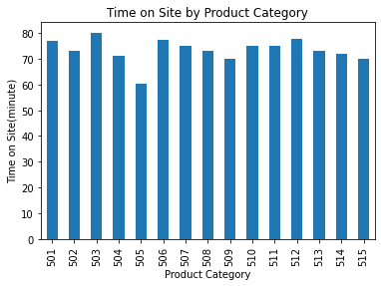
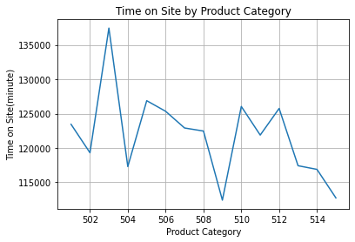

Slide 7
Conclusions
505 may be over-advertised
There may be low-advertised for 503

Slide 8
Future Work
What else would be done?
To be able to determine which product they have given up on purchasing
By looking at the dates, it can be determined which product is bought on special days.

Slide 9
THANKS

