Slide 1
Cadence
The agentic money OS you can actually trust.
Chat to move, convert, and pay across any currency — with security built into every step.
NITHUB 2026
Built on BMONI
cadence-dun-five.vercel.app

Slide 2



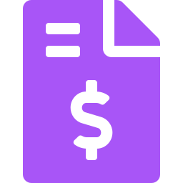

Cadence
THE PROBLEM
Moving money across currencies is still slow, costly, and manual.
Receive
Convert
Budget
Pay a bill
Four apps. Every step is friction — and every conversion is a hidden tax.
millions
of cross-border earners in emerging markets
02

Slide 3



Cadence
WHO FEELS IT
Cross-border earners — the people money apps forgot.
Freelancers & remote workers
Families across borders
Small importers
Paid in USD, living in naira — earning globally, banking locally.
Sending and receiving support between countries, every month.
Pricing and paying in two currencies at once, by hand.
03

Slide 4
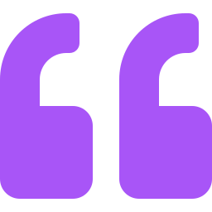
Cadence
WHY NOW
AI could run all of this.
It's my money. Why would I let an AI touch it?
Trust is the real blocker — not the technology. Whoever solves it unlocks agentic finance. That's Cadence.
04

Slide 5







Cadence
THE SOLUTION
An agentic money OS you run by chatting.
Just say it
AUTONOMY MODES
Tell Cadence what you want — it converts, allocates, and pays.
Automatic
It runs your money
Currency-agnostic
Pay any currency from any balance, routed live through BMONI.
Hybrid
Agent-first, controls a tap away
Your level of control
Manual
Automatic, Hybrid or Manual — you decide how much it runs.
You drive; it assists
05

Slide 6




Cadence
HOW IT WORKS
Intent in, money out — with a firewall in between.
1
2
3
4
5
You chat
AI proposes
Engine validates
BMONI settles
You get
an instruction
a structured intent
against your rules & signs
at the live rate
a receipt + reasoning
The AI proposes. It never holds the keys. The engine — with your keys and your rules — is the only thing that can pay.
06

Slide 7
Cadence
DEMO
See it move real money.
Real BMONI wallets
Send Musa ₦20k from my dollars
Funded USD (USDB) + naira (CNGN).
Send money
Live FX conversion
To Musa
₦20,000
Real exchange, balances actually move.
~$14.45 at ₦1,384/$ · via BMONI
On-chain settlement
Successful CDN5427857391
Owner-key signed — not a mockup.
Processed via Cadence · powered by BMONI
Live demo: convert $5 → naira, watch balances change — then a chat payment end-to-end.
07

Slide 8





Cadence
THE DIFFERENTIATOR
Trust Architecture — autonomy without surrender.
AI never holds the keys
Spending guardrails
Risk-based step-up
It proposes — it can't sign or pay.
Per-payment & daily caps it runs inside.
Anomalies demand PIN + safe-word.
Safe-word
Injection defense
Freeze switch
Defeats coercion & impersonation.
Screenshots are data, never commands.
One tap halts the agent instantly.
Even if the AI is jailbroken, it cannot move money — no keys, and it lives inside your fence.
08

Slide 9


Cadence
THE ENGINE
BMONI is the financial engine under the agent.
You
AI proposes
Engine signs
BMONI rails
The AI is the interface. BMONI is the rails.
Per-user smart wallets
Real FX conversion
Owner-key signing
Own account each user
USDB + CNGN, provisioned at onboarding.
Live exchange rates, on every payment.
Encrypted at rest; keys never in the browser.
Real multi-user auth, real balances.
09

Slide 10


Cadence
WHY WE WIN
It's real, it's live, and it's the safe one.
Real & working
The trust story
Genuinely useful
Real auth, real BMONI money movement, real receipts — not a chat box over a fake balance.
A Trust Architecture no other agent has — the answer to 'is it safe?'
Currency-agnostic, conversational, and explainable end-to-end.
10

Slide 11
Cadence
IMPACT
Intelligent money — for everyone, safely.
Cheaper & effortless
Cuts the cost and manual work of cross-border money for ordinary earners.
Safe enough to adopt
Makes autonomy trustworthy — the real unlock for agentic finance.
Corridor-agnostic
Scales across any BMONI-supported currency corridor.
'Everyone' only happens if it's safe enough for people who can't afford a mistake.
11

Slide 12
Cadence — find your rhythm.
An AI you can hand your money to — because it's built so you never have to give up control.
LIVE cadence-dun-five.vercel.app
Built solo, end-to-end, on BMONI. Thank you.

