Slide 1
AVEO

Slide 2
Team
Ipshita Singh
Rahul Tilockchandani
Sachin Som
Pushpendra Singh
Mohan Mankani

Slide 3
The best way to learn design is to clone another website.
AVEO is a YouTube clone

Slide 4
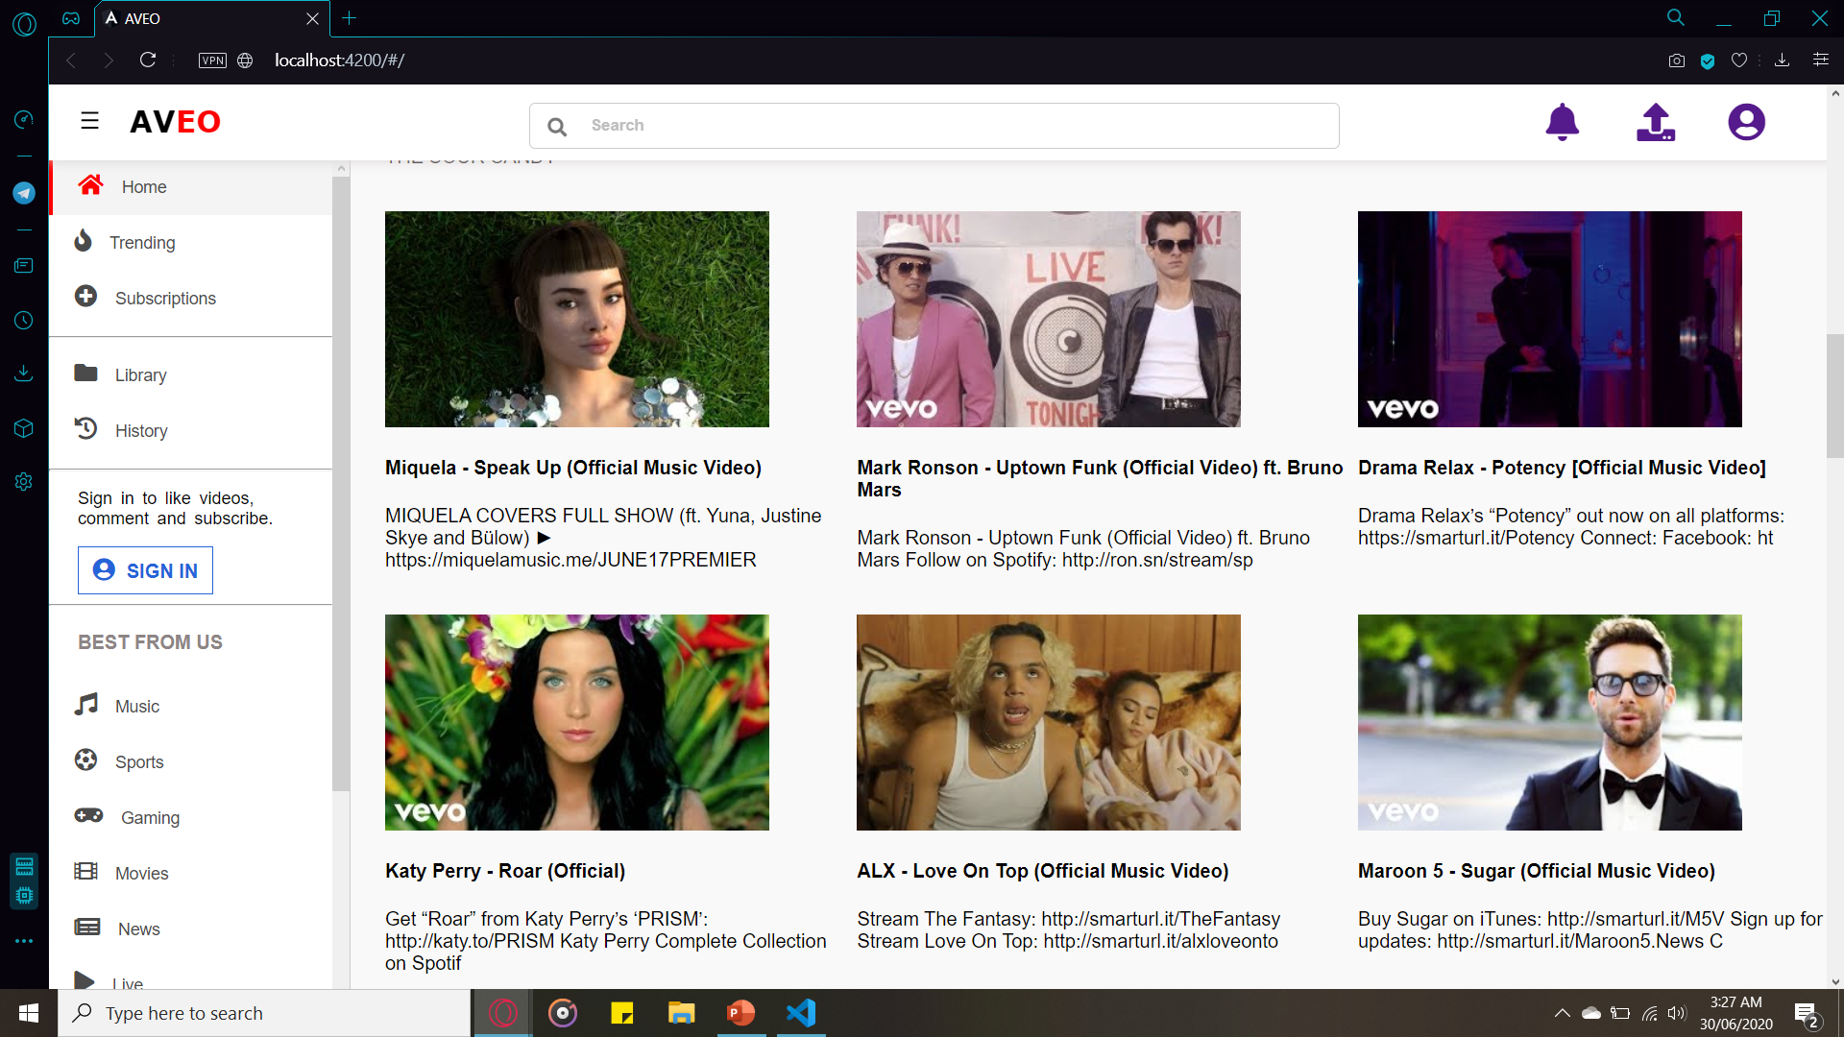
A picture is worth a thousand words!
Homepage on AVEO

Slide 5
Introduction
AVEO is an Angular web application which consumes the YouTube v3 Data API to create a minimal user-interface where YouTube videos can be viewed.
The application uses JavaScript for interactivity, ExpressJS and MongoDB for the process of storing user’s data.

Slide 6
Technology Stack
Angular
MongoDB
Express.js
Node.js
Javascript
CSS
YouTube v3 Data API

Slide 7
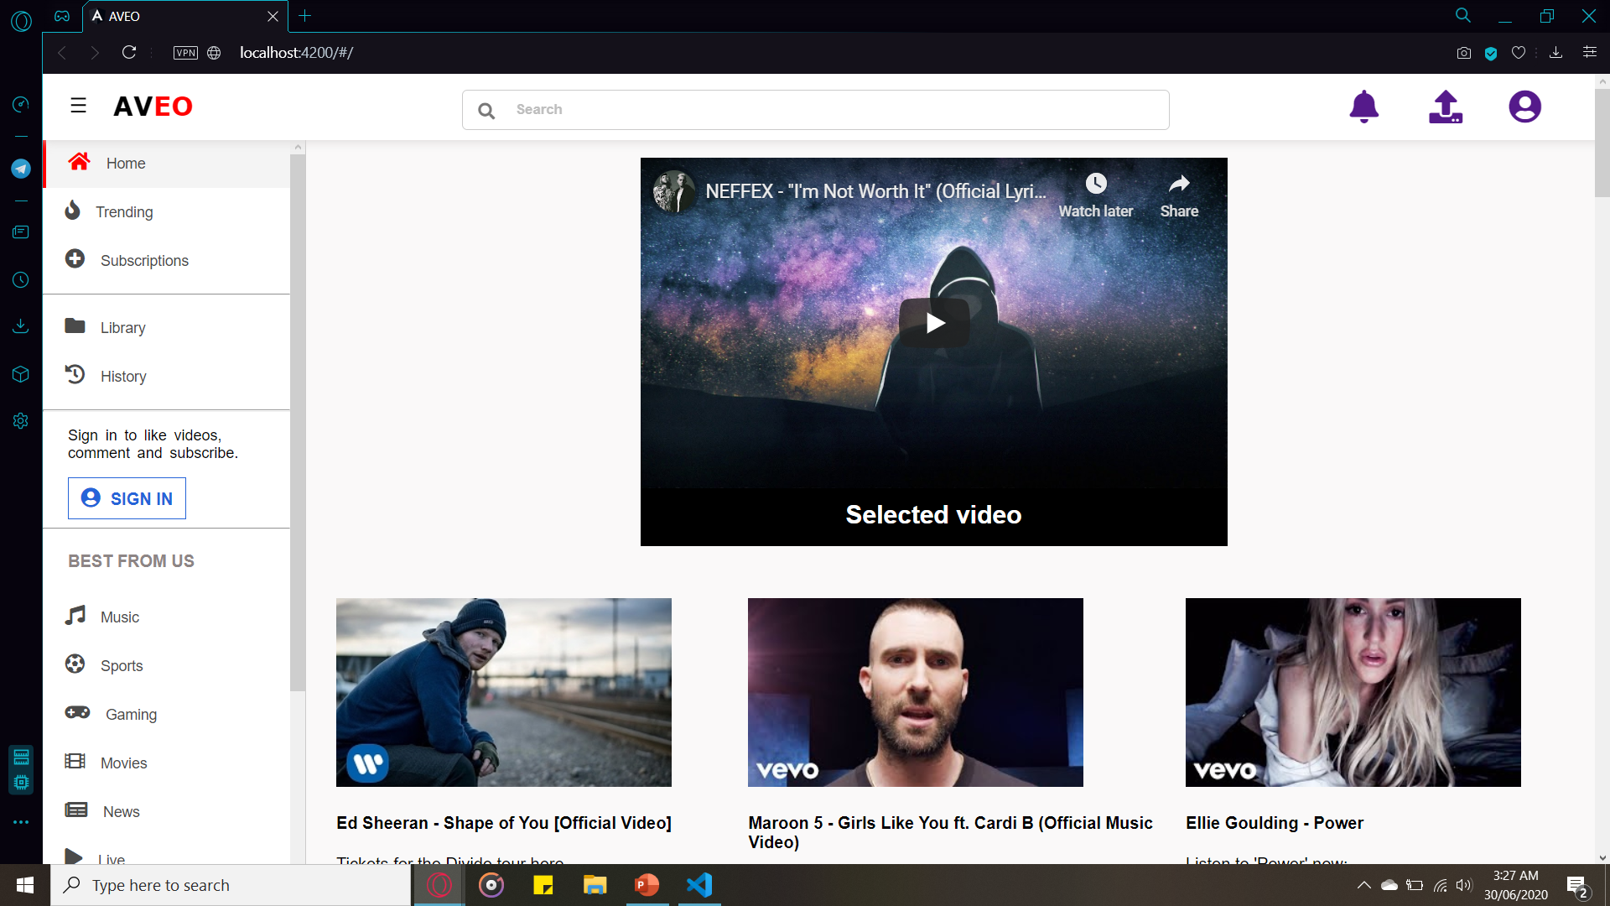
Selecting and Viewing

Slide 8
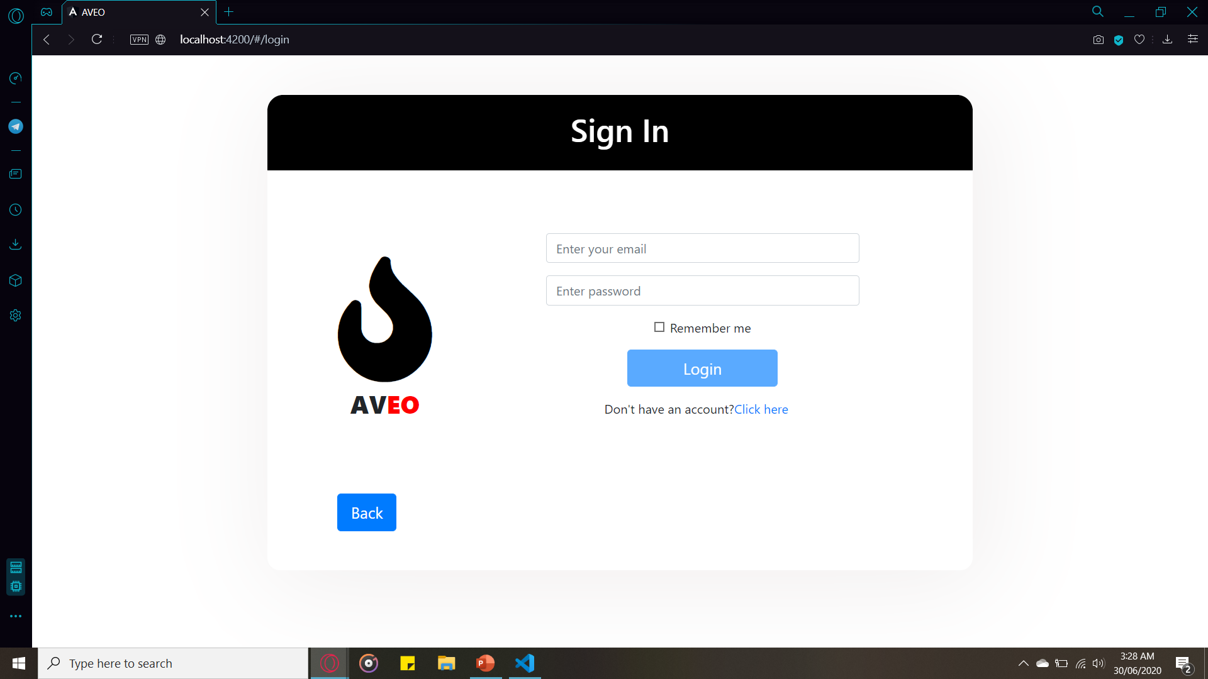
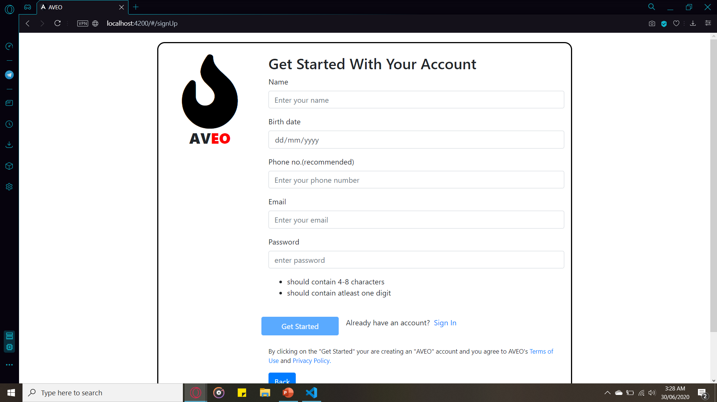
Sign In & Sign Up

Slide 9
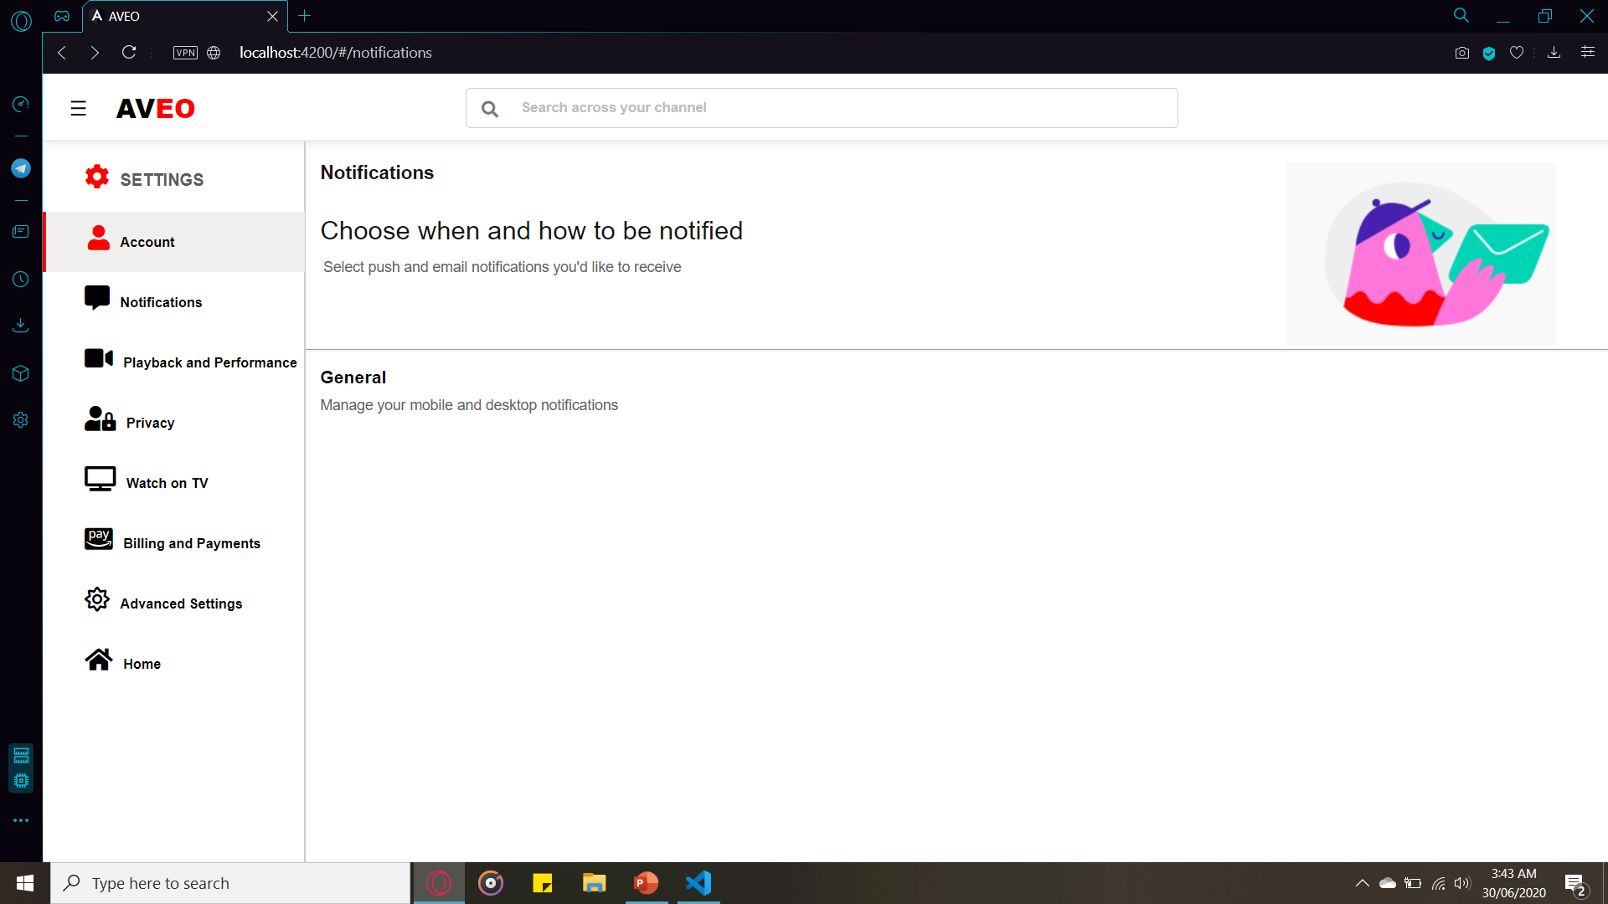
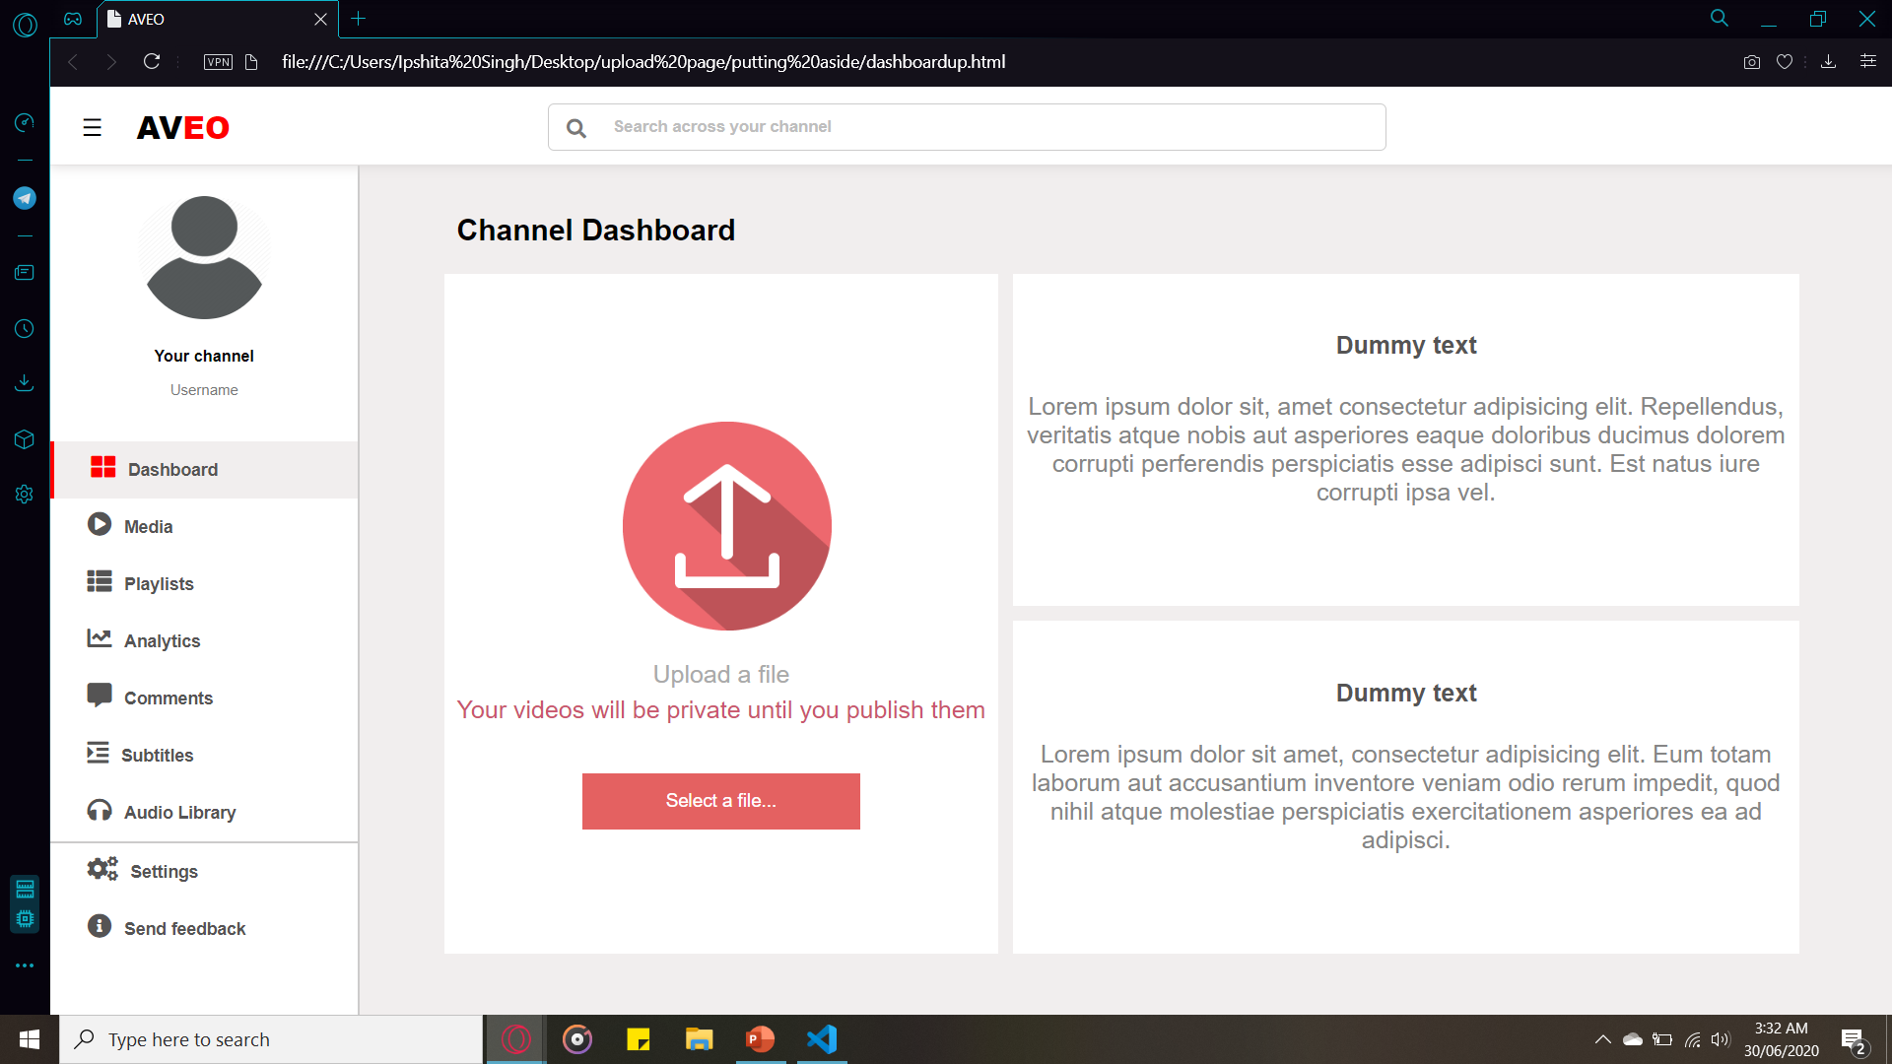
Settings & Studio Dashboards

Slide 10
Thanks!
The instructions to use it are available on GitHub.com/IpshitaSingh/AVEO

