Slide 1

Problem Statement and Team Details
Problem Statement: Develop an intelligent vision system to detect and track mission-critical objects like oxygen cylinders, toolboxes, and fire extinguishers in space stations, ensuring safety through real-time monitoring.
Team Name: SnapCode
Team Leader Name: Ipshita Sethi
Institute Name: Bharati Vidyapeeth(Deemed to be University)Institute of Management and Research
Theme Name: Duality AI Space Station Hackathon- Object Detection
Team Leader Email ID: iipshitasethii03@gmail.com

Slide 2
Problem and Solution
PROBLEM: In the zero-gravity environment of a space station, essential items like oxygen cylinders, toolboxes, and fire extinguishers can easily drift or become misplaced—posing serious safety risks. Existing monitoring methods lack the intelligence and immediacy needed to prevent such hazards in real time.
SOLUTION: To address this, we developed an adaptive object detection system using a YOLOv8 model trained on a mission-specific dataset. Our solution includes a lightweight, user-friendly desktop application that:
Detects key objects via real-time webcam feed or static images
Audio output announcing detected objects with confidence scores
Model selection dropdown, allowing future integration of updated models
Shows total number of objects per frame and saves results.
Clean, intuitive UI designed for non-technical users in high-stakes environments
Provides accurate results in dynamic environments, supporting safety and accountability aboard the station.

Slide 3
Methodology & Implementation
1. Dataset & Training
Used Falcon simulated synthetic dataset.
Focused on: oxygen cylinders, toolboxes, and fire extinguishers.
Trained the YOLOv8 model using optimized hyperparameters(epochs=100, mosaic scheduling, early stopping).
Achieved 94.4% mAP@50 and 86.5% mAP@50–75 with 97.3% Precision, on training ensuring high detection accuracy under varied conditions.
2. Model Optimization
Performed data augmentation to simulate real-world variations (lighting, angles, occlusion):
>HSV shifts: Hue(0.015), Saturation(0.7), Value(0.4) for lighting Variation
>Rotation ±10°, Scaling 0.5, Translation 10%, Shear 2
4. Model Testing And Evaluation
Evaluated model on a test set of 400 real-world simulated images.
Achieved overall mAP@50 = 84.7% and mAP@50–95 = 73.4%, ensuring strong detection Precision 91.3%
5.Application Development
Built a lightweight real-time app using Streamlit for rapid prototyping and intuitive UI
Verified smooth detection performance with live feed and image uploads

Slide 4
Technology Used
Model Training
YOLOv8 (Ultralytics) – For real-time object detection
PyTorch – Deep learning framework behind the model
Google Colab – GPU-powered environment for training and experimentation
Falcon Synthetic Dataset – Simulated space station data for domain-specific learning
Model Optimization
Albumentations – Data augmentation: HSV, Mosaic, MixUp
Ultralytics Training Utilities – For custom hyperparameter tuning and early stopping
Testing & Evaluation
Python (OpenCV, NumPy) – Image processing and performance testing
YOLO Validation Engine – For generating mAP, precision, recall, etc.
App Development
Streamlit – Fast UI framework for real-time deployment
Text-to-Speech (pyttsx3) – Audio alerts on detection
Threading: for running text to speech without blocking UI
PIL – Save frames as images

Slide 5
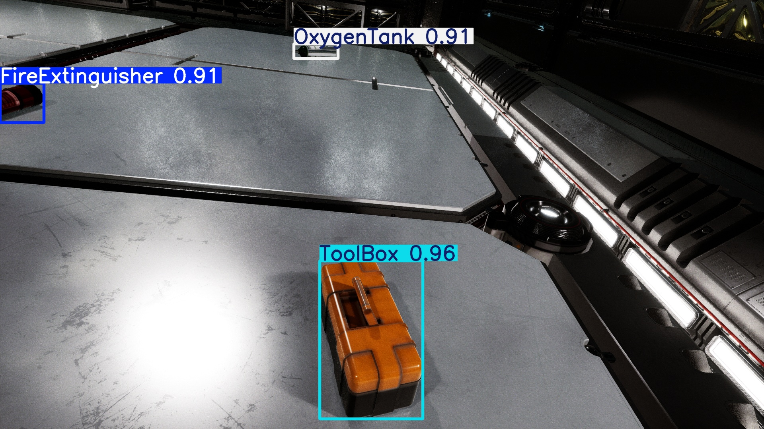
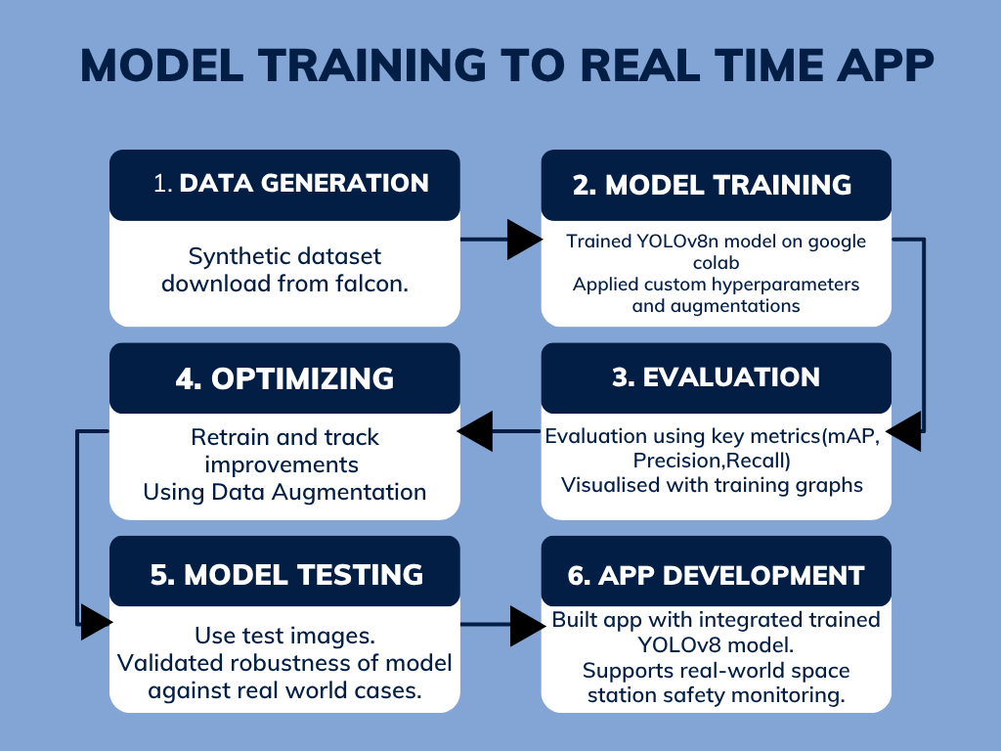
Flowchart & Supporting Images
Flowchart
Successful Detection on Synthetic Test Image Model identifies all critical space objects with high confidence: Toolbox (96%), Fire Extinguisher (91%), and Oxygen Tank (91%)
Workflow of our YOLOv8 object detection project

Slide 6
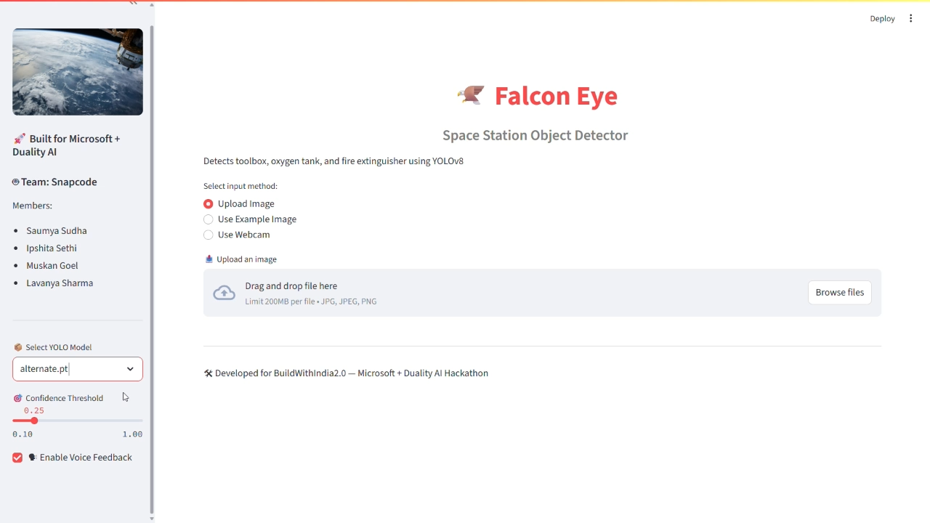
APPLICATION DEMO

Slide 7
1. Multi-Class Expansion: From oxygen tanks, fire extinguishers & toolboxes → to astronaut suits, panels, leaks, waste items, and unauthorized objects. Making the system a true all-in-one space inventory & anomaly monitor. 2. Dynamic Environment Simulation with Falcon: Use Falcon Editor to generate complex scenarios : Lighting shifts, Occlusion, Tool floating in motion, Emergency drills. Retrain the model continuously on evolving mission scenarios for stronger generalization. 3. Cloud & Mission Control Integration: Deploy the app on cloud servers for live monitoring from ground stations, enabling mission control to: Review object logs, Get alerts, Analyze safety compliance. A bridge between on-ground control and in-space safety automation. 4. Edge Deployment on Space Hardware: Optimize the model for Jetson Nano, Raspberry Pi, or TFLite to run on-board the spacecraft itself. Autonomous detection without needing internet — real AI at the edge of the galaxy.
FUTURE SCOPE

Slide 8
Feasibility and Market Use
Feasibility:
Lightweight YOLOv8n Model: Optimized for low-compute environments like space stations with limited GPU resources.
Real-Time Performance: Achieves fast inference with high accuracy (mAP@50: 84.7%) even on synthetic space data.
Modular & Update-Friendly: Model selection dropdown allows future upgrades without altering core app logic.
Built Using Free/Open-Source Tools: Trained on Google Colab; deployed using Streamlit — ensures zero-cost scalability.
Augmented for Realism: Falcon-generated diverse datasets simulate low-light, occlusion, and object rotations.
Built for Edge Deployment: Zero internet dependency — fully offline-capable. Ideal for space, military, or remote industrial zones.
Market Use:
Astronaut Safety Automation: Helps prevent tool misplacement, fire hazards, and low oxygen risks — currently managed manually on the ISS.
Market Niche Advantage: Very few commercial solutions currently target safety monitoring in zero-gravity — this puts us in a first-mover position for future collab with ISRO/SpaceX/DARPA.
Cross-Vertical Scalability: Retrainable to suit mining tunnels, submarines, oil rigs — any closed, high-risk environment with visual detection needs.
Compliance + Incident Reporting Tool Can be expanded to auto-log object counts and save images, aiding audit trails or accident investigations.
“Space-safe, earth-ready — our system isn’t just feasible, it’s future-proof and built for missions that can’t afford to fail.”

Slide 9
Conclusion
We developed a highly accurate, lightweight, and real-time object detection system optimized for the unique challenges of space stations.
By leveraging YOLOv8, synthetic data from Falcon, and a custom Streamlit application, we created a deployable safety tool — not just a prototype.
Our model not only detects — it communicates, logs, and adapts.
With seamless scalability and real-world potential, this system lays the foundation for AI-driven safety in zero-gravity missions.

