Slide 1
FAKE NEWS DETECTOR FOR STUDENTS
CAPSTONE PROJECT
Presented By:
Student Name- IPSITA CHOWDHURY
College Name- Narula Institute Of Technology
Department- CSE (Data Science)

Slide 2
OUTLINE:
Problem Statement
Proposed System/Solution
System Development Approach (Technology Used)
Algorithm & Deployment
Result
Conclusion
Future Scope
References

Slide 3
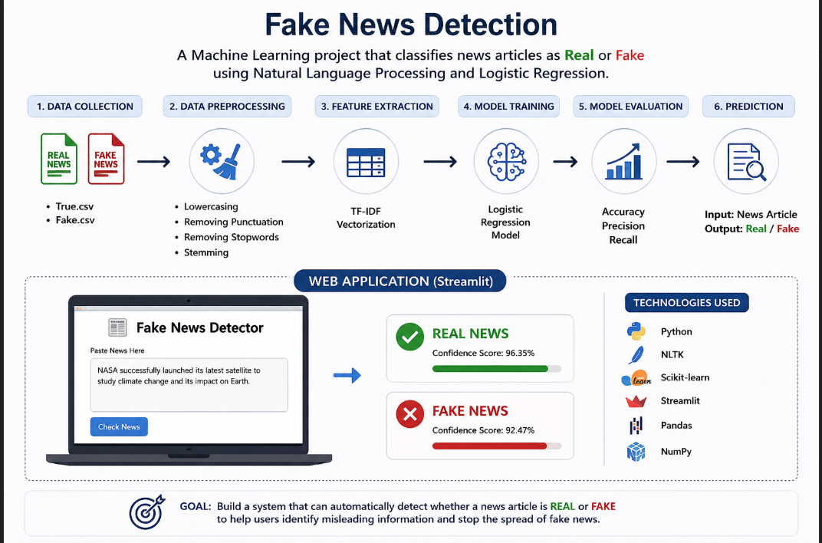
PROBLEM STATEMENT
Misinformation spreads quickly through online news and social media, making it hard for students to differentiate between reliable and fake information. There is a need for an AI solution that can analyze articles, assess credibility, and provide concise, trustworthy summaries to prevent the spread of false information.

Slide 4
PROPOSED SOLUTION
1.Collect News Data :
Gather real and fake news articles from reliable datasets.
Label the data as "Real" or "Fake".
2. Preprocess the Text:
Remove special characters, punctuation, and stopwords.
Convert text into a clean format suitable for analysis.
3. Feature Extraction :
Apply TF-IDF (Term Frequency-Inverse Document Frequency) to convert text into numerical features.
Capture important words and patterns from news articles.
4. Train a Machine Learning Model:
Use Logistic Regression to learn patterns from real and fake news.
Train the model using the processed dataset.
5. Evaluate Model Performance :
Measure accuracy, precision, recall, and F1-score.
Generate a confusion matrix to analyze predictions.

Slide 5
PROPOSED SOLUTION
6. Develop a User-Friendly Web Application :
Build an interactive interface using Streamlit .
Allow users to enter or paste news articles.
7. Predict News Authenticity :
Process the user input through the trained model.
Classify the news as:
✅ Real News
❌ Fake News
8. Display Confidence Score :
Show the prediction confidence to help users understand the model's certainty.
9. Deploy the Application Online:
Host the application using Streamlit Community Cloud.
Provide a public link accessible to users and examiners.
10. Support Informed Decision-Making :
Help users identify potentially misleading news.
Promote awareness and reduce the spread of misinformation

Slide 6
SYSTEM APPROACH
1. Data Collection:
Collect Real News and Fake News datasets.
Store data in CSV format (True.csv and Fake.csv).
2. Data Preprocessing:
Remove punctuation, special characters, and irrelevant words.
Convert text to lowercase.
Remove stopwords using NLTK.
Apply stemming for text normalization.
3. Feature Extraction:
Use TF-IDF Vectorization to transform textual data into numerical vectors.
Identify important words and their significance in news articles.
4. Model Training:
Split dataset into training
Train the model using Logistic Regression.
Learn patterns that distinguish real news from fake news.

Slide 7
SYSTEM APPROACH:
5. Model Evaluation
Calculate:
Accuracy
Precision
Recall
F1-Score
Generate Confusion Matrix for performance analysis.
6. Model Serialization
Save trained model as:
fake_news_model.pkl
Save vectorizer as:
vectorizer.pkl
7. Web Application Development
Create an interactive user interface using Streamlit.
Allow users to input news text.

Slide 8
SYSTEM APPROACH:
8. Prediction Process:
User enters a news article.
Text is preprocessed.
TF-IDF vectorizer converts text into features.
Logistic Regression model predicts:
Real News
Fake News
9. Result Display :
Show prediction result.
Display confidence score.
Provide user-friendly output.
10. Cloud Deployment :
Upload project to GitHub.
Deploy on Streamlit Community Cloud.
Generate a public URL for users and examiners.

Slide 9
Technologies Used:
Component | Technology Used
Programming Language | Python
Machine Learning | Scikit-Learn
NLP Library | NLTK
Data Handling | Pandas, NumPy
Feature Extraction | TF-IDF Vectorizer
Classification Algorithm | Logistic Regression
Model Storage | Pickle (.pkl)
Visualization | Matplotlib, Seaborn
Development Platform | Google Colab
Version Control | GitHub
Web Framework | Streamlit
Cloud Deployment | Streamlit Community Cloud

Slide 10
ALGORITHM & DEPLOYMENT
Algorithm Used: Logistic Regression Algorithm
Why Logistic Regression?
Efficient for text classification problems.
Works well with TF-IDF features.
Provides probability scores for predictions.
Fast training and prediction speed.
Working of the Algorithm:
1. Input News Text :
User enters a news article.
2. Text Preprocessing :
Convert text to lowercase.
Remove punctuation and special characters.
Remove stopwords.
Apply stemming.
3. TF-IDF Vectorization
Convert cleaned text into numerical feature vectors

Slide 11
Working of the Algorithm:
4. Model Prediction :
Logistic Regression calculates the probability of the news belonging to:
Real News (Class 0)
Fake News (Class 1)
5. Classification :
If probability > threshold:
Fake News
Otherwise:
Real News
6. Display Result :
Show prediction and confidence score.

Slide 12
DEPLOYMENT
Deployment Platform :
Streamlit Community Cloud
Deployment Steps :
Step 1: Train the Model
Train Logistic Regression model using Fake.csv and True.csv datasets.
Save trained model using Pickle.
Files Generated:
Fake-news-model.pkl, vectorizer.pkl
Step 2: Develop Web Application
Create a Streamlit application (app.py).
Load saved model and vectorizer.
Design user interface for news input and prediction.

Slide 13
DEPLOYMENT
Step 3: Create GitHub Repository:
Upload project files:
app.py, fake-news-model.pkl, vectorizer.pkl, requirements.txt, README.md
Step 4: Connect GitHub with Streamlit Cloud :
Sign in to Streamlit Community Cloud using GitHub.
Select repository and branch.
Step 5: Deploy Application :
Specify: Repository: Fake-News-Prediction, Branch: main, Main File: app.py
Click Deploy.
Step 6: Generate Public URL:
Streamlit creates a public link.
Example: https://fakenewsprediction-bypcfqzvadveqzfzvx6tkd.streamlit.app/
Step 7: User Access:
Users open the URL.
Enter news text.
Click "Check News".
Receive prediction results instantly.

Slide 14
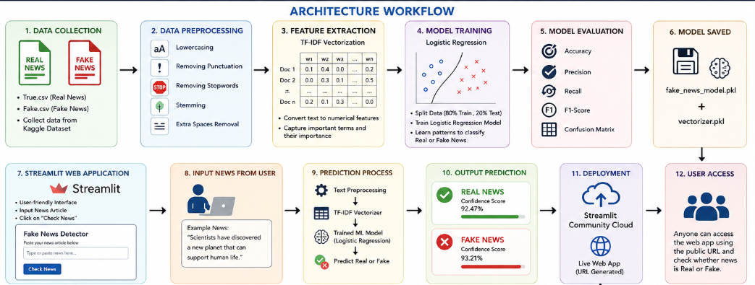
ARCHITECTURE WORKFLOW:

Slide 15
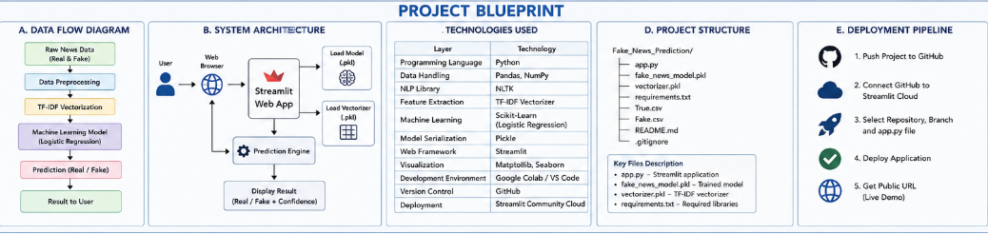
PROJECT BLUEPRINT:

Slide 16
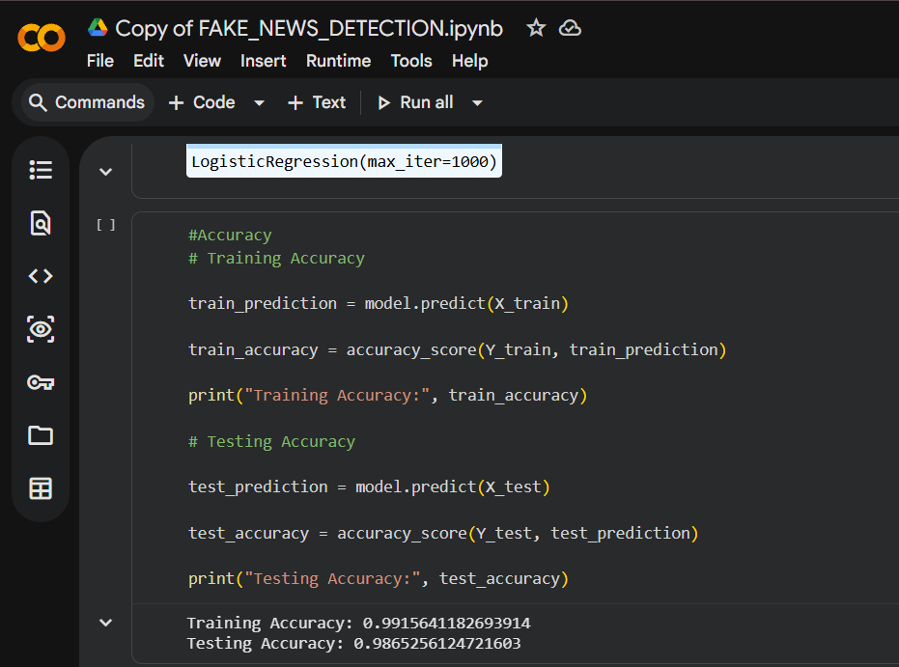
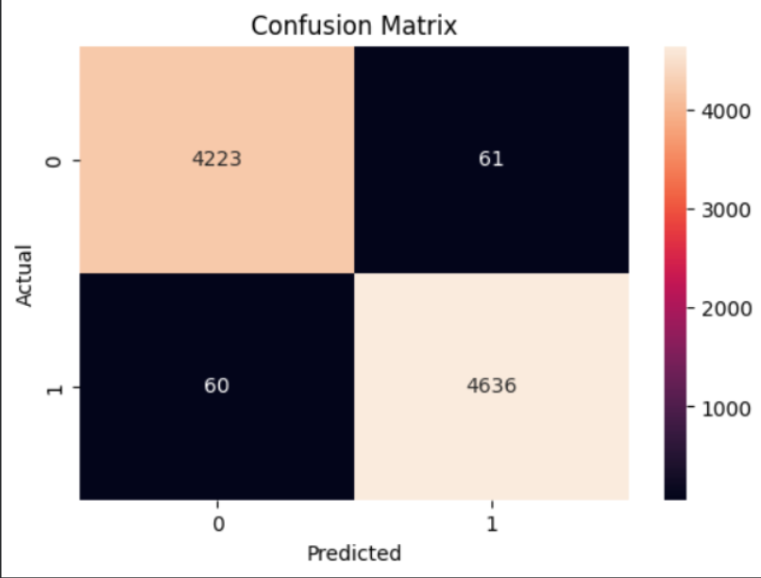
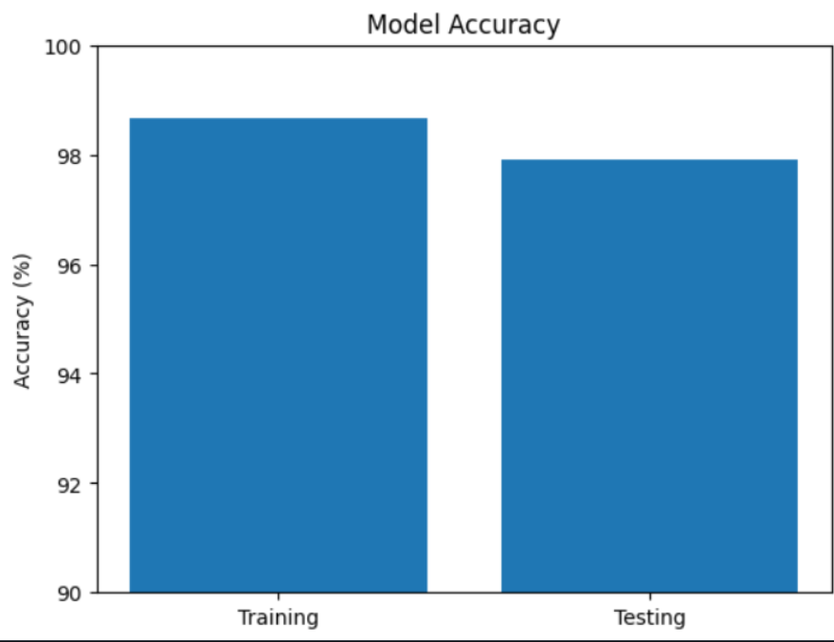
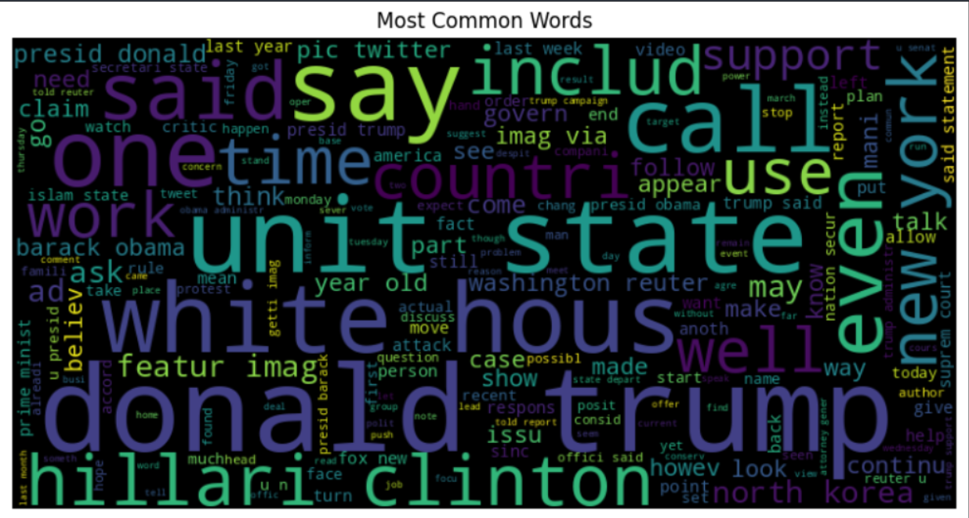
PROJECT SCREENSHOT:
Model Accuracy

Slide 17
RESULT:
Experimental Results:
Successfully collected and processed Real and Fake News datasets.
Applied NLP preprocessing techniques including text cleaning, stopword removal, and stemming.
Converted text data into numerical form using TF-IDF Vectorization.
Trained a Logistic Regression model for news classification.
Developed a user-friendly Streamlit web application.
Successfully deployed the application on Streamlit Community Cloud.
Performance Results:
Training Accuracy: ~99%
Testing Accuracy: ~98-99% (use your actual accuracy if available)
Model effectively classified news articles as Real or Fake.
Generated confidence scores for prediction reliability.
Deployment Result:
Publicly accessible web application developed and deployed.
Users can input news text and instantly receive classification results.
Application successfully integrates Machine Learning and Web Deployment.

Slide 18
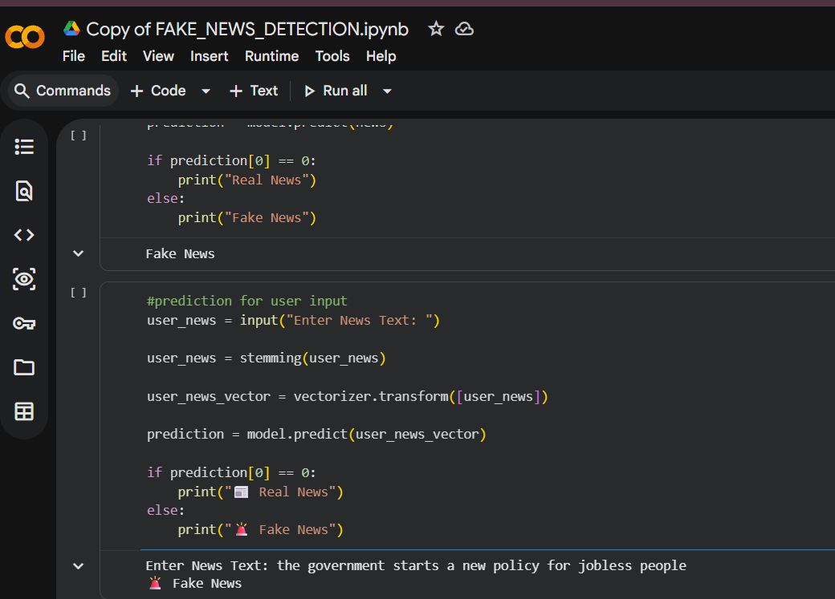
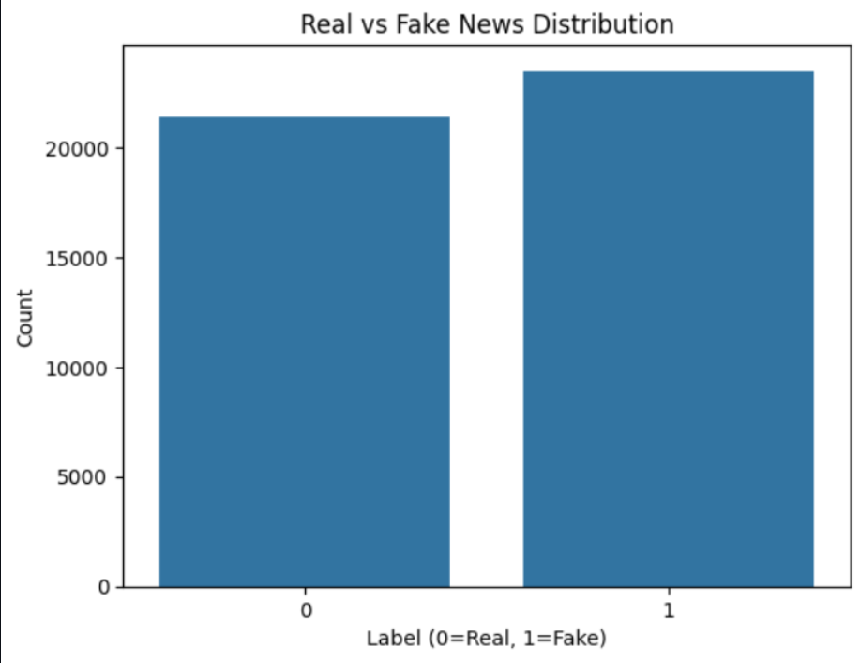
MODEL PREDICTION:

Slide 19
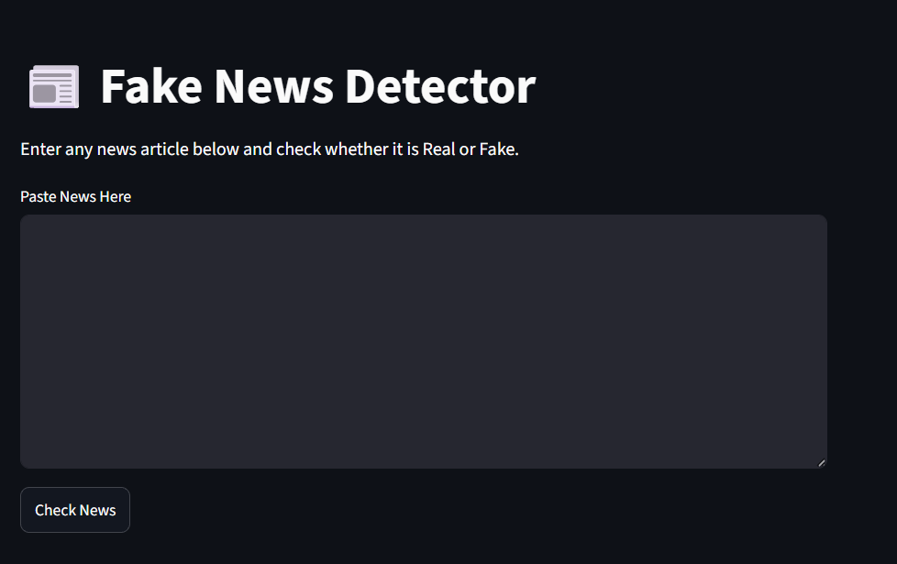
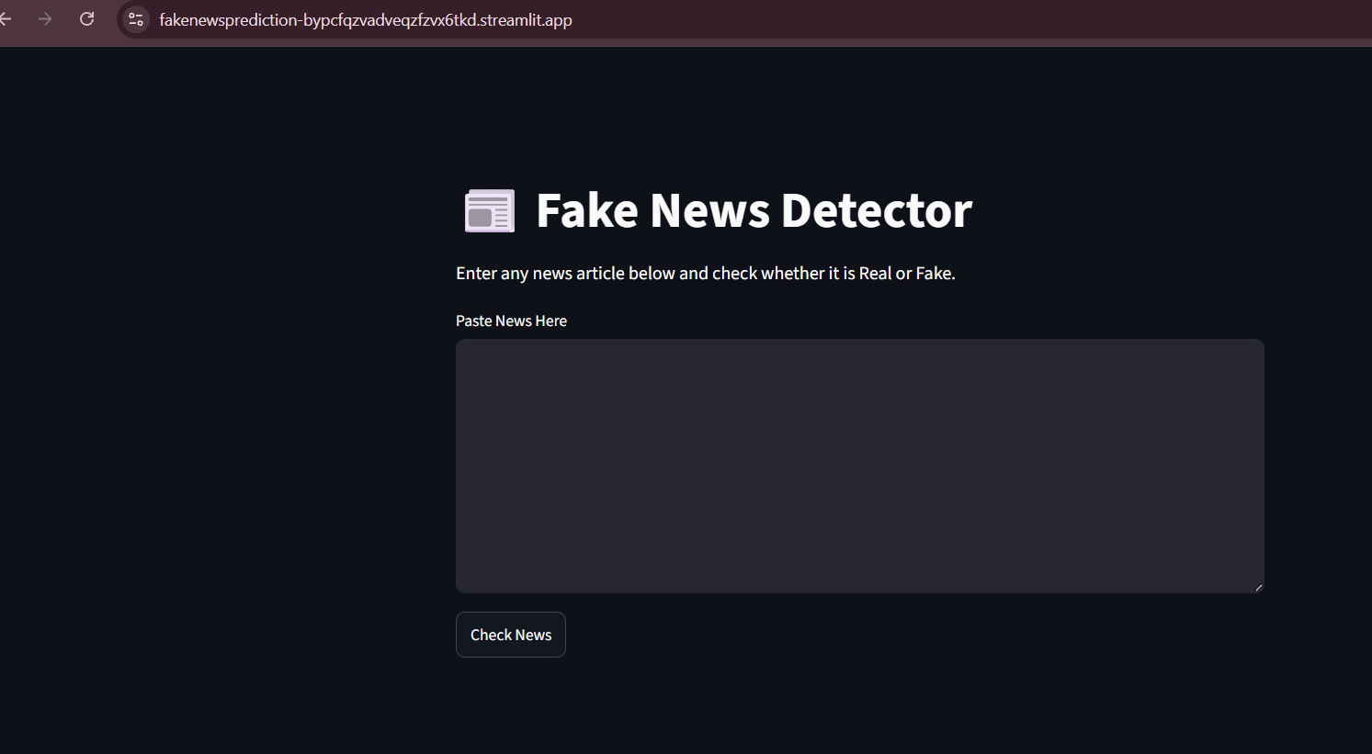
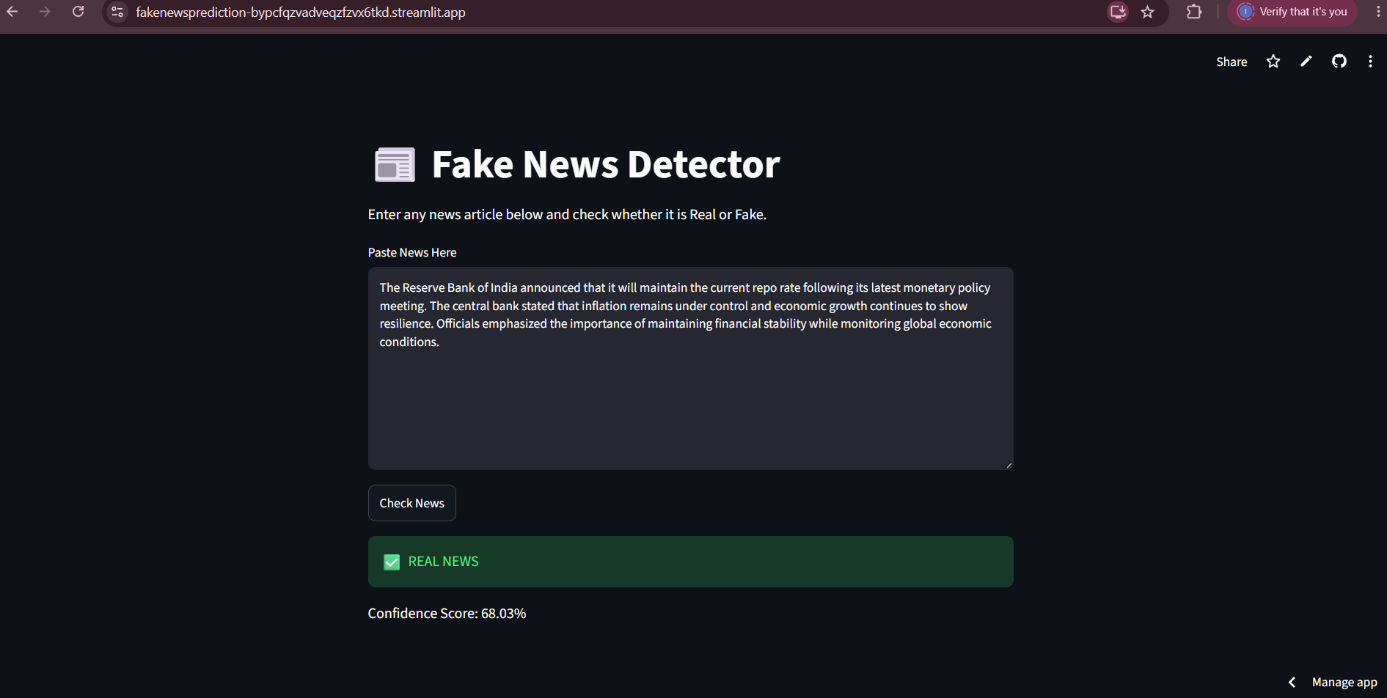
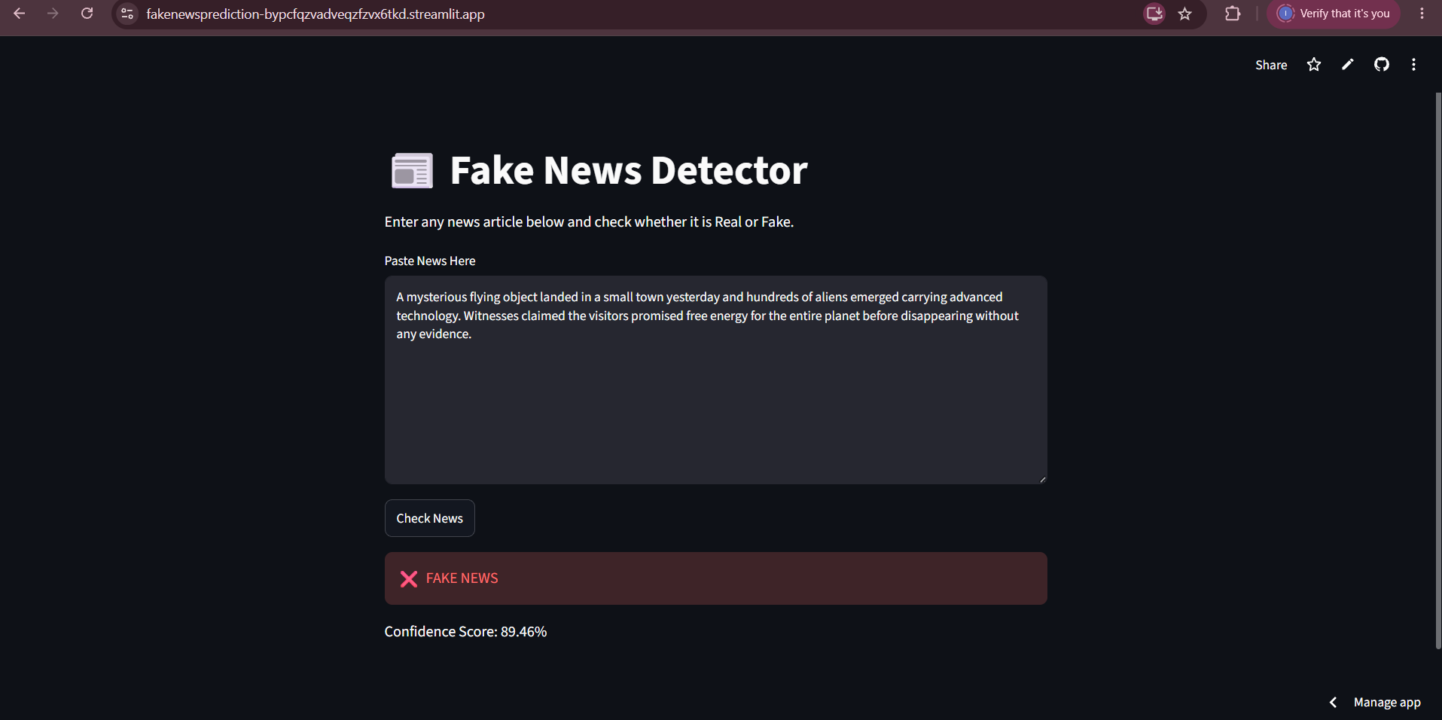
WEB APPLICATION INTERFACE & LIVE PREDICTION RESULT:

Slide 20
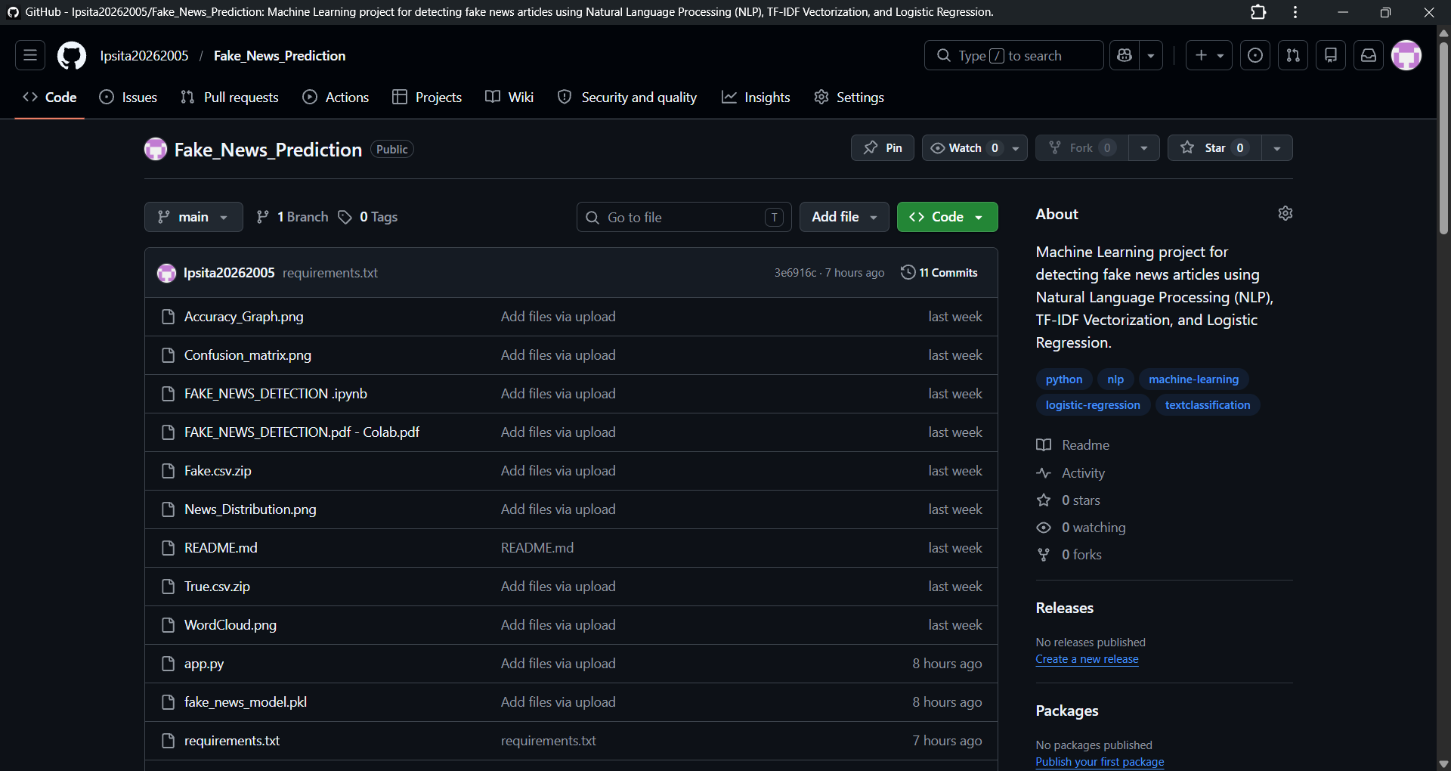
Cloud Deployment & GitHub Repository :

Slide 21
Future Scope:
1. Real-Time Fact Checking:
Integrate news APIs and fact-checking websites.
Verify news content against trusted sources.
2. Deep Learning Models :
Implement advanced models such as: LSTM, GRU, BERT, RoBERTa, Transformers
3. Multi-Language Support:
Detect fake news in: English, Hindi, Bengali, Other regional languages
4. News URL Verification:
Allow users to submit article URLs instead of only text.
5. Image and Video Verification:
Detect manipulated images and deepfake videos.
Develop a multimodal fake news detection system.
6. Browser Extension:
Create a Chrome Extension for real-time fake news alerts.
7. Mobile Application:
Develop Android and iOS versions of the application.
8. Social Media Integration:
Detect misinformation on platforms such as: X (Twitter), Facebook,Instagram,YouTube

Slide 22
REFERENCES:
1. TensorFlow Documentation – [https://www.tensorflow.org/](https://www.tensorflow.org/)
2. Keras Documentation – [https://keras.io/](https://keras.io/)
3. NLTK Documentation – [https://www.nltk.org/](https://www.nltk.org/)
4. Scikit-learn Documentation – [https://scikit-learn.org/](https://scikit-learn.org/)
5. GloVe Word Embeddings – [https://nlp.stanford.edu/projects/glove/](https://nlp.stanford.edu/projects/glove/)
6. Kaggle Fake News Dataset – [https://www.kaggle.com/](https://www.kaggle.com/)
7. Research papers on Fake News Detection using NLP and Deep Learning.

Slide 23
GITHUB LINK & DEPLOYMENT LINK :
GITHUB LINK : https://github.com/Ipsita20262005/Fake_News_Prediction.git
DEPLOYMENT LINK: https://fakenewsprediction-bypcfqzvadveqzfzvx6tkd.streamlit.app/

Slide 24
CONCLUSION
A Machine Learning-based Fake News Detection System was successfully developed using Natural Language Processing (NLP) techniques.
TF-IDF Vectorization and Logistic Regression effectively identified patterns in news articles and classified them as Real or Fake.
The developed Streamlit web application provides a simple and interactive interface for users.
The model demonstrated high accuracy and reliable performance on unseen news data.
This project highlights how Artificial Intelligence can assist in combating misinformation and improving information credibility.

Slide 25
THANK YOU

