Slide 1
IBM University Engagement Project Submission
“Exploring the Power of Agentic AI with IBM Granite and LangFlow”

Slide 2


Project Tile – Industrial Machinery Predictive Maintenance
Domain of Project – Industrial Engineering / Industry 4.0
Student Name | Recent Passport Photo | Email ID | Mobile number [WhatsApp]
IPSITA CHOWDHURY |  | ipsitachowdhury01@gmail.com helloipsita2026@gmail.com | 7439777959

Slide 3
Problem Statement -
Problem Statement : Industrial Machinery Predictive Maintenance
The Challenge
Develop a predictive maintenance model for a fleet of industrial machines to anticipate failures before they occur. This project will involve analyzing sensor data from machinery to identify patterns that precede a failure. The goal is to create a classification model that can predict the type of failure (e.g., tool wear, heat dissipation, power failure) based on real-time operational data. This will enable proactive maintenance, reducing downtime and operational costs.
The Objective
The objective of this project is to develop a Machine Learning-based predictive maintenance system that can analyze industrial machinery sensor data and predict potential machine failures before they occur. By identifying patterns associated with different failure types such as tool wear failure, heat dissipation failure, power failure, overstrain failure, and random failures, the system enables industries to perform maintenance proactively. This helps reduce unexpected downtime, improve machine reliability, increase productivity, and lower maintenance costs.
Develop a predictive maintenance model using Machine Learning.
Analyze industrial machine sensor data in real time.
Detect patterns that indicate upcoming machine failures.
Classify different types of failures accurately.
Reduce unplanned machine downtime.
Improve operational efficiency and productivity
Minimize maintenance and repair costs
Enable proactive and data-driven maintenance decisions

Slide 4
Technology Used
Platform:
IBM Cloud Lite , IBM Watsonx.ai , IBM Watson Machine Learning
Machine Learning:
AutoAI, Random Forest Classifier (Best Performing Model) , Classification Algorithms
Dataset:
Kaggle Predictive Maintenance Dataset
Programming & Data Processing :
Python, Pandas, NumPy, Scikit-learn
Deployment:
IBM Watson Machine Learning Deployment Space, REST API Endpoint, Online Prediction Service
Data Storage:
IBM Cloud Object Storage

Slide 5
Proposed Solution -
Proposed Solution: Industrial Machinery Predictive Maintenance
The proposed solution utilizes Machine Learning and IBM Watsonx.ai to create a predictive maintenance system for industrial machinery. Historical sensor data containing operational parameters such as temperature, rotational speed, torque, and tool wear are analyzed to identify patterns associated with machine failures. The data is preprocessed and used to train a classification model through IBM Watsonx.ai AutoAI. The best-performing model is deployed on IBM Cloud, allowing real-time prediction of failure types. This enables maintenance teams to take preventive actions before breakdowns occur, improving machine availability and reducing operational costs .
Phase 1: Data Collection
Obtain machinery sensor data from Kaggle dataset.
Store data in IBM Cloud Object Storage.
Phase 2: Data Preprocessing
Data cleaning.
Handling missing values.
Feature selection.
Train-test data split.
.

Slide 6
Proposed Solution -
Phase 3: Model Development
Use IBM Watsonx.ai AutoAI.
Train multiple classification algorithms.
Evaluate model performance.
Select best-performing model.
Phase 4: Deployment
Deploy model using IBM Watson Machine Learning.
Create REST API endpoint.
Enable online prediction service.
Phase 5: Prediction
Input machine operational parameters.
Predict failure type.
Generate confidence score.
Provide maintenance recommendations

Slide 7
Machine Learning components Used -
1. Data Collection
Source: Kaggle Predictive Maintenance Dataset, Machinery operational and sensor data collected for analysis.
2. Data Preprocessing
Data Cleaning
Missing Value Handling
Feature Selection
Data Transformation
Train-Test Split
3. Exploratory Data Analysis (EDA)
Understanding data patterns
Failure distribution analysis
Feature correlation analysis
4. Feature Engineering
Selection of important features such as:
Air Temperature
Process Temperature
Rotational Speed (RPM)
Torque
Tool Wear

Slide 8
Machine Learning components Used-
5. Model Training
AutoAI in IBM Watsonx.ai automatically trains multiple algorithms.
6. Model Evaluation
Accuracy
Precision
Recall
F1-Score
Cross Validation
7. Model Deployment
IBM Watson Machine Learning
REST API Endpoint
Online Prediction Service
8. Real-Time Prediction
Predicts machine failure type
Generates confidence score
Supports proactive maintenance

Slide 9
Algorithms Used :
Final Selected Algorithm:
Random Forest Classifier
Why Random Forest?
High prediction accuracy
Handles large datasets efficiently
Reduces overfitting
Works well for multiclass classification
Provides robust performance on industrial sensor data
Other Algorithms Tested by AutoAI:
IBM AutoAI generally evaluates multiple algorithms such as:
Random Forest Classifier
Decision Tree Classifier
XGBoost Classifier
Logistic Regression
Extra Trees Classifier
Gradient Boosting Classifier
The best-performing model is automatically selected and deployed.

Slide 10
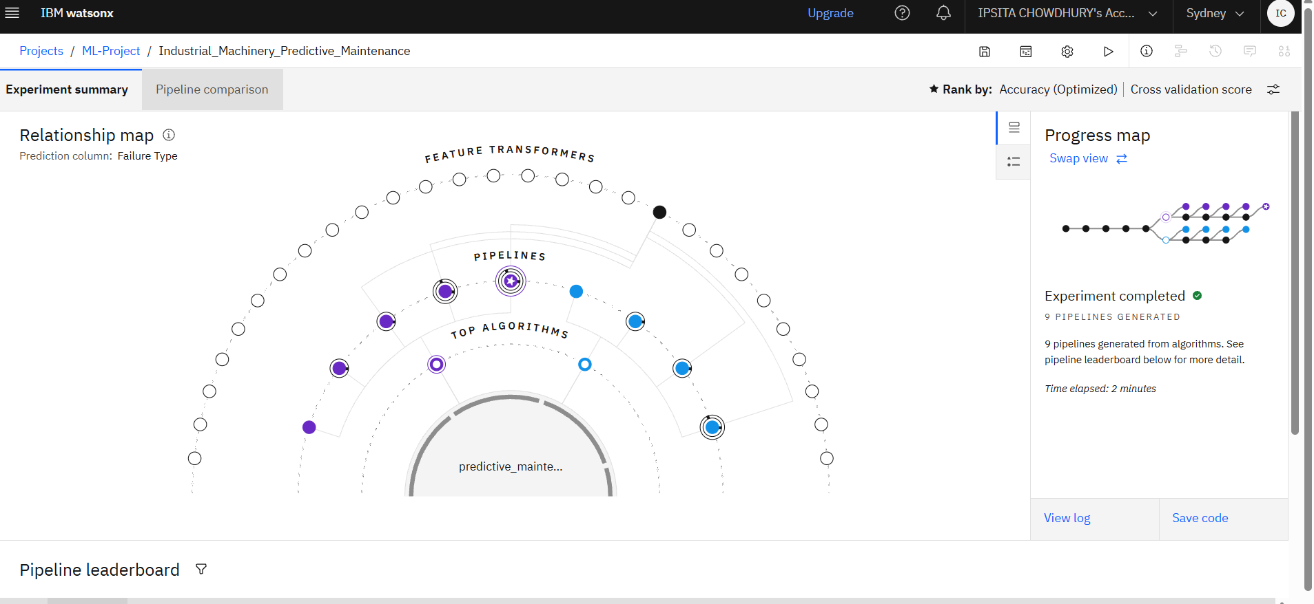
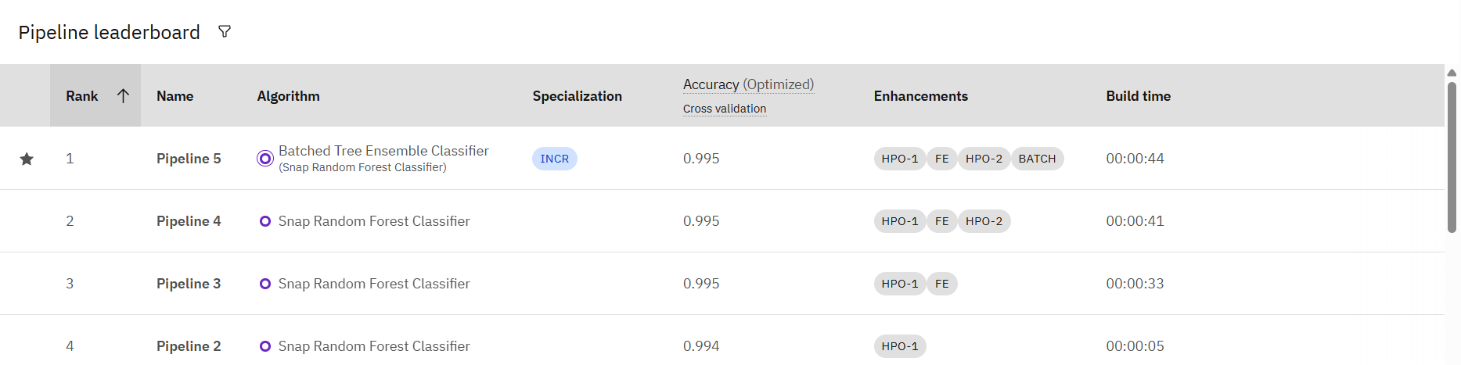
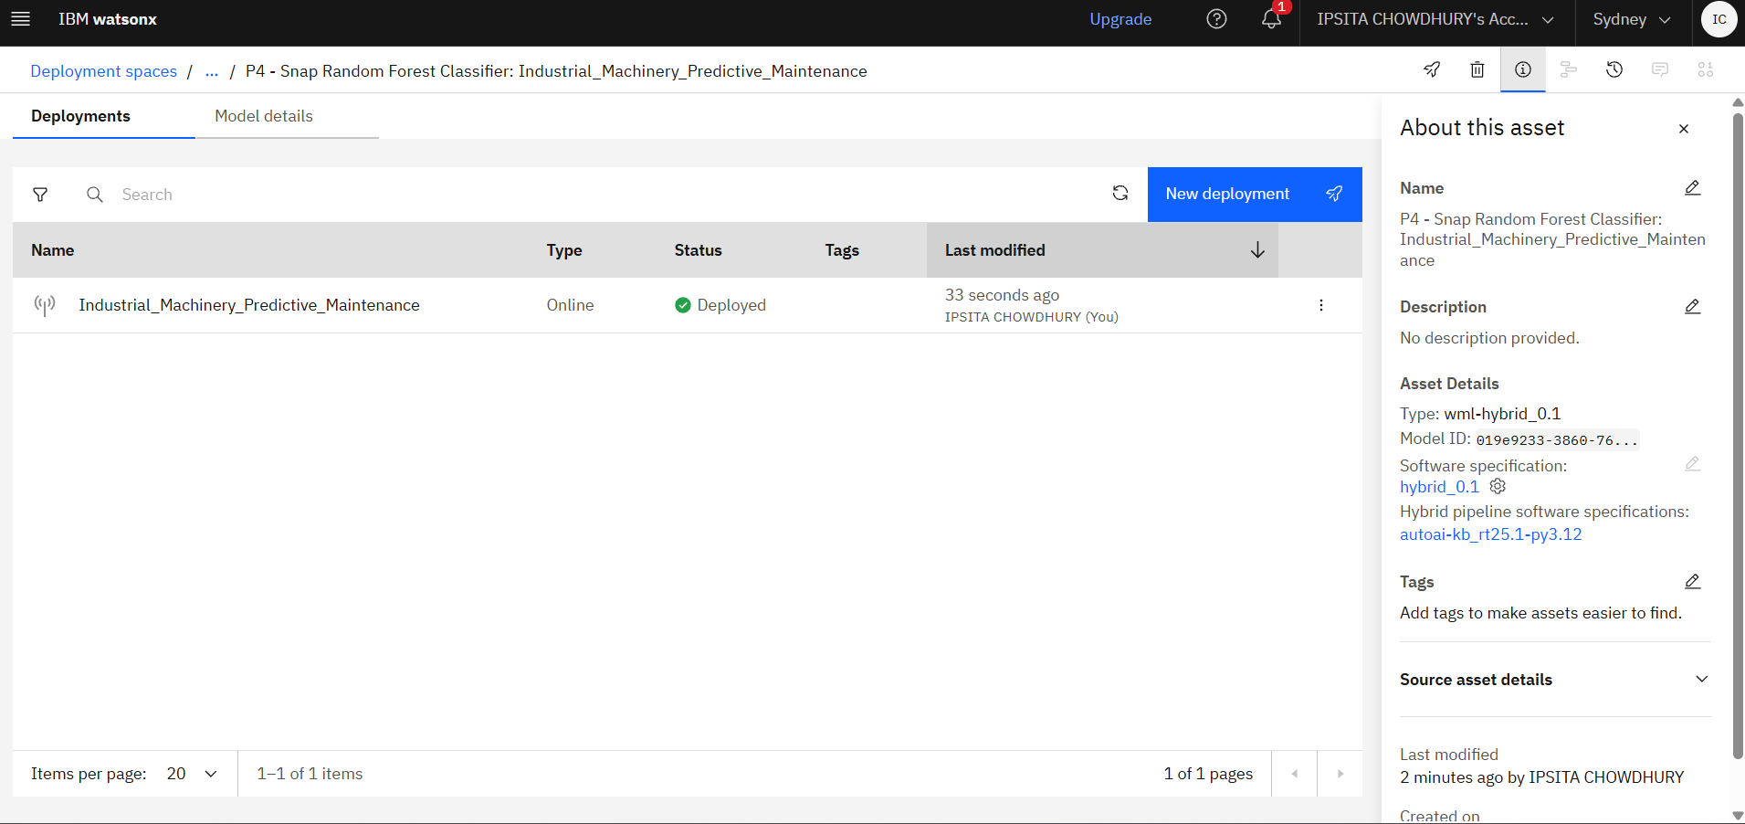
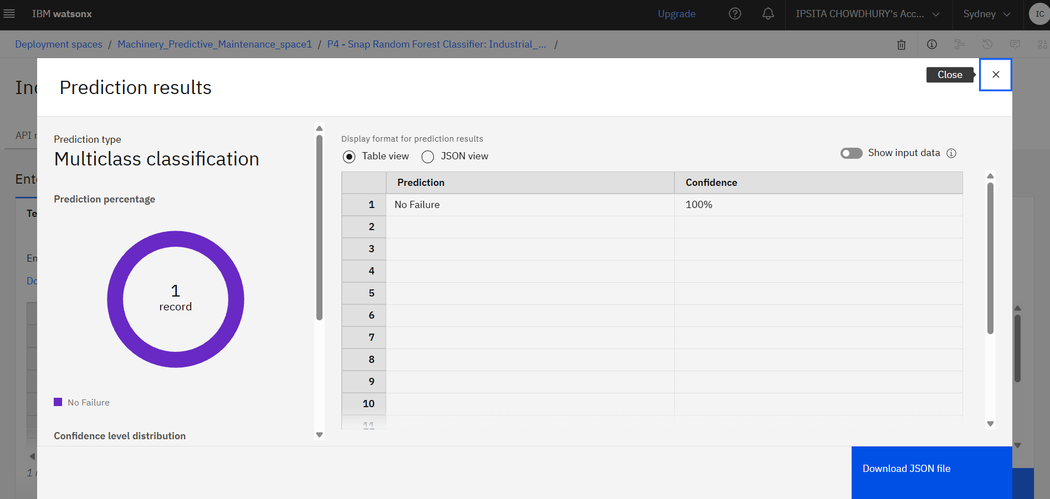
Screenshots : -

Slide 11
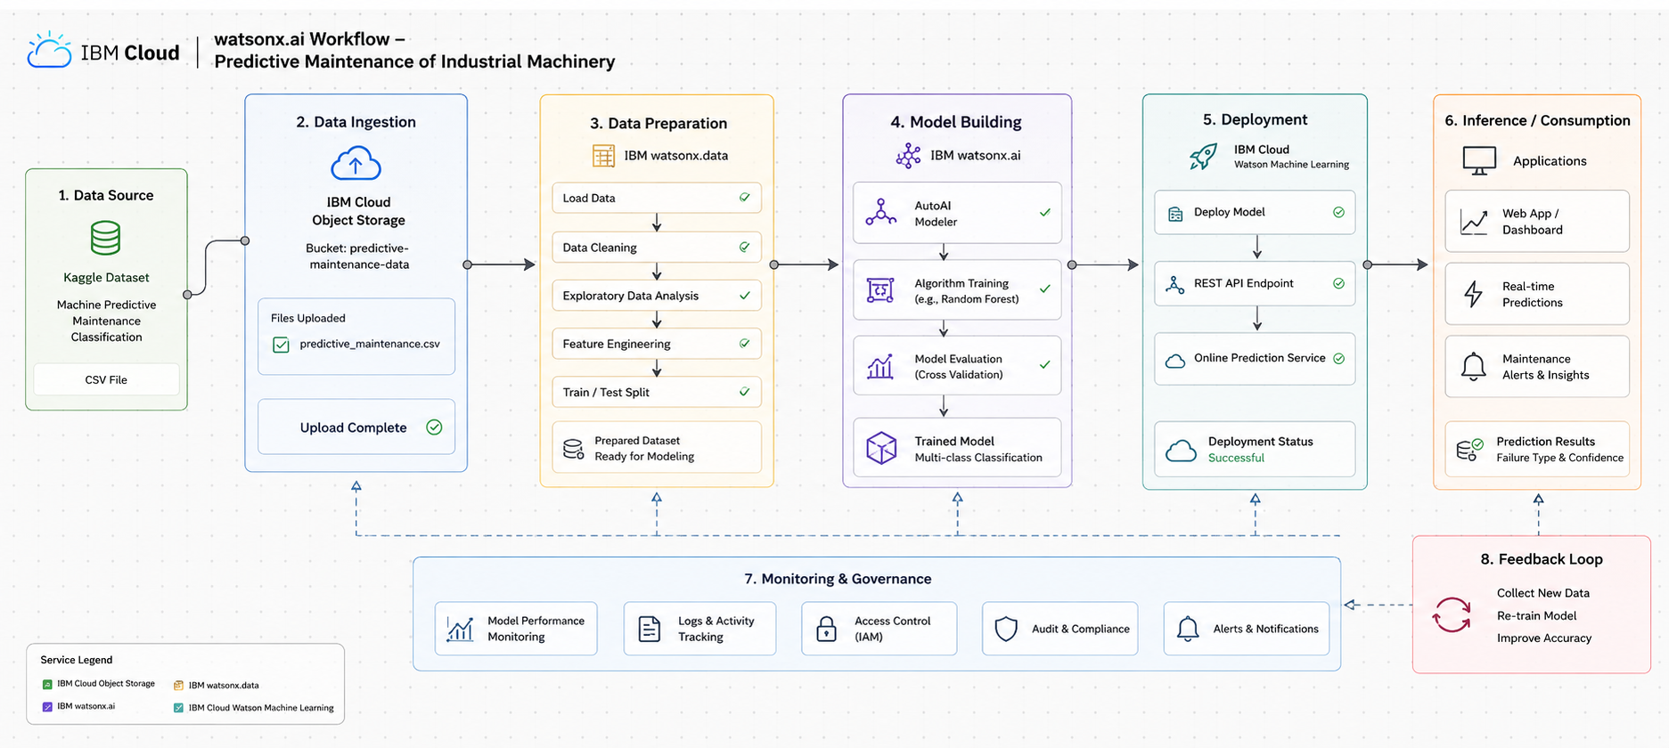
Architecture Workflow: -

Slide 12
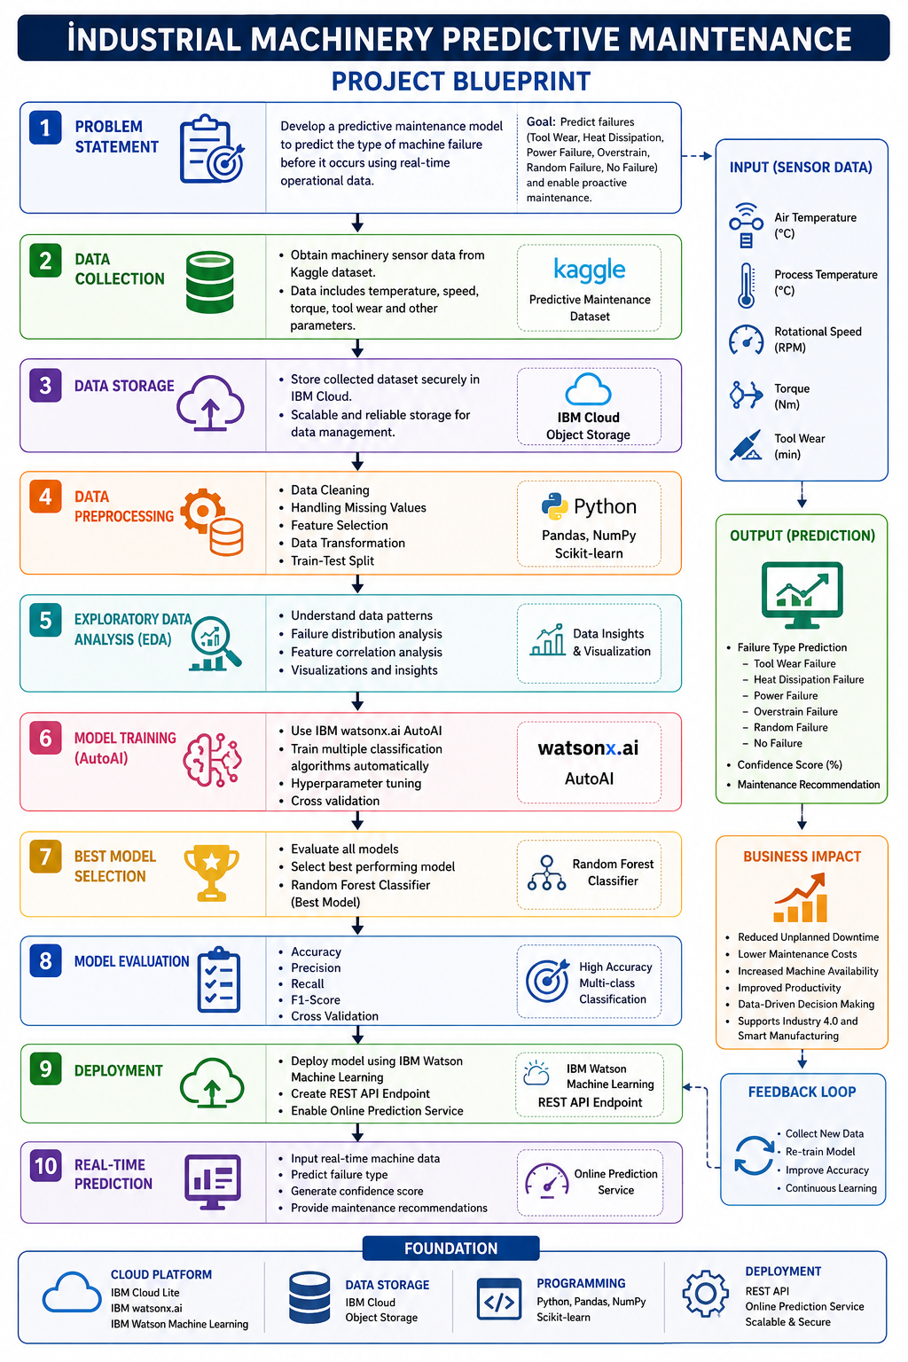
Project Blueprint

Slide 13
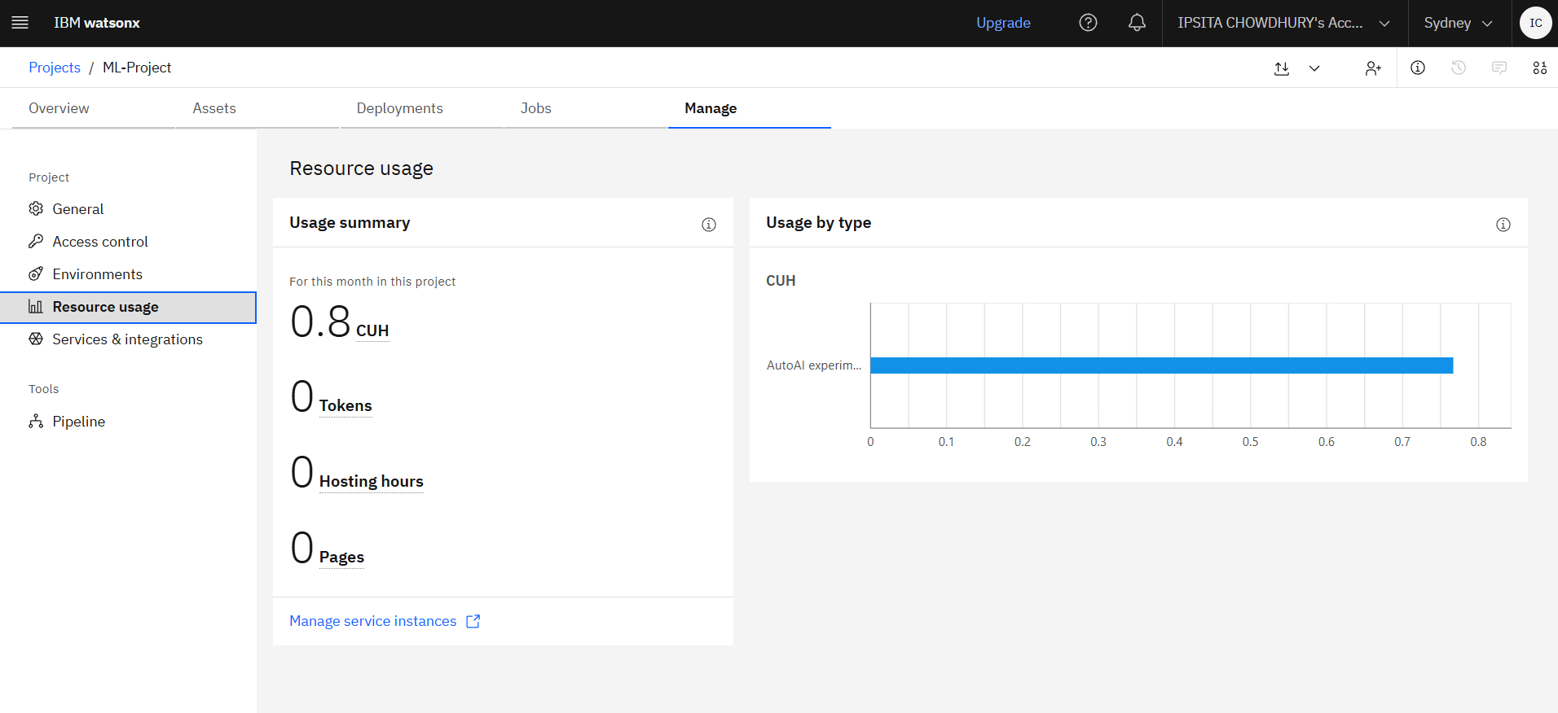
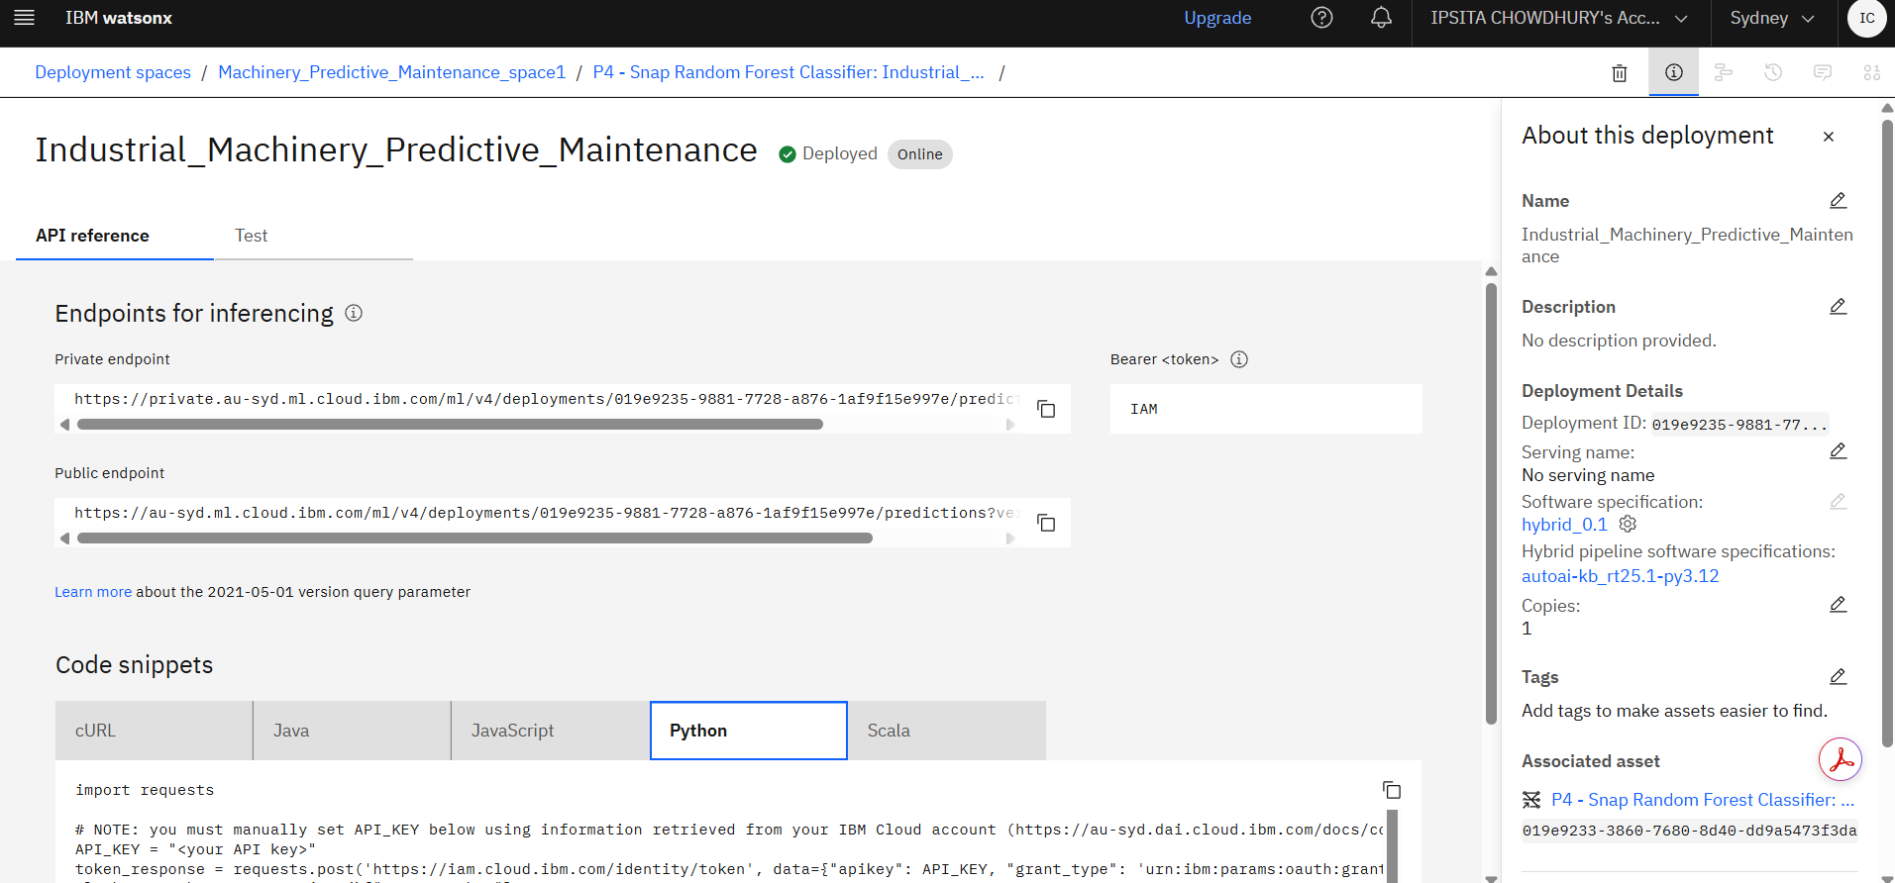
Resource Consumption and Compute Usage:-

Slide 14
Conclusion: -
The Industrial Machinery Predictive Maintenance project successfully demonstrates how Machine Learning, Artificial Intelligence, and Cloud Computing can be integrated to improve the reliability and efficiency of industrial operations. Traditional maintenance approaches often rely on fixed schedules or reactive repairs after a machine failure has already occurred, which can lead to unexpected downtime, production losses, increased maintenance costs, and reduced equipment lifespan. This project addresses these challenges by implementing a predictive maintenance solution capable of forecasting potential failures before they happen.
Using the Kaggle Predictive Maintenance Dataset, machinery sensor parameters such as air temperature, process temperature, rotational speed, torque, and tool wear were analyzed to identify patterns associated with different types of failures. Through the use of IBM Watsonx.ai AutoAI, multiple machine learning models were automatically trained, evaluated, and compared. The best-performing model, Random Forest Classifier, was selected and deployed using IBM Watson Machine Learning services on IBM Cloud.
The developed model is capable of performing multiclass classification, allowing it to predict specific failure categories such as Tool Wear Failure, Heat Dissipation Failure, Power Failure, Overstrain Failure, Random Failure, and No Failure. This provides more actionable insights than a simple failure/no-failure prediction system, enabling maintenance teams to take targeted preventive measures based on the predicted fault type.
The deployment of the model as an online prediction service demonstrates the practical applicability of the solution in real-world industrial environments. By enabling real-time predictions, organizations can monitor machine health continuously, schedule maintenance activities proactively, reduce operational interruptions, and optimize resource utilization. This ultimately leads to improved productivity, increased equipment availability, enhanced safety, and significant cost savings.
Furthermore, the project highlights the importance of Industry 4.0 technologies, where data-driven decision-making and intelligent automation play a key role in modern manufacturing and industrial systems. The successful integration of cloud-based machine learning services with predictive analytics showcases a scalable and efficient framework that can be extended to larger industrial ecosystems.
In conclusion, this project proves that predictive maintenance powered by Machine Learning and IBM Watsonx.ai is an effective solution for minimizing machine failures, improving operational efficiency, and supporting smart manufacturing initiatives. It serves as a strong foundation for developing advanced industrial monitoring systems that contribute to more reliable, sustainable, and intelligent industrial operations in the future.

Slide 15
Novelty and Uniqueness: -
Uses Artificial Intelligence for predictive maintenance instead of traditional scheduled maintenance.
Predicts machine failures before actual breakdowns occur.
Classifies multiple failure types rather than only detecting failure/non-failure.
Utilizes IBM Watsonx.ai AutoAI for automated model generation and optimization.
Provides real-time prediction capability through cloud deployment.
Reduces maintenance costs and production losses.
Supports Industry 4.0 and Smart Manufacturing concepts.
Scalable solution for large fleets of industrial machinery.
Cloud-based deployment enables remote monitoring and access.
Data-driven decision-making improves maintenance planning.

Slide 16
Git Hub Link : -
LINK:
https://github.com/Ipsita20262005/Industrial-Machinery-Predictive-Maintenance
This includes :
Project_Submission_for_EdunetFoundation_IBMUniversityEngagement_ppt
Machine Predictive Maintenance Code.txt
Architecture Workflow.png
Predictive_maintenance.csv (dataset)
README.md
·
·
·

Slide 17
Future Scope
Integrate live IoT sensors for real-time monitoring.
Develop a web-based dashboard for visualization and alerts.
Implement automated maintenance scheduling.
Incorporate Deep Learning models for improved prediction accuracy.
Enable predictive maintenance across multiple factory locations.
Integrate with ERP and Manufacturing Execution Systems (MES).
Use Digital Twin technology for machine health simulation.
Add anomaly detection for unknown failure patterns.
Develop mobile applications for maintenance engineers.
Implement predictive maintenance for various industrial sectors such as manufacturing, energy, mining, and automotive industries.
·
·
·

Slide 18


