Slide 1

Project Title –Seasonal Agriculture Performance Analysis
Student Name - IPSITA CHOWDHURY
College Name- Narula Institute Of Technology
AICTE STU ID : STU691200e003b0d1762787552

Slide 2

PROBLEM STATEMENT
Agricultural activities are influenced by seasonal variations in environmental conditions, farming practices, resource availability and market conditions. As a result, agricultural performance may differ from one season to another. However, raw agricultural data does not clearly explain how agricultural performance changes across seasons or what patterns can be observed in different seasonal conditions. The problem is to analyze the given agricultural dataset and investigate seasonal differences in agricultural performance by identifying meaningful patterns, trends, relationships and variations within the available data.

Slide 3
Project Description
Seasonal Agriculture Performance Analysis is a Python-based data analytics project that examines agricultural performance across different seasons, crops, irrigation methods and regions. The project analyzes yield, production, revenue, cost, profit, water efficiency and environmental factors to identify important patterns and provide evidence-based recommendations for better agricultural planning.

Slide 4

WHO ARE THE END USERS?
End Users / Target Users :
1. Farmers 👨‍🌾 Can use the findings to understand seasonal yield, profitability, irrigation and resource-use patterns.
2. Agricultural Planners 🌱 Can use seasonal and regional comparisons for better agricultural planning.
3. Government & Agricultural Departments 🏛️ Can use data-driven insights for resource allocation and agricultural policies.
4. Agribusiness & Farm Managers 📊 Can evaluate crop profitability, irrigation performance and resource utilization.
5. Agricultural Researchers 🔬 Can use the analysis to identify patterns and areas for further research.

Slide 5

Technology Used
Technology | Purpose
Python | Data analysis
Pandas | Data cleaning and manipulation
NumPy | Numerical computation
Matplotlib | Data visualization
Seaborn | Statistical visualization
SciPy | Statistical testing
Google Colab | Development environment
Jupyter Notebook (.ipynb) | Project implementation

Slide 6
RESULTS
Key Insights :
1. Agricultural performance varies across seasons.
2. Seasonal differences exist in yield, profitability and resource utilization.
3. Crop performance changes across seasons.
4. Irrigation methods show different yield, profit and water-efficiency patterns.
5. Some crops demonstrate greater resilience across seasons.
6. Profitability can vary considerably between states and seasons.
7. Water efficiency has an observable relationship with agricultural yield.
8. Environmental and agricultural variables show different levels of correlation.
9. Disease/pest risk varies across agricultural conditions.
10. Statistical analysis helps distinguish visible differences from statistically significant differences.

Slide 7
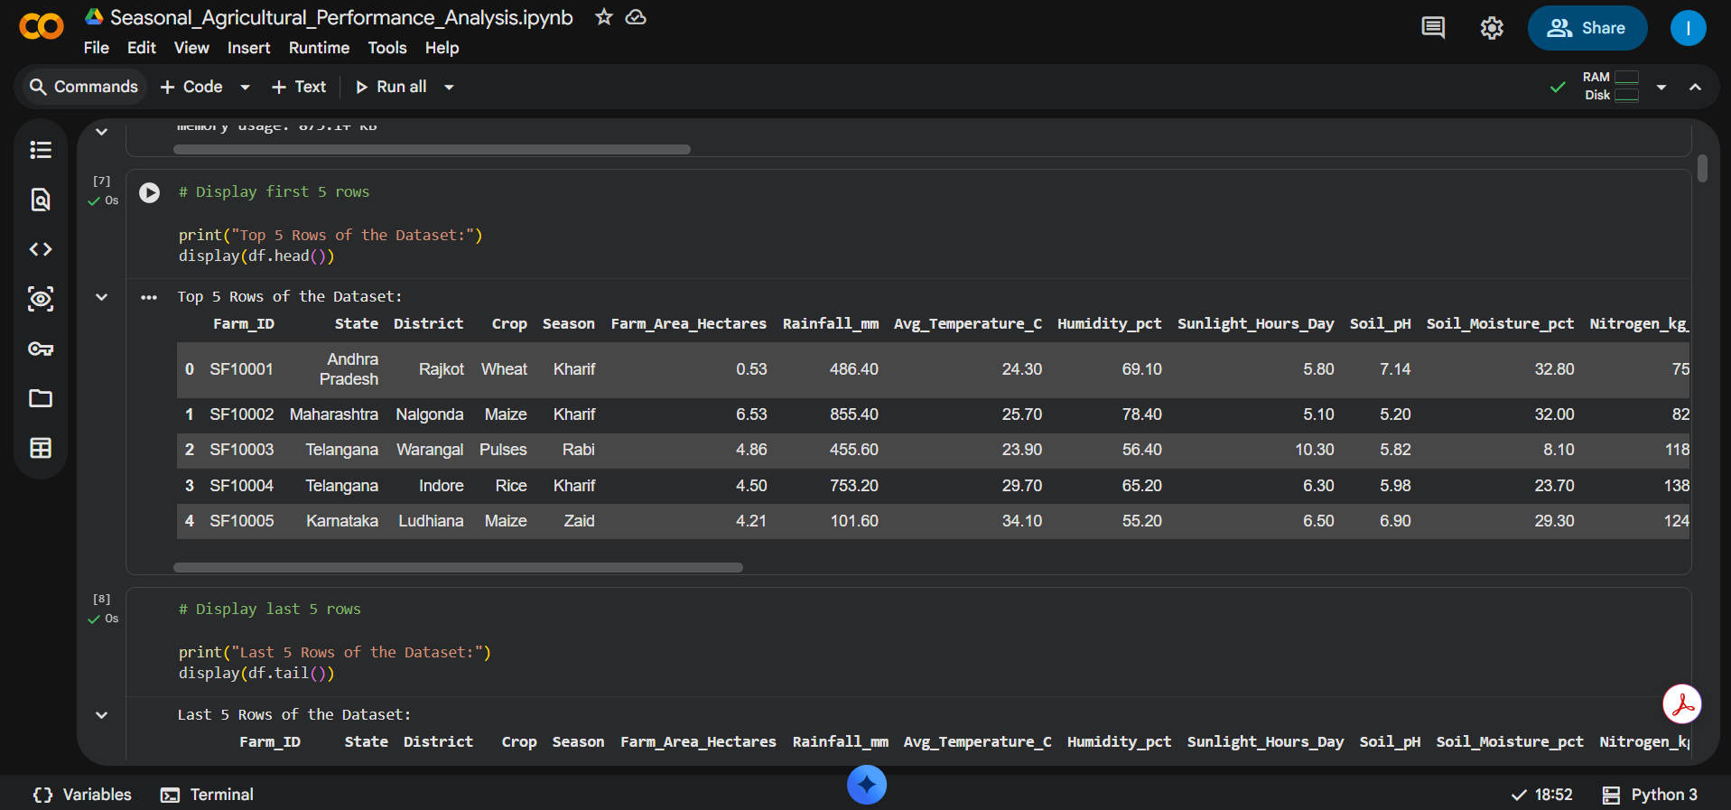
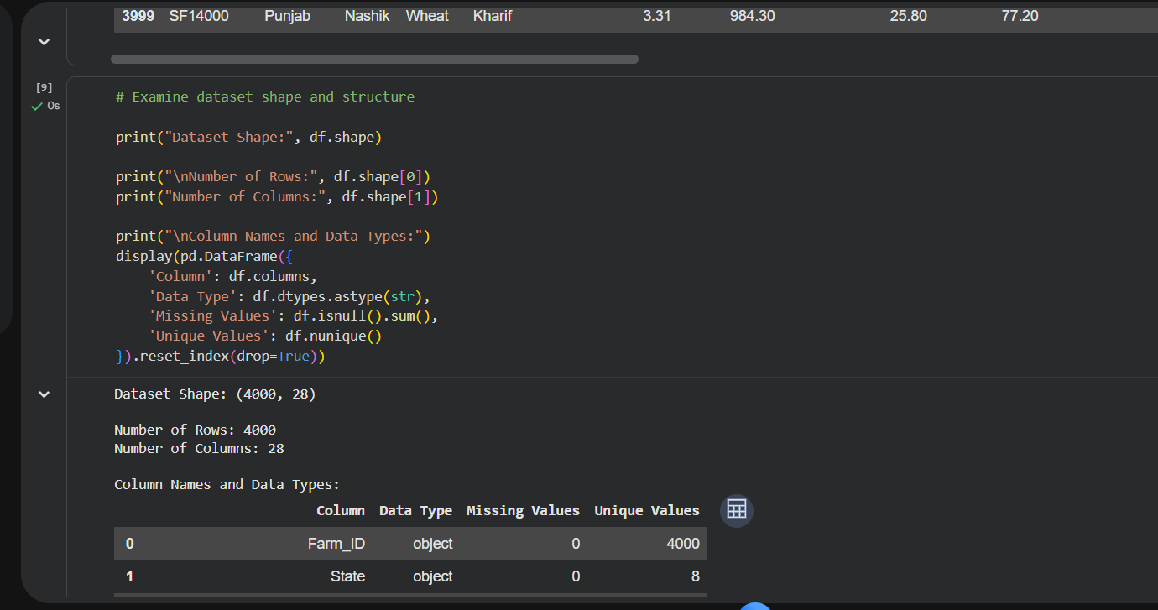
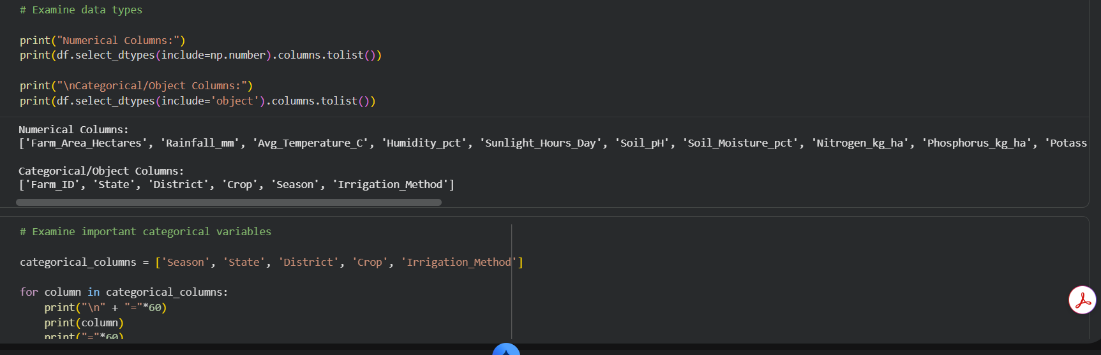
RESULTS

Slide 8
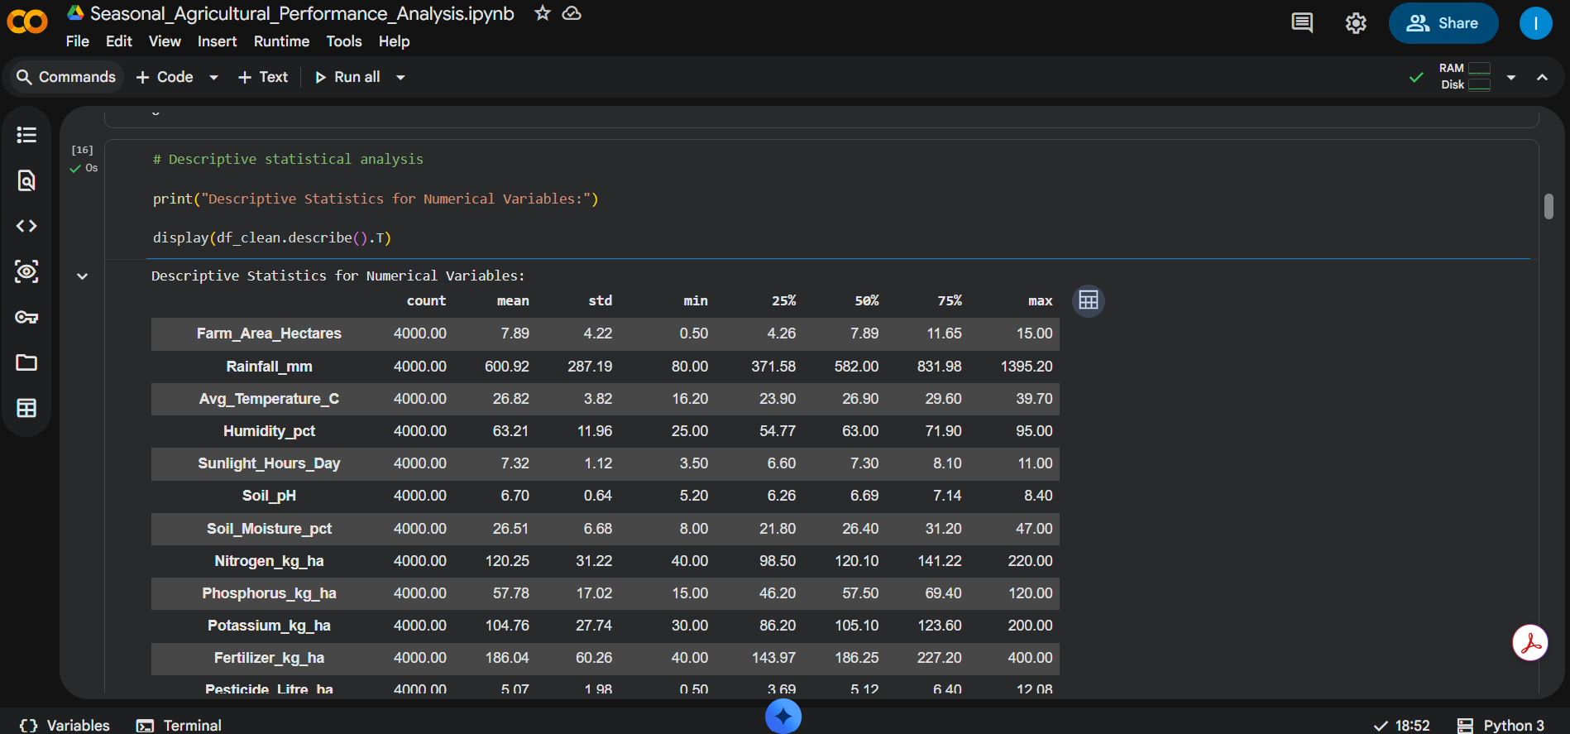
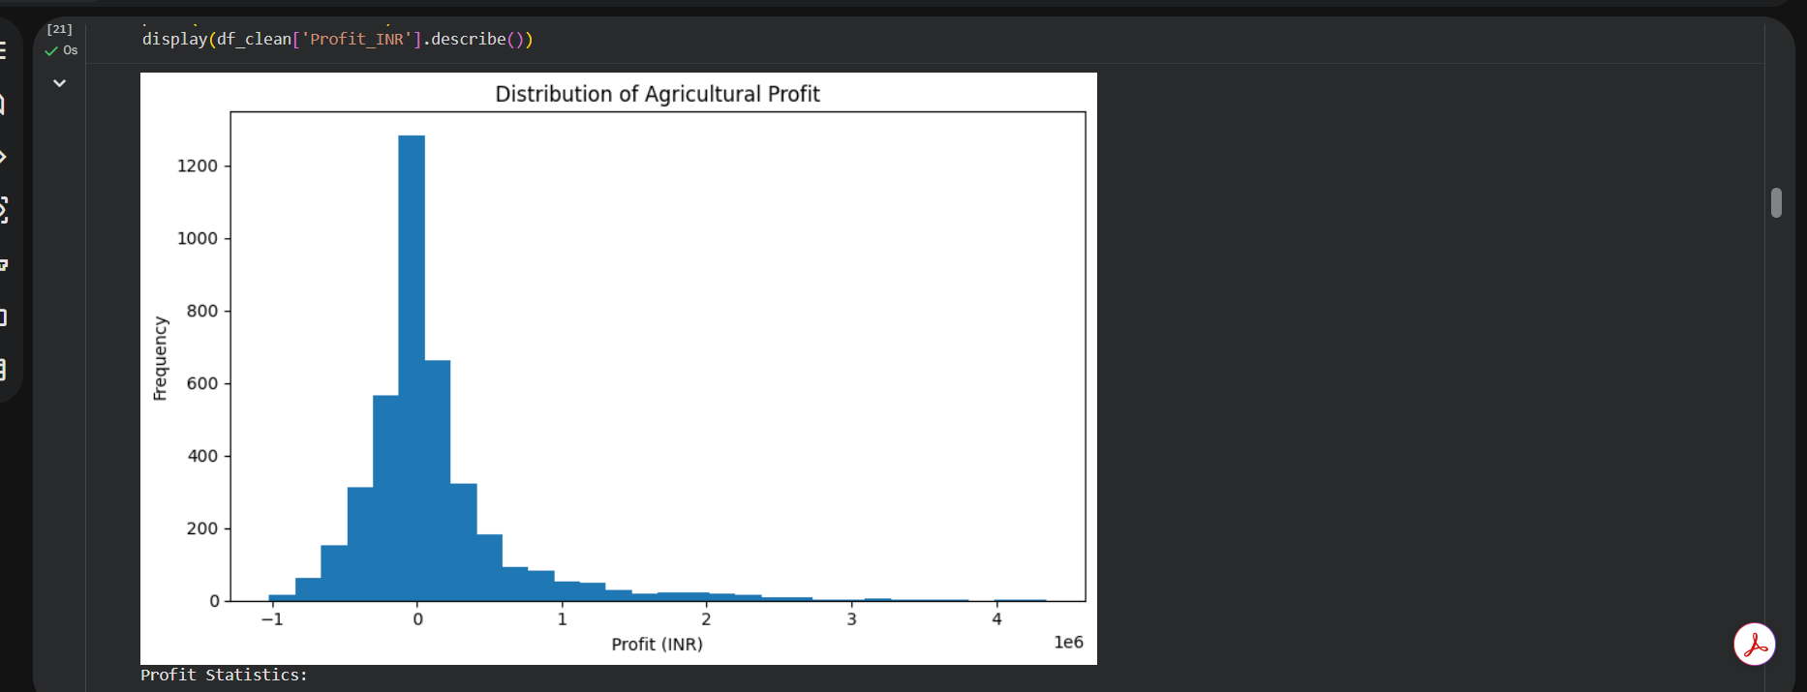
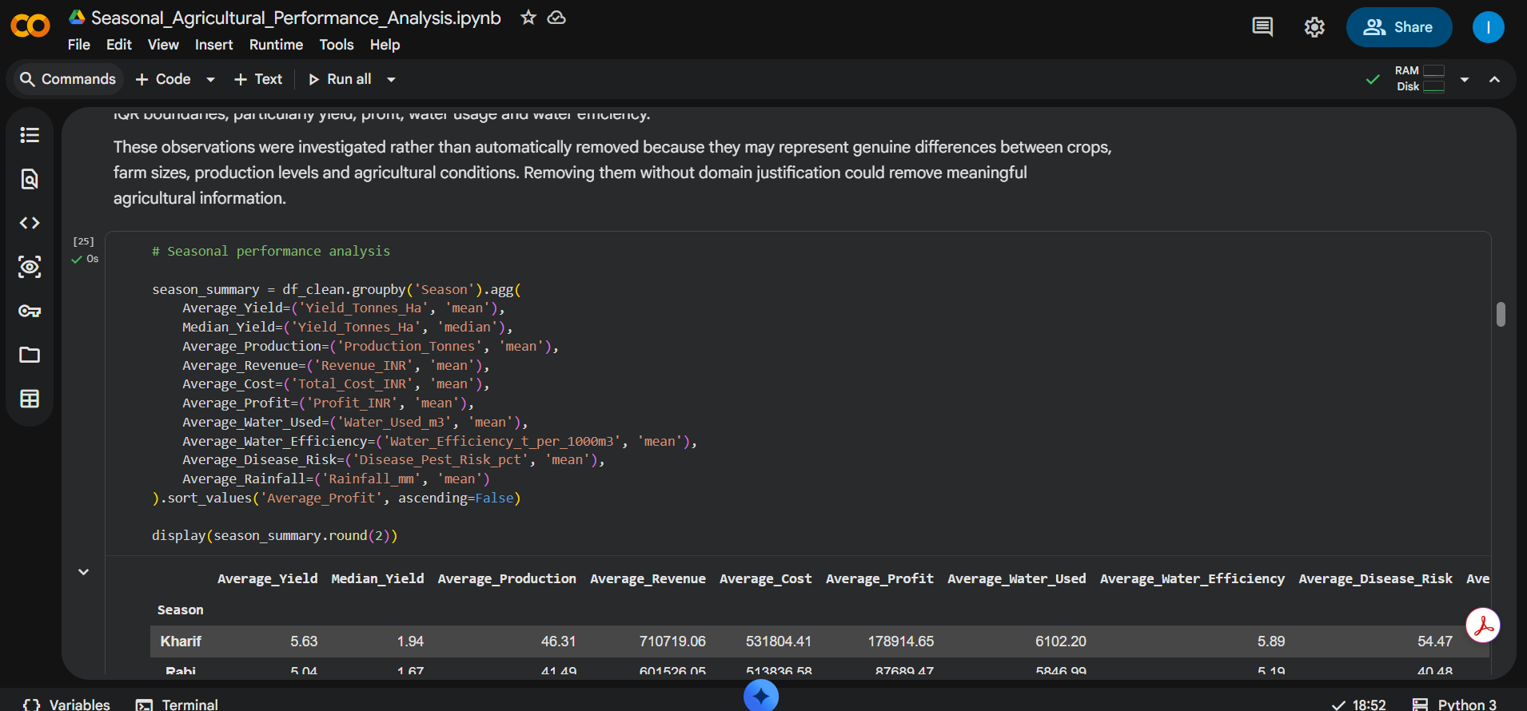
RESULTS

Slide 9
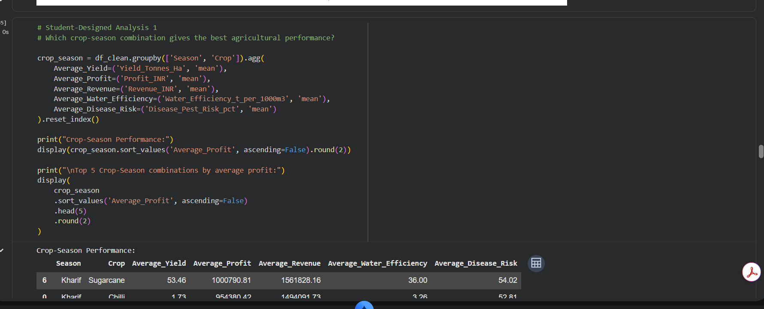
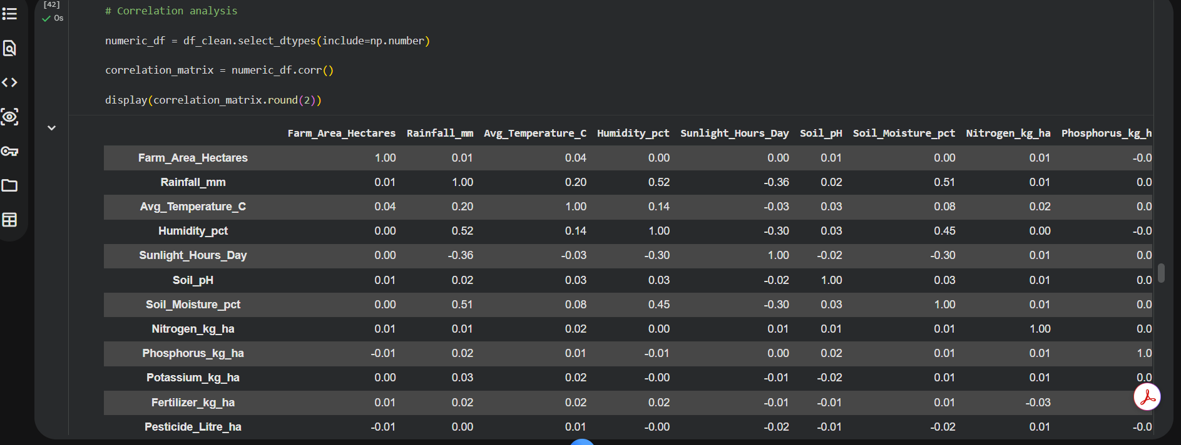
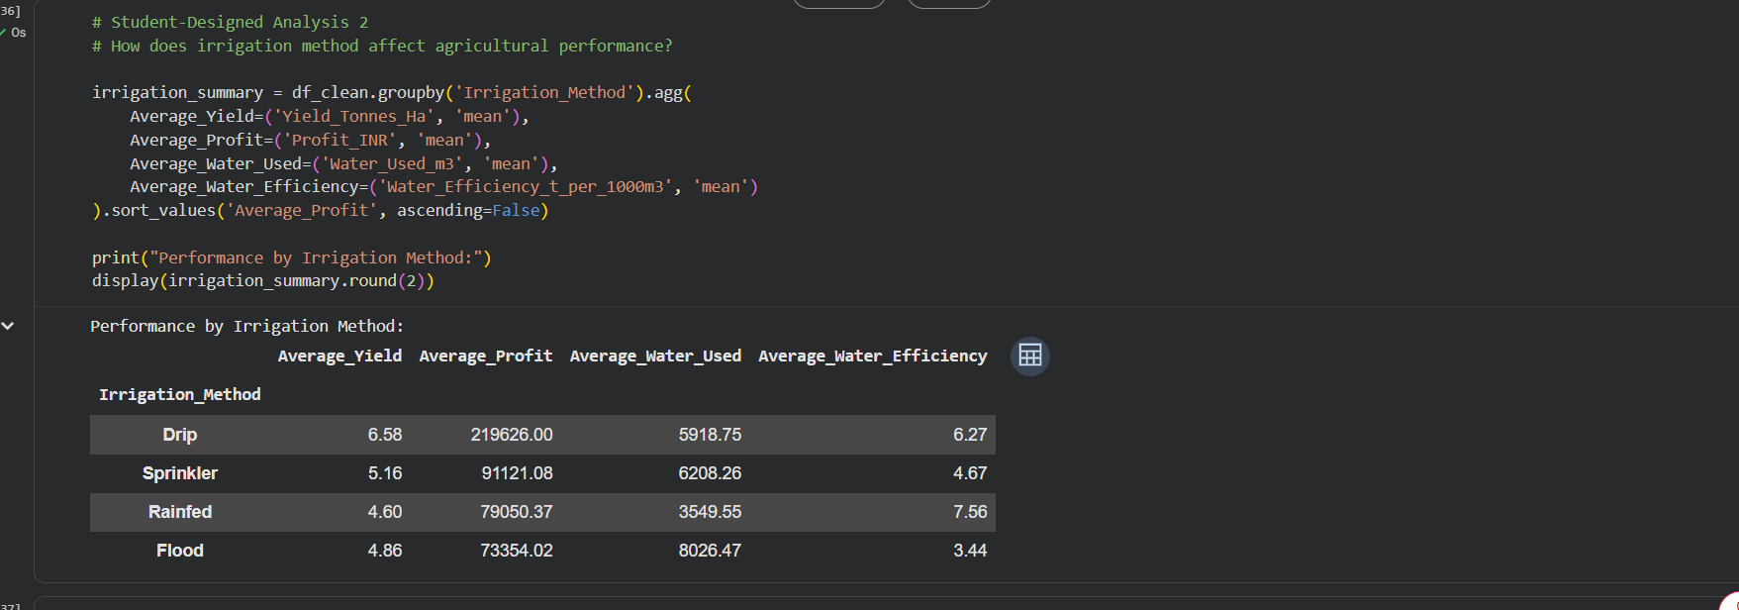
RESULTS

Slide 10
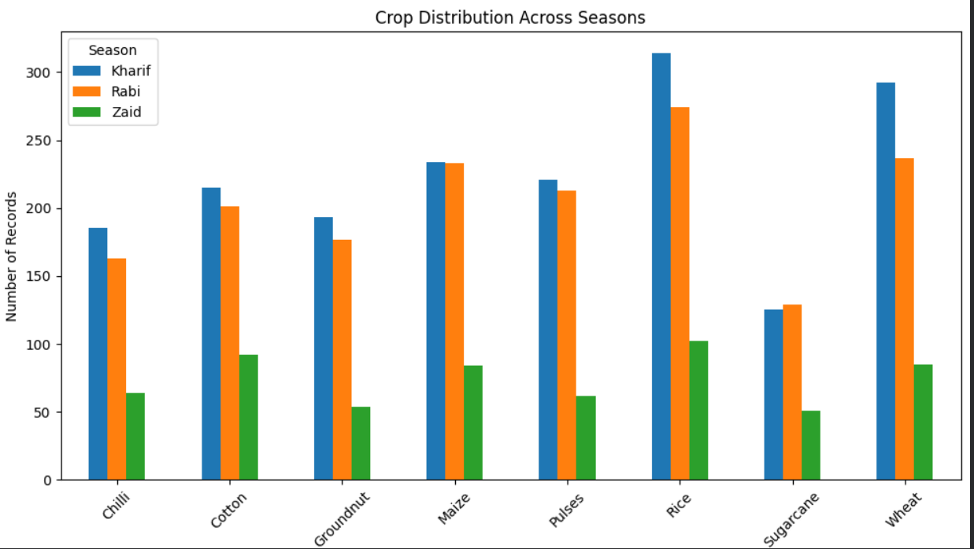
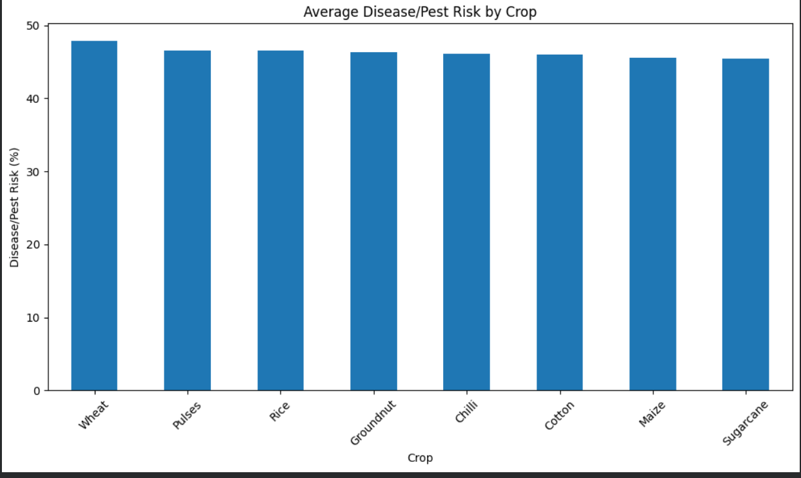
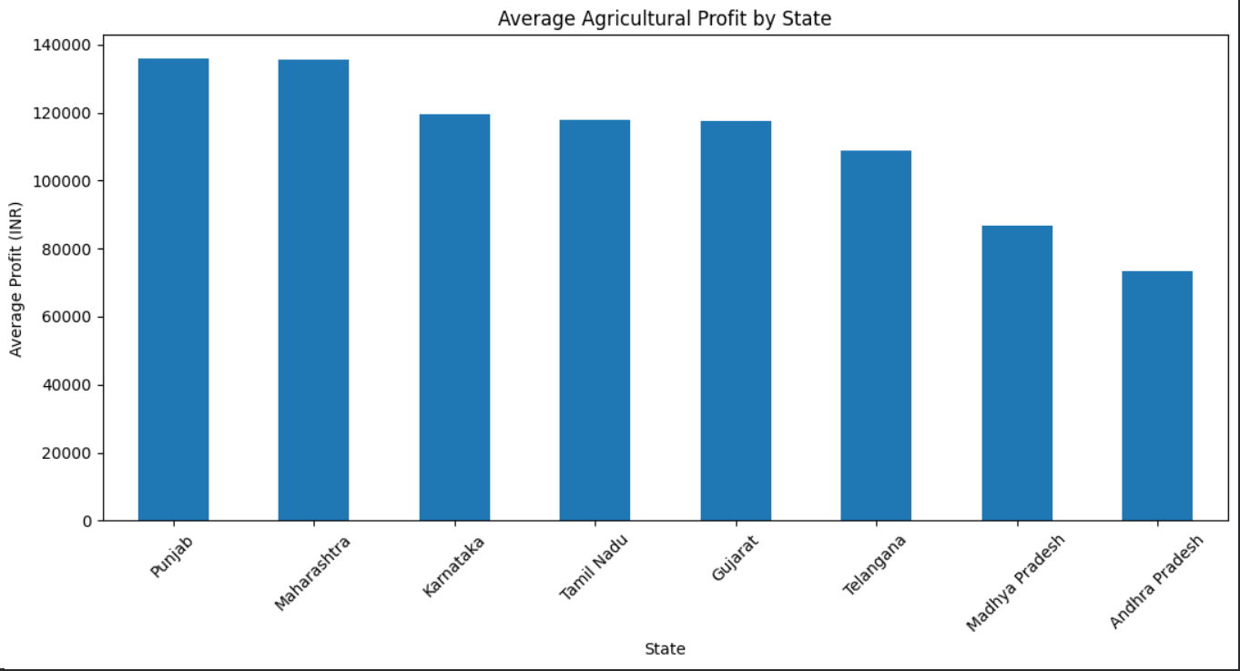
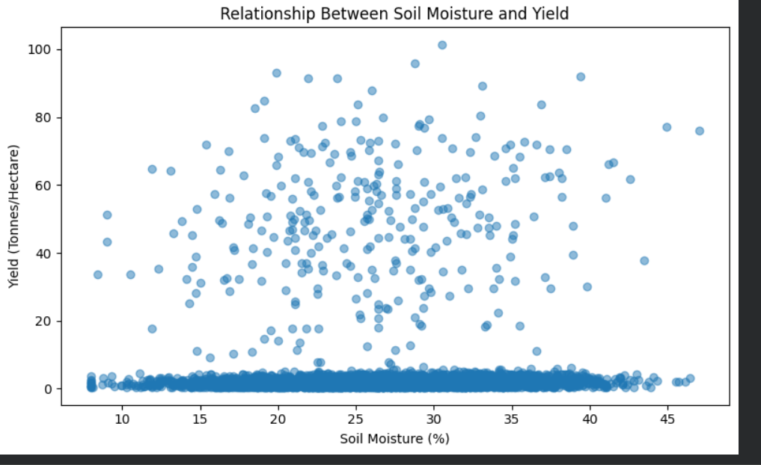
RESULTS
[Add screen shots of your code ]

Slide 11
Future scope
Predictive Modeling: Develop Machine Learning models to predict crop yield and agricultural profit using environmental, soil and farm-related factors.
Real-Time Data Integration: Integrate real-time weather, rainfall, soil-moisture and market-price data for continuous monitoring.
Crop Recommendation System: Build a recommendation system to suggest suitable crops based on season, soil conditions, weather and expected profitability.
Advanced Irrigation Optimization: Develop a smart irrigation model to recommend efficient water usage for different crops and seasons.
Interactive Dashboard: Create a Power BI/Streamlit dashboard for farmers, agricultural planners and government departments.
Disease & Pest Prediction: Extend the analysis to predict disease/pest risk using environmental and historical agricultural data.
Time-Series Analysis: Use multi-year agricultural data to identify long-term seasonal trends and changes.
Geographical Analysis: Incorporate GIS/maps to visualize regional agricultural performance and identify high- and low-performing areas.

Slide 12
GitHub Link
https://github.com/Ipsita20262005/Seasonal-Agriculture-Performance-Analysis.git

Slide 13

VOIS Course completion certificate - Course name- Data Visualization

Slide 14
Thank you
THANK YOU
.
.

