Slide 1


Cwc project presentation
Ipsita Behera Abhilash Kumar Behera
2041002048 2041002047
Cse CSE

Slide 2


Wildfire tracker website
A live wildfire tracker that allow the user to check current wildfires around the world at Realtime.
Live Map integration using NASA’s EONET API and Google Map API.

Slide 3
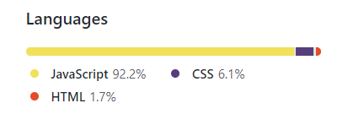
Technologies used
Languages Used: React.js, JSS, Node.js
Packages Used: react-iconify, google-map-react, express
Languages used according to GitHub

Slide 4
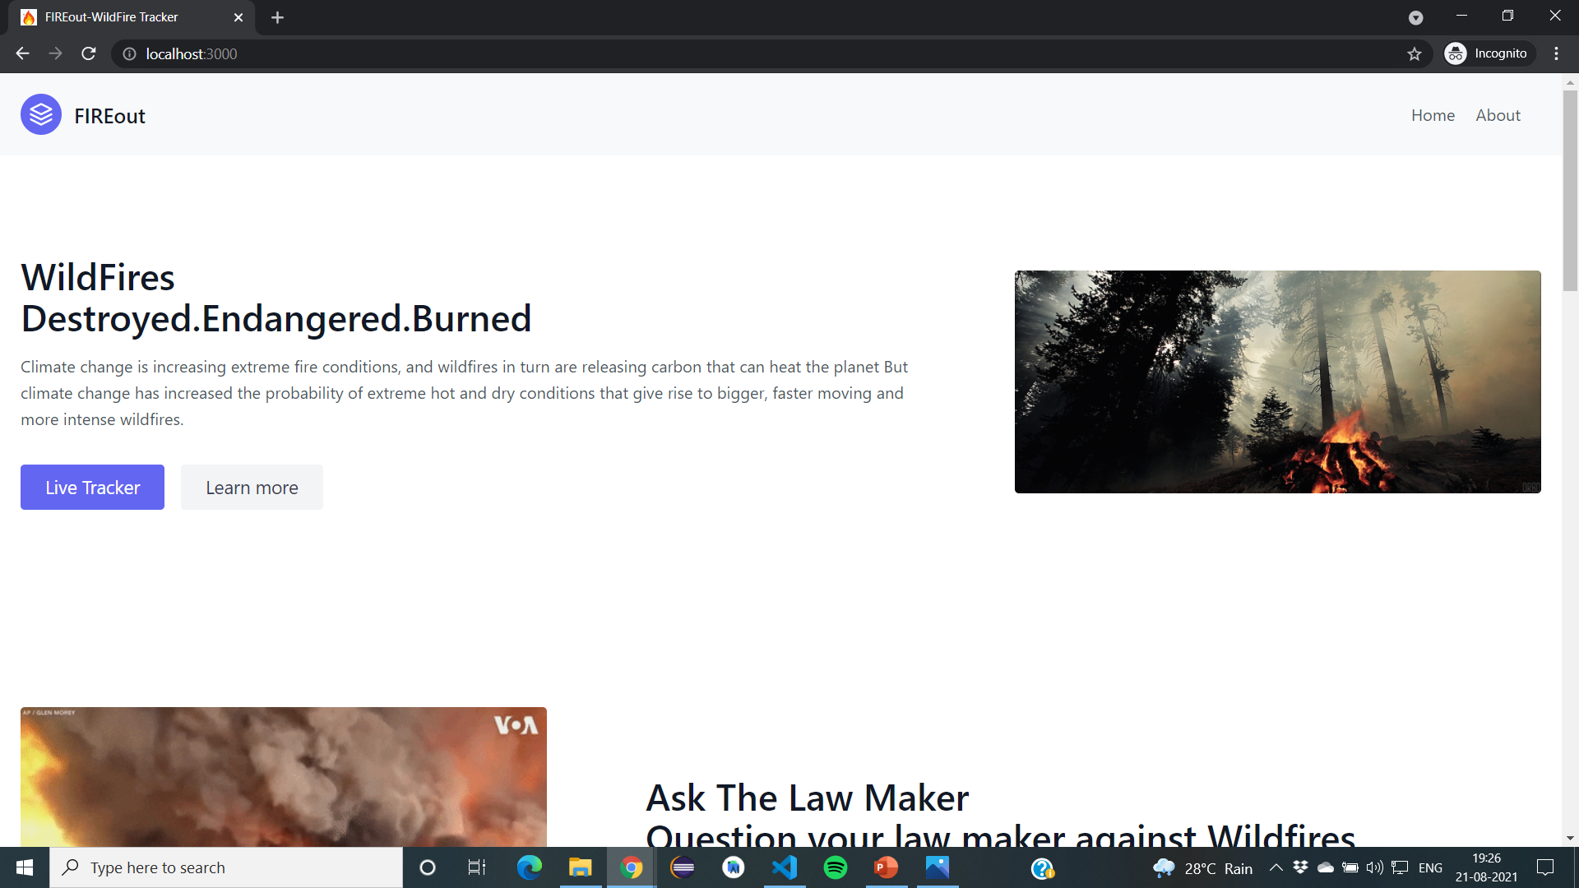
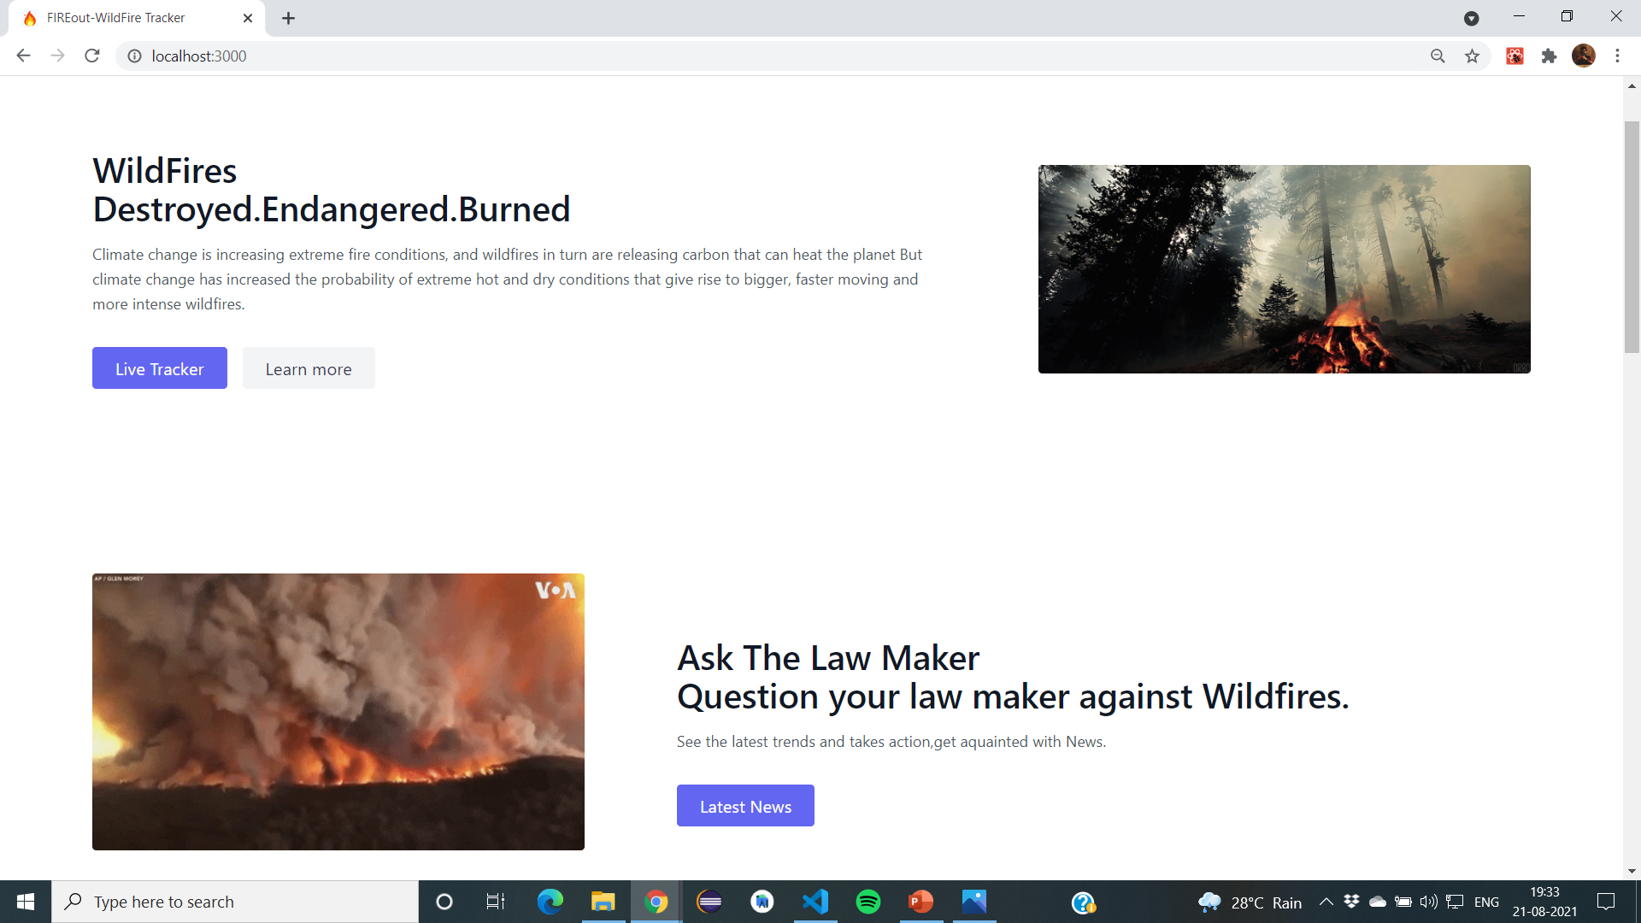
Interface
The website has a total 5 section : Navbar, Hero, Steps, Testimonials, Footer
Homepage Hero Section

Slide 5
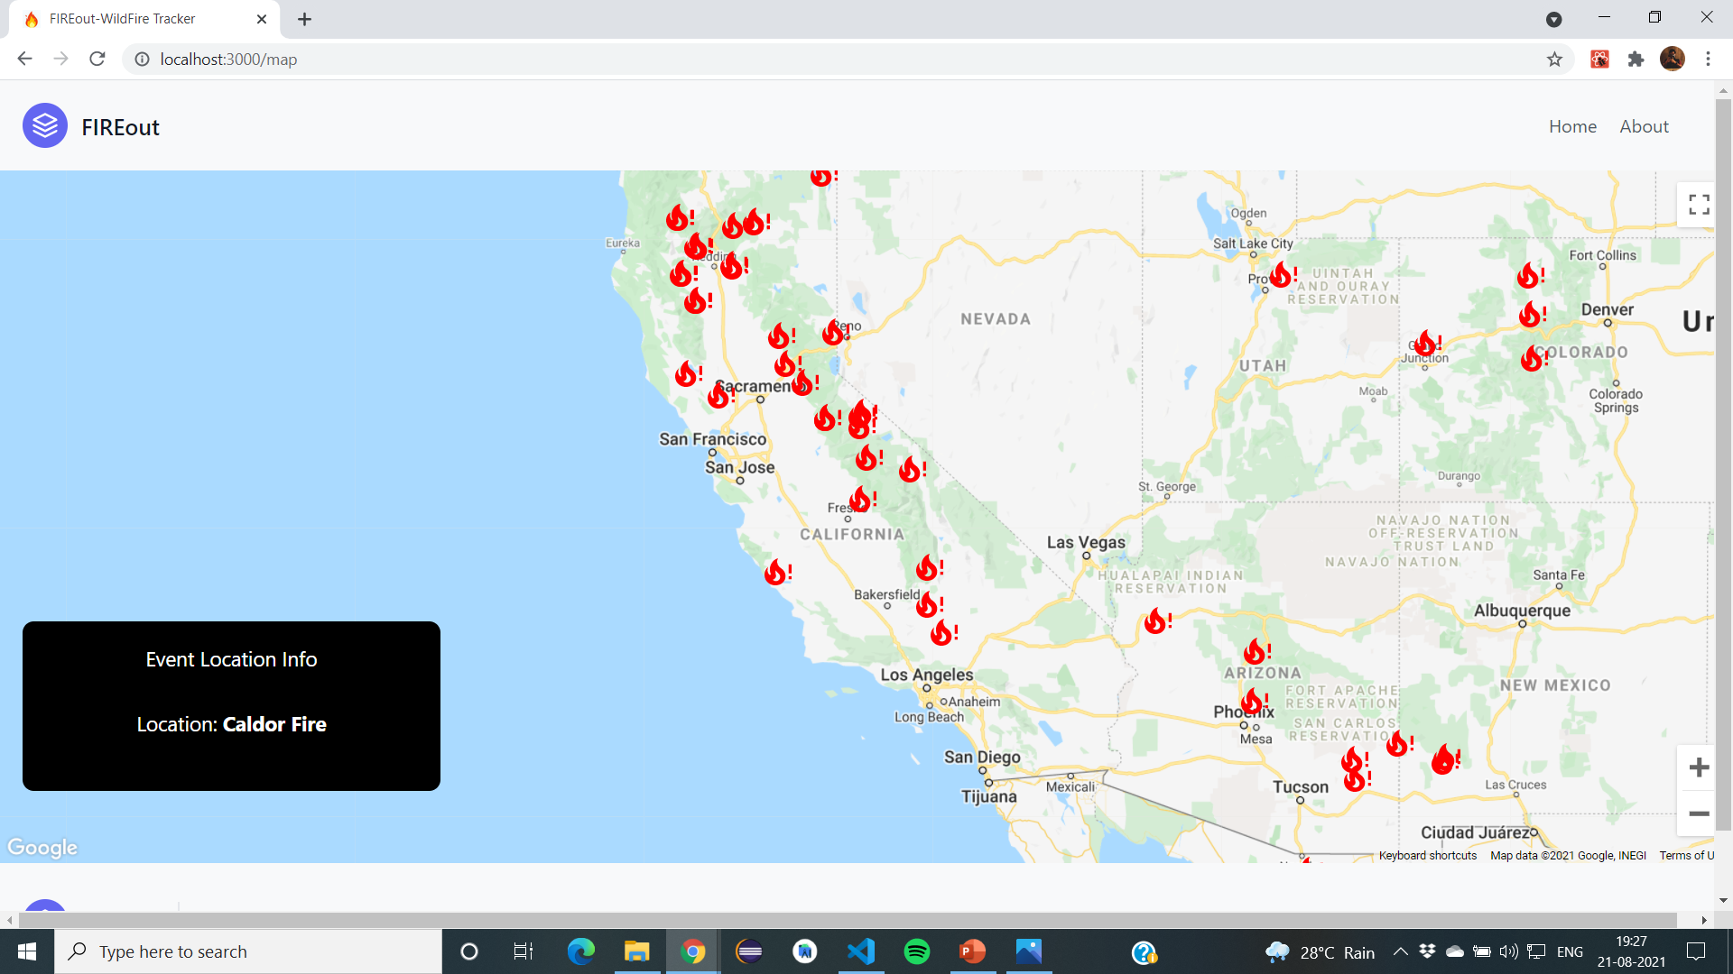
Live wildfire tracking page
The places indicated with a fire emoji are the those places which were recently or currently have faced wildfires
The Black box indicates the exact location of the incidents
The page can be zoomed in or out using +/- sign on the right corner

Slide 6
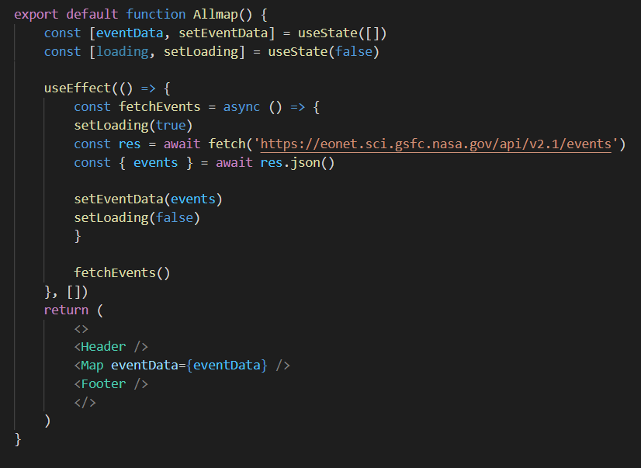
How it uses the api
It uses the EONET API : The Earth Observatory Natural Event tracker
Users can browse the entire globe daily and look for natural events as they occur.

Slide 7
Citation/project idea
The project takes references from different sources such as YouTube, Udemy but below are some links that the webpage is heavily inspired from
Web Dev Tutorials by CodeWithHarry : https://youtube.com/playlist?list=PLu0W_9lII9agiCUZYRsvtGTXdxkzPyItg
The Complete Web Development Bootcamp by Angela Yu : https://www.udemy.com/course/the-complete-web-development-bootcamp/
Wildfire Tracker With React by Traversy Media : https://youtu.be/ontX4zfVqK8

Slide 8

Thank you

