Slide 1
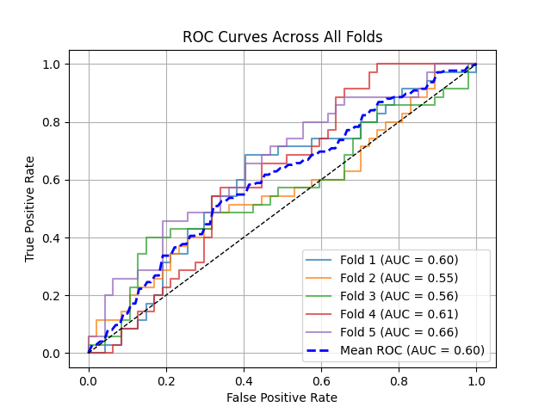
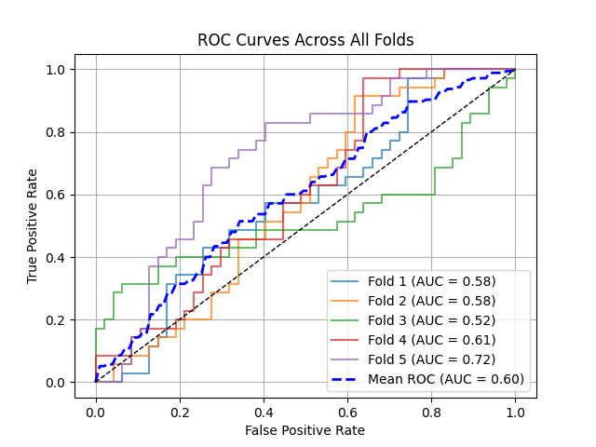
Experiements: Imagenet Benchmark Models
Model | AUC
Densenet | 0.60
Resnet50 | 0.60
VGG16 | In progress

Slide 3
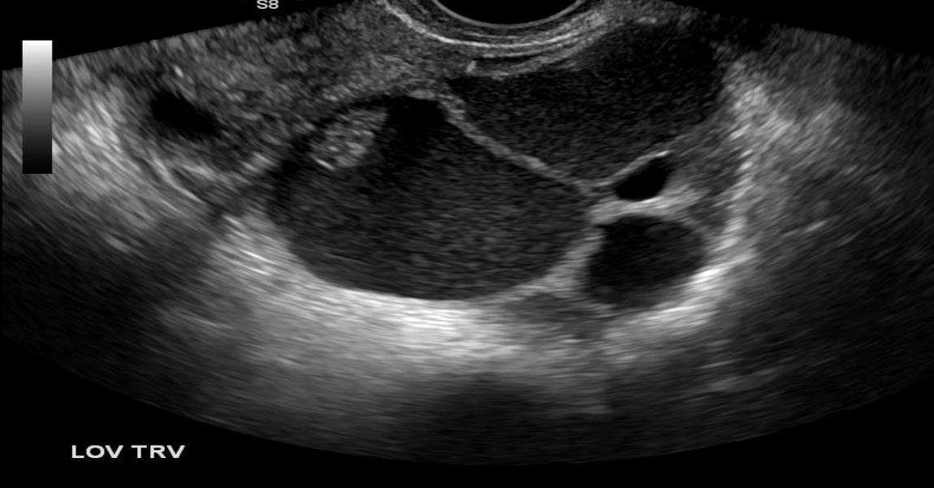
Feature extraction network
Binary Mask
Encoder
Decoder
Lesion Roi
Bottleneck Feature

Slide 4
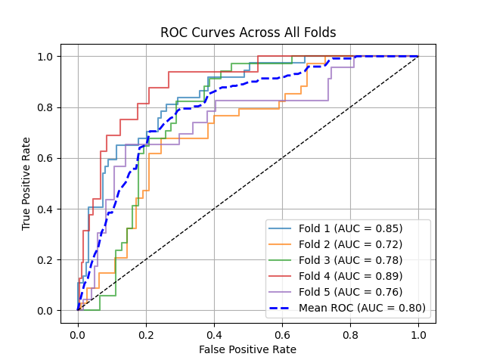
Experiment 0:
Details:
Binary Classification Setup
Classification Based on US Image Only
FC Layer
0/1
Pretrained Encoder
(Frozen)
Result on 5 Fold Validation Set

Slide 5
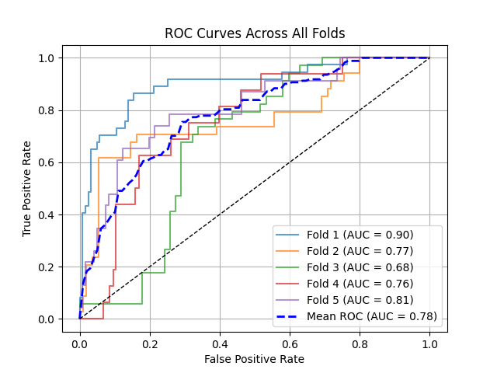
Experiment 1:
Details:
Binary Classification Setup
Classification Based on US Image Only
FC Layer
0/1
Pretrained Encoder
(Frozen)
FC Layer
0/1
Pretrained Encoder
(Trainable)
Validation Result 5 Fold Model

Slide 6
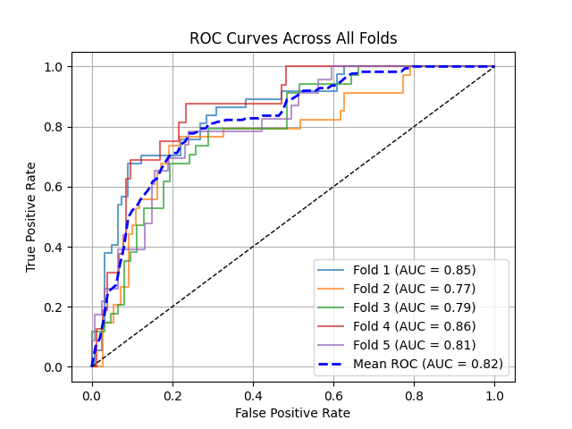
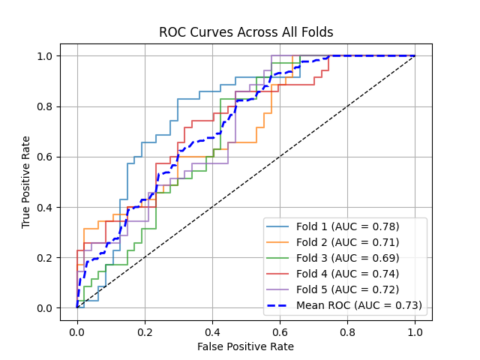
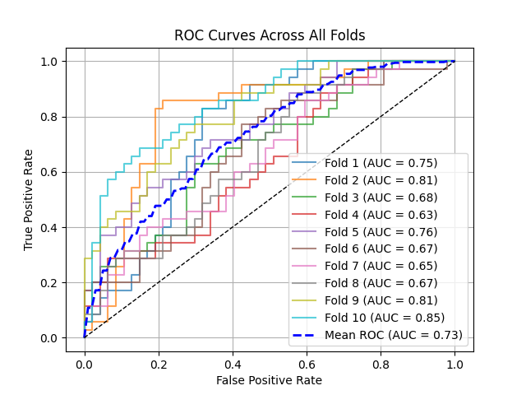
FC Layer
0/1
Pretrained Encoder
(Frozen)
Experiment 2.1:
Binary Classification Setup
Classification Based on US Image Only
Testset on 120 to 143 Patient IDs:
Total images 82
Malignant 35, Benign 47
FC Layer
0/1
Encoder
From Scratch
(Trainable)
Validation on 5 fold
Test Result on
5 fold models
Test Result on
10 fold models

Slide 7
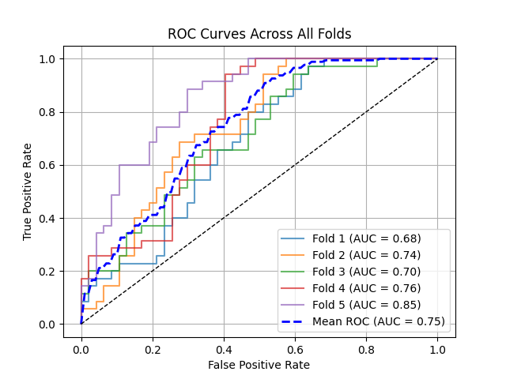
FC Layer
0/1
Pretrained Encoder
(Frozen)
Experiment 2.2:
Binary Classification Setup
Classification Based on US Image Only
Changed the BCElogits loss with Assymetric and focal loss. Where the trained encoder is weighted less (0.5, 1) respectively.
Testset on 120 to 143 Patient IDs:
Total images 82
Malignant 35, Benign 47
FC Layer
0/1
Encoder
From Scratch
(Trainable)
Test Result on
5 fold models

Slide 8
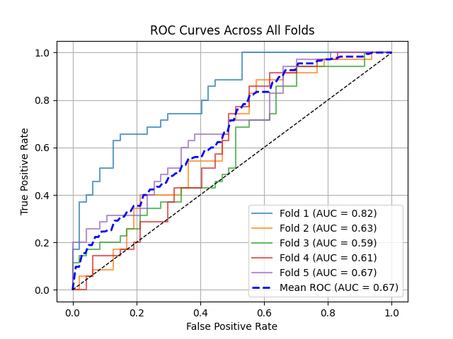
Experiment 3.1:
Binary Classification Setup
Classification Based on US Image Only
Weighted Score
Testset on 120 to 143 Patient IDs:
Total images 82
Malignant 35, Benign 47
FC Layer
0/1
Pretrained Encoder
(Frozen)
0/1
FC Layer
0/1
Encoder
From Scratch
(Trainable)
Test Result on 5 fold models

Slide 9
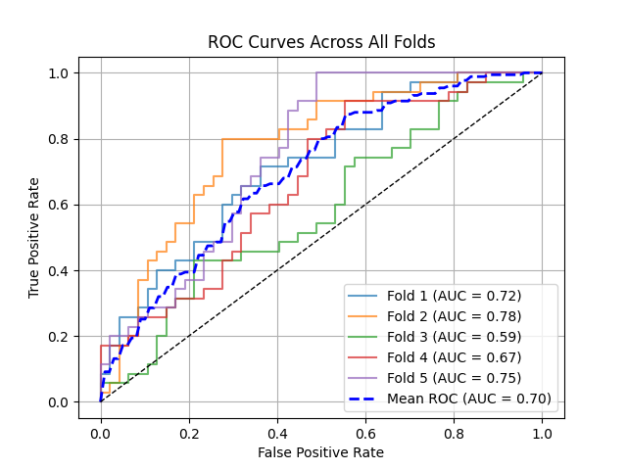
Experiment 3.2:
Binary Classification Setup
Classification Based on US Image Only
Two separate encoder with detached tail
Weighted Score
Testset on 120 to 143 Patient IDs:
Total images 82
Malignant 35, Benign 47
FC Layer
0/1
Pretrained Encoder
(Frozen)
0/1
FC Layer
0/1
Encoder
From Scratch
(Trainable)
Test Result on 5 fold models

Slide 10
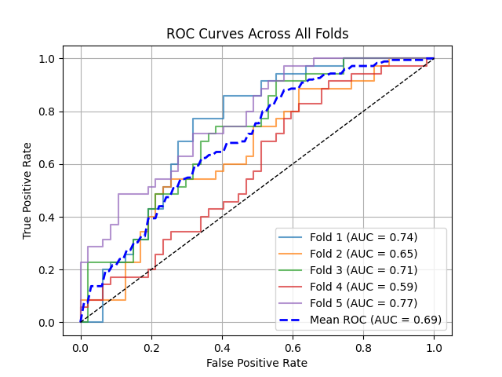
Experiment 3.3:
Binary Classification Setup
Classification Based on US Image Only
Two separate encoder with detached tail
Weighted Score
Testset on 120 to 143 Patient IDs:
Total images 82
Malignant 35, Benign 47
FC Layer
0/1
Pretrained Encoder
(Frozen)
0/1
FC Layer
0/1
Encoder
From Scratch
(Trainable)
Test Result on 5 fold models

Slide 12
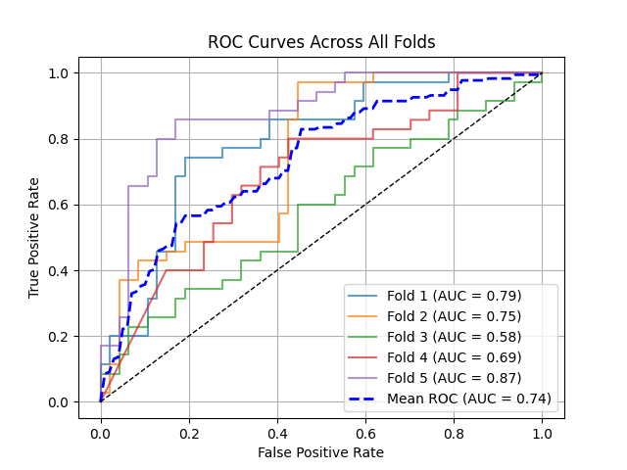
FC Layer
0/1
Pretrained Encoder
(Frozen)
Experiment 4.1:
Binary Classification Setup
Classification Based on US Image Only
4 separate encoder with different types of US input
Linear layer weighted score
BCEWithLogits Loss
Testset on 120 to 143 Patient IDs:
Total images 82
Malignant 35, Benign 47
FC Layer
0/1
Encoder
From Scratch
(Trainable)
0/1
1. SDF-Model ->
2 .Binary Boundary Mask->
3. US image within Boundary->
4. Encoder
FC Layer
0/1
1. SDF-Model ->
2 . Lesion Centre Mask->
3. US image within Lesion Center->
4. Encoder
FC Layer
0/1
Test Result on 5 fold models

Slide 13
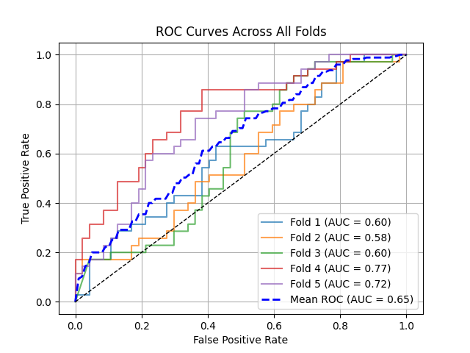
FC Layer
0/1
Pretrained Encoder
(Frozen)
Experiment 4.2:
Binary Classification Setup
Classification Based on US Image Only
4 separate encoder with different types of US input
Linear layer weighted score
Asymmetrics Loss
Testset on 120 to 143 Patient IDs:
Total images 82
Malignant 35, Benign 47
FC Layer
0/1
Encoder
From Scratch
(Trainable)
0/1
1. SDF-Model ->
2 .Binary Boundary Mask->
3. US image within Boundary->
4. Encoder
FC Layer
0/1
1. SDF-Model ->
2 . Lesion Centre Mask->
3. US image within Lesion Center->
4. Encoder
FC Layer
0/1
Test Result on 5 fold models

Slide 14
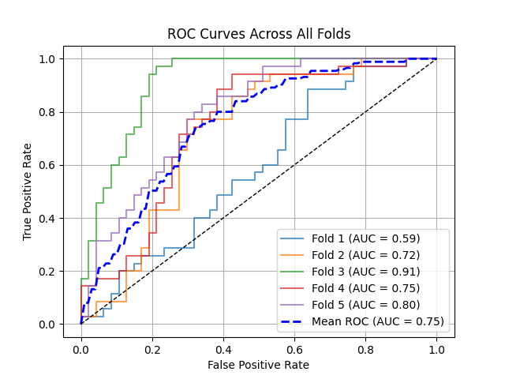
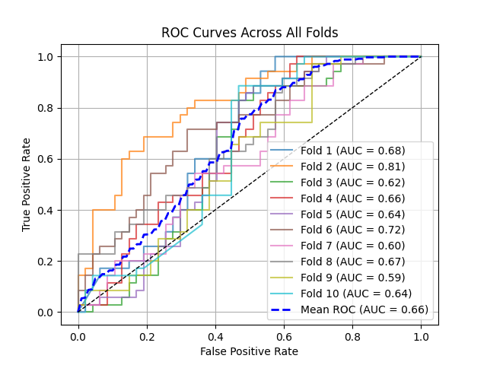
FC Layer
0/1
Pretrained Encoder
(Frozen)
Experiment 4.3:
Binary Classification Setup
Classification Based on US Image Only
4 separate encoder with different types of US input
Linear layer weighted score
Asymmetrics Loss + Focal Loss
Testset on 120 to 143 Patient IDs:
Total images 82
Malignant 35, Benign 47
FC Layer
0/1
Encoder
From Scratch
(Trainable)
0/1
1. SDF-Model ->
2 .Binary Boundary Mask->
3. US image within Boundary->
4. Encoder
FC Layer
0/1
1. SDF-Model ->
2 . Lesion Centre Mask->
3. US image within Lesion Center->
4. Encoder
FC Layer
0/1
Test Result on 5 fold models and 10 Fold Models

Slide 16
FC Layer
0/1
Pretrained Encoder
(Frozen)
Experiment 4.3:
Binary Classification Setup
Classification Based on US Image Only
4 separate encoder with different types of US input
Linear layer weighted score
Asymmetrics Loss + Focal Loss
Testset on 4 to 20 Patient IDs:
FC Layer
0/1
Encoder
From Scratch
(Trainable)
0/1
1. SDF-Model ->
2 .Binary Boundary Mask->
3. US image within Boundary->
4. Encoder
FC Layer
0/1
1. SDF-Model ->
2 . Lesion Centre Mask->
3. US image within Lesion Center->
4. Encoder
FC Layer
0/1
Test Result on 5 fold models

Slide 17
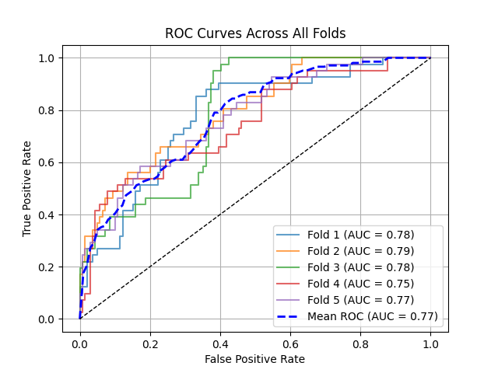
FC Layer
0/1
Pretrained Encoder
(Frozen)
Experiment 4.3:
Binary Classification Setup
Classification Based on US Image Only
4 separate encoder with different types of US input
Linear layer weighted score
Asymmetrics Loss + Focal Loss
Testset on 4 to 20 Patient IDs:
FC Layer
0/1
Encoder
From Scratch
(Trainable)
0/1
1. SDF-Model ->
2 .Binary Boundary Mask->
3. US image within Boundary->
4. Encoder
FC Layer
0/1
1. SDF-Model ->
2 . Lesion Centre Mask->
3. US image within Lesion Center->
4. Encoder
FC Layer
0/1

