Slide 1
Robust Multimodal Deep Learning Model For Ovarian Tumor Classification
Md Iqbal Hossain
07/25/25
Dr. Quing Zhu

Slide 2
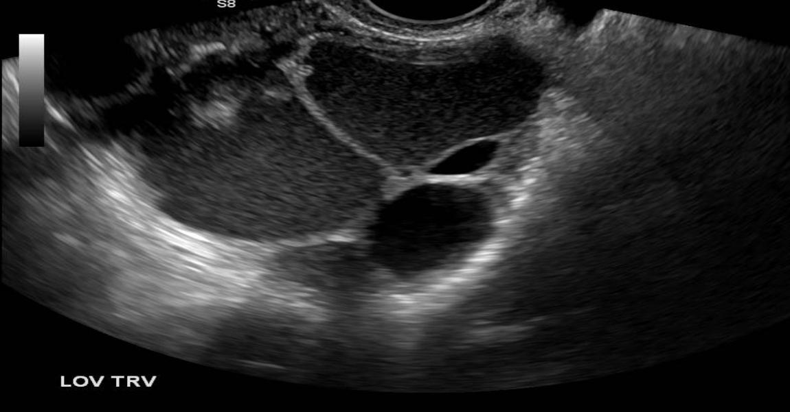
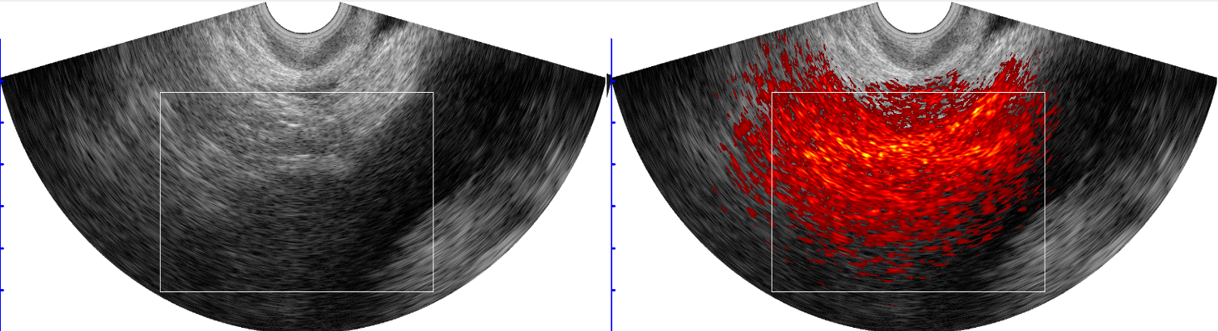
Aim
Develop a robust multi-modal deep learning framework
Integrate diagnostic features from ultrasound (US) and photoacoustic (PA) imaging
Enable accurate detection and classification of ovarian cancer
Leverage complementary strengths of US and PA modalities for enhanced diagnosis
US Image
PA Image

Slide 3


Model Architecture
*
Lesion Boundary Mask
ResNet50 Backbone1
Benign
or
Malignant
US Image
Signed Distance Function Neural Network
*
Classification
Head
ResNet50 Backbone2
Lesion Center Mask
ResNet50 Backbone3

Slide 4
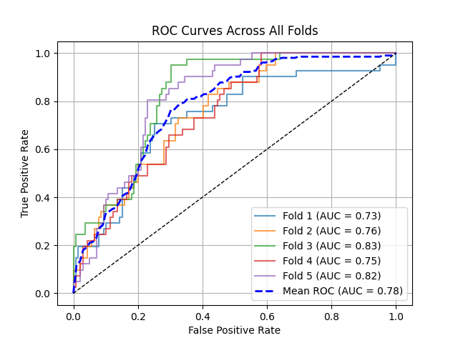
Experimental Results
Dataset Details:
Train and Validation set: 507 Images
Test set: 180 US images.
1) Malignant Sample: 41
2) Benign Samples: 139
Model | AUC
DenseNet121 | 0.70
ResNet50 | 0.71
VGG16 | 0.67
Ours | 0.78

Slide 5
Experimental Results
Dataset Details:
Train and Validation set: 507 Images
Test set: 180 US images.
1) Malignant Sample: 41
2) Benign Samples: 139
Model | AUC
DenseNet121 | 0.70
ResNet50 | 0.71
VGG16 | 0.67
Ours | 0.78

Slide 6
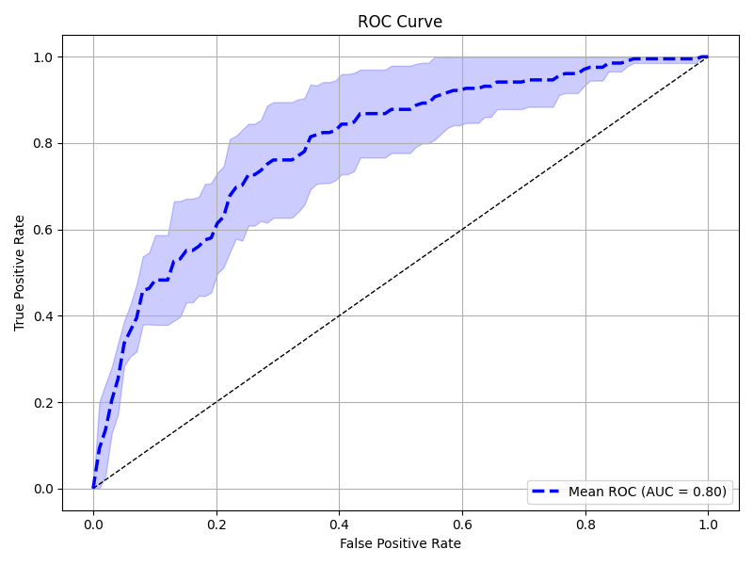
Experimental Results
Dataset Details:
Train and Validation set: 507 Images
Test set: 180 US images.
1) Malignant Sample: 41
2) Benign Samples: 139
Model | AUC
DenseNet121 | 0.70
ResNet50 | 0.71
VGG16 | 0.67
Ours | 0.78

Slide 8
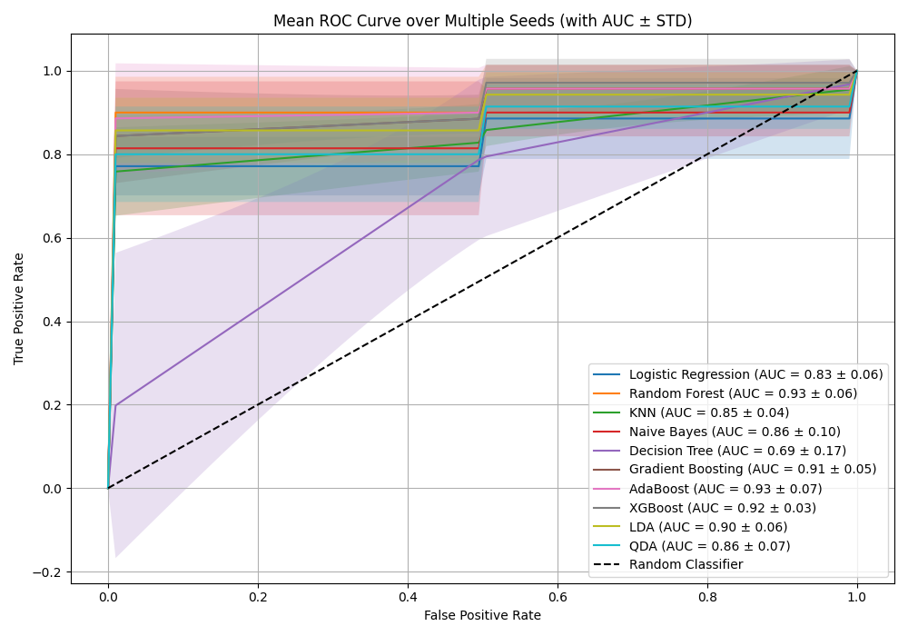
Experimental Results
PA Image Features:
1) SO2
2) THb

