Slide 1
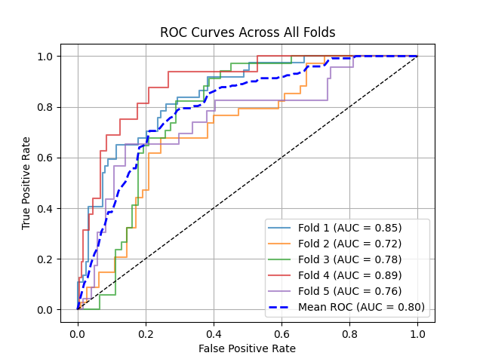
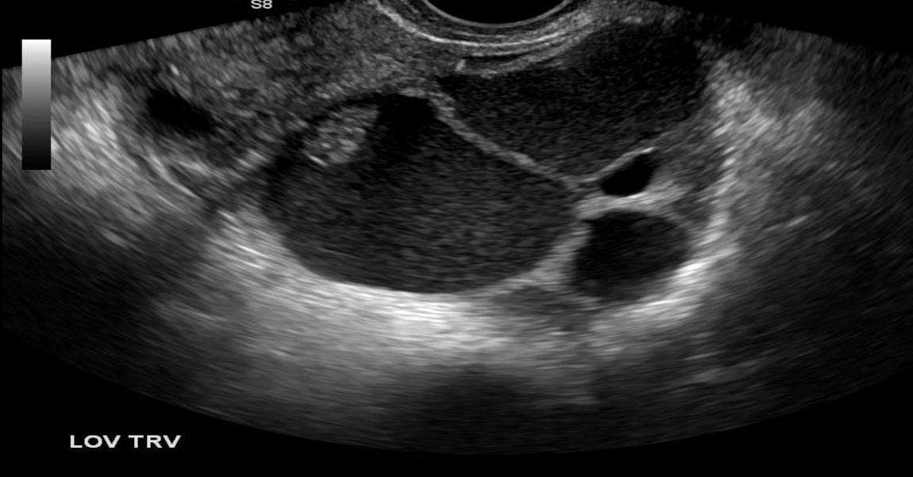
Experiment 0:
Details:
Binary Classification Setup
Classification Based on US Image Only
FC Layer
0/1
Pretrained Encoder
(Frozen)

Slide 2
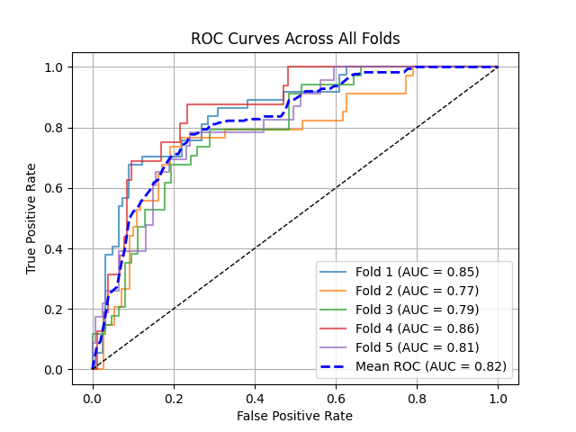
Experiment 1:
Details:
Binary Classification Setup
Classification Based on US Image Only
FC Layer
0/1
Pretrained Encoder
(Frozen)
FC Layer
0/1
Encoder
From Scratch
(Trainable)

Slide 3
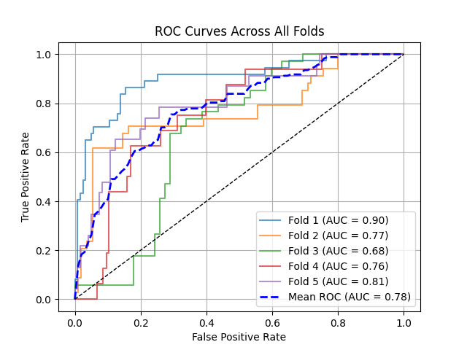
Experiment 2:
Details:
Binary Classification Setup
Classification Based on US Image Only
FC Layer
0/1
Pretrained Encoder
(Frozen)
FC Layer
0/1
Pretrained Encoder
(Trainable)

