Slide 1
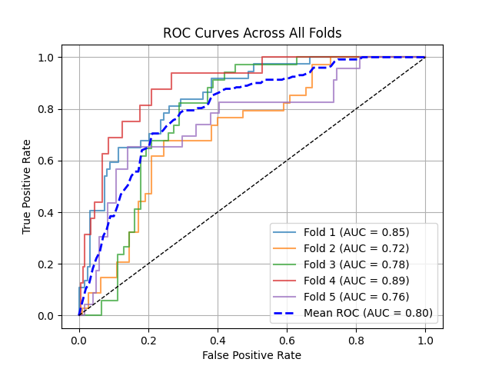
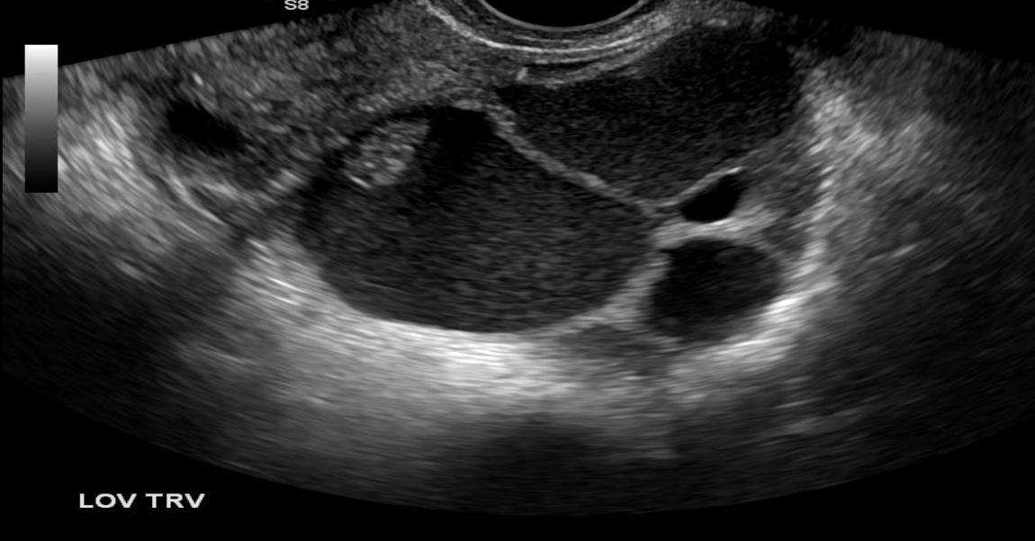
Experiment 0:
Details:
Binary Classification Setup
Classification Based on US Image Only
FC Layer
0/1
Pretrained Encoder
(Frozen)
Result on 5 Fold Validation Set

Slide 2
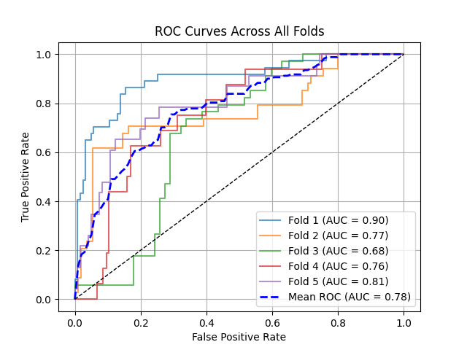
Experiment 1:
Details:
Binary Classification Setup
Classification Based on US Image Only
FC Layer
0/1
Pretrained Encoder
(Frozen)
FC Layer
0/1
Pretrained Encoder
(Trainable)
Validation Result 5 Fold Model

Slide 3
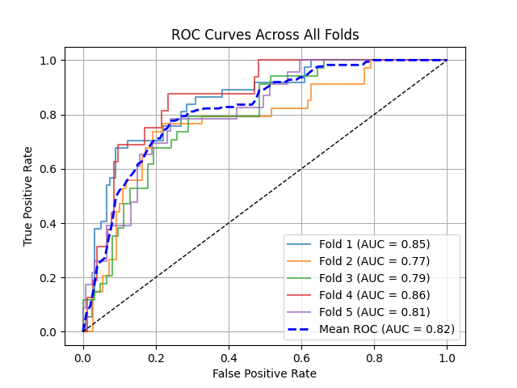
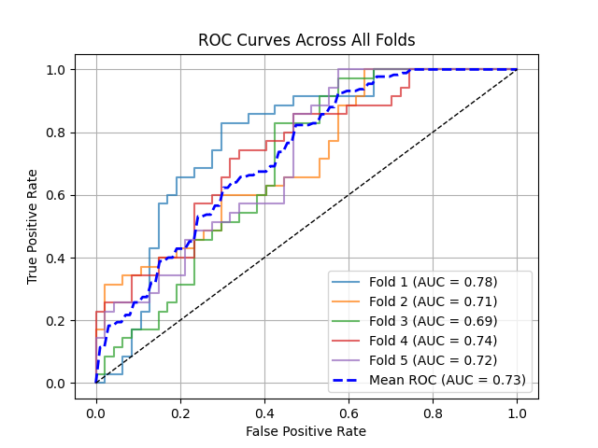
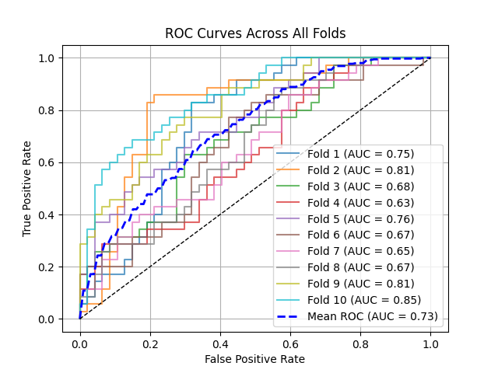
FC Layer
0/1
Pretrained Encoder
(Frozen)
Experiment 2:
Binary Classification Setup
Classification Based on US Image Only
Testset on 120 to 143 Patient IDs:
Total images 82
Malignant 35, Benign 47
FC Layer
0/1
Encoder
From Scratch
(Trainable)
Validation on 5 fold
Test Result on
5 fold models
Test Result on
10 fold models

Slide 4
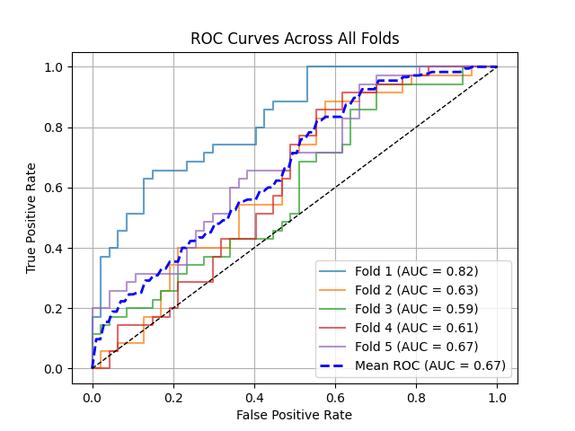
Experiment 3.1:
Binary Classification Setup
Classification Based on US Image Only
Weighted Score
Testset on 120 to 143 Patient IDs:
Total images 82
Malignant 35, Benign 47
FC Layer
0/1
Pretrained Encoder
(Frozen)
0/1
FC Layer
0/1
Encoder
From Scratch
(Trainable)
Test Result on 5 fold models

Slide 5
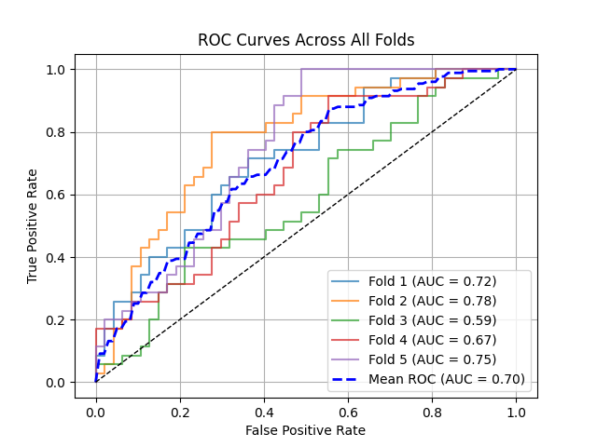
Experiment 3.2:
Binary Classification Setup
Classification Based on US Image Only
Two separate encoder with detached tail
Weighted Score
Testset on 120 to 143 Patient IDs:
Total images 82
Malignant 35, Benign 47
FC Layer
0/1
Pretrained Encoder
(Frozen)
0/1
FC Layer
0/1
Encoder
From Scratch
(Trainable)
Test Result on 5 fold models

Slide 6
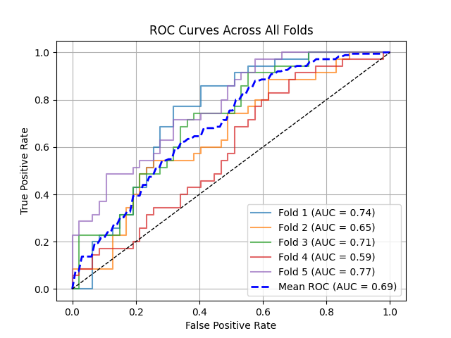
Experiment 3.3:
Binary Classification Setup
Classification Based on US Image Only
Two separate encoder with detached tail
Weighted Score
Testset on 120 to 143 Patient IDs:
Total images 82
Malignant 35, Benign 47
FC Layer
0/1
Pretrained Encoder
(Frozen)
0/1
FC Layer
0/1
Encoder
From Scratch
(Trainable)
Test Result on 5 fold models

Slide 8
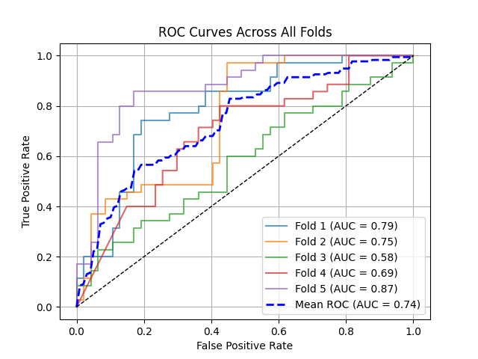
FC Layer
0/1
Pretrained Encoder
(Frozen)
Experiment 4.1:
Binary Classification Setup
Classification Based on US Image Only
4 separate encoder with different types of US input
Linear layer weighted score
BCEWithLogits Loss
Testset on 120 to 143 Patient IDs:
Total images 82
Malignant 35, Benign 47
FC Layer
0/1
Encoder
From Scratch
(Trainable)
0/1
1. SDF-Model ->
2 .Binary Boundary Mask->
3. US image within Boundary->
4. Encoder
FC Layer
0/1
1. SDF-Model ->
2 . Lesion Centre Mask->
3. US image within Lesion Center->
4. Encoder
FC Layer
0/1
Test Result on 5 fold models

Slide 9
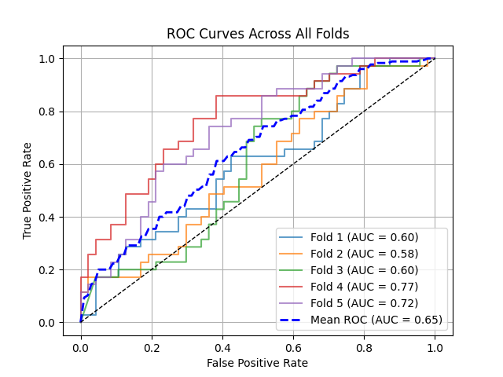
FC Layer
0/1
Pretrained Encoder
(Frozen)
Experiment 4.2:
Binary Classification Setup
Classification Based on US Image Only
4 separate encoder with different types of US input
Linear layer weighted score
Asymmetrics Loss
Testset on 120 to 143 Patient IDs:
Total images 82
Malignant 35, Benign 47
FC Layer
0/1
Encoder
From Scratch
(Trainable)
0/1
1. SDF-Model ->
2 .Binary Boundary Mask->
3. US image within Boundary->
4. Encoder
FC Layer
0/1
1. SDF-Model ->
2 . Lesion Centre Mask->
3. US image within Lesion Center->
4. Encoder
FC Layer
0/1
Test Result on 5 fold models

Slide 10
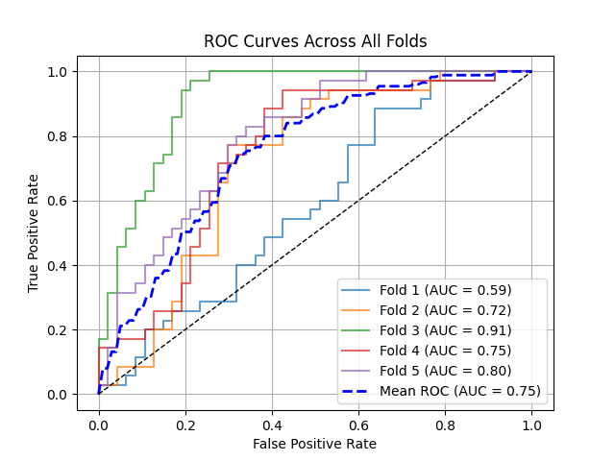
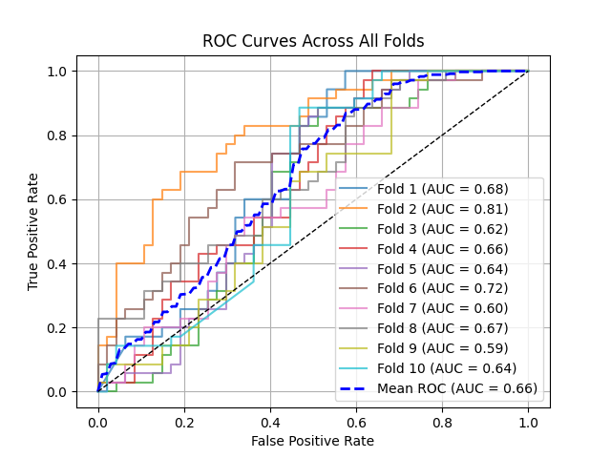
FC Layer
0/1
Pretrained Encoder
(Frozen)
Experiment 4.3:
Binary Classification Setup
Classification Based on US Image Only
4 separate encoder with different types of US input
Linear layer weighted score
Asymmetrics Loss + Focal Loss
Testset on 120 to 143 Patient IDs:
Total images 82
Malignant 35, Benign 47
FC Layer
0/1
Encoder
From Scratch
(Trainable)
0/1
1. SDF-Model ->
2 .Binary Boundary Mask->
3. US image within Boundary->
4. Encoder
FC Layer
0/1
1. SDF-Model ->
2 . Lesion Centre Mask->
3. US image within Lesion Center->
4. Encoder
FC Layer
0/1
Test Result on 5 fold models and 10 Fold Models

