Slide 1
Dataset:
Patients: 51
Total images: 400
Malignant: 77
Benign: 323
Training Configuration:
Split the dataset based on patient 80:20 for train test set.
5-fold validation was performed.

Slide 2
K-Fold | Weighted ACC | ACC | AUC
1 | 98.53 | 99.02 | 98.91
2 | 94.72 | 87.37 | 92.32
3 | 90.97 | 85.41 | 90.33
4 | 88.56 | 86.40 | 86.40
5 | 88.01 | 73.05 | 77.71

Slide 3
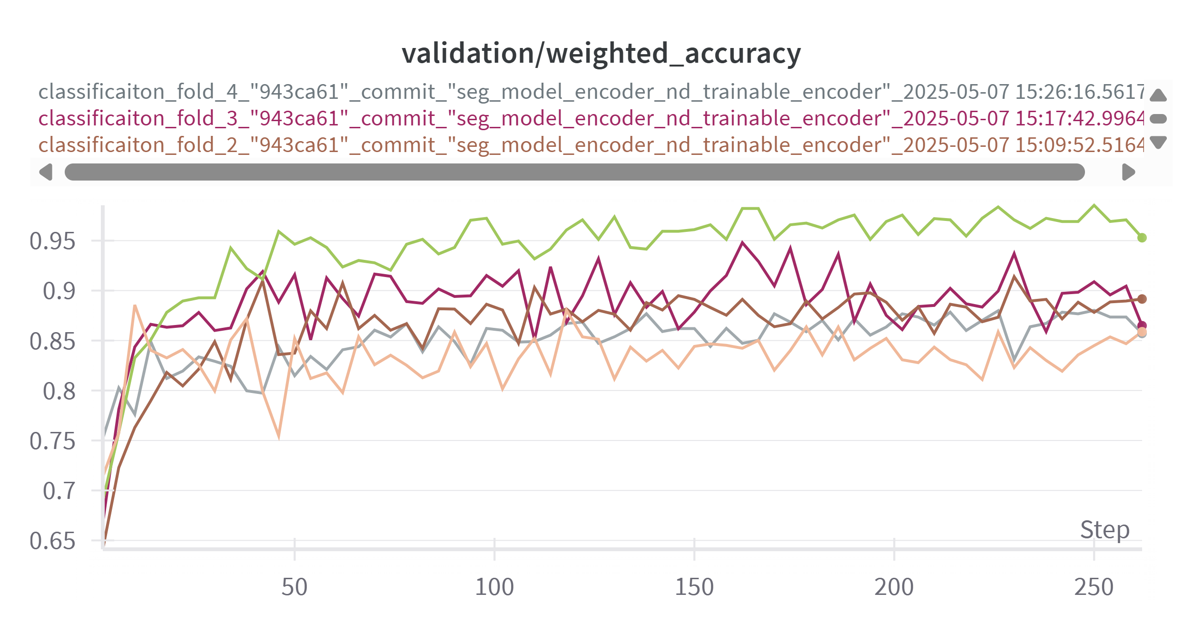

Slide 4
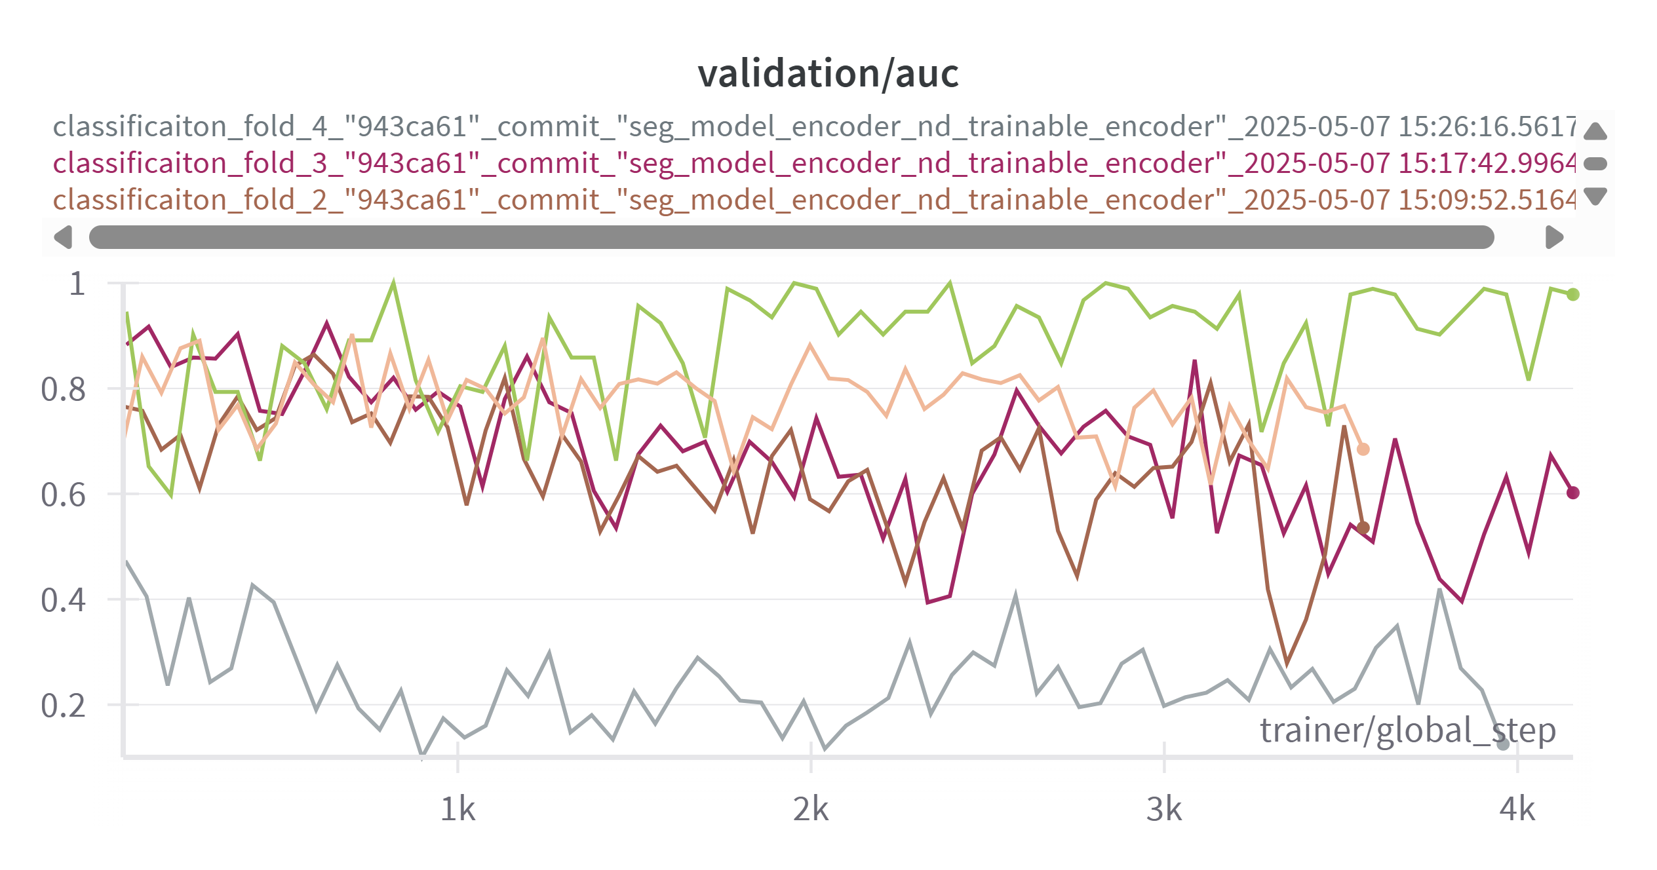

Slide 5
