Slide 1
POST-MORTEM · WEST BENGAL 2026
We staked TMC.
Bengal voted otherwise.
DECISION INFRASTRUCTURE · 4 MAY 2026
Simulatte

Slide 2
01 — THE CALL VS THE RESULT
Every party landed outside the band.
TMC
BJP
LEFT + CONG
OTHERS
PREDICTED
PREDICTED
PREDICTED
PREDICTED
194 ± 10
45 ± 10
50 ± 10
5 ± 3
ACTUAL
ACTUAL
ACTUAL
ACTUAL
84
203
6
1
−110
+158
−44
−4
BJP voteshare 45.1% (modelled ~22%) · TMC 41.0% (modelled ~52%)
Simulatte / Confidential
2

Slide 3
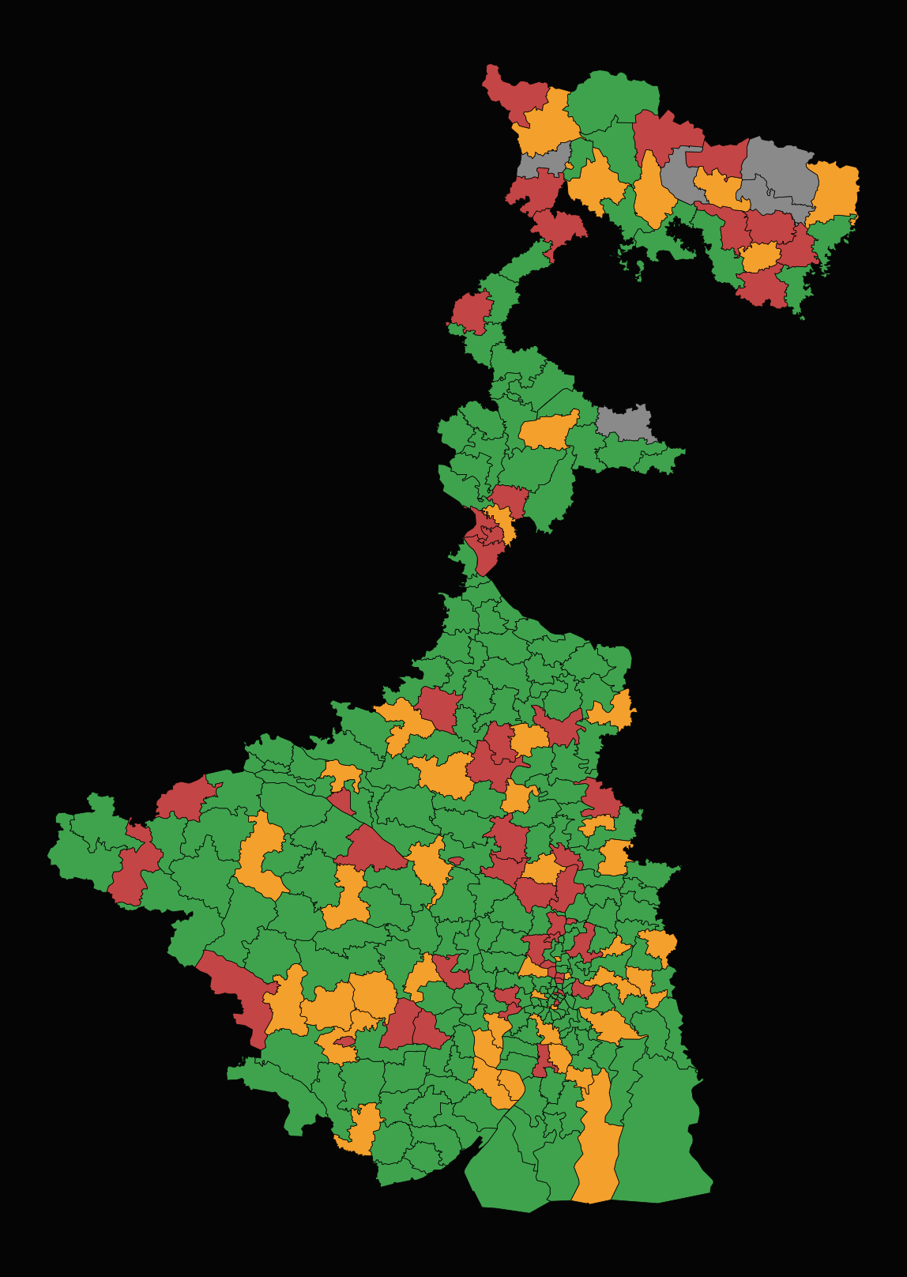
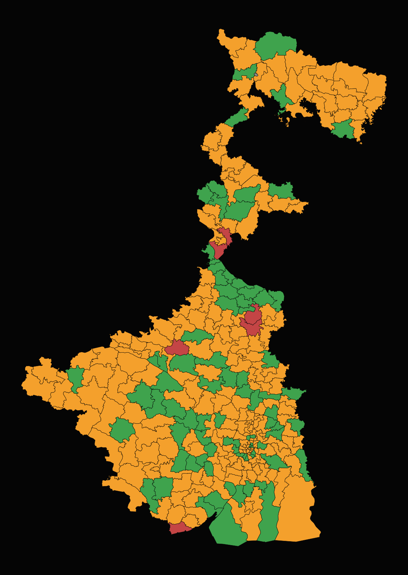
02 — PREDICTED VS ACTUAL | WEST BENGAL 2026
We staked TMC. Bengal voted otherwise.
PREDICTED
ACTUAL
TMC 194 · BJP 45 · INDI 50 · OTH 5
BJP 203 · TMC 84 · INDI 6 · OTH 1
TMC majority by +47
BJP majority by +55
Vote share: TMC 52% · BJP 22%
Vote share: BJP 45.1% · TMC 41.0%
Simulatte / Confidential
3

Slide 4
03 — WHERE THE SIMULATION FAILED
What the simulation got wrong.
01
2021 baseline anchored every seat projection.
The model over-weighted the 2021 anti-BJP correction. BJP's organisational depth and Hindu consolidation reversed that swing statewide — we had no prior encoding this.
02
CAA modelled as Matua backlash — it was Matua reward.
We expected Matua grievance over delayed citizenship delivery. The community instead credited BJP for CAA passage; our voteshare prior for Nadia/N24Pgs was ~20pp off.
03
Muslim vote modelled as a unified TMC bloc.
4-way fragmentation (AIMIM, AJUP, AISF, independents) in Kolkata, Malda and presidency seats handed BJP pluralities in seats we had TMC leading by 8–12pp.
04
Global voteshare prior: BJP ~22%, TMC ~52%.
Actual: BJP 45.1%, TMC 41.0%. A ~20pp miss on BJP voteshare propagated through every cluster model. The prior came from 2021 assembly, not from 2024 Lok Sabha signals.
Simulatte / Confidential
4

Slide 5
04 — STRUCTURAL LIMITS
What no dataset could see.
01
Voter-roll revisions under SIR were not captured in our population data.
Name deletions across multiple blocks in North Bengal and Murshidabad created a turnout asymmetry our population layer did not account for. No per-block attrition signal was available at modelling time.
02
Anti-incumbency depth was qualitative, not quantifiable.
Sandeshkhali incidents, teacher recruitment scam, post-2021 booth violence — each individually measurable, but the compounding effect on swing was not. No composite index existed.
03
The mobilisation frame shifted from welfare delivery to political consolidation.
The simulation's signal layer was built on scheme reach and beneficiary satisfaction. The dominant operative dynamic on election day was cross-community political consolidation — a frame welfare metrics cannot proxy.
04
BJP booth-level expansion was silent and unmeasured.
Shakha density, worker count, mobilisation capacity — none are in any public dataset. The silent voter mobilisation differential vs 2021 was the largest single unmodelled variable.
Simulatte / Confidential
5

Slide 6
05 — CALIBRATION LOOP
What changes next.
01
Re-weight priors toward Lok Sabha over assembly cycles.
Per-cluster Bayesian prior will weight 2024 + 2019 Lok Sabha results at 60%, 2021 assembly at 40%. Assembly corrections now treated as transient, not structural.
02
SIR deletion rate as a structural population feature.
Add voter-roll attrition signal to the Niobe population layer — per-block deletion rate as a suppression proxy, especially in Muslim-majority geographies.
03
Anti-incumbency composite index.
Build a scored index: scandal exposure × media intensity + violence incidents + service delivery gap score. Feed as a cluster-level adjustment on top of base voteshare.
04
Replace uniform swing with cluster-bounded correction.
Each cluster treated independently with its own volatility ceiling. No statewide uniform-swing assumption. Cluster-level MAE from WB 2026 becomes the seed prior for the next study.
Simulatte / Confidential
6

