Slide 1
AI for Green Workshop
Jasmin Lampert, Tech Talk Seminar, 4.5.2021

Slide 2
In a nutshell
Call Topic: AI for Green
Framework: New national call within IKTdZ programme
Budget: around 10 million EURs
Call opens mid June
Submission deadline: end of 2021
Two workshops with experts to set scope

Slide 3
first workshop: Overview and AIMS
Organizer: Helmut Berger (max recall)
Participants: approx. 45
First contact between AI and Climate Communities
Validation/Extension of ideas from expert interviews
Which are the technological challenges in the field of AI?
Which are the most important application fields of AI for dealing with climate change and protection?
Marketing of the „AI for Green“ Call

Slide 4
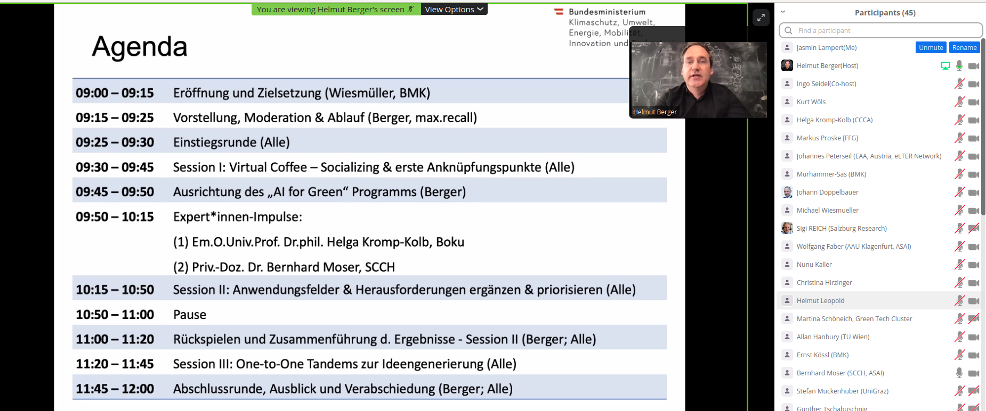
„AI for green“ workshop

Slide 5
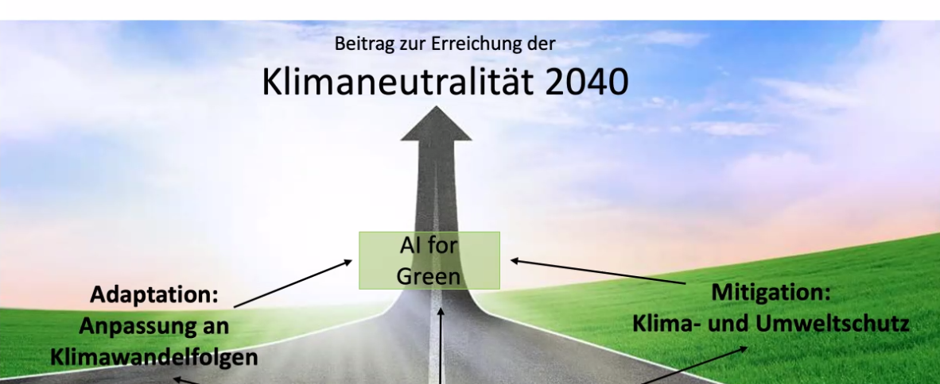
Scope of the „AI for green“ Programme

Slide 6
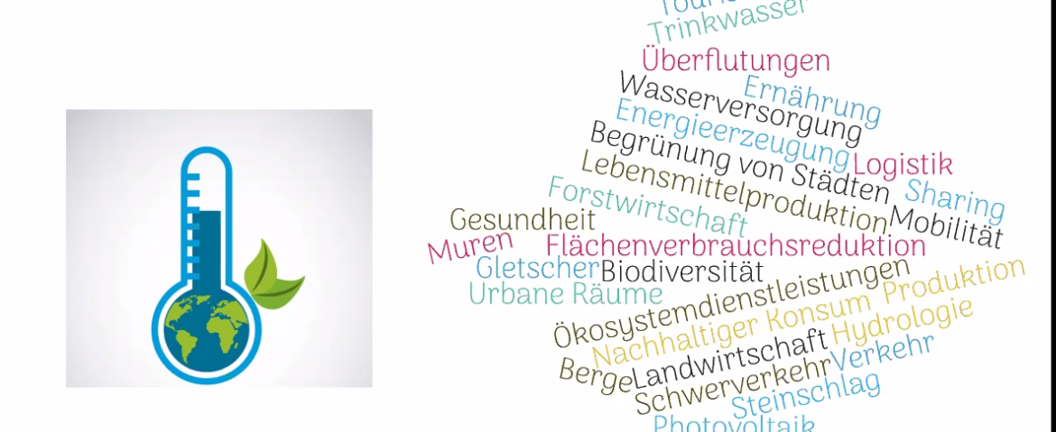
appLICATIon Fields for AI

Slide 7
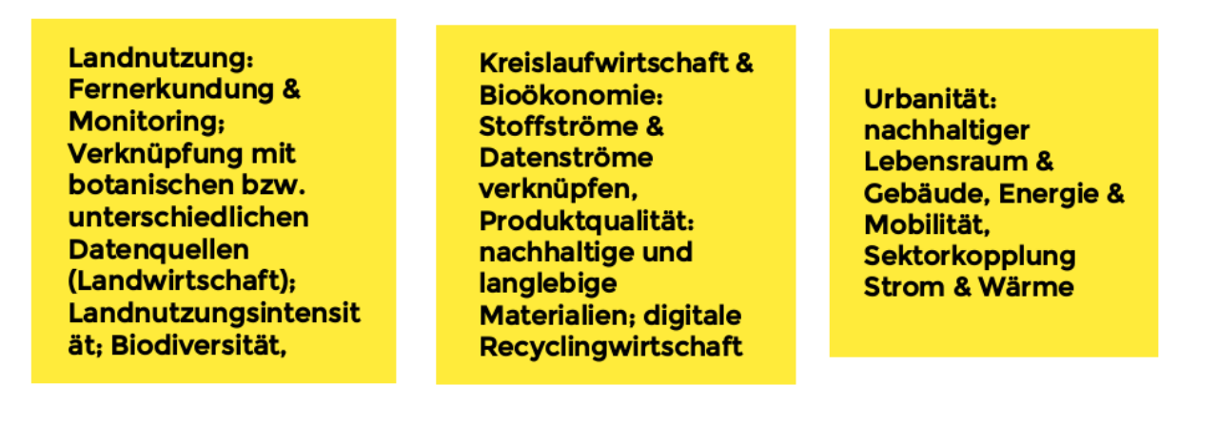
TOP 3 Application AREAS

Slide 8
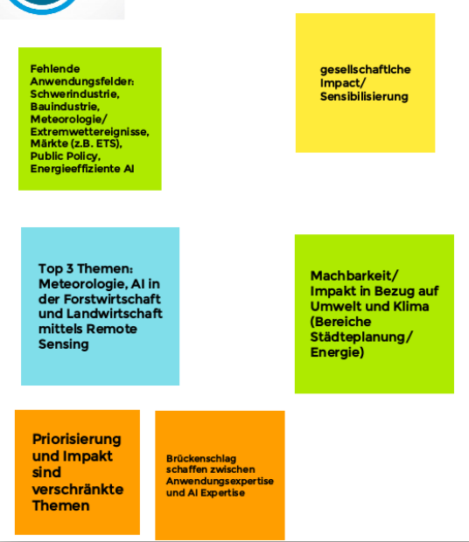
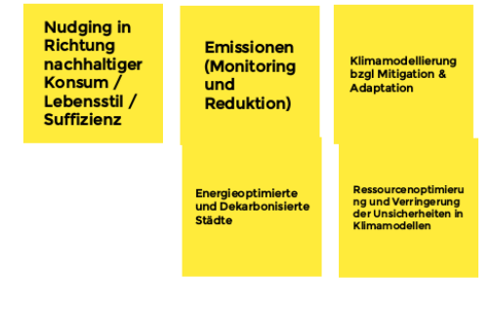
TOP 3 APPLICATION AREAS

Slide 9
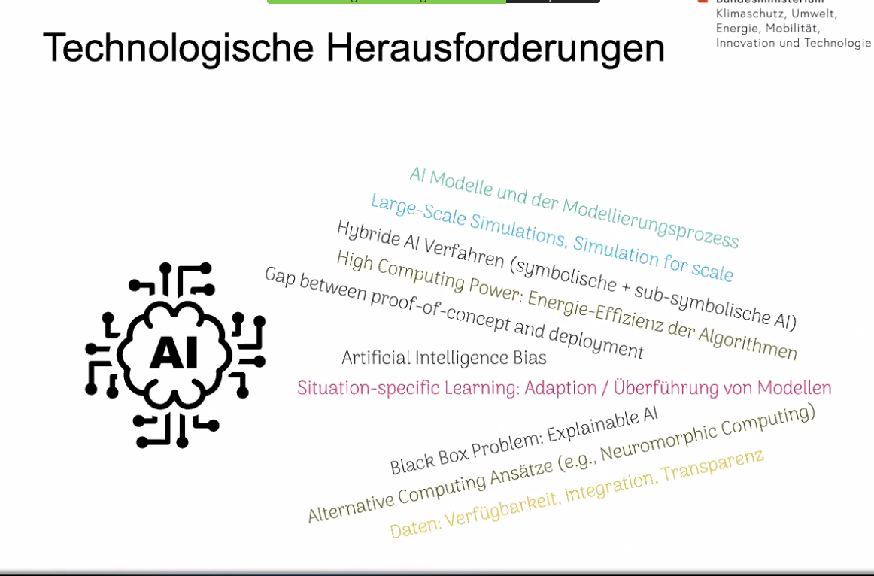
AI Challenges

Slide 10
TOP 3 AI CHallenges
Data: Quality, robustness, bias, trust, certificates, standards
Data ecosystems and technical requirements, data saccess
Efficiency: Low-power, distributed computing/AI systems, federated learning
Hybrid AI & Modelling: Explainability, understandability, knowledge graphs
Modelling of geophysical systems
Behaviour change modell; interaction with humans
Transfer learning?

Slide 11
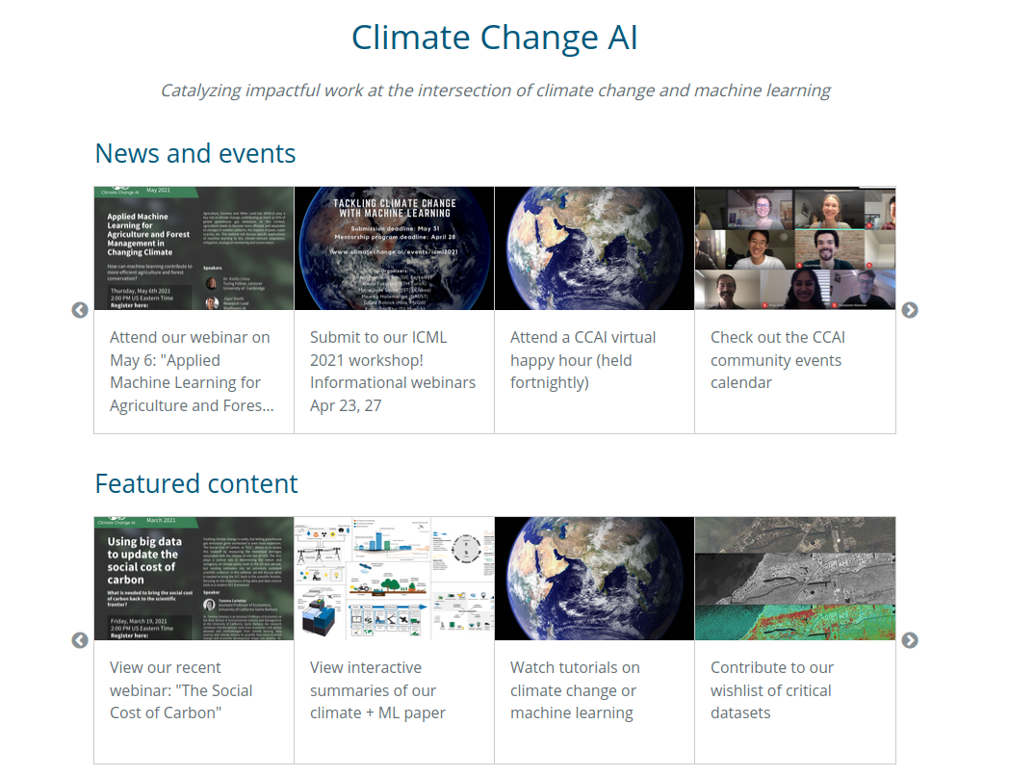
Climate Change AI NetWORK
Climate Change AI (CCAI) is an organization composed of volunteers from academia and industry founded in June 2019.
Mission: To catalyze impactful work at the intersection of climate change and machine learning.
Goals:
To build a community of diverse stakeholders.
To guide impactful work through educational resources and programs.
To fill gaps in essential infrastructure such as funding, tools, and datasets.
To advance discourse and advise relevant players.
https://arxiv.org/pdf/1906.05433.pdf

Slide 12
Thank you!

