Slide 1

Excelerate AI-Powered Virtual Internship (May - June 2025)
Project Title: AI-Powered Learner Engagement & Churn Analysis
Team Name: Team E
Team Members : Diya Kharel (Team Lead), Iqra Shaikh (Project Lead), Faith Odhe (Team Member)

Slide 2

Internship Overview
Duration: 4 Weeks of immersive learning and project execution
Main Goal: Use data to reduce student drop-offs and improve engagement
Weekly Progress Overview -
Week 1: Data cleaning & feature engineering
Week 2: Exploratory data analysis
Week 3: Predictive modeling of churn
Week 4: Recommendation system & report

Slide 3

Project Overview
Work Overview -
Identify causes behind learner churn and low engagement.
Build predictive models to flag at-risk learners.
Create personalized retention strategies.
Implement a rule-based recommendation engine.
Tools Used -
Python, Pandas, Scikit-learn, Matplotlib
Google Colab & Sheets
ROC, Confusion Matrix, Feature Importance

Slide 4
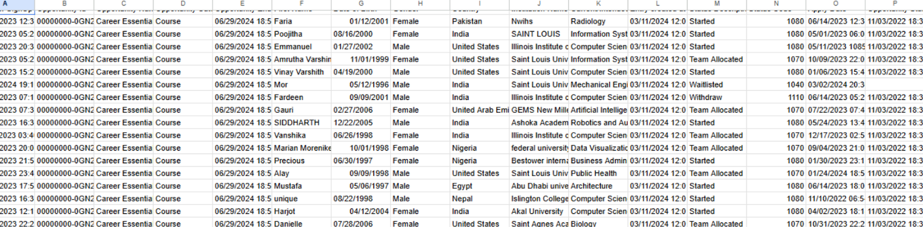
Dataset Overview
Records: 8,558 learners
Timeframe: May 2023 - April 2025
Features: 24 original + 6 engineered
Target: Churn (Dropped Out = 1 , Others = 0)

Slide 5
Week 1 - Data Cleaning
Before -

Slide 6
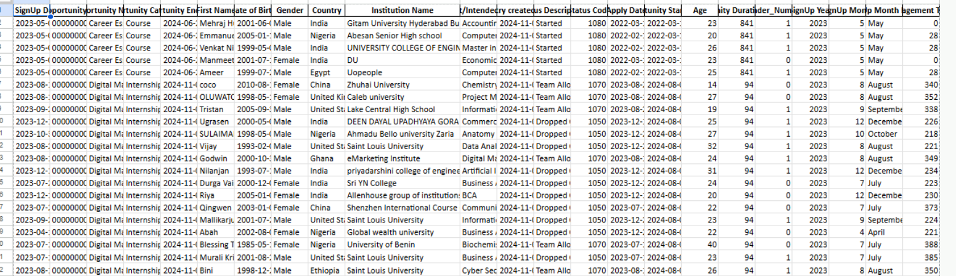
After -

Slide 7
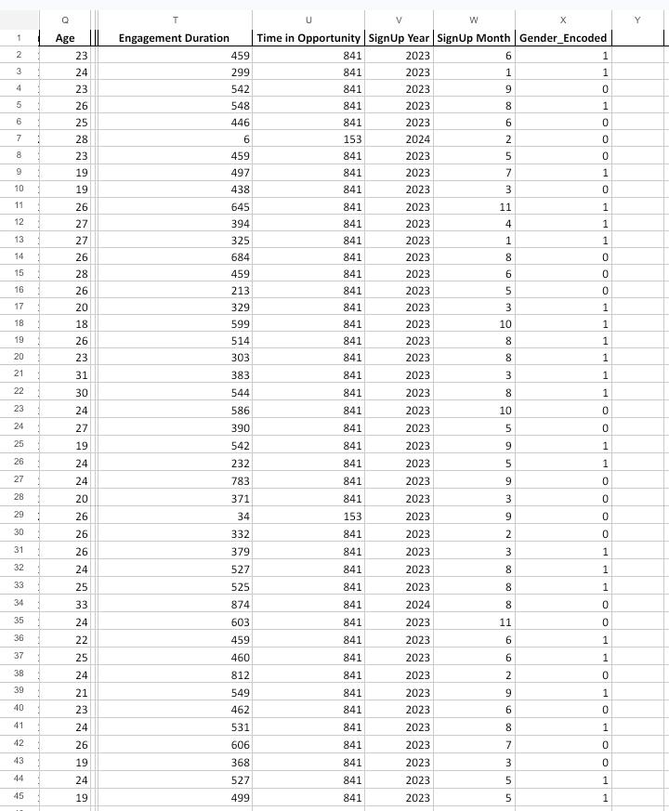
Feature Engineering Highlights
Derived Features:
Engagement Duration
Time in Opportunity
Age, Sign-Up Month, Sign-Up Year
Gender_Male (binary)
Encoding: One-hot encoding for categorical fields

Slide 8
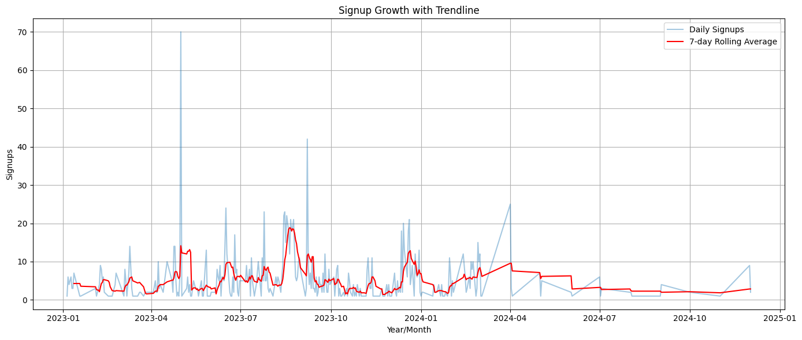
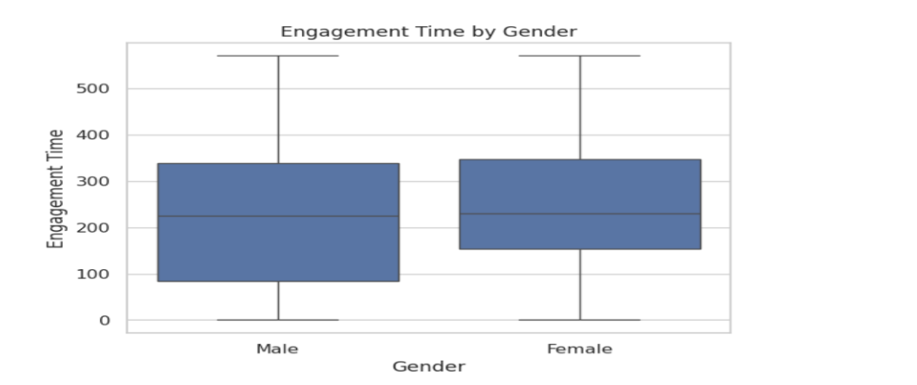
Week 2 - Exploratory Data Analysis
Monthly sign-ups peaked in Apr & Aug
Male learners engage longer

Slide 9
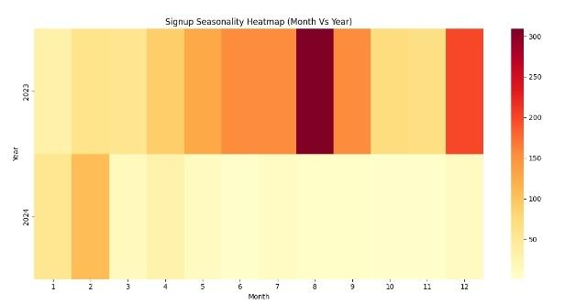
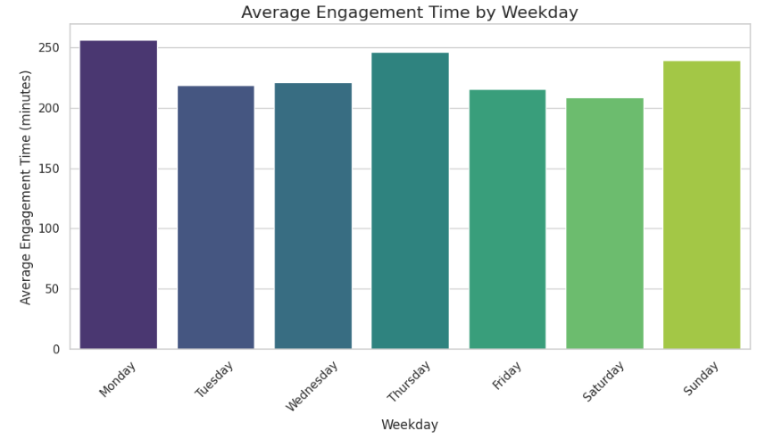
Higher completions on Tuesdays & Thursdays and in the months from May to August

Slide 10
Week 3 - Predictive Modeling
Model Evaluation: Stratified 80-20 split, ROC, Confusion Matrix
Key predictors: Engagement Duration, Age, Sign-Up Timing
Model 1 -
Logistic Regression
Accuracy: 90.5%
Recall (Churn): 87%
Model 2 -
Random Forest Classifier
Accuracy: 92.2%
Recall (Churn): 90%

Slide 11
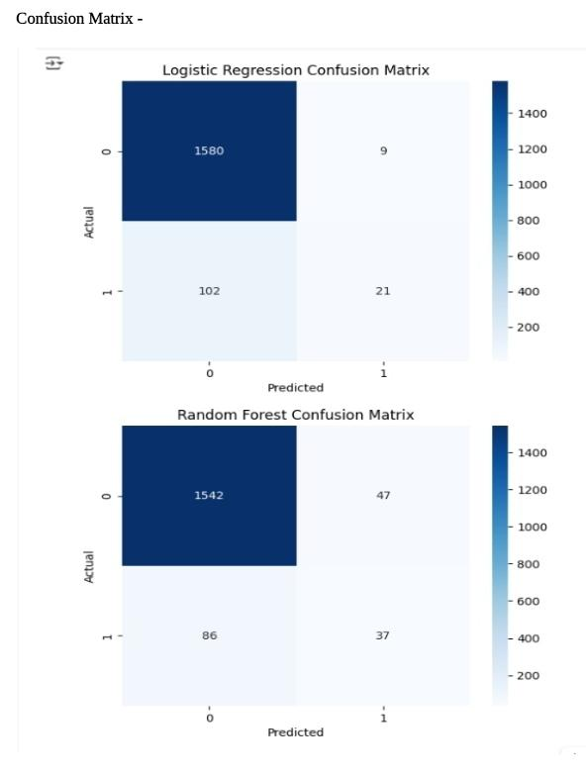
Why Random Forest Wins ?
Better at detecting churn (higher recall)
More useful in early warning scenarios
More balanced precision-recall trade-off

Slide 12
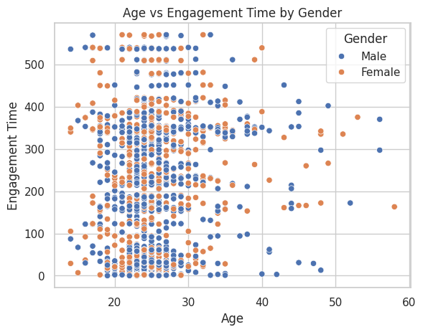
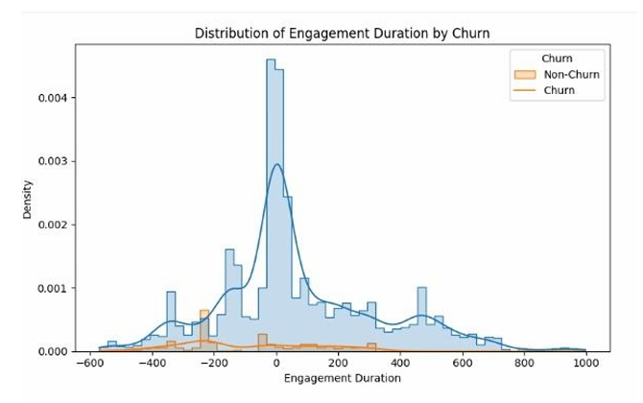
Week 3 - Churn Drivers
Churners have 62% lower engagement
Average churn rate: 7.2%
Churners slightly younger on average

Slide 13
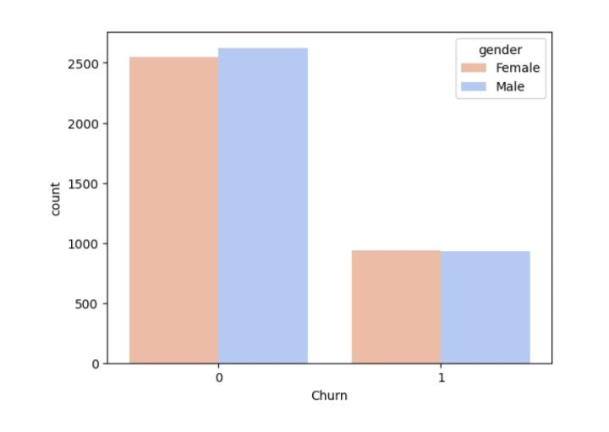

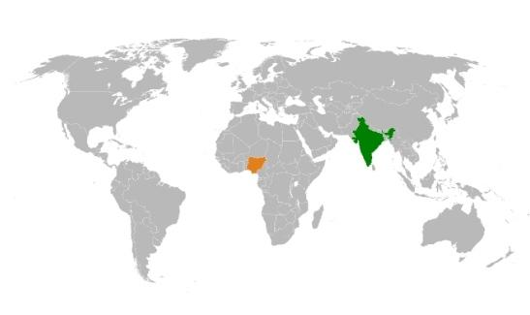
Week 3 - Demographic Patterns Results
Male churn > female churn
Intern participants churn more than course learners
Highest churn in Nigeria & India

Slide 14
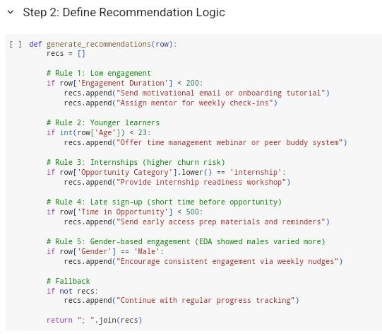
Week 4 - Recommendation System
Rule-based engine on 5 learner attributes
Personalized actions: mentors, tutorials, nudges
Code -

Slide 15
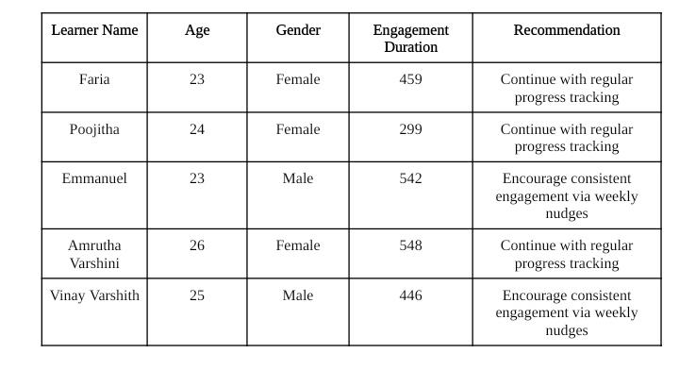
Week 4 - System Summary
Interpretable & scalable rules
Attributes: engagement, age, timing, gender, opportunity
Actionable suggestions for retention
Rule-based logic triggers tailored support:
<200 days Engagement → Mentor assignment
Age < 23 → Time management webinars
Internship → Onboarding + reminders
Male learners → Weekly motivational nudges

Slide 16



Recommendations Recap
Automated onboarding
Peer support for younger learners
Timely reminders & resources
Targeted outreach in high-churn regions

Slide 17
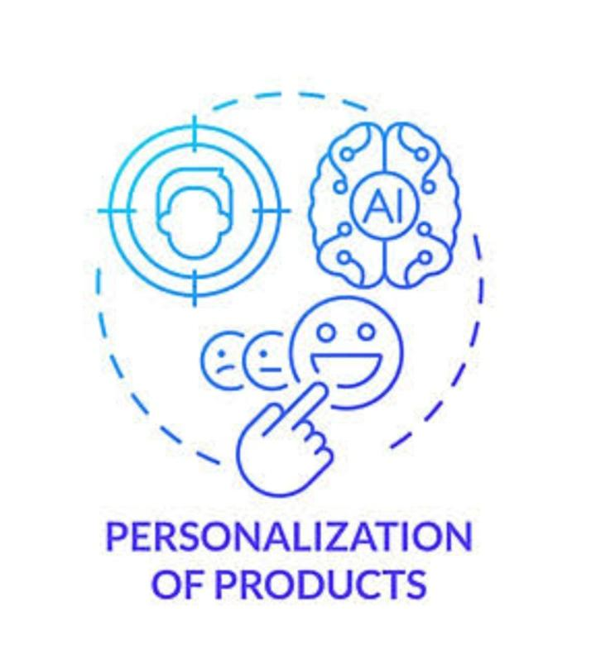
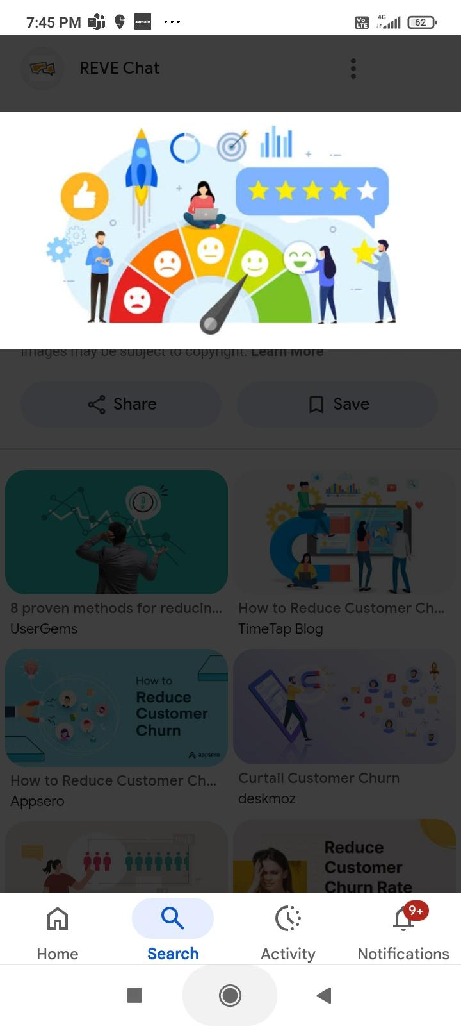

Expected Impact
20-30% reduction in churn
Improved completion rates
Foundation for AI-based personalization

Slide 18
Summary
Key Outcomes
Built predictive churn models with up to 0.88 AUC
Developed engagement-based intervention logic
Proposed retention strategies based on real trends
Expected Churn Reduction: 20–30%
Future Scope
Real-time dashboards for churn risk
AI-driven personalized content workflows
Automated interventions and success coach outreach
Final Reflections
Gained hands-on experience in real-world ML workflows
Learned importance of recall over accuracy in social impact ML
Built teamwork, data interpretation, and presentation skills

Slide 19
Thank You !
Let's build platforms that help learners succeed , not just enroll.

