Slide 1
AI-Powered Personalized
Fitness & Diet System
PRESENTED BY
PROFESSOR
Dr. Shahzad Ahmed Quresh
Omamah Ajmal
SUPERVISOR
Dure Shahwar
Daniya Aamir
Iqra Iqbal

Slide 2
Problem Statement & Motivation
The Problem
Our Solution
Generic fitness apps offer one-size-fits-all plans
Separate Random Forest models trained on 4 real datasets
Individual health profiles vary greatly in BMI, vitals, lifestyle, and goals
Each model specialises in one health domain
No single model can capture all aspects of a person's health
All model outputs fused via PCA into one unified representation
Rule-based systems miss subtle patterns in user data
RL agent learns the optimal daily plan per user

Slide 3
Datasets Used
Gym Members Exercise Tracking
Personalized Diet Recommendations
973 records · 15 features
9,873 records · 25 features
· Age, weight, height, BMI
· Blood pressure, cholesterol, blood sugar
· Heart rate metrics (max, avg, resting BPM)
· Daily steps, sleep hours, exercise frequency
· Session duration, fat %, water intake
· Current caloric & macro intake
· Workout frequency, experience level
· Genetic risk, smoking, alcohol habits
Predicts: Workout Type + Calories Burned
Predicts: Meal Plan + Recommended Macros
Kaggle: Gym Members Exercise Dataset
Kaggle: Personalized Diet Recommendations
Daily Activity Dataset
Health & Lifestyle Survey
457 records · 15 features
261 records · 22 features
· Total steps, distance, active minutes
· Age, physical self-ratings (Likert scale)
· Very/moderately/lightly active minutes
· Fruit, vegetable & meal cooking habits
· Sedentary minutes, calories burned
· Income, spending, gym frequency
· Activity date, tracker vs logged distance
· Disease flag, work type, gender
Predicts: Intensity Level + Calorie Burn
Predicts: Adherence Score (composite)
Kaggle: Fitbit Daily Activity Dataset
Kaggle: Lifestyle and Wellbeing Survey

Slide 4
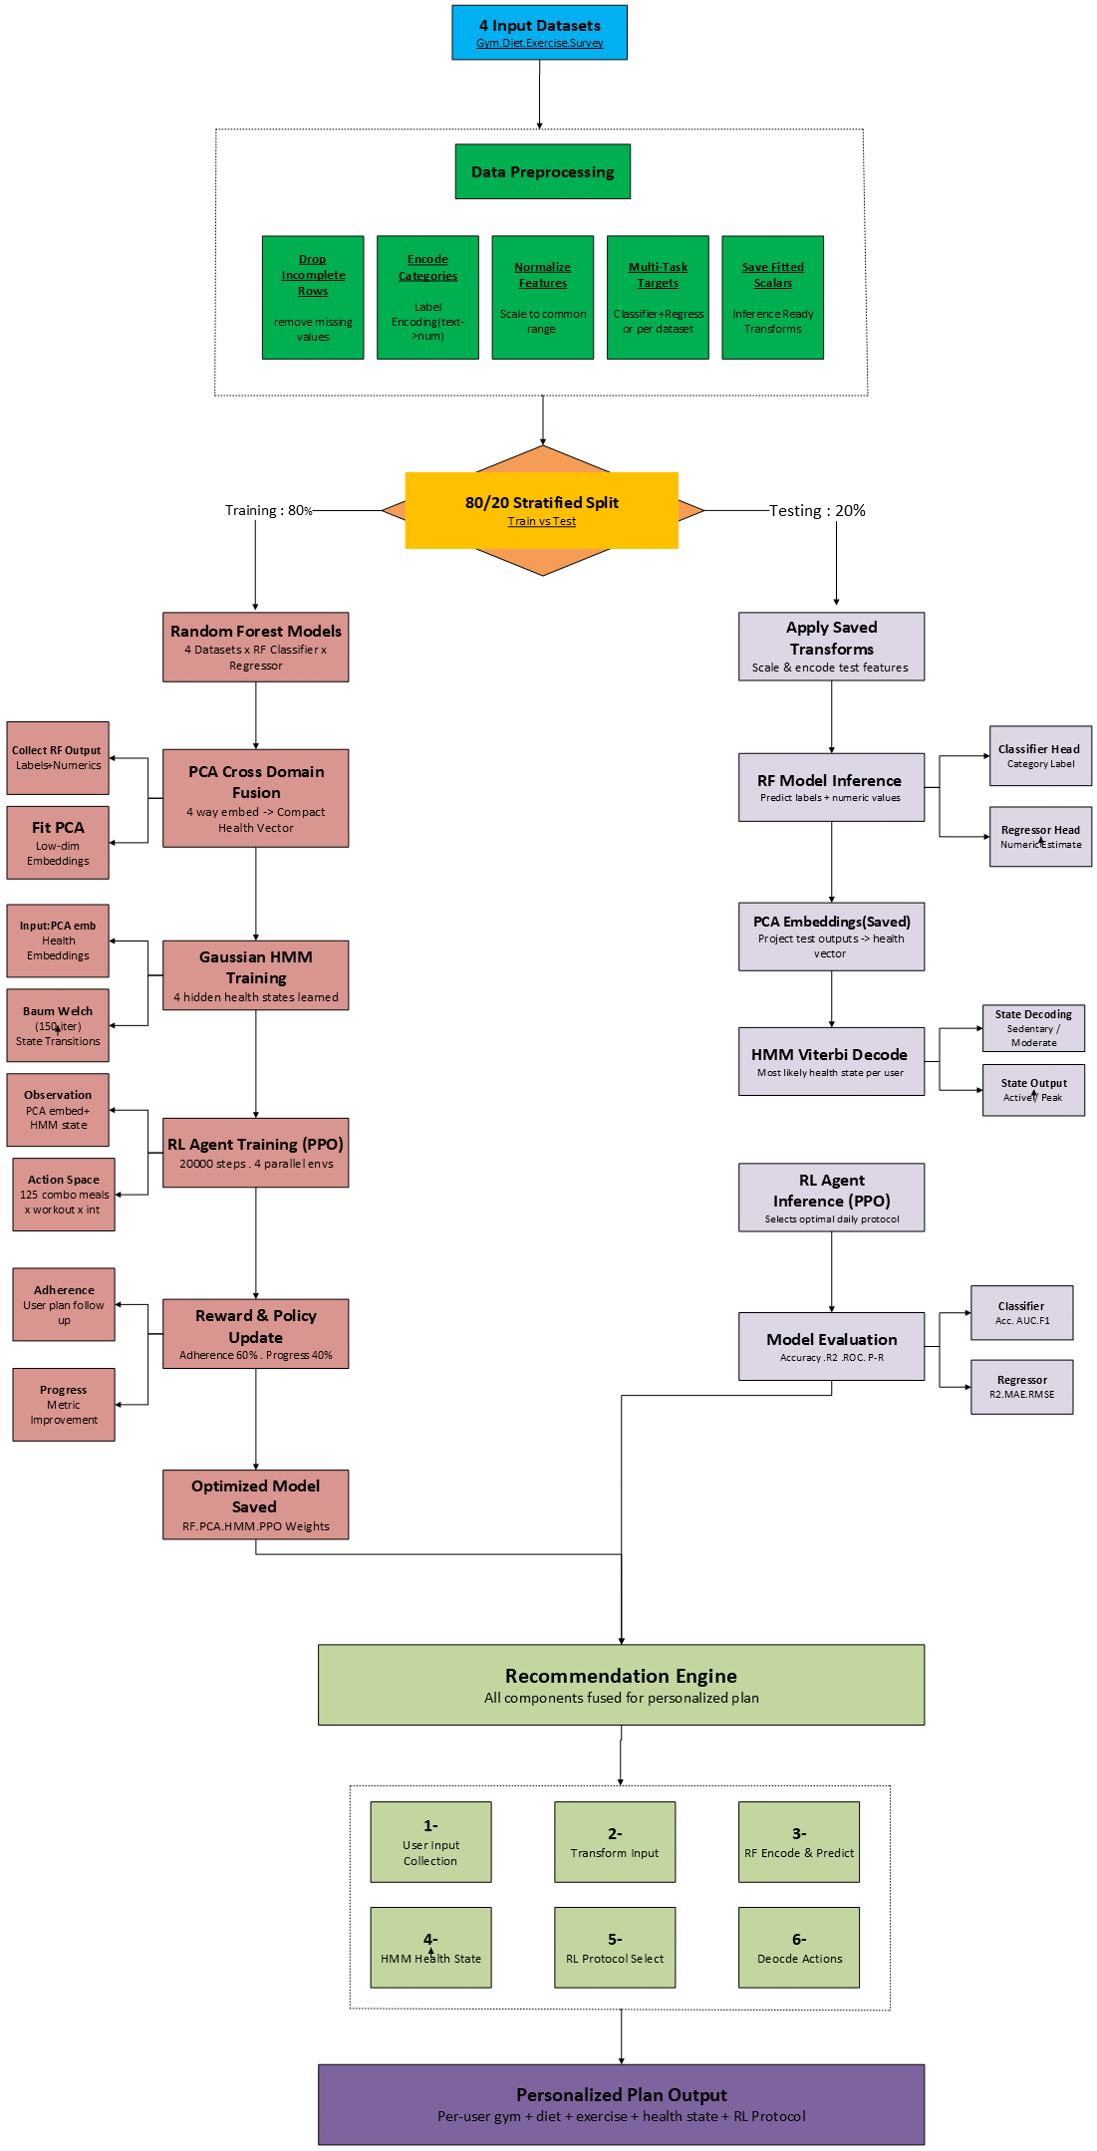
System Flowchart

Slide 5
Data Preprocessing
01
Drop Incomplete Rows
Model Selected Per Dataset
Any row missing a required feature or target is removed before training
Dataset | Model | Reason
Gym | Random Forest | Classifier + regressor for workout type and calories
Diet | Random Forest | Classifier + multi-output regressor for meal plan and macros
Exercise | Random Forest | Classifier + regressor for intensity and calorie burn
Survey | Random Forest | Regressor for composite adherence score
02
Encode Categories
Text values like Gender, Workout Type, Meal Plan are converted to numbers using Label Encoding
03
Normalize Features
All numeric columns are scaled to a common range, so no single feature dominates the model
Survey Adherence Score
04
Multi-Task Targets
The survey dataset has no single ready-made target, so a composite score is calculated from three self-rated health attitude questions. The average of these three ratings becomes the value the model learns to predict.
Each preprocessor produces one classification target and one regression target at the same time
05
Inference-Ready
Fitted scalers and label encoders are saved so new user data can be transformed consistently at prediction time

Slide 6
Machine Learning Models
Each domain uses a Random Forest model — one classifier and one regressor per dataset
Random Forest- Gym & Exercise
Random Forest — Diet
Random Forest — Survey
Gym & Daily Activity
Diet
Survey
How it works
How it works
How it works
Two separate RF models per dataset — one classifier for workout/intensity type, one regressor for calorie burn. Same architecture applied to both Gym and Daily Activity data
Two Random Forest models trained on diet records — a classifier for meal plan and a MultiOutputRegressor for all macro targets simultaneously
A single Random Forest regressor trained on survey Likert-scale data to predict a composite adherence score from self-rated health attitude items
Key steps
Key steps
Key steps
1. 100 trees, max depth 10
1. 100 trees, max depth 10
1. 100 trees, max depth 10
2. Stratified 80/20 train-test split
2. MultiOutputRegressor wraps RF for macro predictions
2. Composite adherence score from 3 self-rated questions
Handles mixed numeric and categorical gym features with high accuracy
Effectively predicts both meal plan category and precise daily macro targets
Robust regressor for independent Likert-scale features with no sequence structure

Slide 7
Multi-Task Learning
Every model trains two tasks at once — one Random Forest classifier and one regressor, trained on the same features
RF
Classification Head
Predicts a category
Category Label
Input Features
Input Features
Regression Head
Predicts a number
Numeric Value
What each model predicts:
Gym Model
Diet Model
Exercise Model
Survey Model
Classification:
Classification:
Classification:
Classification:
Workout Type
Meal Plan
Exercise Intensity
— (regression only)
Regression:
Regression:
Regression:
Regression:
Calories Burned
Daily Macros (4 values)
Calorie Burn
Adherence Score
Training: 80% of data for training · 20% held out for testing · Results: Gym 99.49% · Diet 96.92% · Exercise 95.74% accuracy

Slide 8
Cross-Dataset Fusion
After training, all four model feature sets are combined via PCA into a single unified representation of the user
Gym
Embedding
Diet
Embedding
Exercise
Embedding
Survey
Embedding
Tiled to equal length, then concatenated → one large combined matrix (4 feature sets)
PCA applied to the concatenated matrix — reduces dimensionality while retaining most variance
Components set to min(64, n_samples, n_features) — auto-scaled to dataset size
Fused Embedding — Compact PCA-reduced vector passed to the HMM and RL agent for health state estimation
Why fuse? Each dataset captures different aspects of health. Combining them via PCA lets the HMM and RL agent reason about the whole person — not just one dimension.

Slide 9
Health State Estimation (HMM)
The fused PCA embedding is fed into a Hidden Markov Model which classifies each user into one of four health states
State 0
State 1
State 3 and 4
Sedentary
Moderate
Active / Peak
The user is in a low-activity phase. Body is recovering. Metrics are below optimal range.
The user maintains some activity. Moderate adherence. Metrics show improvement potential.
The user is performing at peak. High adherence, optimal fitness indicators, and consistent progress.
Key signals:
Key signals:
Key signals:
› Low workout frequency
› Moderate workout frequency
› High workout frequency
› Poor sleep or high fatigue
› Adequate diet adherence
› Optimal caloric and macro intake
› Sub-optimal BMI trend
› Improving BMI and heart rate
› High adherence scores
Model:
Gaussian HMM (hmmlearn library)
Prediction:
Viterbi algorithm — finds the most likely state per user
States:
4 hidden health states
Input:
Fused PCA embedding
Training:
Baum-Welch (150 iterations)

Slide 10
Reinforcement Learning — Daily Protocol Agent
A PPO agent learns which combination of meal plan, workout, and intensity produces the best long-term outcomes
The Training Environment
How Reward is Calculated
Observation:
The user's PCA-fused health embedding + current HMM health state
■ Adherence (60%)
Did the user follow the plan?
Choices:
5 meal plans × 5 workout types × 5 intensities = 125 options
■ Progress (40%)
Did health metrics improve?
Reward:
Based on predicted adherence and progress
■ Extreme Penalty
Deducted if intensity is too easy or too hard
Algorithm:
PPO — Proximal Policy Optimization (Stable-Baselines3)
Action Space
Meal Plans:
High-Protein · Low-Carb · Balanced · Mediterranean · Keto
Workouts:
Yoga · HIIT · Cardio · Strength Training · Cycling
Intensities:
Levels 1 through 5 (from light to maximum effort)
The agent outputs a single action number (0–124) which is decoded back into a meal plan + workout type + intensity level

Slide 11
Recommendation Engine & Sample Output
All trained components come together to produce one personalised plan for any given user
1
2
3
4
5
User Inputs
Transform
Encode & Predict
HMM State
RL Protocol
4 sets of personal data (gym, diet, exercise, survey)
Each preprocessor scales and encodes the inputs
RF models produce category labels and numeric estimates
PCA-fused embedding fed to HMM for health state
PPO agent selects optimal daily plan
What the system outputs for each user:
Gym Plan
Diet Plan
Exercise
· Recommended workout type
· Recommended meal plan type
· Intensity level (scale of 1–10)
· Estimated calories burned per session
· Daily targets for calories, protein, carbs, fats
· Estimated calorie burn
Health State
RL Protocol
· Current state: Sedentary / Moderate / Active / Peak
· Agent's chosen meal plan
· Inferred from full health embedding
· Recommended workout + intensity level

Slide 12
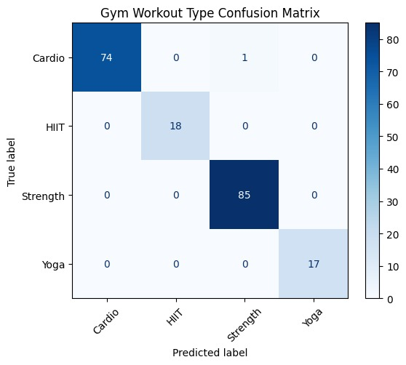
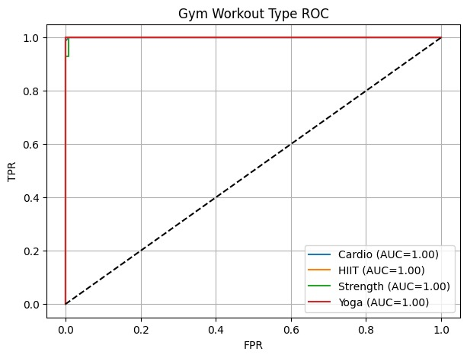
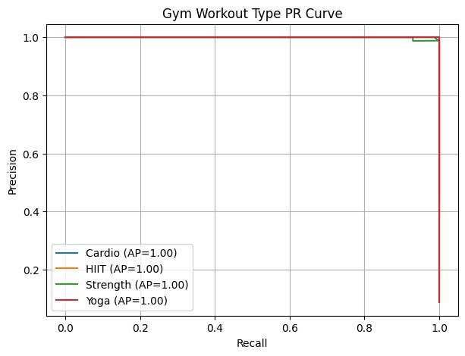
Model Evaluation — Gym Dataset
Random Forest Classifier: Workout Type · Accuracy: 99.49% · All classes AUC = 1.00
Confusion Matrix
ROC Curve
Precision-Recall Curve
Cardio
Precision: 1.00 | Recall: 0.99 | F1: 0.99
HIIT
Precision: 1.00 | Recall: 1.00 | F1: 1.00
Strength
Precision: 0.99 | Recall: 1.00 | F1: 0.99
Yoga
Precision: 1.00 | Recall: 1.00 | F1: 1.00

Slide 13
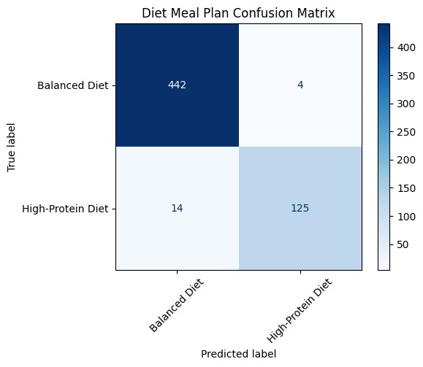
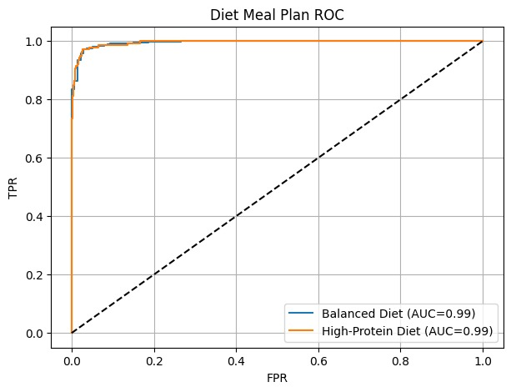
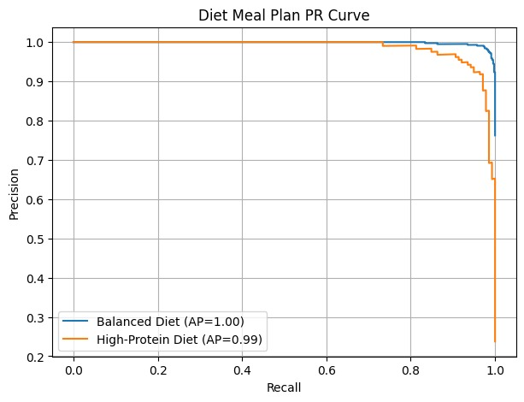
Model Evaluation — Diet Dataset
Random Forest Classifier: Meal Plan · Accuracy: 96.92% · Both classes AUC = 0.99
Confusion Matrix
ROC Curve
Precision-Recall Curve
Balanced Diet
P: 0.97 | R: 0.99 | F1: 0.98
High-Protein Diet
P: 0.97 | R: 0.90 | F1: 0.93
Macro R² ≈ 1.00
Calories R²:0.9998 | Protein R²:1.00
Macro MAE
Calories MAE:0.58 | Protein MAE:0.06

Slide 14
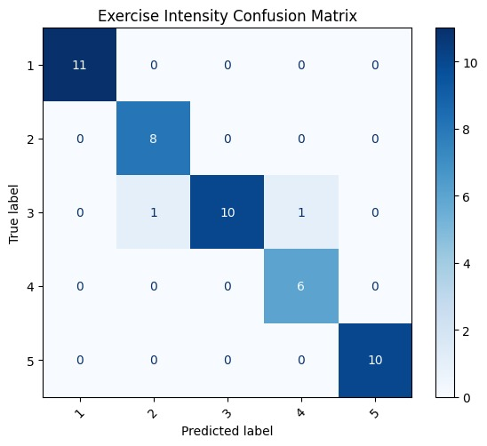
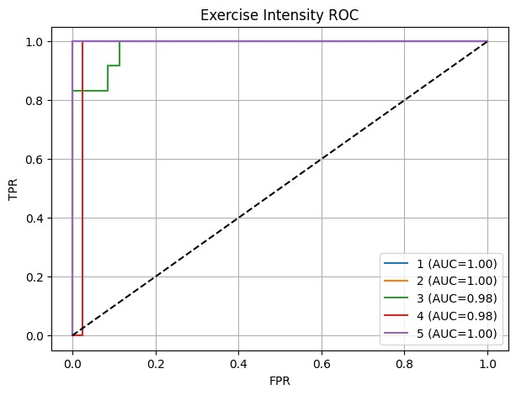
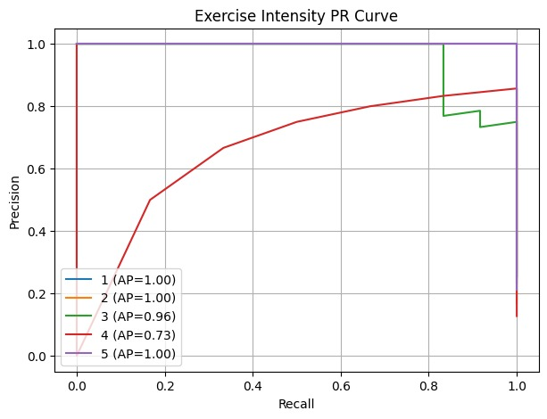
Model Evaluation — Exercise Dataset
Random Forest Classifier: Intensity Level · Accuracy: 95.74% · Avg AUC = 0.99
Confusion Matrix
ROC Curve
Precision-Recall Curve
Level 1
P:1.00 R:1.00 F1:1.00 | AP=1.00 AUC=1.00
Level 2
P:0.89 R:1.00 F1:0.94 | AP=1.00 AUC=1.00
Level 3
P:1.00 R:0.83 F1:0.91 | AP=0.96 AUC=0.98
Level 4
P:0.86 R:1.00 F1:0.92 | AP=0.73 AUC=0.98

Slide 15
Regression Performance Summary
Numeric prediction quality across all four regression targets
Gym Calorie Burn
Diet Macros (avg)
Exercise Calorie Burn
Survey Adherence
R² = 0.9724
R² ≈ 1.00
R² = 0.8718
R² = 0.9716
MAE: 36.39 kcal RMSE: 47.96 kcal
Calories MAE: 0.58 Protein MAE: 0.06
MAE: 469.23 kcal RMSE: 590.12 kcal
MAE: 0.32 RMSE: 0.43
⚠ Exercise calorie burn R²=0.37 reflects high natural variability in daily activity data (dailyActivity_merged.csv). The classifier (intensity level, 95.74%) and other regressors perform strongly.
Classification Accuracy at a Glance
Gym Workout Type: 99.49%
Diet Meal Plan: 96.92%
Exercise Intensity: 95.74%
Survey Adherence R²: 0.9716

Slide 16
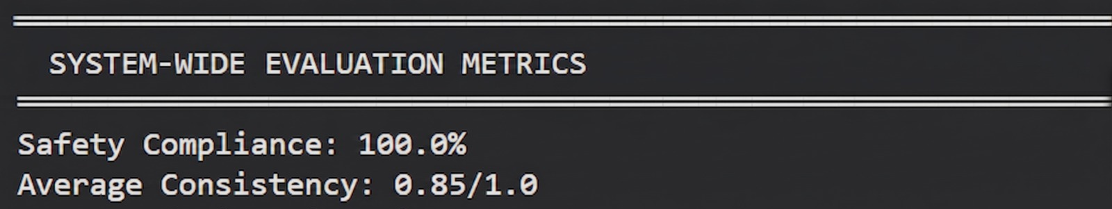
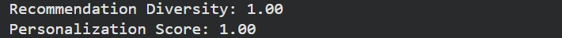
Overall Model Evaluation

Slide 17
Thank You
AI-Powered Personalized Fitness & Diet System
Omamah Ajmal · Daniya Aamir · Iqra Iqbal

