Slide 1
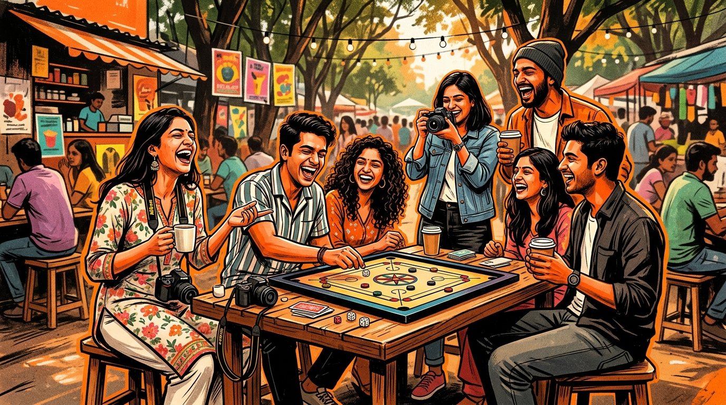
SOCIAL
SPARK
Building Social Fitness, One Connection at a Time.
Presented by: Team SocialSpark
Entrepreneurship Cell · Shark Tank Competition
SocialSpark · Building Social Fitness, One Connection at a Time.
01 / 12

Slide 2

THE PROBLEM
LONELINESS IS AN ECONOMIC CRISIS.
1 IN 4
adults experience chronic loneliness globally.
"We don't lack people around us. We lack meaningful connections."
3×
higher risk of clinical depression & burnout.
16–60
— the full age spectrum it affects in India.
SocialSpark · Building Social Fitness, One Connection at a Time.
02 / 12

Slide 3
THE GAP
COMMUNICATION VS CONNECTION.
Apps help people talk. We help people belong.
Existing Apps
SocialSpark
💬 Endless chats — no action required
🌟 Experience-first, real-world events
📱 Online-only, screen-addictive loops
🚶 Offline-first — QR-verified attendance
👁 Passive scrolling drives anxiety
🤝 Active participation & community
❤️ Vanity metrics: likes & followers
🏆 Social XP & gamified progress
😶 Zero offline habit formation
🎯 Streak-based social fitness habits
SocialSpark · Building Social Fitness, One Connection at a Time.
03 / 12

Slide 4
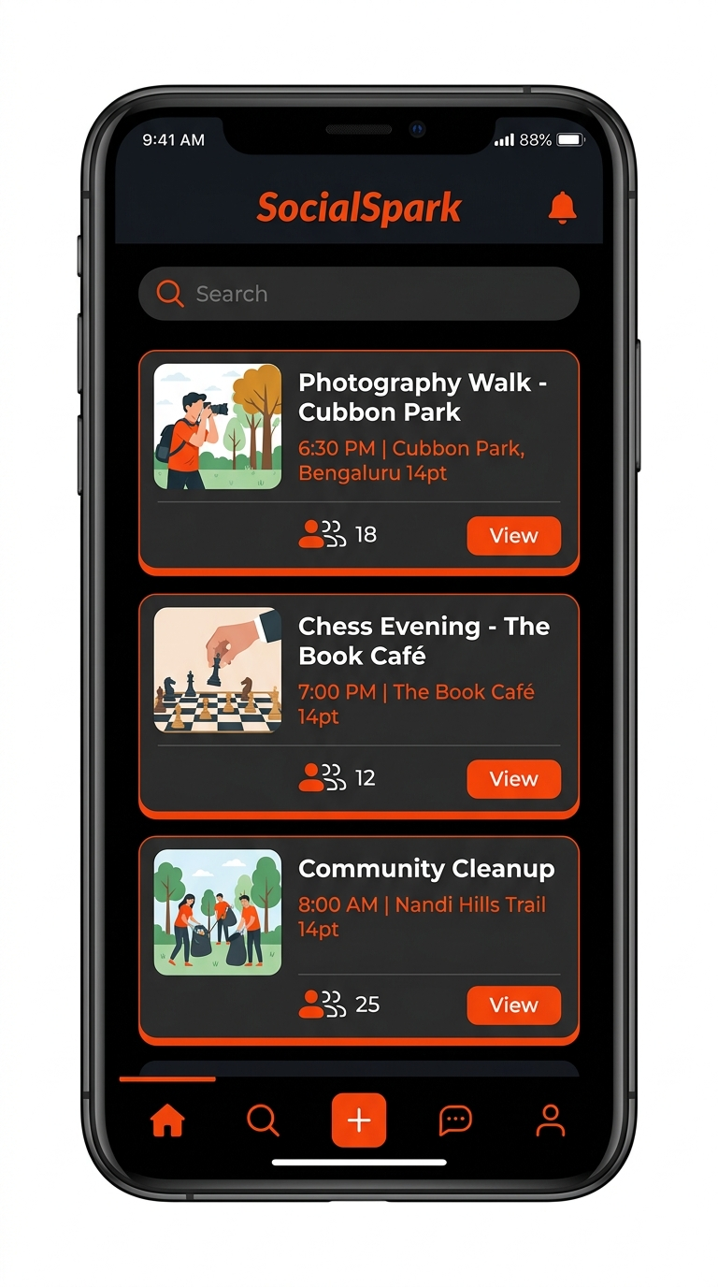
OUR SOLUTION
INDIA'S FIRST SOCIAL FITNESS PLATFORM.
Instead of: "Who do you want to talk to?"
We ask: "What do you want to experience today?"
🎨 Hobby Clubs — Photography, Chess, Music
🏃 Community Activities — Sports, Tournaments
🤝 Volunteering Drives — NGO-verified
🎤 Workshops — Cooking, Coding, Pottery
☕ Local Meetups — Cafés, Book Clubs
SocialSpark · Building Social Fitness, One Connection at a Time.
04 / 12

Slide 5
THE PRODUCT
HOW IT WORKS.
Four steps. Fully offline-verified.
01
02
03
04
SIGN UP & SELECT
AI MATCHES
ATTEND & SCAN
EARN XP & REDEEM
Choose your interests — Photography, Football, Yoga, Cooking, Music, Coding, Reading, or Volunteering.
Our algorithm recommends verified, nearby events tailored precisely to your interest profile.
Show up in person. Scan the host's QR code. Attendance is instantly verified on-chain — no cheating.
Collect Social XP. Hit weekly streaks. Climb leaderboards. Unlock coffee coupons, movie tickets, gym passes.
SocialSpark · Building Social Fitness, One Connection at a Time.
05 / 12

Slide 6

GAMIFICATION ENGINE
MAKING SOCIAL INTERACTION A HABIT.
Attend standard event
+50 XP
Volunteer at NGO drive
+150 XP
Host a community experience
+300 XP
Bring a new friend along
+100 XP
Complete weekly quest
+250 XP
Just like fitness apps create daily exercise habits — SocialSpark creates lifelong social wellness habits.
SocialSpark · Building Social Fitness, One Connection at a Time.
06 / 12

Slide 7
BUSINESS MODEL
FIVE REVENUE STREAMS.
Diversified · Sustainable · Scalable.
☕
B2B Hosting Fees
Cafés, bookstores, coworking spaces pay to host branded community events and drive authentic offline footfall — no billboard spend needed.
👑
Premium Membership
₹199/month unlocks priority bookings, exclusive workshops, bonus XP multiplier, and advanced networking features.
🎟️
Event Ticket Cut
20% commission on all paid hobby workshops — pottery, dance, coding, music, photography, cooking.
🏷️
Brand Partnerships
Local brands sponsor XP rewards, leaderboards, and seasonal campaigns instead of paying for influencers.
❤️
NGO Subscriptions
Monthly SaaS fee for NGOs to recruit, verify, and manage dedicated volunteer groups through our network.
SocialSpark · Building Social Fitness, One Connection at a Time.
07 / 12

Slide 8
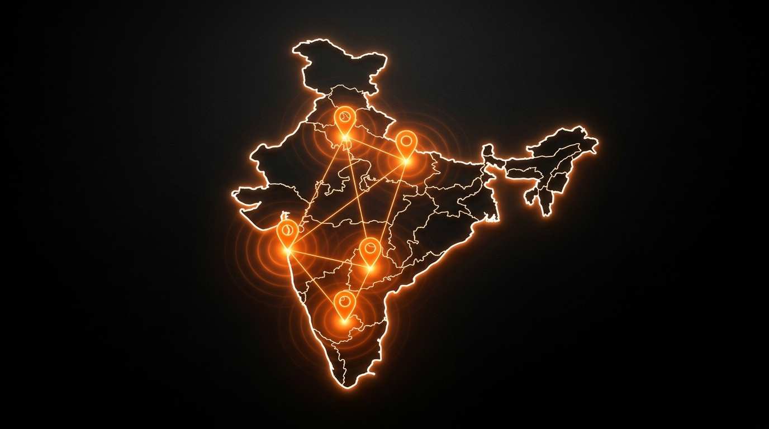
SCALABILITY ROADMAP
BUILT TO SCALE.
01
PILOT CITY
20 cafés · 15 NGOs · 10 colleges · 100 verified events.
02
CAMPUS & CORPS
Universities, corporates, coworking networks.
03
METRO INDIA
Bangalore · Mumbai · Delhi · Hyderabad · Pune.
04
PAN INDIA
Tier-1 and Tier-2 cities. Nation-scale community.
05
GLOBAL
South-East Asia, Middle East, student hubs worldwide.
SocialSpark · Building Social Fitness, One Connection at a Time.
08 / 12

Slide 9
WHY SOCIALSPARK
FIVE REASONS WE WIN.
🌟
🚶
🎮
🔒
💼
SOCIAL FITNESS
OFFLINE FIRST
GAMIFIED HABITS
VERIFIED SAFETY
FULL ECOSYSTEM
Not social media. We track real offline interactions and reward genuine human connection.
Technology initiates the connection. Real friendships are forged face-to-face, not on a feed.
XP, streaks, leaderboards, weekly quests — the same psychology that made fitness apps indispensable.
Verified profiles, verified hosts, verified venues. Trust is the foundation of our community.
Every stakeholder wins — users, businesses, brands, and NGOs are rewarded for participating.
"We don't build users. We build communities."
SocialSpark · Building Social Fitness, One Connection at a Time.
09 / 12

Slide 10
MARKET TIMING
RIGHT PROBLEM. RIGHT TIME.
🧠
🏢
✊
MENTAL HEALTH AWARENESS
HYBRID WORK IS THE NORM
SCREEN FATIGUE
Loneliness is now a declared public health epidemic. Governments and investors globally are funding solutions to the loneliness crisis.
Remote and hybrid work eliminated daily spontaneous office interactions for millions. The hunger for community has never been greater.
Gen-Z and Millennials are actively pursuing digital detoxes. Real, tangible experiences are the new social currency.
"People already track their sleep, their calories, their heartbeats. Why not their social wellbeing?"
SocialSpark · Building Social Fitness, One Connection at a Time.
10 / 12

Slide 11
INVESTMENT ASK
₹20 LAKHS
OUR VISION
To build India's largest platform for meaningful human connection — transforming loneliness into community, one city at a time. The technology stays the same. Only communities grow.
FOR 10% EQUITY
FUND ALLOCATION
Product Development & App Refinement
40%
YEAR 1 TARGETS
Marketing & City Launch Campaigns
30%
→ 20 business partners onboarded
→ 15 NGO integrations live
Partnership Expansion (B2B + NGOs)
20%
→ 10,000+ active verified users
→ 100+ monthly community events
Operations & Customer Support
10%
SocialSpark · Building Social Fitness, One Connection at a Time.
11 / 12

Slide 12
THANK
SOCIALSPARK
QUESTIONS?
"Building Social Fitness, One Connection at a Time."
YOU.
Let's Connect.
team@socialspark.in
Entrepreneurship Cell Shark Tank Competition
For Your Attention
"Loneliness isn't solved by more screen time. It's solved by more real time."
SocialSpark Pitch Deck · Shark Tank Competition · Slide 12 / 12

