Slide 1
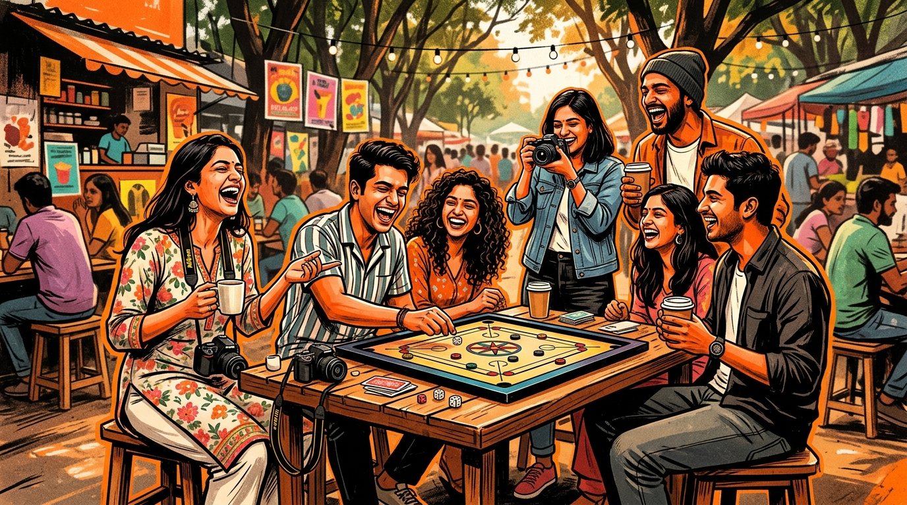
SOCIAL
SPARK
Building Social Fitness, One Connection at a Time.
Presented by: Team SocialSpark
Entrepreneurship Cell — Shark Tank Competition
SocialSpark — Building Social Fitness, One Connection at a Time.
01 / 12

Slide 2

THE PROBLEM
LONELINESS IS AN ECONOMIC CRISIS.
1:4
Adults worldwide experience chronic loneliness.
"We don't lack people around us. We lack meaningful connections."
3x
Higher risk of depression, anxiety & burnout.
16-60
The full age range impacted in India alone.
SocialSpark — Building Social Fitness, One Connection at a Time.
02 / 12

Slide 3
THE GAP
COMMUNICATION VS CONNECTION.
Apps help people talk. SocialSpark helps people belong.
Existing Platforms
SocialSpark
— Chat-first — conversation without real action
+ Experience-first — real-world offline events
— Screen-addictive — passive, online-only loops
+ QR-verified attendance — no screen addiction
— Anxiety-inducing — vanity metrics drive comparison
+ Gamified XP — positive reinforcement system
— No offline accountability or habit formation
+ Streaks & missions — builds long-term habits
— Connections are weak — no shared experience
+ Bonds through shared activities, not chatting
SocialSpark — Building Social Fitness, One Connection at a Time.
03 / 12

Slide 4
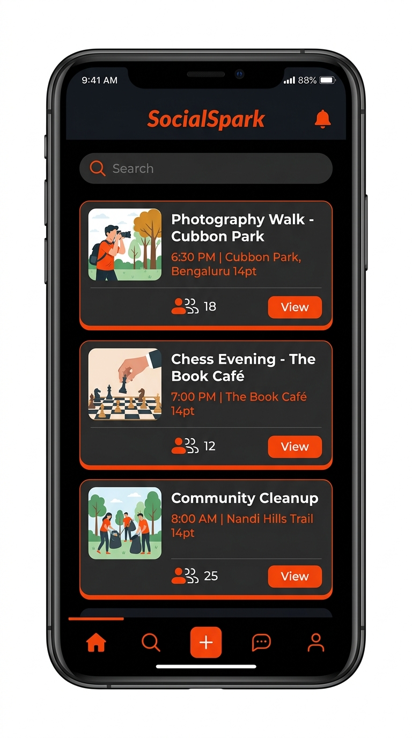
OUR SOLUTION
INDIA'S FIRST SOCIAL FITNESS PLATFORM.
Instead of asking who you want to talk to,
We ask: "What do you want to experience today?"
HC
Hobby Clubs
Photography, Chess, Music, Cooking
CE
Community Events
Sports, Tournaments, Fitness Drives
VD
Volunteer Drives
NGO-verified, XP-rewarded
LW
Local Workshops
Coding, Pottery, Dance, Language
SocialSpark — Building Social Fitness, One Connection at a Time.
04 / 12

Slide 5
THE PRODUCT
HOW IT WORKS.
Four steps. Fully verified. Beautifully simple.
01
02
03
04
SIGN UP & SELECT
AI MATCHES
ATTEND & SCAN
EARN XP & WIN
Pick your world — Photography, Football, Yoga, Cooking, Music, Coding, Reading, or Volunteering.
Our algorithm surfaces the right verified, nearby events based on your interest profile and location.
Show up. Scan the host QR code. Attendance is instantly verified — no self-reporting, no cheating.
Collect Social XP. Hit streaks. Climb leaderboards. Unlock real rewards — coffee, cinema, gyms, classes.
SocialSpark — Building Social Fitness, One Connection at a Time.
05 / 12

Slide 6
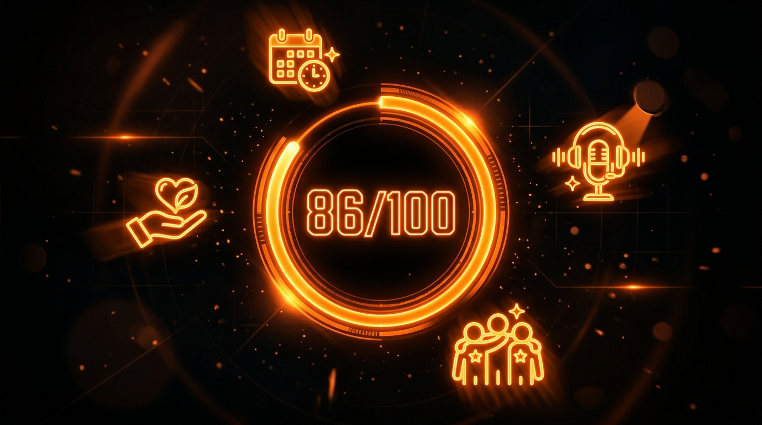
SOCIAL FITNESS ENGINE
MAKING SOCIAL INTERACTION A HABIT.
ATT
Attend any verified event
+50 XP
VOL
Volunteer at an NGO drive
+150 XP
HST
Host a community experience
+300 XP
REF
Refer and bring a new friend
+100 XP
QST
Complete the weekly social quest
+250 XP
Exactly how RunSpark built exercise habits — SocialSpark builds lifelong social fitness habits.
SocialSpark — Building Social Fitness, One Connection at a Time.
06 / 12

Slide 7
BUSINESS MODEL
FIVE REVENUE STREAMS.
Diversified — Recurring — Scalable.
B2B
B2B Hosting Fees
Cafes, bookstores, and coworking spaces pay a listing and promotion fee to host branded experiences and drive real offline footfall — no billboard spend.
PRE
Premium Membership
Rs 199/month unlocks priority event bookings, exclusive workshops, a 2x XP multiplier, and advanced community networking tools.
COM
Ticket Commission
20% cut on all paid hobby workshops — pottery, dance, coding, music, photography, cooking. Every event is recurring revenue.
BRD
Brand Partnerships
Local and national brands sponsor XP leaderboards, seasonal campaigns, and community challenges instead of expensive influencer deals.
NGO
NGO Subscriptions
Monthly SaaS fee for NGOs to recruit, verify, and manage dedicated volunteer cohorts through our platform with mission tracking.
SocialSpark — Building Social Fitness, One Connection at a Time.
07 / 12

Slide 8
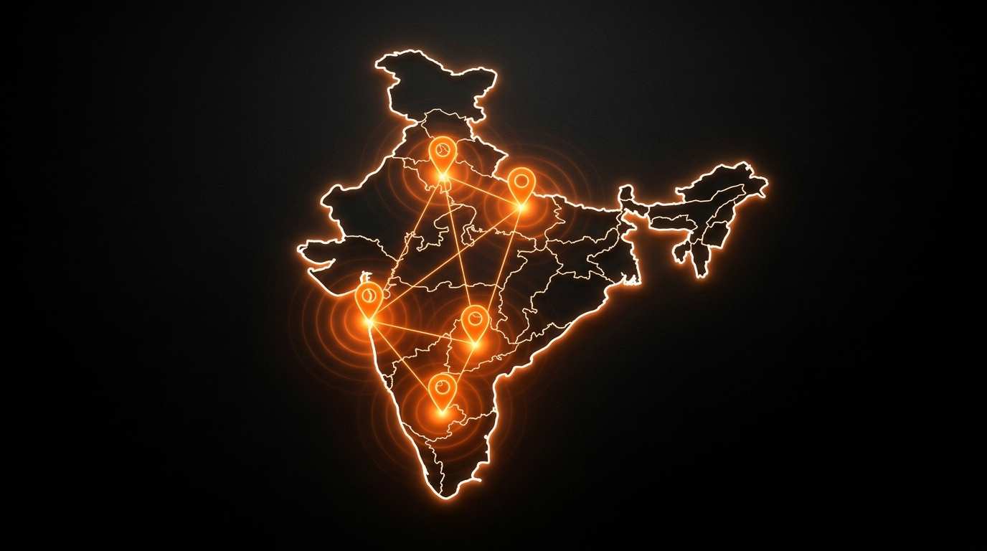
SCALABILITY ROADMAP
BUILT TO SCALE.
01
PILOT CITY
20 cafes, 15 NGOs, 10 colleges, 100 monthly events.
02
CAMPUS & CORPORATES
Universities, hybrid workplaces, and coworking networks.
03
METRO CITIES
Bangalore, Mumbai, Delhi, Hyderabad, Pune.
04
PAN INDIA
Tier 1 and Tier 2 cities. National community scale.
05
GLOBAL EXPANSION
South-East Asia, Middle East, and international student hubs.
SocialSpark — Building Social Fitness, One Connection at a Time.
08 / 12

Slide 9
COMPETITIVE ADVANTAGE
FIVE REASONS WE WIN.
SF
OF
XP
VF
EC
SOCIAL FITNESS
OFFLINE FIRST
GAMIFIED HABITS
VERIFIED & SAFE
FULL ECOSYSTEM
We don't compete with Instagram. We track and reward what Instagram ignores — real offline human connection.
Technology is just the trigger. Real friendships are forged through shared experiences, not shared feeds.
XP, streaks, leaderboards, weekly quests. The psychology that made fitness apps indispensable — applied to social life.
Verified profiles, verified hosts, verified venues. Trust is not an add-on. It is the foundation of every interaction.
Users, businesses, NGOs, and brands. Every stakeholder is rewarded, creating a self-sustaining value network.
"We don't build users. We build communities."
SocialSpark — Building Social Fitness, One Connection at a Time.
09 / 12

Slide 10
MARKET TIMING
RIGHT PROBLEM. RIGHT TIME.
MH
HW
SF
MENTAL HEALTH AWARENESS
HYBRID WORK IS THE NORM
SCREEN FATIGUE
Loneliness has been declared a global health epidemic. WHO and governments worldwide are actively funding community health solutions.
Remote and hybrid work has eliminated the daily spontaneous social contact of an office. The demand for real community has never been greater.
Gen-Z and Millennials are actively seeking digital detoxes. Real, tangible experiences are becoming the new social currency.
"People track sleep, calories, steps. Why not their social wellbeing?"
SocialSpark — Building Social Fitness, One Connection at a Time.
10 / 12

Slide 11
THE ASK
Rs.20 LAKHS
OUR VISION
To become India's largest platform that transforms loneliness into meaningful human connection — one city, one community at a time. The technology scales. Only the communities grow.
FOR 10% EQUITY
FUND ALLOCATION
PD
Product Development & App Refinement
40%
YEAR ONE TARGETS
MK
Marketing & City Launch Campaigns
30%
20+
business partners onboarded
15+
NGO integrations live
PS
Partnership Expansion — B2B and NGOs
20%
10K+
verified active users
100+
community events per month
OP
Operations & Customer Support Infrastructure
10%
SocialSpark — Building Social Fitness, One Connection at a Time.
11 / 12

Slide 12
THANK
SOCIALSPARK
QUESTIONS?
YOU.
"Building Social Fitness, One Connection at a Time."
Let's Connect.
team@socialspark.in
For Your Attention
Entrepreneurship Cell Shark Tank Pitch Competition
"Loneliness is not solved by more screen time. It is solved by more real time."
SocialSpark Pitch Deck — Shark Tank Competition — Slide 12 of 12

