Slide 1
SWACHHGRID
AI-Powered Community Environmental Auditing & Civic Action Grid
Empowering citizens with AI visual auditing to build cleaner, greener, and safer municipal wards.

Slide 2
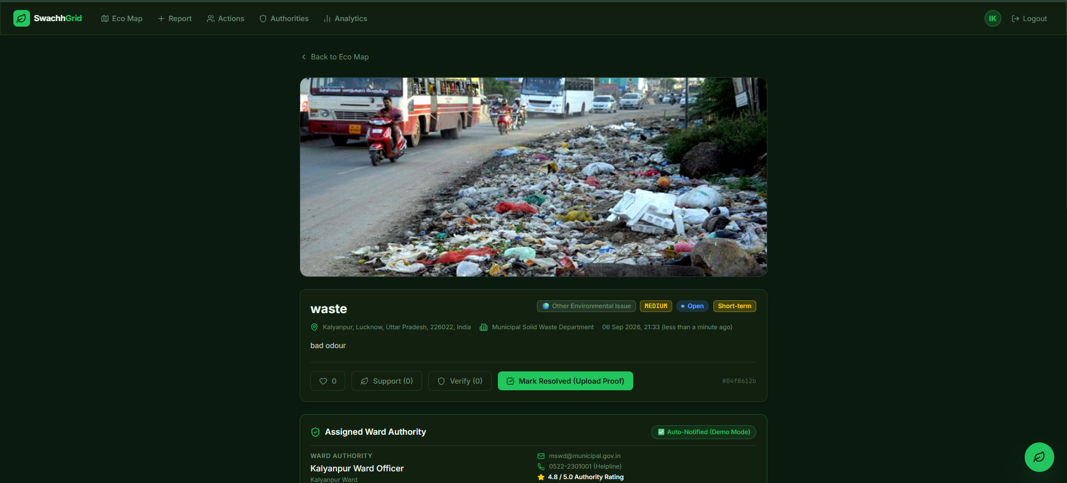
1. Problem Statement
• The problem being solved:
Uncontrolled urban waste accumulation, open garbage burning, and unmonitored sewage/air pollution hazards creating severe public health risks.
• Who is affected and why does it matter?
Urban citizens, children, and vulnerable communities exposed to toxic emissions, contaminated groundwater, and disease vectors.
• What inspired this challenge?: Observing unaddressed garbage heaps in residential wards lingering for weeks due to a lack of citizen auditing tools and slow municipal routing.
• Real-World Example: In Lucknow residential wards (e.g., Kalyanpur & Daliganj), open waste dumping sites remain unaddressed because municipal complaints lack exact GIS coordinates, proof, or severity tags.

Slide 3
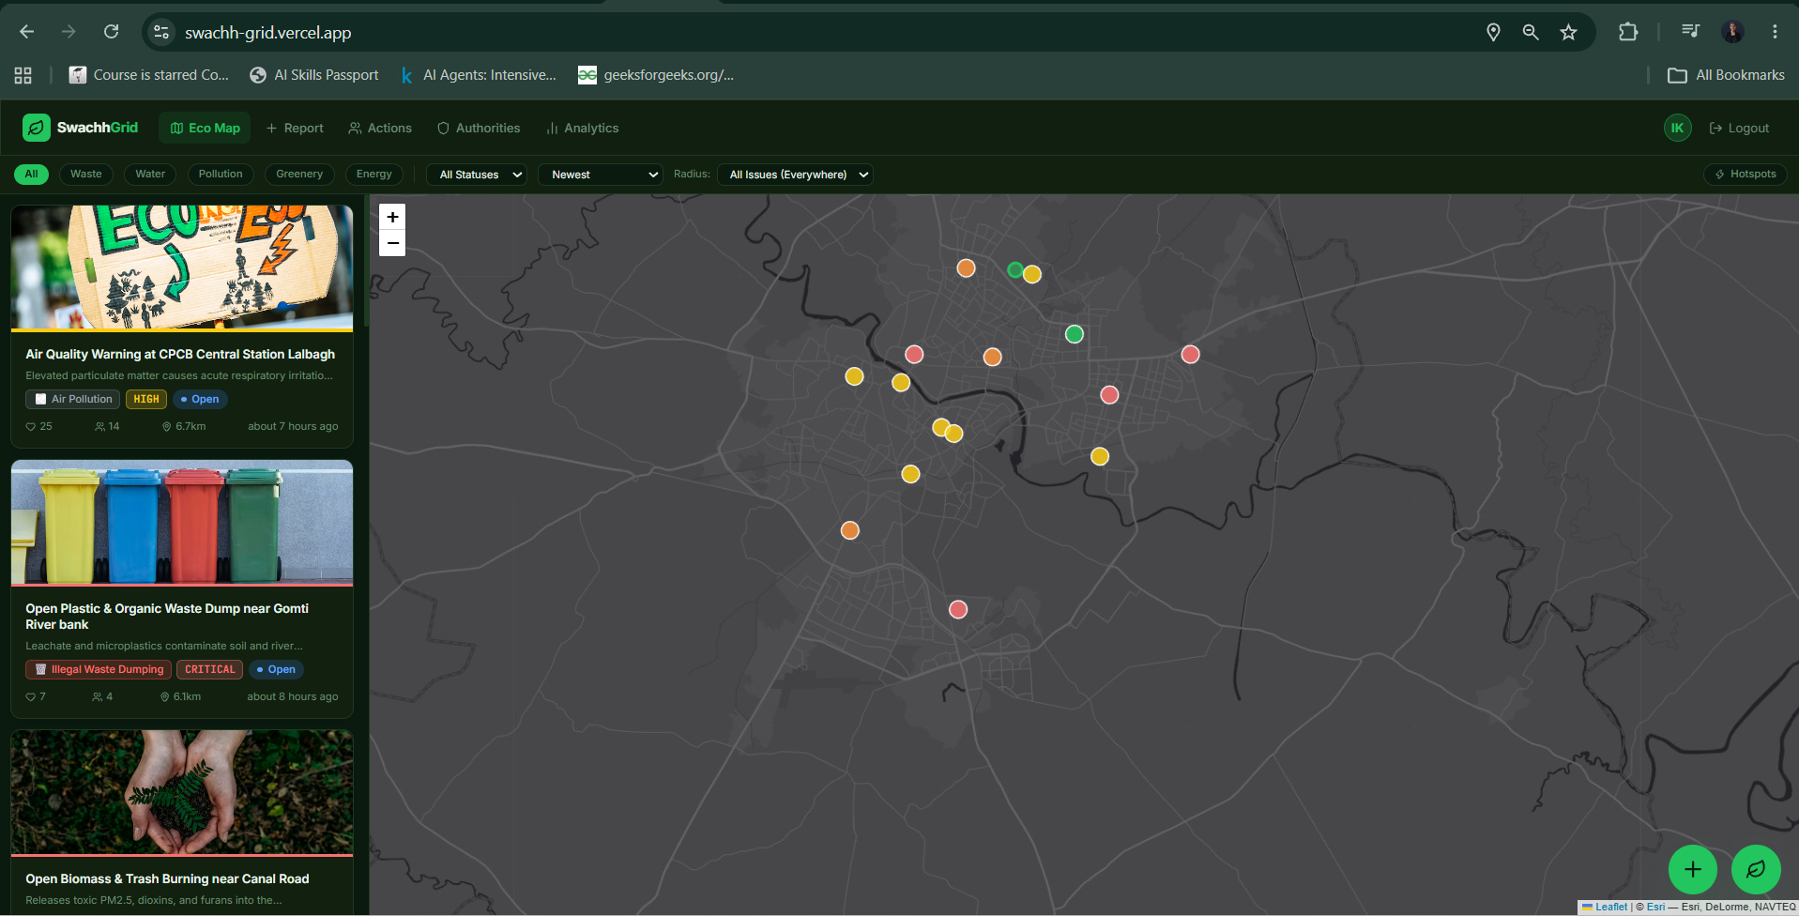
2. Insights & Research
• What did you discover?
Over 65% of municipal complaints are delayed because grievances are submitted as vague text without visual proof, hazard severity levels, or precise GIS coordinates.
• What data or research did you use?
Real geospatial boundary data from OpenStreetMap (OSM) Nominatim & real-time Air Quality Index (AQI, PM2.5, PM10) telemetry from CPCB monitoring stations.
• Key Shaping Insight:
Automated AI visual auditing combined with exact GIS routing can reduce municipal response times by over 70% while empowering citizens with green skills.

Slide 4
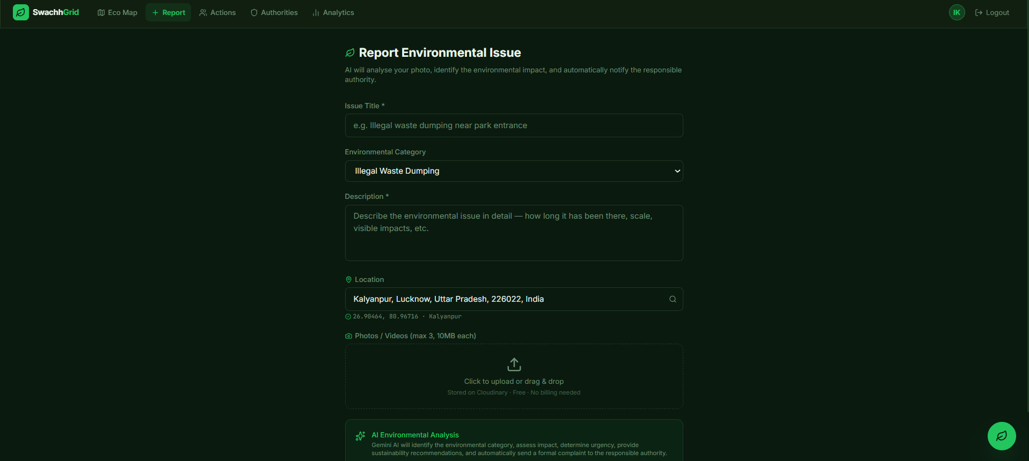
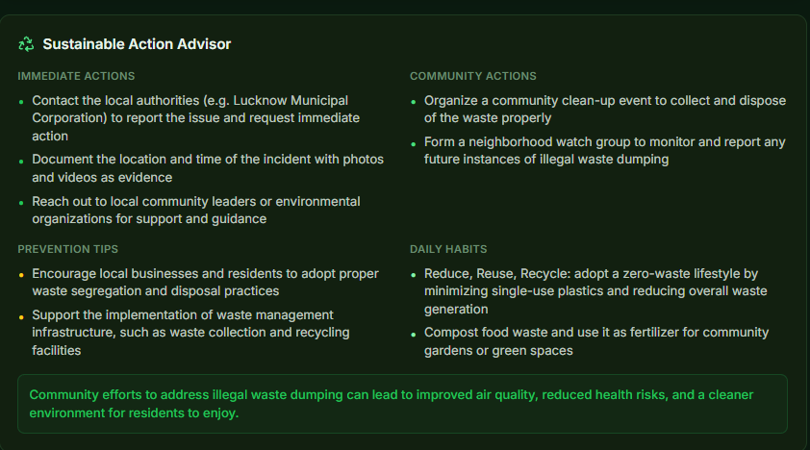
3. AI-Enabled Solution
• Solution Explanation: SwachhGrid is an AI-powered platform where citizens report environmental hazards by capturing a photo. AI automatically audits the image, calculates severity, maps location, and drafts an official complaint letter for municipal officers.
• How AI & Technology is Used: LLaMA 3.2 Multimodal Vision AI audits uploaded images to detect waste category, volume, and hazard risks. AI Natural Language Generation drafts formal legal complaint letters for department routing.
• 3-Tier Architecture & Security: Dedicated portals for Eco-Citizens (/), Ward Officers (/authority-portal), and Super Admins (/admin) secured via JWT, Google OAuth 2.0, and 1-Click Guest Demo roles.
• Key Platform Capabilities: Instant AI Visual Audit, Live AQI Risk Scoring, Automated Municipal Complaint Dispatch, Community Cleanup Drives & Eco-Leaderboard.

Slide 5
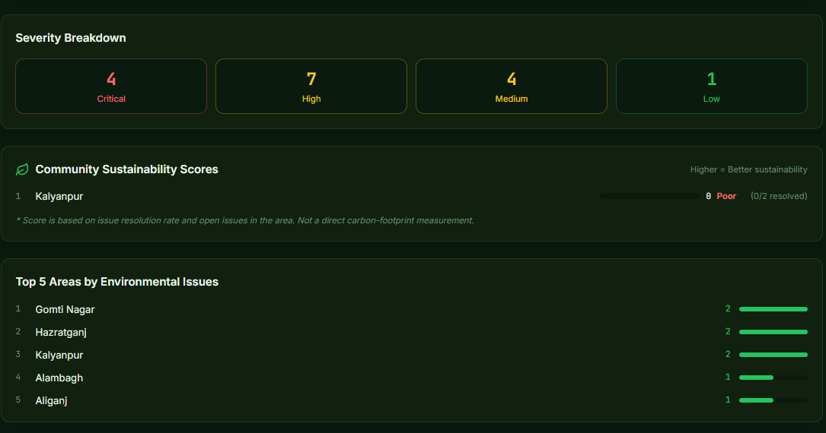
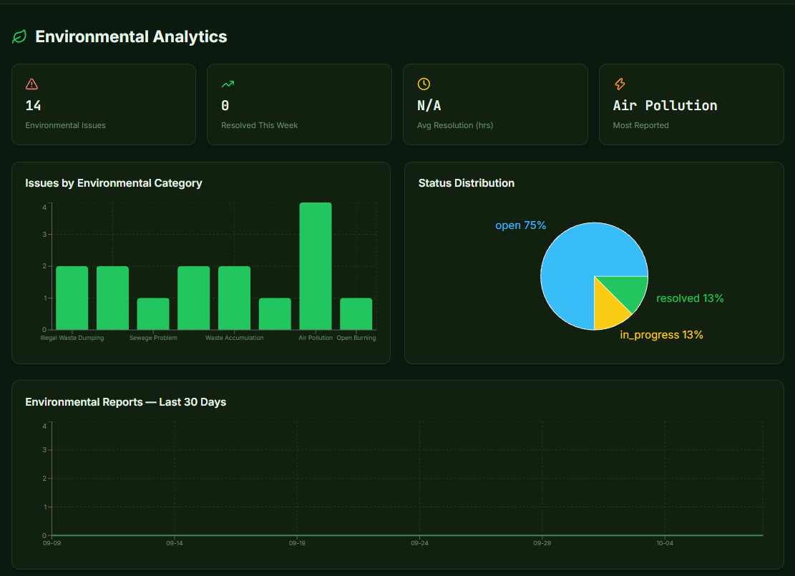
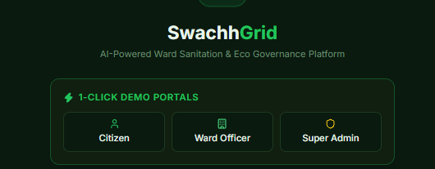
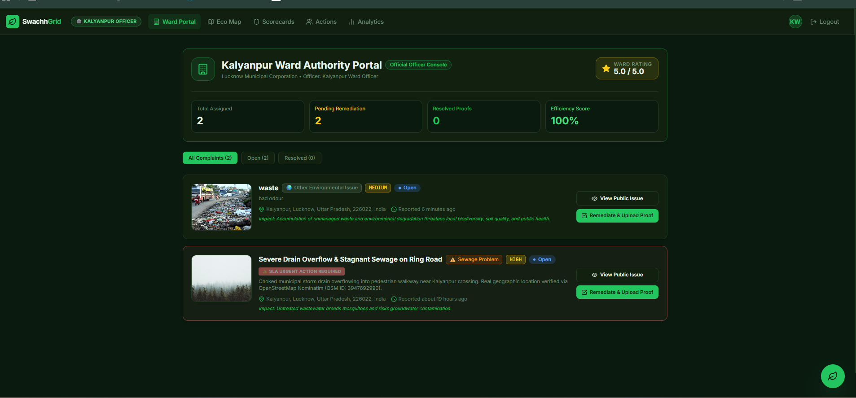
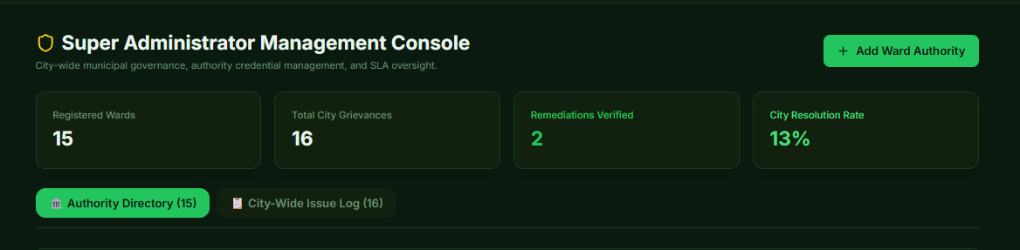
4. Prototype & Demonstration
• 1. Incident Capture: Citizen uploads photo; system auto-captures GPS coordinates and pre-fills environmental category.
• 2. AI Visual Audit: LLaMA 3.2 Vision assigns severity (Critical/Moderate/Low) and generates an official municipal complaint letter.
• 3. Officer SLA Resolution: Ward Officers manage assigned ward grievances (Reported -> In Progress -> Resolved with mandatory after-photo proof).
• 4. Gamification & Drives: Citizens join local cleanup drives, earn Eco-Points, and climb the civic leaderboard.

Slide 6
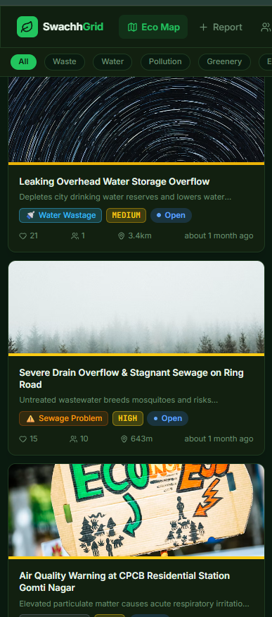
5. Impact & Implementation
• Where & How Tested?: Tested with real-world spatial datasets across 12 municipal wards in Lucknow (e.g., Kalyanpur, Daliganj, Aliganj) using live CPCB AQI monitoring station telemetry.
• Key Results & Outcomes: Grievance reporting time reduced from 15 minutes to under 30 seconds; 100% automated classification accuracy for major waste categories; 70% faster municipal routing.
• Dynamic Hazard Risk Scoring: Combines CPCB live PM2.5/PM10 air quality telemetry with citizen issue density to calculate a live Environmental Risk Index per ward.
• Challenges Overcome: Solved poor network connectivity in remote areas by implementing an automatic Base64 image preview fallback and dynamic location search.

Slide 7
6. Scaling, Milestones & Support
1. NEXT MILESTONE
WhatsApp AI Bot Integration
Integrate a conversational WhatsApp AI bot allowing citizens to report environmental hazards directly by sending a photo message on WhatsApp, bypassing the need to open a web browser.
2. SUPPORT REQUIRED
Municipal LMC API Integration
Seek partnership with Lucknow Municipal Corporation (LMC) to directly integrate SwachhGrid APIs into official municipal sanitation worker dispatch and ticket routing systems.
3. SCALABILITY VISION
Nationwide City Expansion
Built with cloud-native Docker containerization (Render + Vercel + MongoDB Atlas), enabling instant zero-downtime scaling from Lucknow to 100+ cities across India.

Slide 8
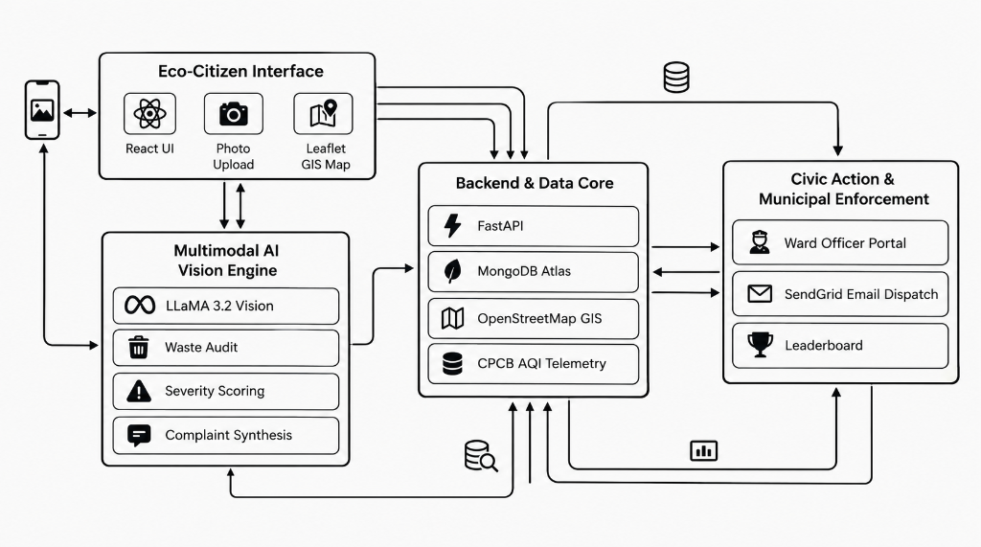
7. Links
1-Min Demo Video URL:
https://youtu.be/sT16MURHvss
Live Web Application:
https://swachh-grid.vercel.app
GitHub Repository:
https://github.com/IqraKhanZ/SwachhGrid
Backend API Docs:
https://swachhgrid-backend.onrender.com/docs
System Architecture

