Slide 1
SWACHHGRID
AI-Powered Community Environmental Auditing & Civic Action Grid
Empowering citizens with AI visual auditing to build cleaner, greener, and safer municipal wards.
Powered by IBM Bob | FastAPI | React | LLaMA 3.2 Vision | MongoDB Atlas
SwachhGrid — AI Environmental Grid | Slide 1 of 15

Slide 2
PROBLEM STATEMENT
The Crisis in Urban Environmental Governance
• Illegal Waste Accumulation: Over 65% of urban waste suffers from delayed clearance, creating severe public health hazards and pest breeding grounds.
• Unmonitored Hotspots: Municipal bodies lack real-time visibility into localized environmental issues such as open garbage dumping, sewage leakage, and industrial smoke.
• High Friction Reporting: Citizens face tedious, bureaucratic manual complaint processes with zero transparency or status tracking.
• Unstructured Grievances: Authorities are flooded with vague complaints lacking actionable GPS coordinates, image proof, or severity classification.
SwachhGrid — AI Environmental Grid | Slide 2 of 15

Slide 3
SOLUTION OVERVIEW
SwachhGrid — Intelligent Civic Action Platform
• Automated AI Visual Audit: Citizens capture images of environmental hazards; AI instantly detects waste type, severity level (Critical/Moderate/Low), and hazardous risks.
• Live GIS Environmental Grid: Interactive ward-level map displaying real-time issue pins and Air Quality Index (AQI) telemetry from CPCB monitoring stations.
• Official Municipal Escalation: Automatically formats AI audit telemetry into formal legal complaint letters dispatched directly to municipal ward officers.
• Community Actions & Gamification: Citizens organize local cleanup drives, earn green points, and climb the civic leaderboard.
SwachhGrid — AI Environmental Grid | Slide 3 of 15

Slide 4
TECHNOLOGY STACK
Modern Full-Stack Cloud Architecture
• Frontend Layer: React 18, Vite, Tailwind CSS, Leaflet Maps, Lucide UI Icons (Hosted on Vercel CDN).
• Backend API Engine: Python 3.11, FastAPI (Asynchronous), Pydantic validation (Hosted on Render Docker Containers).
• AI & Vision Pipeline: LLaMA 3.2 Vision Model for real-time image analysis & natural language complaint generation.
• Database & GIS Data: MongoDB Atlas Cloud Cluster, OpenStreetMap Nominatim GIS, Central Pollution Control Board (CPCB) AQI data.
• Development Accelerator: IBM Bob AI Assistant for full-stack scaffolding, prompt engineering, and deployment pipelines.
SwachhGrid — AI Environmental Grid | Slide 4 of 15

Slide 5
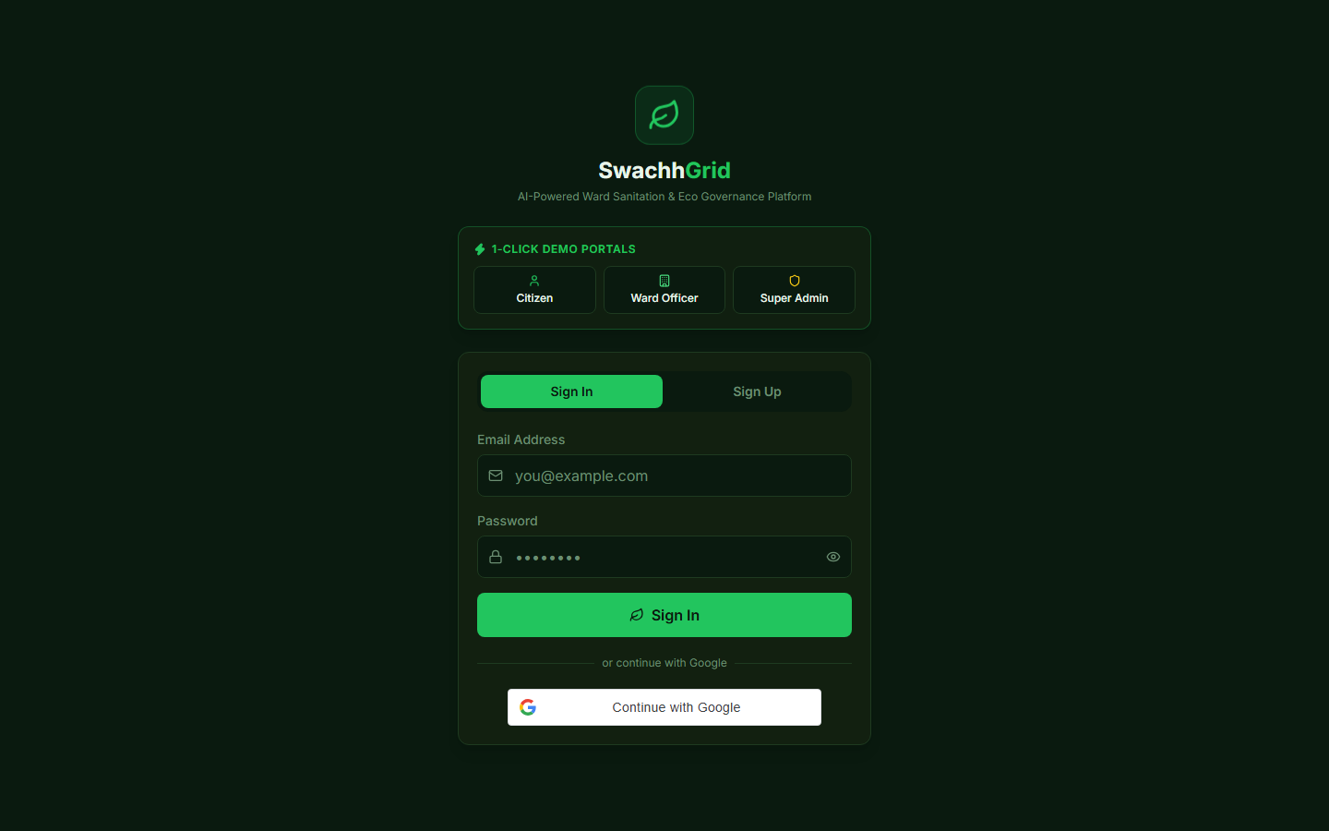
LIVE APPLICATION SHOWCASE
Live GIS Environmental Dashboard
• Geospatial Issue Mapping: Displays verified environmental issues across Lucknow municipal wards with color-coded severity markers (Red = Critical, Yellow = Moderate, Green = Resolved).
• Single-Click Filtering: Filter issues by category (Solid Waste, Sewage, Air Pollution, Hazardous Waste) or by resolution status.
• Instant Action Hub: Quick navigation to report issues, join cleanup drives, or view ward rankings.
SwachhGrid — AI Environmental Grid | Slide 5 of 15

Slide 6
GIS & REAL-TIME OPEN DATA
Live Air Quality & Environmental Telemetry
• CPCB Station Integration: Fetches live Air Quality Index (AQI), PM2.5, PM10, and NO2 metrics across monitoring stations (e.g., Talkatora, Lalbagh, Kendriya Vidyalaya).
• Dynamic Hazard Scoring: Combines AQI telemetry with citizen issue density to calculate a live Environmental Risk Index per ward.
• Public Transparency: Provides citizens and officers with immediate environmental health insights for their immediate neighborhood.
SwachhGrid — AI Environmental Grid | Slide 6 of 15

Slide 7

AI FEATURE WORKFLOW
Instant AI-Powered Incident Reporting
• Seamless Media Upload: Citizens upload or capture a photo of the environmental hazard via phone or desktop.
• Automated Geolocation: Captures exact GPS coordinates and maps the issue to the correct municipal ward automatically.
• Real-Time Classification: AI vision model processes the image in seconds, pre-filling hazard category, estimated volume, and urgency level.
SwachhGrid — AI Environmental Grid | Slide 7 of 15

Slide 8

MULTIMODAL AI VISION
Deep-Dive AI Diagnostic Audit
• Automated Severity Assessment: Classifies risk into Critical (immediate health hazard), Moderate, or Low based on visual density and proximity to water/residential areas.
• Hazard Risk Tags: Tags specific hazards like bio-medical risk, fire hazard, or water contamination potential.
• Transparent Audit History: Displays timestamps, reporter identity, upvotes, and verification status.
SwachhGrid — AI Environmental Grid | Slide 8 of 15

Slide 9
AUTOMATED CIVIC ESCALATION
Legal-Grade Municipal Letter Synthesis
• Automated Letter Drafting: Converts raw image telemetry and GPS coordinates into an official, legally structured municipal complaint letter.
• Department Routing: Automatically identifies the responsible municipal department (e.g., Lucknow Municipal Corporation Sanitation Dept) and recipient email.
• Automated Dispatch: Dispatches the letter via SendGrid API and logs delivery confirmation on the issue timeline.
SwachhGrid — AI Environmental Grid | Slide 9 of 15

Slide 10
MUNICIPAL OFFICER DASHBOARD
Empowering Municipal Enforcement
• Role-Based Admin Panel: Dedicated interface for Ward Officers (e.g., Kalyanpur Ward, Daliganj Ward) to manage incoming grievances.
• Status Lifecycle Management: Officers update issue progress in real time (Reported -> Under Investigation -> In Progress -> Resolved).
• Verification Proof: Officers upload post-cleanup resolution photos to close issues transparently.
SwachhGrid — AI Environmental Grid | Slide 10 of 15

Slide 11

COMMUNITY & GAMIFICATION
Driving Citizen Engagement & Gamification
• Community Cleanup Drives: Citizens create or join local volunteer drives for neighborhood waste collection and tree planting.
• Eco-Points & Badges: Earn points for reporting valid issues, upvoting grievances, and participating in cleanup events.
• Civic Leaderboard: Highlights top individual Eco-Citizens and cleanest municipal wards to foster healthy civic competition.
SwachhGrid — AI Environmental Grid | Slide 11 of 15

Slide 12

SECURITY & AUTHENTICATION
Secure & Accessible Authentication Architecture
• Hybrid Authentication: Supports native Google OAuth 2.0 Sign-In alongside JWT email/password authentication.
• Role-Based Access Control (RBAC): Strict separation of privileges between Eco-Citizens, Ward Authorities, and Super Admins.
• One-Click Demo Access: Integrated guest profiles allowing judges and evaluators to test all roles immediately without setup.
SwachhGrid — AI Environmental Grid | Slide 12 of 15

Slide 13
TECHNOLOGY INTEGRATION
Accelerating Engineering with IBM Bob AI
• Decoupled Architecture Generation: IBM Bob designed the entire project structure, establishing clean contracts between FastAPI and React.
• Multimodal AI Pipeline Setup: Engineered prompt templates and API connectors for LLaMA 3.2 Vision and automated letter generation.
• GIS & Open Data Scripting: Created automated scripts fetching real OpenStreetMap ward geometries and CPCB AQI data.
• Cloud Containerization & CI/CD: Wrote production multi-stage Dockerfiles and Vercel routing rules, cutting deployment time by 80%.
SwachhGrid — AI Environmental Grid | Slide 13 of 15

Slide 14
FUTURE ROADMAP
Scalability, Vision & Environmental Impact
• Short-Term Goals: Integrate WhatsApp Bot integration for reporting via simple photo messages; expand GIS mapping nationwide.
• Long-Term Vision: Deploy IoT sensors on municipal garbage vehicles for real-time bin level telemetry and automated route optimization.
• Target Impact Metrics: 70% Reduction in complaint resolution turnaround time; 100% Transparency on municipal grievance escalation; Active Civic Participation across 100+ municipal wards.
SwachhGrid — AI Environmental Grid | Slide 14 of 15

Slide 15
SUBMISSION SUMMARY
Thank You! — Experience SwachhGrid Today
Live Web Application: https://swachh-grid.vercel.app
GitHub Repository: https://github.com/IqraKhanZ/SwachhGrid
IBM Bob Tech Report: https://github.com/IqraKhanZ/SwachhGrid/blob/main/IBM_BOB_USAGE.md
Backend API Docs: https://swachhgrid-backend.onrender.com/docs
SwachhGrid — AI Environmental Grid | Slide 15 of 15

