Slide 1
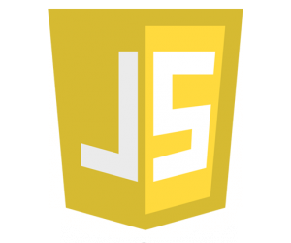
Programming Languages and Methodology
JavaScript
REN YING
#44161627-8
任颖
LAI RUJIE
#44161666-2
赖儒杰
SONG DAIWEI
#44161588-3
宋代偉

Slide 2
JavaScript
Programming Languages and Methodology
Introduction and history
REN YING
#44161627-8
01
JavaScript feature
LAI RUJIE
#44161666-2
02
03
Installation and example
SONG DAIWEI #44161588-3
2

Slide 3
How you think of JavaScript ?
high-level dynamic
untyped interpreted
Alongside HTML and CSS,
JavaScript is one of the three core technologies of
World Wide Web content production.
3

Slide 4

Java VS JavaScript
Similarity and difference
Similar Point :
language name
syntax
Difference:
JavaScript ：dynamically typed language Java : static typed language
untyped language strongly-typed language
prototype-based class-based
JavaScript was influenced by programming languages such as Self and Scheme.
4

Slide 5
JavaScript scenes
Not Web-based
PDF documents
site-specific browsers
desktop widgets.
server-side:
JavaScript virtual machines and platforms have increased the popularity of JavaScript for server-side Web applications.
client-side:
Traditionally : implement JavaScript as an interpreted language
More recent: browsers perform just-in-time compilation
5

Slide 6
Server-side JavaScript
Standardization
History
Beginnings at Netscape
Adoption by Microsoft
Later developments
In 1993, the National Center for Supercomputing Applications released the first popular graphical Web browser.
Netscape Communications wanted to create the language which complement Java and should have a similar syntax, which excluded adopting other languages such as Python, TCL, or Scheme.
6

Slide 7
Server-side JavaScript
Standardization
History
Beginnings at Netscape
Adoption by Microsoft
Later developments
Netscape introduced an implementation of the language for server-side scripting with Netscape Enterprise Server, soon after releasing JavaScript for browsers. Since the mid-2000s, there has been a resurgence of server-side JavaScript implementations.
7

Slide 8
Server-side JavaScript
Standardization
History
Beginnings at Netscape
Adoption by Microsoft
Later developments
Microsoft script technologies including JScript were released in 1996. However, it difficult for designers and programmers to make a single website work well in both browsers.
With the release of Internet Explorer 4, Microsoft introduced the concept of Dynamic HTML .
8

Slide 9
Server-side JavaScript
Standardization
History
Beginnings at Netscape
Adoption by Microsoft
Later developments
In1996, Netscape submitted JavaScript to carve out a standard specification,which led to the publishing of the first edition of the ECMA-262 standard in 1997.
The standards process：
1998：ECMAScript 2 1999：ECMAScript 3
2000：ECMAScript 4 2011： ECMAScript 5.1
2015： ECMAScript 2015 2016：ECMAScript 2016
9

Slide 10
Server-side JavaScript
Standardization
History
Beginnings at Netscape
Adoption by Microsoft
Later developments
JavaScript has become one of the most popular programming languages on the Web.
The advent of Ajax returned JavaScript improve JavaScript programming practices and increased usage of JavaScript outside Web browsers.
The rise of single-page applications and JavaScript-heavy sites are used as a compile target for source-to-source compilers.
10

Slide 11
JavaScript
Programming Languages and Methodology
01
Introduction and history
REN YING
#44161627-8
JavaScript Feature
LAI RUJIE
#44161666-2
02
Installation and example
SONG DAIWEI #44161588-3
03
11

Slide 12
Core JavaScript
Imperative & Structured
Dynamic
Prototype-based
Functional
12

Slide 13
Core JavaScript
Imperative & structured
JavaScript supports much of the structured programming syntax from C (e.g., if statements, while loops, switch statements, do while loops, etc.).
Like C, JavaScript makes a distinction between expressions and statements.
One syntactic difference from C is automatic semicolon insertion, which allows the semicolons that would normally terminate statements to be omitted.
13

Slide 14
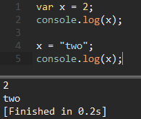
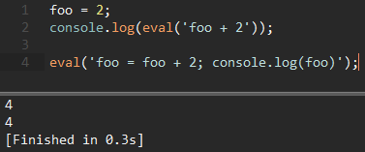
Core JavaScript
Dynamic
Typing
JavaScript is dynamically typed; a type is associated with each value, rather than just with each expression.
Run-time Evaluation
JavaScript includes an eval function that can execute statements provided as strings at run-time.
14

Slide 15
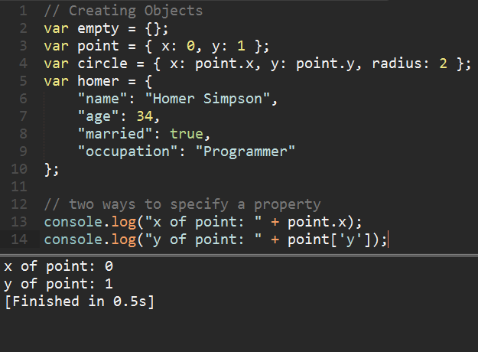
Core JavaScript
Prototype-based
Object-based
JavaScript is almost entirely object-based. In JavaScript, an object is an associative array, augmented with a prototype.
Each string key provides the name for an object property, and there are two syntactical ways to specify such a name: dot notation (obj.x = 10) and bracket notation
(obj['x'] = 10).
15

Slide 16
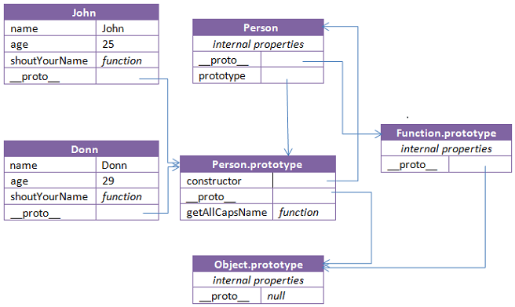
Core JavaScript
Prototype-based
Prototypes
JavaScript uses prototypes where many other object-oriented languages use classes for inheritance.
It is possible to simulate many class-based features with prototypes in JavaScript.
16

Slide 17
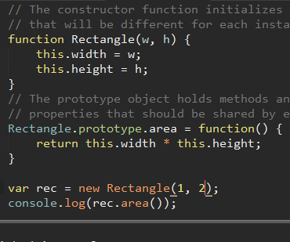
Core JavaScript
Prototype-based
Functions as object constructors
Functions double as object constructors, along with their typical role.
Prefixing a function call with new will create an instance of a prototype, inheriting properties and methods from the constructor (including properties from the Object prototype).
17

Slide 18
Core JavaScript
Prototype-based
Functions as methods
Unlike many object-oriented languages, there is no distinction between a function definition and a method definition.
Rather, the distinction occurs during function calling; when a function is called as a method of an object, the function's local this keyword is bound to that object for that invocation.
18

Slide 19
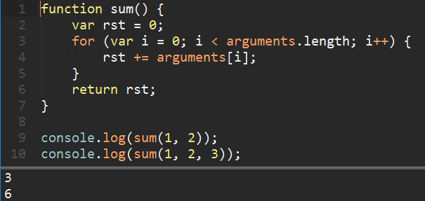
Core JavaScript
Functional
A function is first-class;
a function is considered
to be an object.
Variadic functions
An indefinite number of parameters can be passed to a function. The function can access them through formal parameters and also through the local arguments object.
19

Slide 20
Core JavaScript
Functional
JavaScript supports functional programming such as anonymous functions, high-order function, closure, etc.
Anonymous function: a function definition that is not bound to an identifier.
Higher-order function: a function that does at least one of the following:
· takes one or more functions as arguments
· returns a function as its result
Closure: technique for implementing lexically scoped name binding in languages with first-class functions.
20

Slide 21
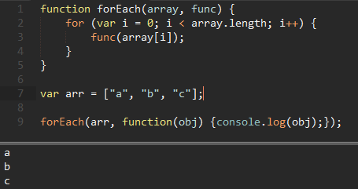
Core JavaScript
Functional
Example:
forEach is a higher-order function with func as a function argument.
The instance of func is an anonymous function.
21

Slide 22
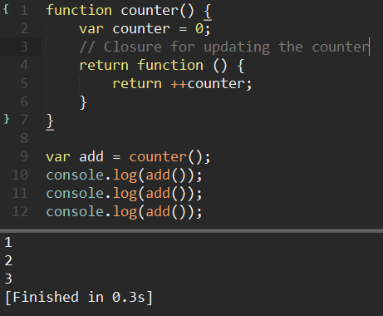
Core JavaScript
Functional
Example:
Closure is used to realize a counter. Thus the value of the local variable counter can be only be changed by invoking the function.
22

Slide 23
Client-side Javascript
BOM
DOM
Event-driven
23

Slide 24
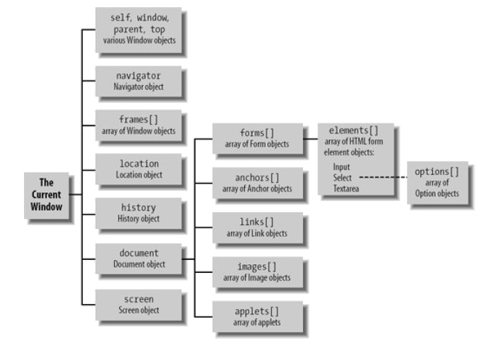
Client-side JavaScript
BOM
Browser Object Model (BOM)
is a browser-specific convention referring to all the objects exposed by the web browser.
The window object is the global object in client-side programming, as the global execution context.
24

Slide 25
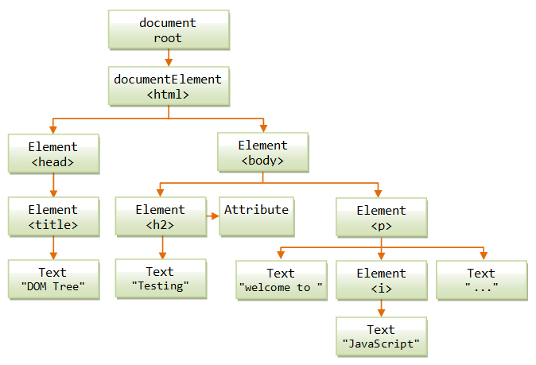
Client-side JavaScript
DOM
Document Object Model (DOM)
is a cross-platform and language-independent application programming interface that treats an HTML, XHTML, or XML document as a tree structure wherein each node is an object representing a part of the document.
25

Slide 26
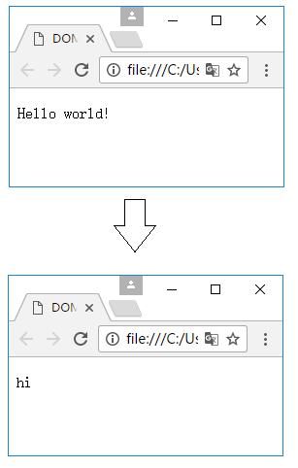
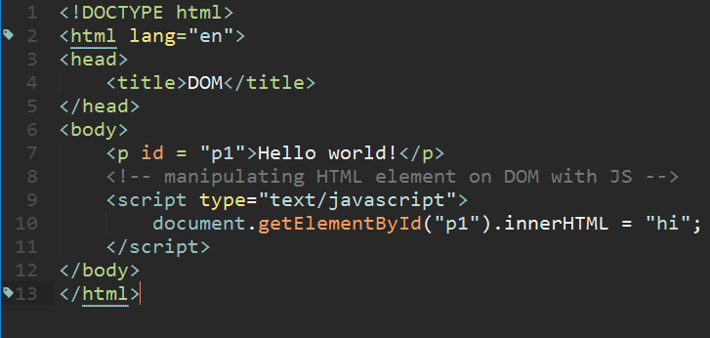
Client-side JavaScript
DOM
Example:
To change the text of the p element
26

Slide 27
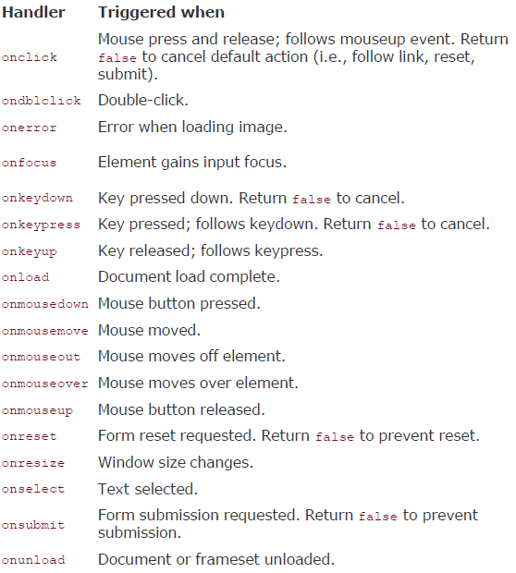
Client-side JavaScript
Event-driven
Event-driven programming is a programming paradigm in which the flow of the program is determined by events such as user actions (mouse clicks, key presses).
JavaScript contains various handlers to deal with different types of events generated by different occurrences.
27

Slide 28

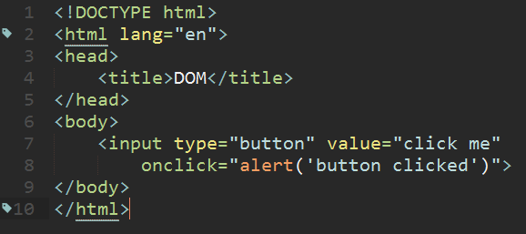
Client-side JavaScript
Event-driven
Example:
The function of alert is driven by the event onclick of the button.
28

Slide 29
JavaScript
Programming Languages and Methodology
Introduction and history
REN YING
#44161627-8
01
JavaScript Feature
LAI RUJIE
#44161666-2
02
Installation and example
SONG DAIWEI #44161588-3
03
29
Notes:
Ok, it is my turn to introduce the installation and examples for JavaScript

Slide 30
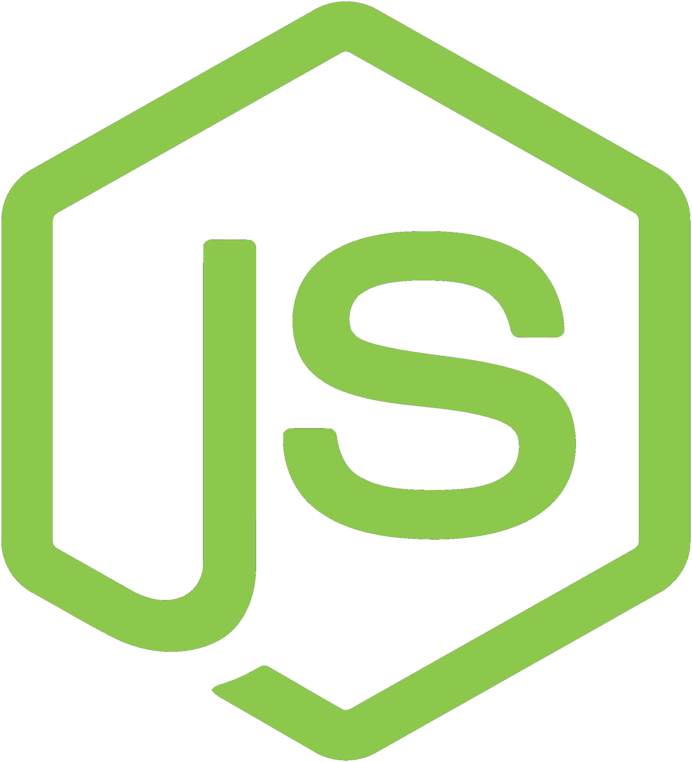
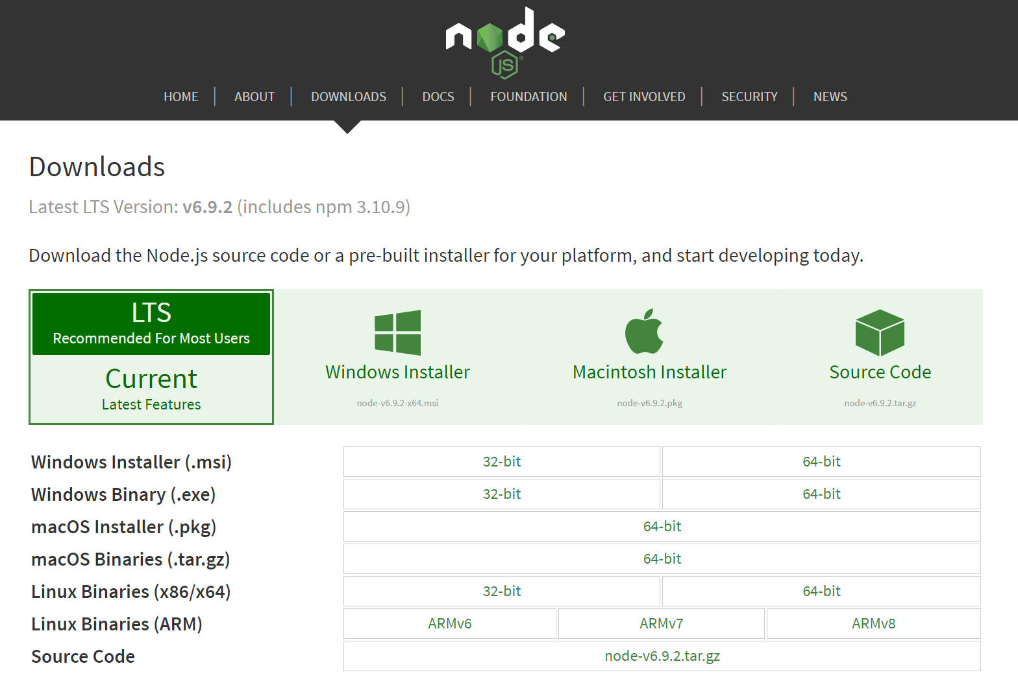
Installation and examples
JavaScript
Web browser
Node.js
Node.js is an open-source, cross-platform JavaScript runtime environment for development
npm : node package management
Download website: https://nodejs.org/
30
Notes:
It is mentioned that the JavaScript can run on both web browser and server.
But we have not learned HTML so I will introduce Node.js which is an open source, cross platform runtime environment. Because of its NPM - node package management, it becomes more and more popular. You could download the node.js in this website.

Slide 31
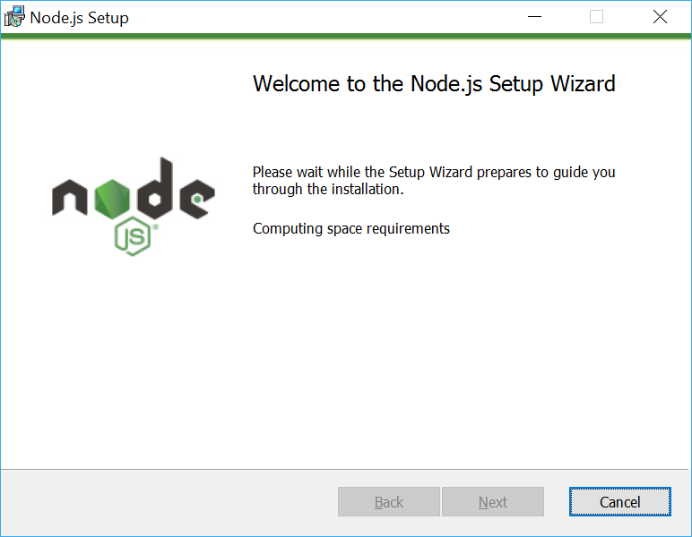
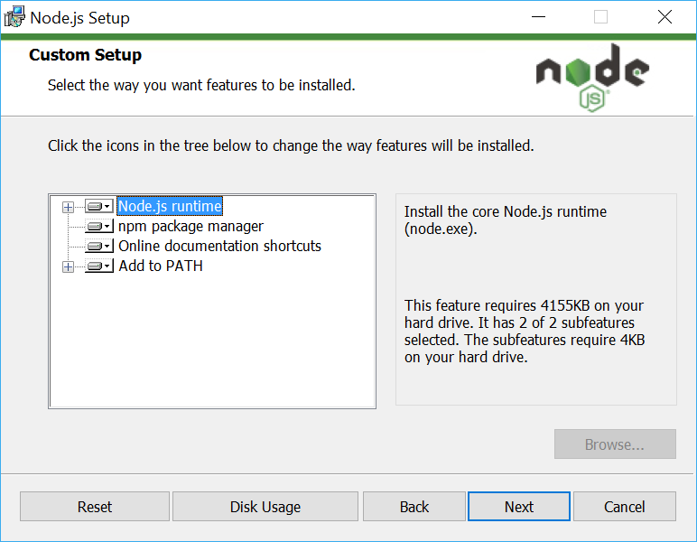
Installation
We add the node.js to environment variables
So we could set up it in terminal.
31
Notes:
When you set up the installation execution, you just need to click next net and finish. It is really simple. The program will add the node.js to the environment variables,

Slide 32
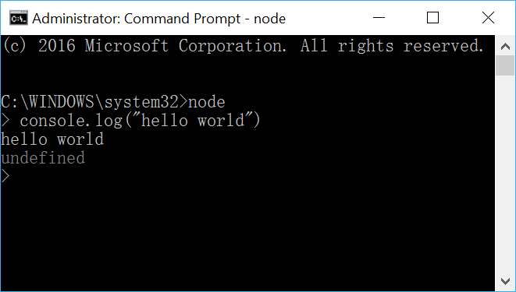
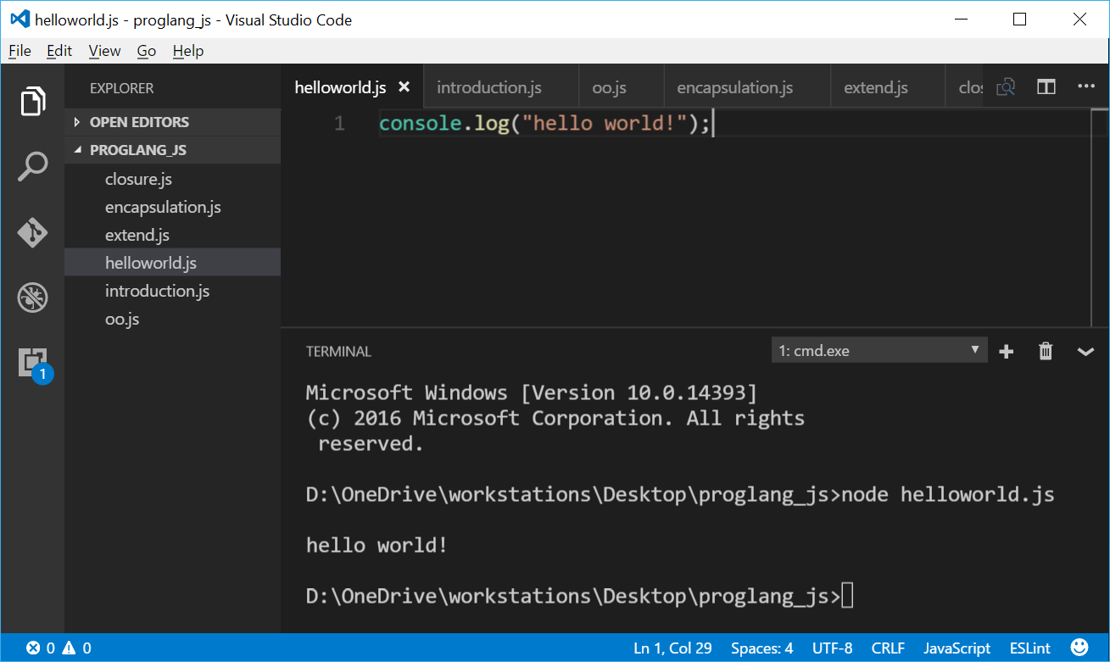



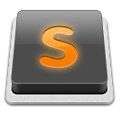

Editor and
runtime environment
Command / PowerShell / Terminal
NotePad++
Atom
Visual Studio Code
WebStorm
Sublime Text 3
32
Notes:
so that we could set it up in terminal, command or PowerShell.
Then, we should use one kind of editors to edit the js file. I prefer to this one VSCode.

Slide 33
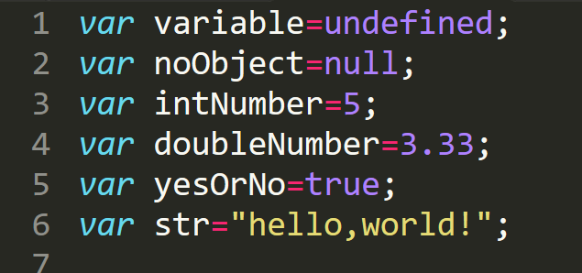
Basic data types
undefined
There should be a value but we have not defined it.
null
There should not be a value.
Object
number
boolean
string
33
Notes:
Js is a week-type programming language. There is five simple data types, undefined, null, number, Boolean and string. There is no double or float. And one complex type - object, which is the father of all simple types.
This is the statement of many variables. Just add a VAR before the name of variable.

Slide 34
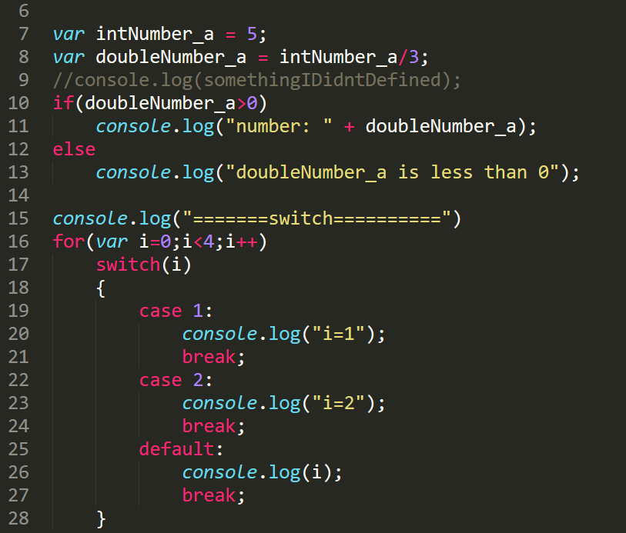
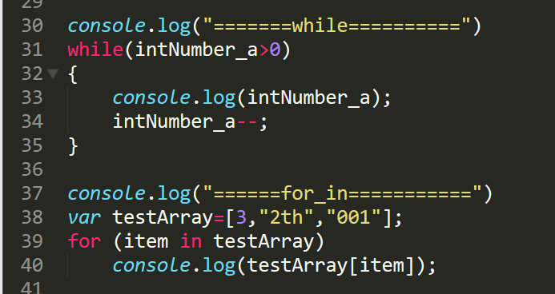
Control statement
Loop
Conditional
34
Notes:
ok let’s go to the control statements.
Look at the conditional statement, if switch, they are really similar with the grammar of CPP, many people have learned it.
And the loop statement, we can use "for from I is equal to 0 to number 4.
And while, for in foreach to enumerate every element in an array.

Slide 35
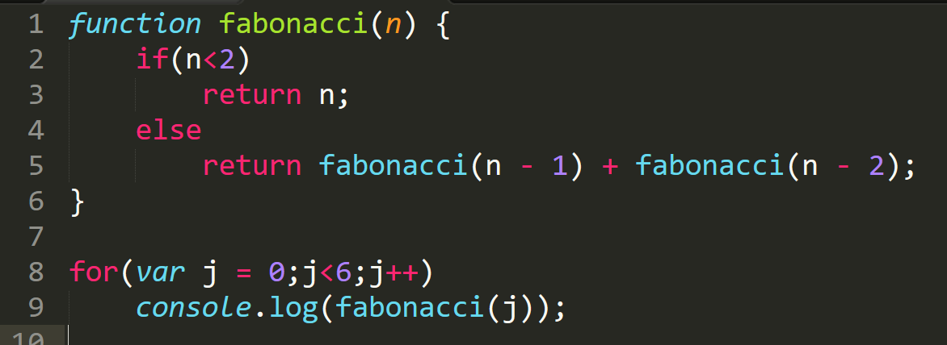
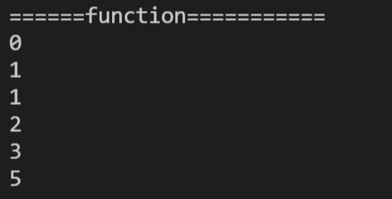
How to define a function
Fibonacci function
Output:
35
Notes:
And how to define a function, we just need to statement a function and return value.
This is Fibonacci function.

Slide 36
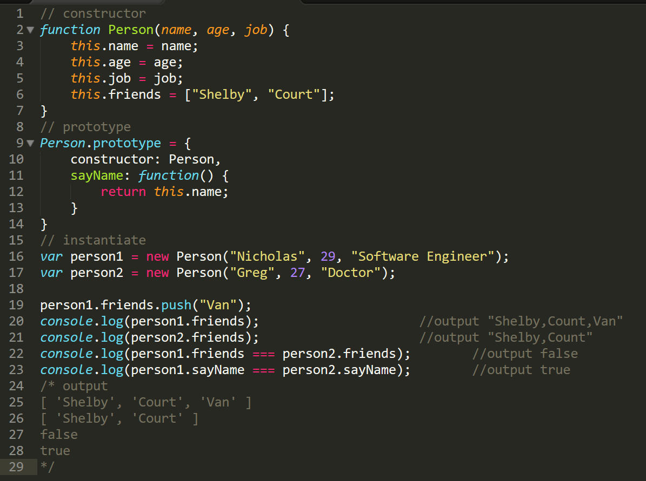
How to implement a class
using closure and anonymous function
36
Notes:
As is known to all, JavaScript is a kind of object-oriented programing language. If you want to implement inheritance, encapsulation, and polymorphic, you should use anonymous function and closure, but they are difficult for beginner, so I
Here is its constructor. And we use prototype to define its member.
Here is the instantiation. We declare an example and output its property.

Slide 37
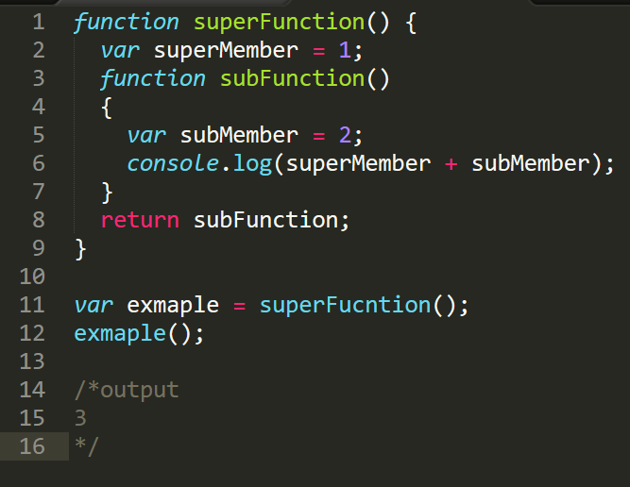
Closure
A simple example of a closure
The subFuction quotes the variable of super function.
And superFunction returns the subFunction.
The reference to the variable in superFunction is the state of the variable after the superFunction has finished running.
How to use the state of the runtime?
Add self-implementation to the function expression
37
Notes:
How about closure, which is really important in JavaScript. In a word, closure means that sub function calls the member of super function. And the super function returns the sub function.
Look at this simple example. The sub function calls the member of supper function.
And we should pay attention that the reference to the variable in super function is the state after the super function has finished running.
If you want to use the state of the runtime, you should add self-implementation to the function expression. Talk is cheap. Show me the code.

Slide 38
THANK YOU.
ありがとうございます！
Presented by
REN YING
#44161627-8
任颖
LAI RUJIE
#44161666-2
赖儒杰
SONG DAIWEI
#44161588-3
宋代偉

