Slide 1
POWERPOINT TEMPLATE
Example Text: This is an Unique PowerPoint Presentation can be used for business or personal purpose.
01
POWERPOINT
You can change the font, font size, color, space on the Home tab. Title, number etc.
02
POWERPOINT
You can change the font, font size, color, space on the Home tab. Title, number etc.
03
installation and example
SONG DAIWEI #44161588-3

Slide 2

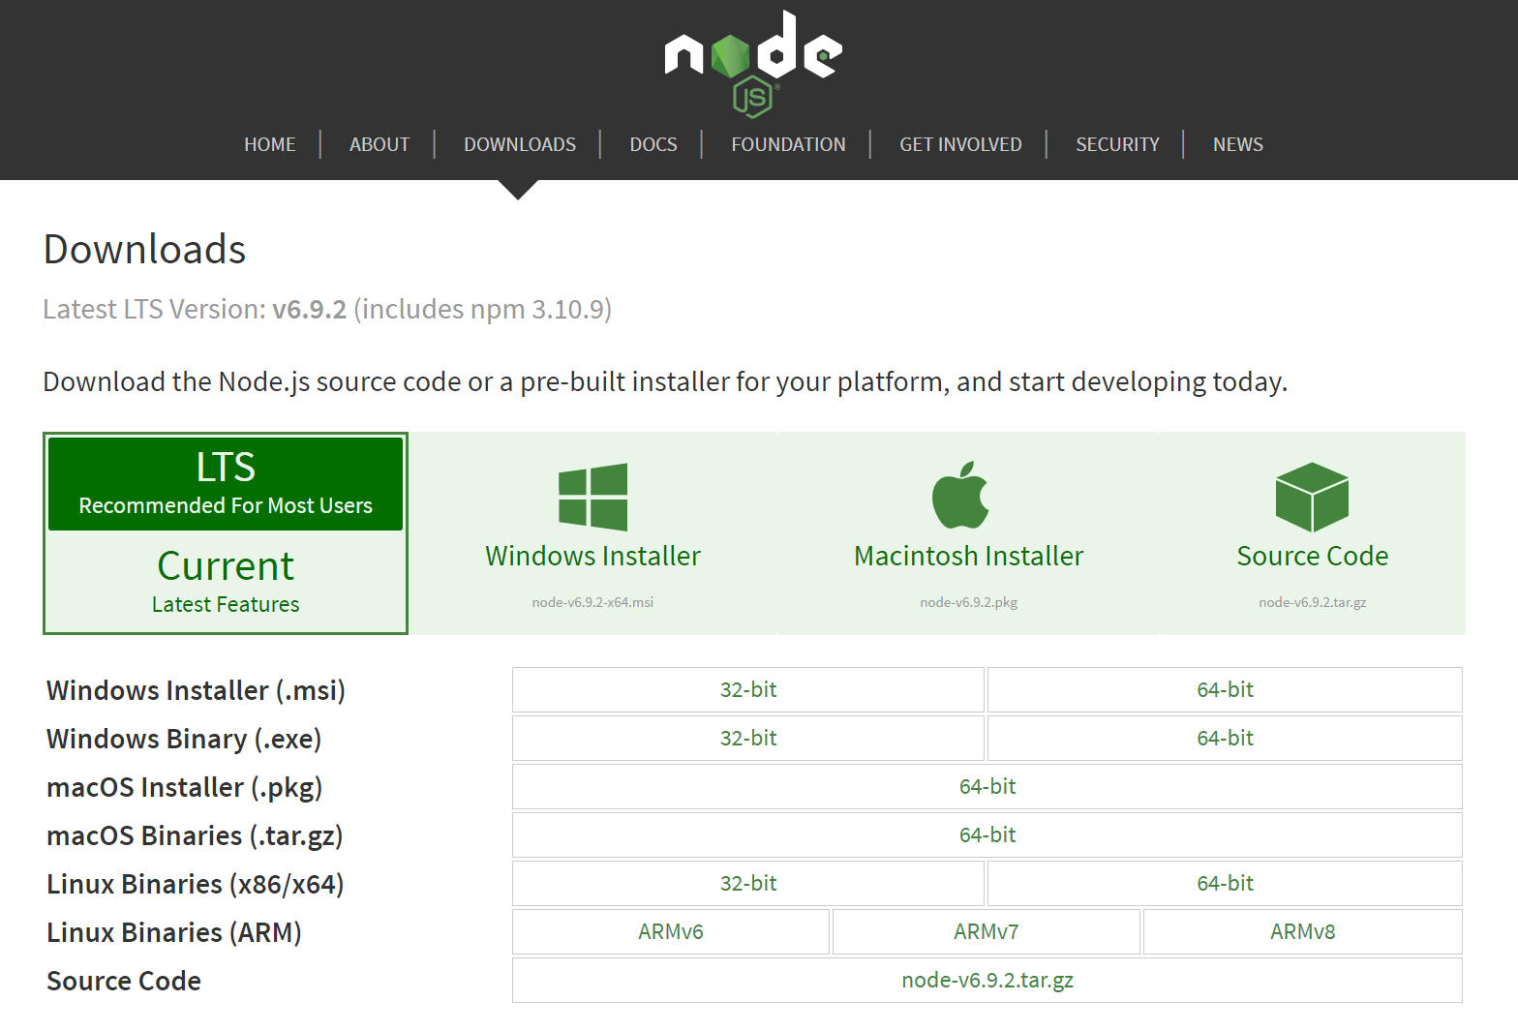
Installation and examples
Example Text: This is an Unique PowerPoint Presentation can be used for business or personal purpose.
JavaScript
Web browser
Node.js
Node.js is an open-source, cross-platform JavaScript runtime environment for development
npm : node package management
Download website: https://nodejs.org/

Slide 3
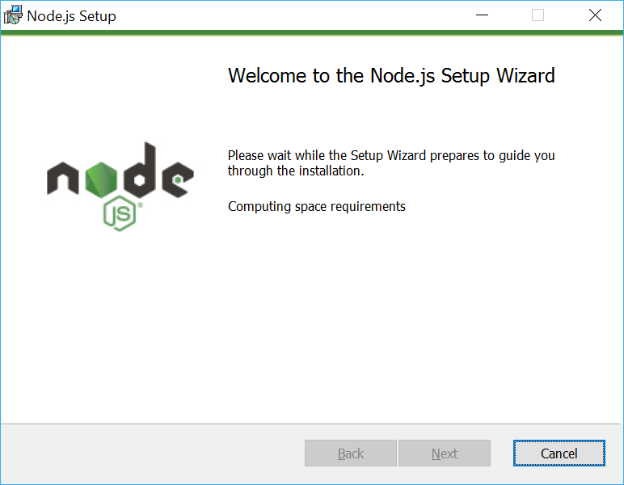
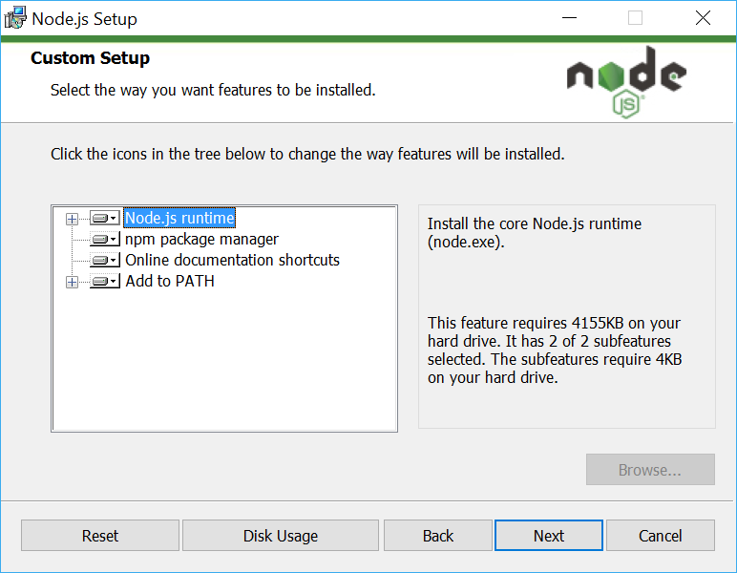
Installation
We add the node.js to environment variables
So we could set up it in terminal.

Slide 4
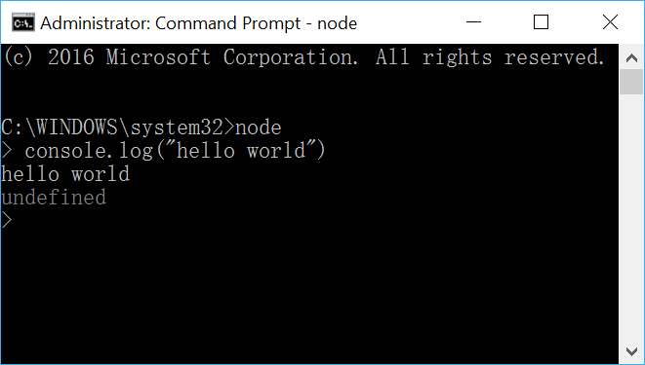
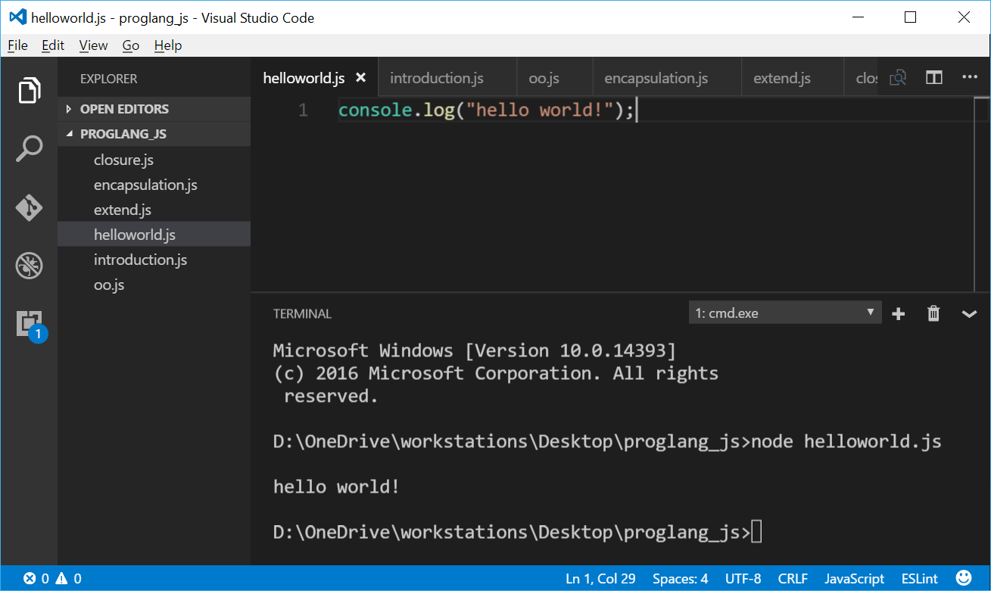





Editor and
runtime environment
Command / PowerShell / Terminal
NotePad++
Atom
Visual Studio Code
WebStorm
Sublime Text 3

Slide 5
Basic data types
undefined:
There should be a value but we have not defined it.
Object
string
undefined
null
boolean
number
null:
There should not be a value.

Slide 6
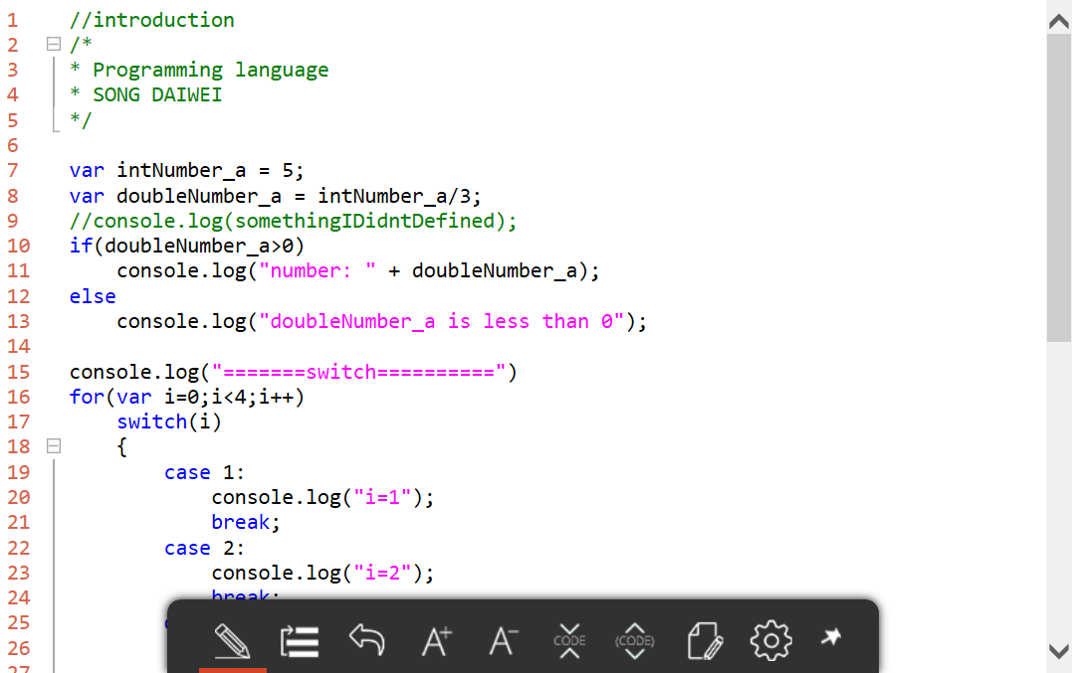
Control statement
if
if…else…
switch(){case …: }
for
for (… in …)
while

Slide 7
Features
GC
OO
anonymous
function
closure
garbage collection
object oriented programming
inheritance encapsulation polymorphic
nested function
to realize OO and closure
Notes:
Nested function , the inner function can use all the variables of the outer function, even if the outer function has been executed.

Slide 8
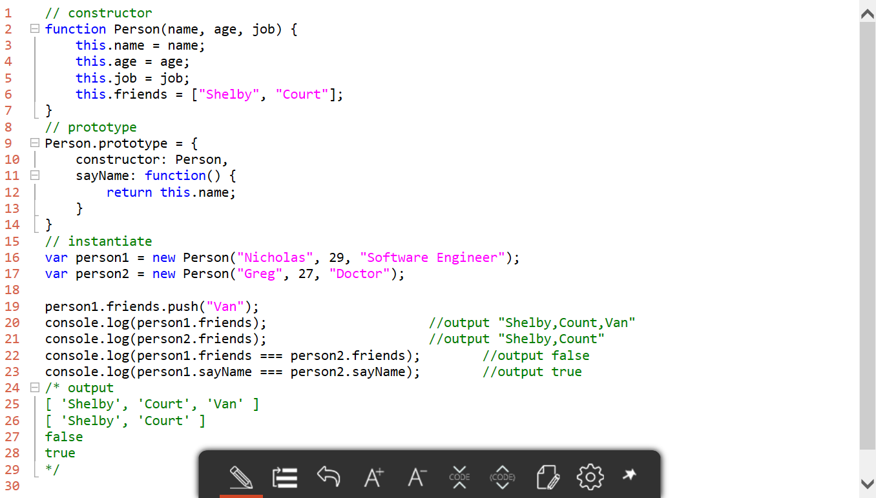
How to implement a class
using closure and anonymous function

Slide 9
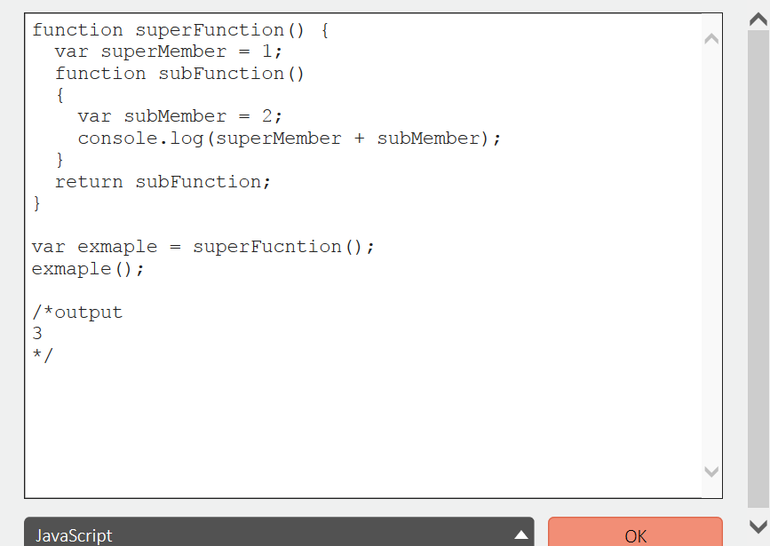
Closure
A simple example of a closure
The subFuction quotes the variable of super function.
And superFunction returns the subFunction.
The reference to the variable in superFunction is the state of the variable after the superFunction has finished running.
how to use the state of the runtime?
we add self-implementation to the function expression

Slide 10
THANK YOU.

