Slide 1
Rental carE commerce website

Slide 2
Introduction
This document provides a focused overview of the user workflow and technical processes for the Rental Car E-Commerce website. Key User Workflow Homepage: Users browse rental cars with filters for category, price range, and rental duration. Car Details: Users view car details like name, category, price, features (e.g., GPS, Hybrid), and availability.

Slide 3
Adding to Cart: Users add cars to the cart after signing in or registering. Checkout Process: Users review cart details, choose rental periods, and make payments. Post-Booking: Booking confirmation, payment, and shipment tracking are provided.

Slide 4
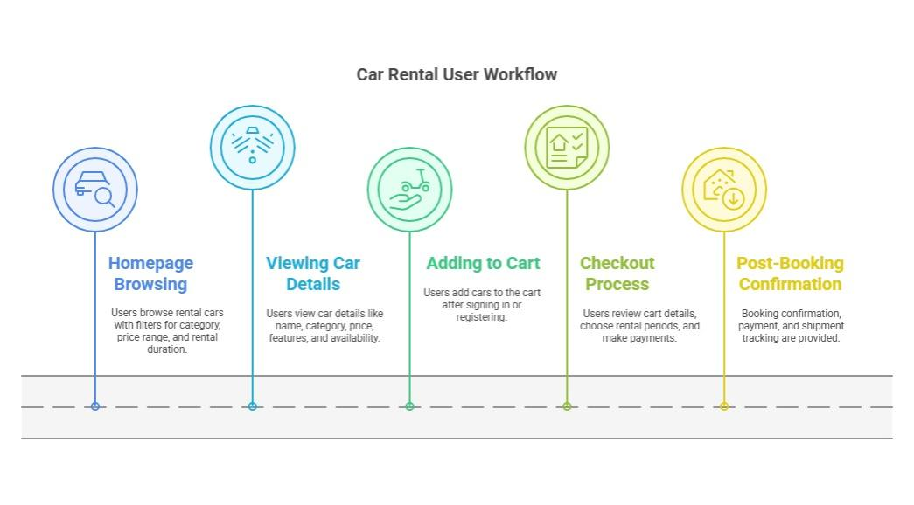

Slide 5
Backend Workflow Sanity CMS: Stores car details, bookings, and customer data. Payment Gateway: Processes secure payments and saves transaction details. Shipment Tracking: Updates car status to “Booked” and provides delivery updates.

Slide 6
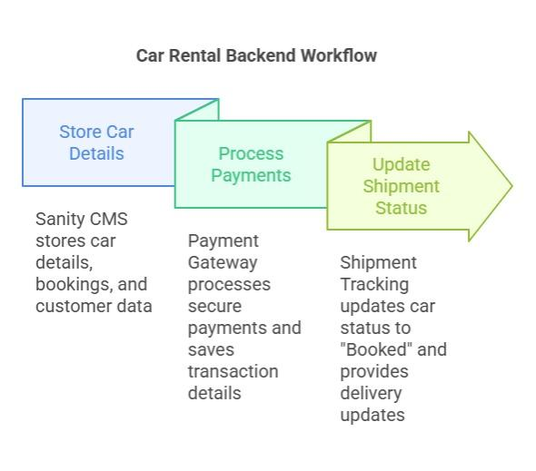

Slide 7
System Architecture Overview: Frontend: User interface built with React/Next.js. Handles browsing, booking, and user interactions. Sanity CMS: Manages all car-related and customer data. APIs: Includes payment, shipment tracking, and car availability services.

Slide 8
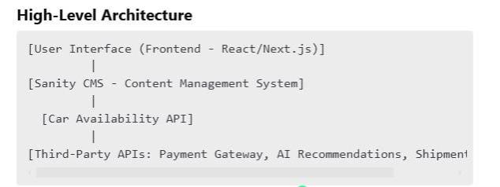

Slide 9
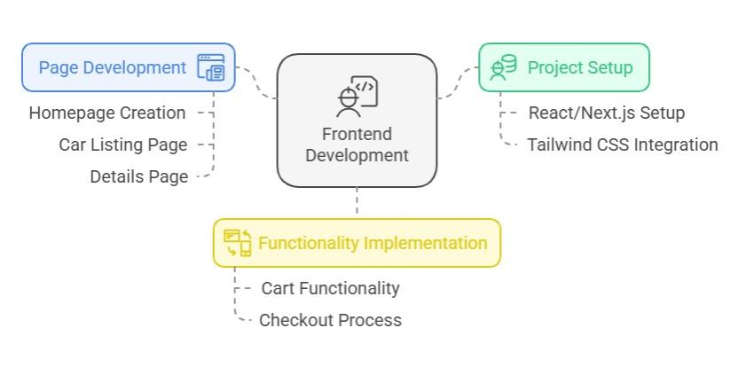

Slide 10
Technical Roadmap
Frontend Setup React/Next.js project with Tailwind CSS. Build homepage, car listing, and details pages. Create cart and checkout functionality.

Slide 11
Backend
Configure Sanity CMS schemas for cars and bookings. Integrate APIs for car availability, payments, and shipment. Deployment Test user workflows and API endpoints. Deploy to platforms like Vercel or Netlify.

Slide 12
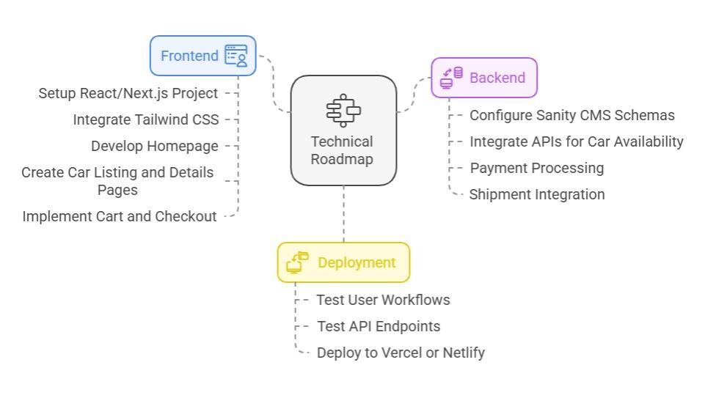

Slide 13
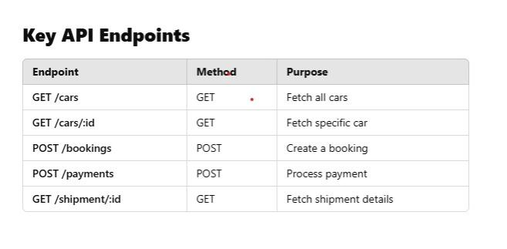

Slide 14
Sanity Schema Examples Cars Schema : export default { name: ‘car’, type: ‘document’, fields: [ { name: ‘name’, type: ‘string’, title: ‘Car Name’ }, { name: ‘price’, type: ‘number’, title: ‘Price’ }, { name: ‘availability’, type: ‘boolean’, title: ‘Availability’ },

Slide 15
Customer Schema : export default { name: ‘customer’, type: ‘document’, fields: [ { name: ‘name’, type: ‘string’, title: ‘Customer Name’ }, { name: ‘email’, type: ‘string’, title: ‘Email Address’ }, { name: ‘phone’, type: ‘string’, title: ‘Phone Number’ }, { name: ‘address’, type: ‘string’, title: ‘Address’ }, { name: ‘drivingLicense’, type: ‘string’, title: ‘Driving License Number’ },

Slide 16
Conclusion This document provides a concise roadmap for implementing a user-friendly and scalable Rental Car E-Commerce platform.

