Slide 1
M
MindHx
Notice the signal. Keep the human.
An early-detection mental-health triage aid that fuses voice, language, and validated clinical
questionnaires into one explainable risk signal - private by default, bilingual in English and Urdu.
Next.js 16 · FastAPI · Qwen / DashScope · PHQ-9 / GAD-7 / K10 · English + Urdu
Presented by Iqra Nazir & Faizan Arshad

Slide 2
AGENDA
What we'll cover.
01 The objective and the problem
02 Why this matters for Pakistan
03 The product - screenshots and functionality
04 Urdu language - the core of MindHx's accessibility mission
05 Technical architecture and endpoints
06 Quality, testing, and safety design
07 Roadmap and future possibilities
08 Team and closing
MindHx
02

Slide 3
01 / OBJECTIVE
Lower the barrier to a first screening step.
Depression, anxiety, and related conditions are frequently under-screened, especially where access to mental-health professionals is limited and stigma discourages self-report. MindHx's objective is a private, low-friction check-in that surfaces a risk signal a person can act on.
Multimodal, not single-signal
Voice, text, and three validated questionnaires fused into one explainable score with a real per-signal attribution breakdown.
Route, don't diagnose
Risk-tier language throughout, never diagnostic. Crisis signals short-circuit everything and go straight to Emergency Support.
Minimal data, accounts optional
The core check-in never requires an account. Audio is processed and discarded. Only score/band/themes are ever saved.
MindHx
03

Slide 4
01 / INTRODUCTION — WHY MINDHX MATTERS
MindHx matters because mental health screening is still hard and expensive to access, especially in a country like Pakistan where psychiatrists are scarce and social stigma keeps people from speaking up.
It combines three signals at once - how someone sounds, what they say, and validated PHQ-9, GAD-7, K10 questionnaires - into one clear score with a breakdown of what contributed to it.
Rather than a formal diagnosis, it assesses the severity of the situation and underlying risk factors by detecting themes like grief, trauma, suicide risk, anxiety, depression, and pain, and uses this to route elevated risk straight to a professional. If something like self-harm comes up, it redirects to emergency support immediately, before any score is even shown.
Signing in is optional, only for people who want their check-in history saved, and even then only the score and general themes are stored, never a transcript or written answers. Audio itself is always deleted right after processing. It also works fully in Urdu and English, making it usable locally rather than just another English-only app.
MindHx
04

Slide 5
02 / WHY THIS MATTERS FOR PAKISTAN
A screening gap that is structural, not incidental.
Access: Pakistan has one of the world's lowest psychiatrist-to-population ratios - widely cited estimates put it under 500 psychiatrists for a population of 240+ million, concentrated in major cities.
Stigma: seeking mental-health help is often read as personal weakness or family shame, especially outside urban centers.
Language: Urdu is the national language and lingua franca, yet most digital mental-health tools are English-only - quietly excluding the people most likely to need them.
Cost and distance: a first appointment often requires travel, time off work, and a fee just to find out if it's worth pursuing further.
MindHx is built directly against these four barriers: private and free to try, no account required, fully bilingual, and paired with a verified directory of Pakistani providers.
MindHx
04

Slide 6
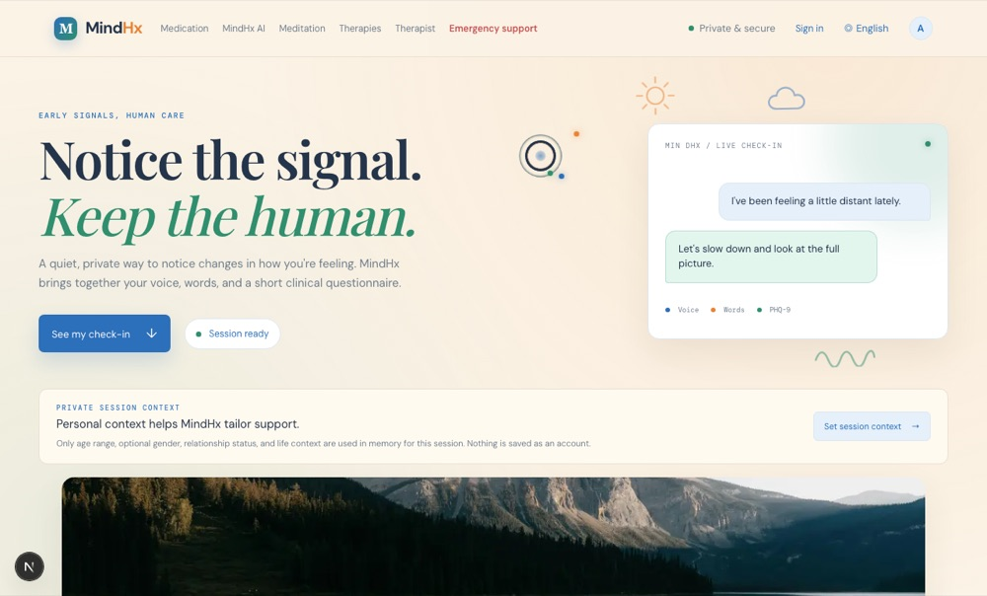
03 / THE PRODUCT
Voice, words, and a short clinical
questionnaire - in one flow.
Home / check-in - a live combined-signal preview
MindHx
06

Slide 7
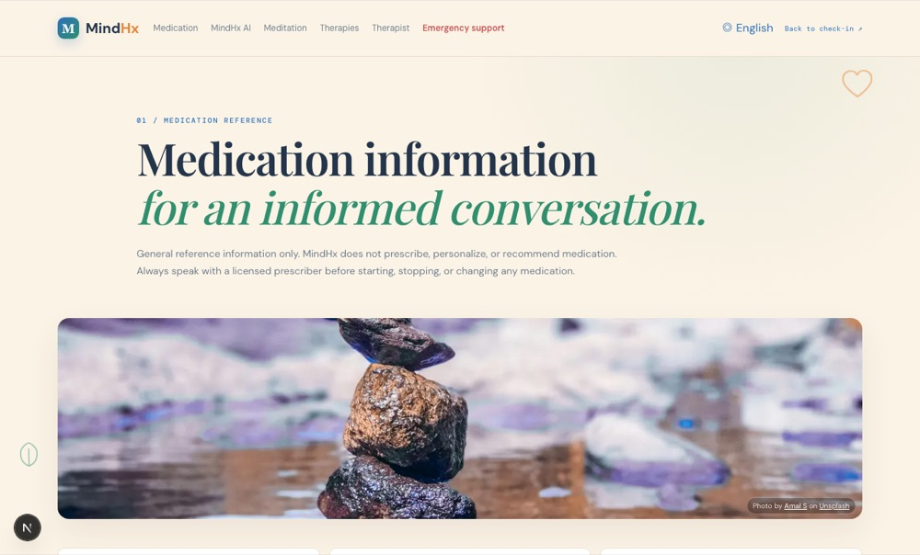
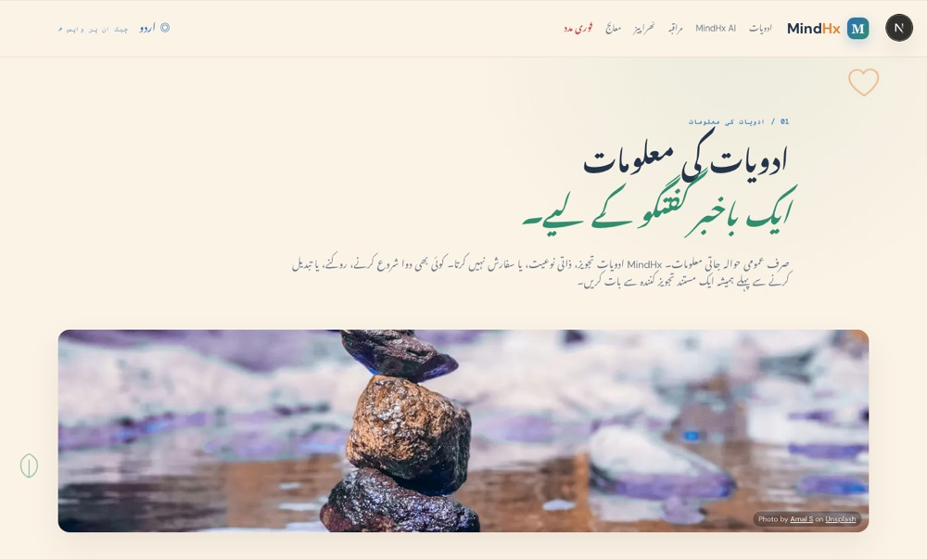
03 / THE PRODUCT
Medication reference —
general education, in both languages.
Medication reference — English
Medication reference — Urdu
MindHx
07

Slide 8
03 / THE PRODUCT
How the combined score is calculated
Each signal - acoustic, linguistic, and clinical - is scored independently first, then combined into one weighted estimate using an additive model. Each term's share in the final number is the real, mathematically exact contribution, not an approximation.
3
FUSED SIGNALS
27
PHQ-9 MAX
21
GAD-7 MAX
50
K10 MAX
MindHx
08

Slide 9
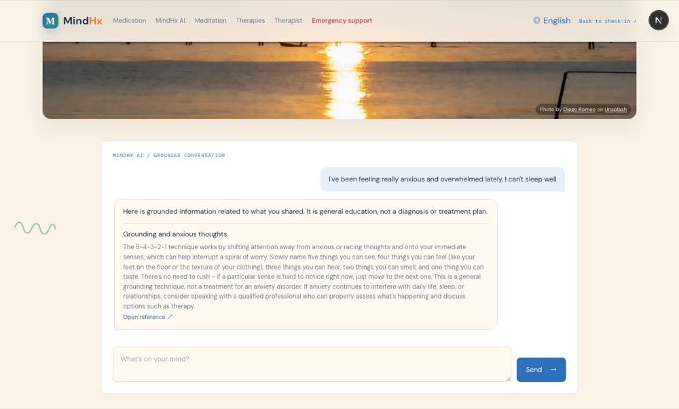
03 / THE PRODUCT
MindHx AI - a real grounded reply,
not a canned demo.
A live exchange, answered from the reviewed reference library
MindHx
09

Slide 10
04 / THE AI CHATBOT — EVERYDAY SUPPORT
A middle ground between doing
nothing and seeing a professional
MindHx also includes an AI chatbot built for everyday stress, anxiety, and burnout - the kind of thing most people never bring up with anyone. It only answers from a fixed, reviewed set of information, so there is no risk of unsafe advice.
Most people here never see a professional for smaller issues like poor sleep, work pressure, or daily anxiety. Through the chatbot they get simple meditation techniques and basic therapy approaches right away - no appointment, no waiting.
It fills a middle ground. Not a replacement for real treatment, but not leaving someone with nothing either. If the conversation turns serious, it stops and redirects to emergency support instead of continuing.
MindHx
10

Slide 11
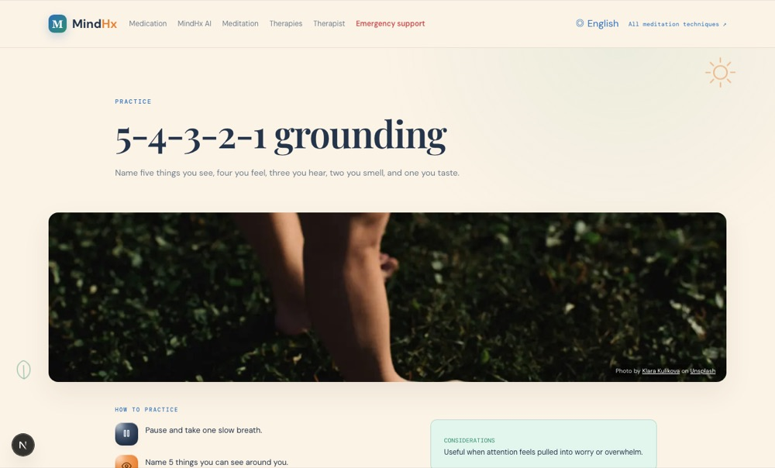
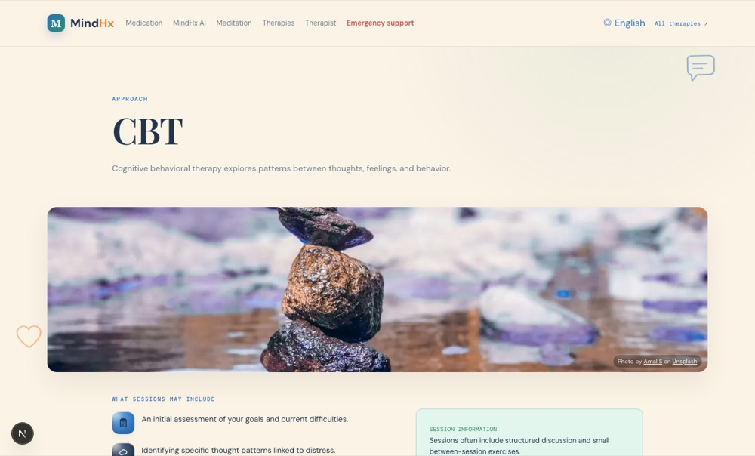
03 / THE PRODUCT
A practice library with
step-by-step 3D icons.
5-4-3-2-1 grounding - original 3D step icons
CBT - what sessions may include
MindHx
11

Slide 12
05 / THERAPY APPROACHES
There is more than
one path to support.
APPROACH
CBT
Cognitive behavioral therapy explores patterns between thoughts, feelings, and behavior.
APPROACH
DBT
Dialectical behavior therapy teaches emotion regulation, distress tolerance, and interpersonal skills.
APPROACH
Exposure therapy
A clinician-guided approach for some anxiety and fear responses.
APPROACH
Trauma-informed therapy
A safety-led approach that respects pacing, choice, and control.
APPROACH
Medical review
Primary-care or psychiatric review can consider physical contributors, sleep, medicines, and safety.
APPROACH
Peer support groups
Structured groups where people with similar experiences share support under trained facilitation.
Discuss treatment with a professional →
MindHx
12

Slide 13
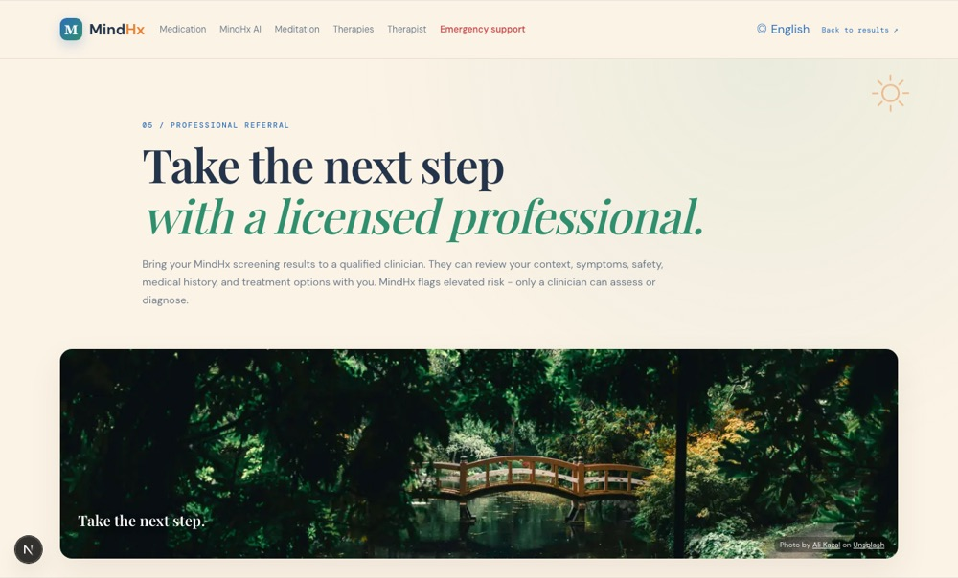
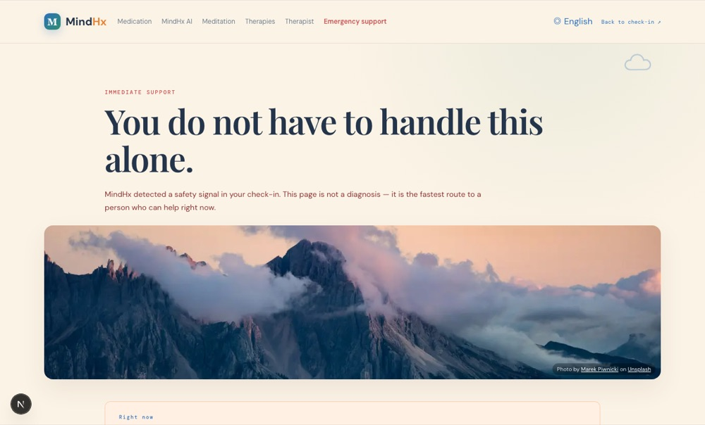
03 / THE PRODUCT
From a private check-in
to a real next step.
Verified Pakistan therapist directory
Emergency support
MindHx
13

Slide 14
05 / FINDING A THERAPIST
Take the next step
with a licensed professional.
Bring your MindHx screening results to a qualified clinician. They can review your context, symptoms, safety, medical history, and treatment options with you. MindHx flags elevated risk - only a clinician can assess or diagnose.
WHAT TO SAY: "I completed a mental-health screening and would like a professional evaluation." Use a regulated local provider directory, hospital service, university clinic, or established telehealth provider in your country.
BEFORE THE APPOINTMENT: Keep your PHQ-9, GAD-7, K10 results, text/voice explanation, current medicines, and questions ready if you choose to share them.
MindHx does not book appointments or provide emergency care.
MindHx
14

Slide 15
05 / FINDING A THERAPIST — FIND A PROFESSIONAL IN PAKISTAN
Search by city — known institutions (Karachi example)
A starting point for finding psychiatrists and psychologists in Pakistan. This is not exhaustive and not an endorsement - confirm credentials and details yourself.
NGO / COMMUNITY CLINIC
Karwan-e-Hayat, Institute for Mental Health Care
Psychiatric treatment, psychological services, and rehabilitation care.
PUBLIC HOSPITAL
Civil Hospital Karachi — Dept. of Psychiatry
Psychiatric inpatient, outpatient, and acute care for adults, adolescents, and children.
PRIVATE HOSPITAL
Karachi Psychiatric Hospital, Quaidabad
General psychiatric hospital with outpatient consultation.
MindHx
15

Slide 16
05 / FINDING A THERAPIST — LIVE DOCTOR DIRECTORIES
More reliable than a static list
These platforms maintain current, verified individual psychiatrist and psychologist profiles with fees, reviews, and booking - more reliable than a static list for finding an individual provider.
oladoc.com
Psychiatrists → Psychologists →
Marham.pk
Psychiatrists → Psychologists →
MindHx does not verify real-time availability, fees, or credentials for any listing above. Confirm details directly with the provider before booking.
MindHx
16

Slide 17
06 / CORE FOCUS
Urdu Language
Not a translation layer -
a core requirement.
The single most important design decision in MindHx: built bilingual from the ground up.
MindHx
17

Slide 18
06 / URDU LANGUAGE
Why Urdu, and why it had to be
built in, not bolted on.
Every page - the check-in itself, the AI chat, the therapist directory - exists in both English and Urdu, switchable with a single tap, with the entire layout correctly mirroring for Urdu's right-to-left script. A screening tool available only in English quietly excludes most of the people who might actually need it in a country where Urdu is the lingua franca.
- Header-level toggle on every page - Full RTL layout mirroring - Server-side Urdu-script safety guard
MindHx
18

Slide 19
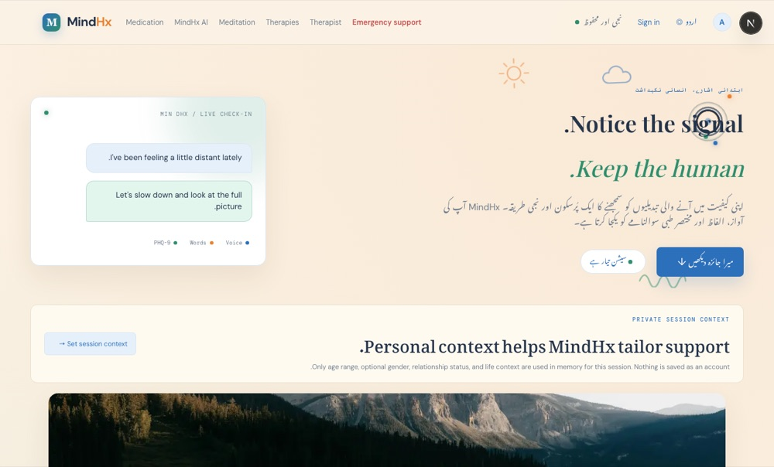
06 / اردو (URDU, RTL)
آہستہ چلیں۔ اشارے کو محسوس کریں۔
Home / check-in - fully mirrored Urdu layout
MindHx
19

Slide 20
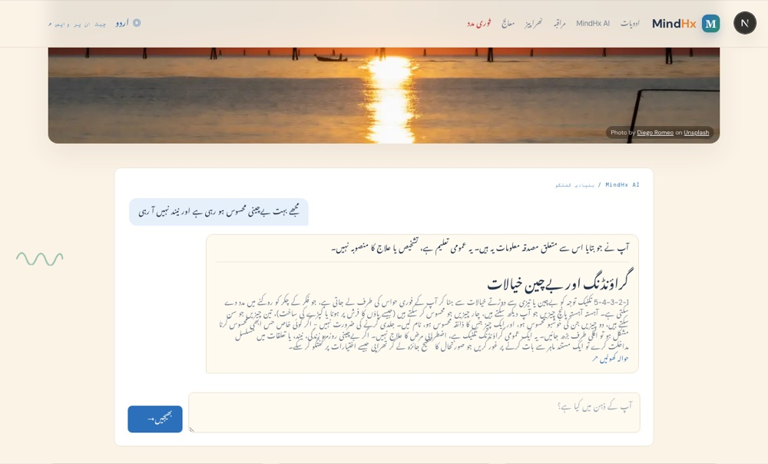
06 / اردو (URDU, RTL)
MindHx AI - ایک حقیقی اردو گفتگو
The same RAG chatbot, live, replying entirely in Urdu
MindHx
20

Slide 21
06 / AI چیٹ بوٹ — اردو میں
MindHx کے اندر ایک AI چیٹ بوٹ بھی شامل ہے جو روزمرہ کے عام ذہنی دباؤ، پریشانی اور تھکن جیسے مسائل میں فوری رہنمائی فراہم کرتا ہے۔
یہ چیٹ بوٹ آزادانہ طور پر کچھ بھی نہیں بناتا بلکہ صرف پہلے سے طے شدہ اور محفوظ معلومات کی بنیاد پر جواب دیتا ہے، تاکہ کوئی غلط یا خطرناک مشورہ نہ دیا جائے۔
پاکستان میں زیادہ تر لوگ چھوٹے موٹے ذہنی مسائل جیسے نیند کی کمی، کام کا دباؤ، گھریلو ذمہ داریوں کا بوجھ یا روزمرہ کی بے چینی کے لیے کسی ماہر کے پاس نہیں جاتے۔ اس چیٹ بوٹ کے ذریعے ایسے لوگوں کو سادہ مراقبے کی تکنیکیں اور بنیادی تھراپی کے طریقے فوری طور پر مل جاتے ہیں، بغیر کسی اپائنٹمنٹ یا انتظار کے۔
MindHx
21

Slide 22
06 / AI چیٹ بوٹ — اردو میں (جاری)
مثال کے طور پر اگر کسی کو نیند نہیں آ رہی یا ذہنی تناؤ محسوس ہو رہا ہے، تو وہ فوراً سانس لینے کی مشقیں، ذہنی سکون کی تکنیکیں یا سادہ طرزِ عمل تھراپی کے مشورے حاصل کر سکتا ہے۔
یہ خاص طور پر ان لوگوں کے لیے مفید ہے جو یہ سمجھتے ہیں کہ ان کا مسئلہ اتنا بڑا نہیں کہ ڈاکٹر کے پاس جایا جائے، مگر پھر بھی روزمرہ زندگی متاثر ہو رہی ہوتی ہے۔ اس طرح یہ چیٹ بوٹ ایک درمیانی درجے کی مدد فراہم کرتا ہے۔ نہ تو یہ طبی علاج کا متبادل ہے اور نہ ہی صارف کو بغیر رہنمائی کے چھوڑتا ہے۔
اگر کبھی بات زیادہ سنگین ہو جائے، جیسے خودکشی کے خیالات ظاہر ہوں، تو چیٹ بوٹ فوراً بات چیت روک کر صارف کو ایمرجنسی سپورٹ کی طرف بھیج دیتا ہے۔ اس طرح MindHx صرف ایک سکریننگ ٹول نہیں بلکہ روزمرہ کی ذہنی صحت کی دیکھ بھال کا ایک عملی ساتھی بھی بن جاتا ہے، خاص طور پر اس ملک میں جہاں تھراپی تک رسائی محدود اور مہنگی ہے۔
MindHx
22

Slide 23
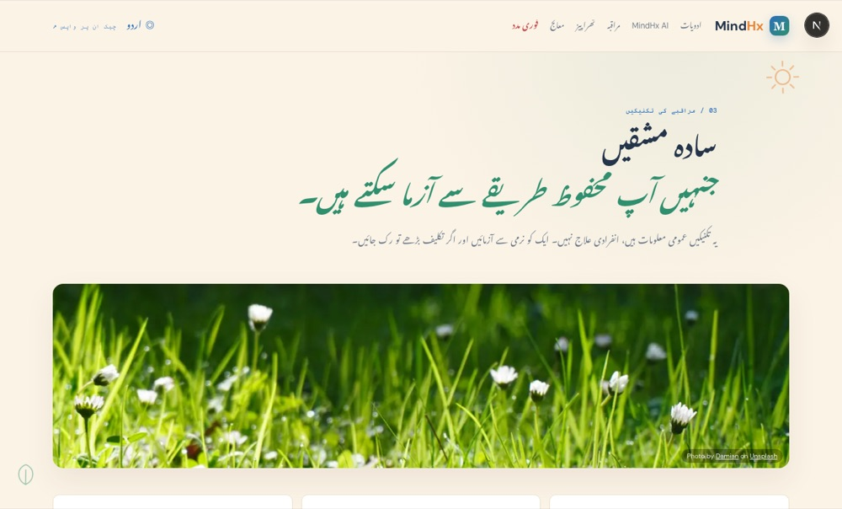
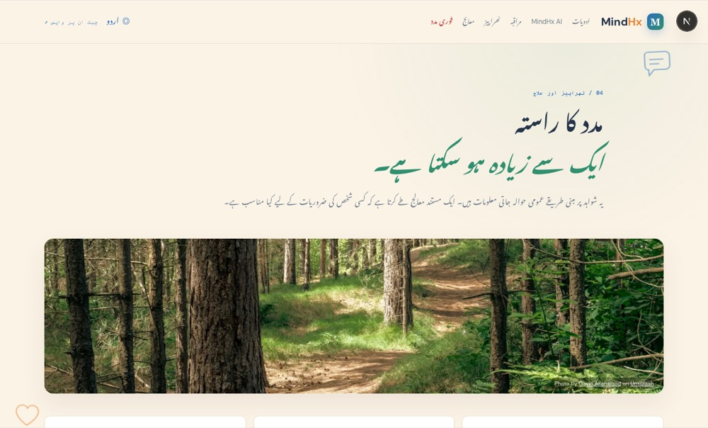
06 / اردو (URDU, RTL)
مراقبے کی تکنیکیں اور تھراپیز
مراقبے کی تکنیکیں
تھراپیز
MindHx
23

Slide 24
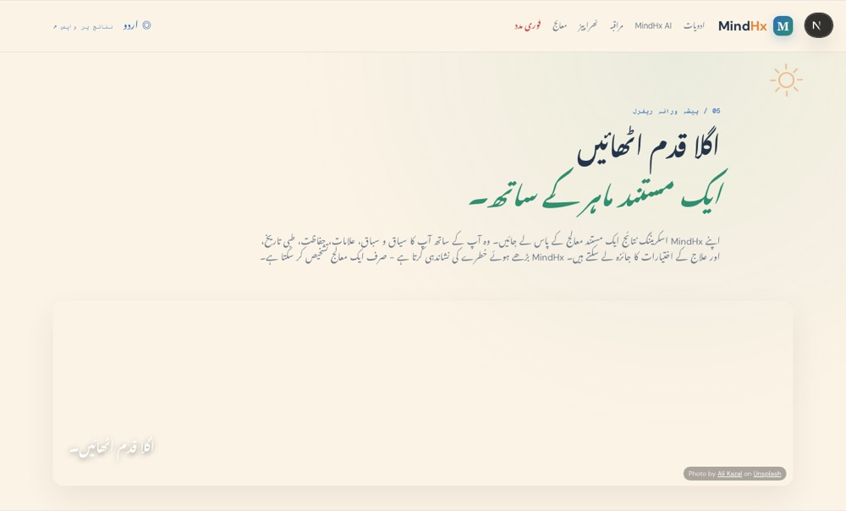
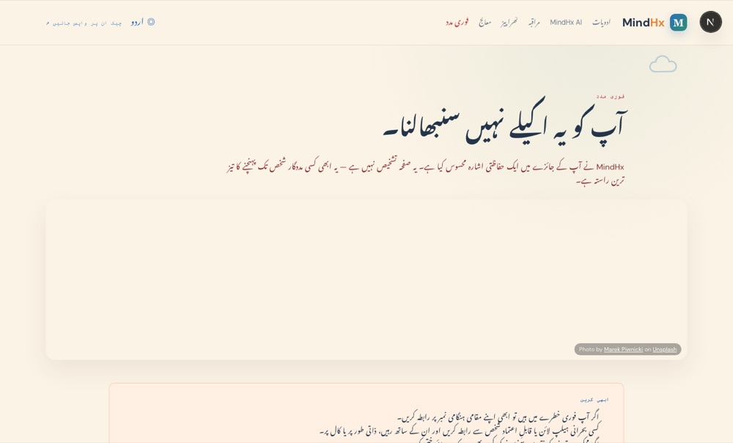
06 / اردو (URDU, RTL)
معالج تلاش کریں اور فوری مدد
معالج تلاش کریں
فوری مدد
MindHx
24

Slide 25
06 / URDU LANGUAGE - TECHNICAL SAFETY
Defense in depth: never show an
English reply when Urdu was requested.
The AI's system prompt instructs Qwen to reply in the requested language - but LLMs don't always comply. MindHx adds a server-side guard, is_urdu_script(), that checks the letter composition of any generated reply. If Urdu was requested and the reply reads as English, it is discarded and replaced with the guaranteed-correct deterministic Urdu template.
if language == "ur" and not is_urdu_script(result["message"]):
return None # fall back to the verified-Urdu template
MindHx
25

Slide 26
06 / URDU LANGUAGE - BEING HONEST
A careful draft, not a validated
instrument - and we say so.
The Urdu translation of PHQ-9, GAD-7, and K10 is a careful draft for this session, not a licensed clinical instrument - stated plainly on-screen whenever Urdu is active. Item 9 (self-harm ideation) is safety-critical in the validated instrument; shipping an unlicensed translation as clinical-grade would be irresponsible.
The roadmap is explicit: partnering for a properly validated Urdu instrument is the single highest-leverage localization gap remaining.
MindHx
26

Slide 27
07 / FUNCTIONS
Everything the app actually does.
CORE
SUPPORT
Voice, text, and PHQ-9/GAD-7/K10 check-in with a live combined-signal preview
Explainable per-signal attribution on the results page
Crisis short-circuiting straight to Emergency Support
Bounded, source-grounded AI chat with interactive exercises
Meditation and therapy libraries with original 3D step icons
Verified Pakistan therapist/psychiatrist directory, city by city
Full English/Urdu bilingual UI, everywhere
Optional accounts for saved check-in history
MindHx
27

Slide 28
08 / TECHNICAL ARCHITECTURE
Two services. Stateless by default.
A Next.js 16 (App Router) frontend and a FastAPI backend. The screening/risk-assessment endpoints are fully stateless - every request self-contained, nothing persisted. An optional layer adds PostgreSQL-backed accounts purely for people who choose to save history.
20
BACKEND ENDPOINTS
12
FRONTEND ROUTES
23
BACKEND TESTS
2
LANGUAGES
MindHx
28

Slide 29
08 / TECHNICAL ARCHITECTURE
Selected backend endpoints
Endpoint | Purpose
POST /analyze-voice | Heuristic prosodic signal - pluggable via VOICE_BIOMARKER_PROVIDER
POST /analyze-text | Sentiment + crisis detection - Qwen -> OpenRouter -> heuristic fallback
POST /ai/chat | Bounded, source-grounded chat; safety-gated; Urdu-script guard on replies
POST /risk-assess | Fuses all signals into the combined score, band, and routing decision
POST /score-phq9, /score-gad7, /score-k10 | Individual validated-questionnaire scoring
POST /auth/register, /auth/login | Optional account creation/sign-in - bcrypt + JWT
POST /synthesize | Urdu text-to-speech via Uplift AI
MindHx
29

Slide 30
08 / QUALITY & SAFETY DESIGN
Verified, not assumed.
TESTED
SAFE
23 backend tests: crisis short-circuiting, bilingual chat, risk-fusion math, account flow
Type-checked and linted on every change - tsc --noEmit, eslint
Real screenshot QA in both English and Urdu, not assumed from code
Defense in depth: crisis re-check and Urdu-script guard both discard unsafe output
MindHx
30

Slide 31
09 / ROADMAP
What's built - and what's
deliberately not.
BUILT
NOT YET BUILT - DELIBERATELY
Voice + text + PHQ-9/GAD-7/K10 fused into one explainable score
Bounded AI chat with a hard safety gate, English and Urdu
Original 3D step-icon library across every page
Real Pakistan therapist/psychiatrist directory
Full site SEO - per-page metadata, sitemap, structured data
Score calibration - no labeled outcome data yet
Clinically validated Urdu PHQ-9/GAD-7/K10 - demo-only today
Real acoustic biomarker vendor - heuristic proxy today
Auth hardening - rate-limiting, httpOnly cookies pending
MindHx
31

Slide 32
09 / FUTURE POSSIBILITIES
Where this goes from here.
- A validated Urdu instrument would unlock real clinical deployment in Urdu-speaking settings.
- Score calibration via real outcome data (Platt scaling / isotonic regression).
- A real acoustic biomarker vendor to replace today's heuristic voice proxy.
- Deeper Alibaba Cloud integration - Function Compute, OSS-backed caching.
- More regional languages (Punjabi, Pashto, Sindhi) using the same bilingual architecture.
MindHx
32

Slide 33
09 / TEAM
Built by
Iqra Nazir
MindHx
Faizan Arshad
MindHx
IN
FA
MindHx
33

Slide 34
MindHx
Notice the signal.
Keep the human.
MindHx is a screening and triage aid, not a diagnosis. Every score is a starting point for a conversation with a qualified professional - never a replacement for one.

