Slide 1
Building a Tic-Tac-Toe AI using the Minimax Algorithm
By Ali Raza
Course: Introduction to AI

Slide 2
Introduction
Minimax is a decision-making algorithm for two-player games.
Used in Tic-Tac-Toe, Chess, Checkers.
One player maximizes score while the other minimizes it.
Helps computers plan and make optimal moves.

Slide 3
How Minimax Works
Explores all possible moves and outcomes.
Assumes both players play optimally.
Maximizing player tries to get highest score.
Minimizing player tries to reduce opponent’s score.

Slide 4
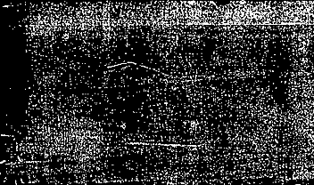
Scoring System
AI Wins → +10
Tie → 0
Human Wins → -10

Slide 5
Minimax Pseudocode
function minimax(board, depth, isMax):
if game over: return score
if isMax:
best = -inf
for move in moves:
make move
best = max(best, minimax(board, depth+1, False))
undo move
return best
else:
best = +inf
for move in moves:
make move
best = min(best, minimax(board, depth+1, True))
undo move
return best

Slide 6
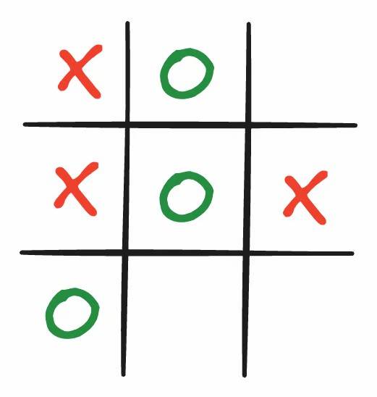
Tic-Tac-Toe Board Example
A simple 3x3 grid representing the game state.
AI ('X') and Human ('O') take alternate turns.
Each empty cell represents a potential move.

Slide 7
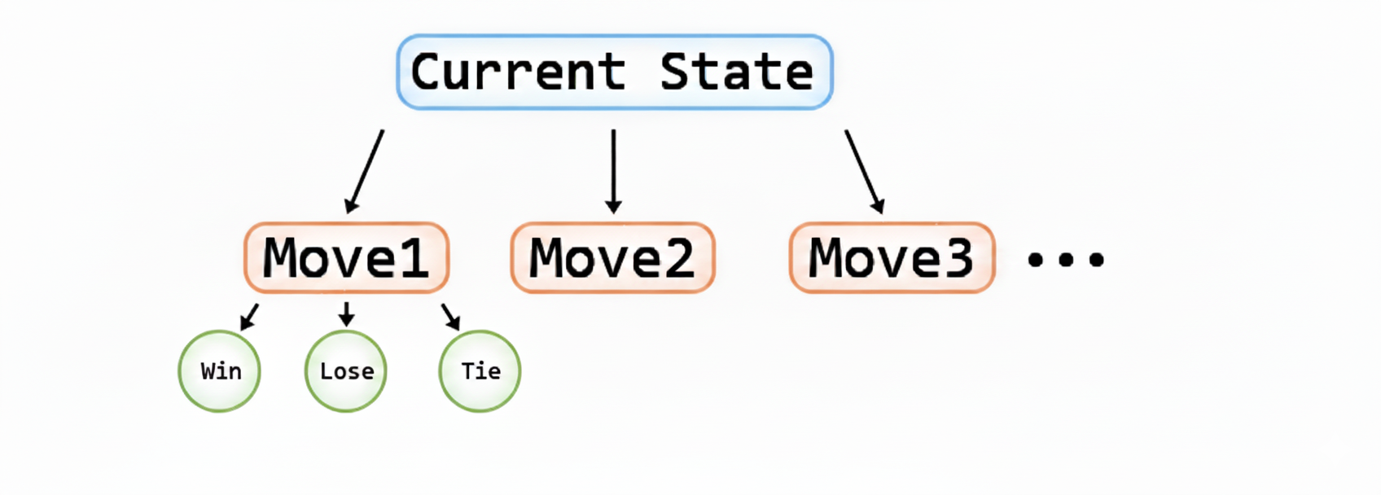
Game Tree Visualization
Root = current board state.
Branches = possible moves.
Leaves = final outcomes (Win/Lose/Tie).
Minimax explores all paths to choose the optimal one.

Slide 8
AI Decision Flow
AI (Max) → Human (Min) → AI (Max)... recursively.
Maximizer aims to maximize score.
Minimizer aims to minimize opponent's score.
The recursion continues until terminal state.

Slide 9
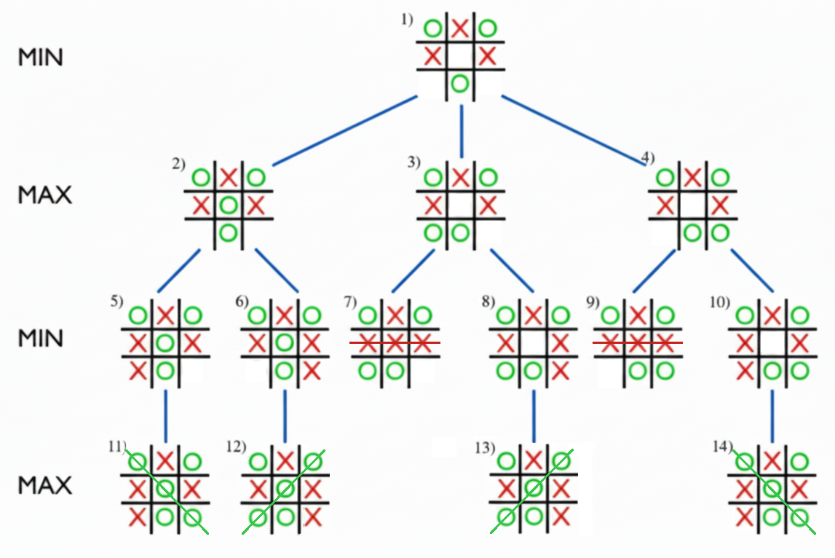
AI Decision Flow

Slide 10
Alpha-Beta Pruning
α = best value that Maximizer can guarantee.
β = best value that Minimizer can guarantee.
Prune branches when α ≥ β.
→ Skips unnecessary calculations to speed up search.

Slide 11
Optimization Tips
• Use Alpha-Beta Pruning to skip redundant nodes.
• Limit recursion depth for complex games.
• Use heuristic evaluation functions for large trees.

Slide 12
Complexity Analysis
Time Complexity: O(b^m)
Space Complexity: O(bm)
Efficient for small games like
Tic-Tac-Toe.

Slide 13
Learning Outcomes
Explain the Minimax Algorithm.
Implement recursive game tree search.
Build a playable Tic-Tac-Toe AI.
Understand optimization techniques.

Slide 14
Conclusion
Minimax is the foundation of modern AI decision-making.
Helps computers reason about optimal strategy.
Builds intuition for Game Theory and AI Planning.

Slide 15
Thank You

Slide 16
Practice
Implement Tic-Tac-Toe AI using Minimax.
Add Alpha-Beta Pruning optimization.
Visualize the game tree

Slide 17
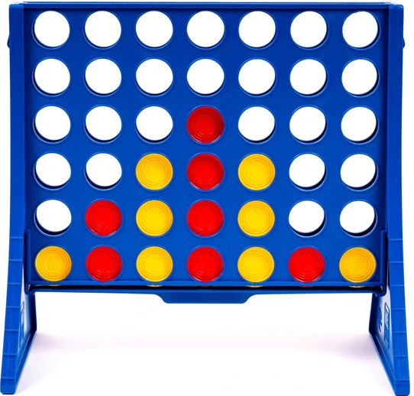
Assignment
Implement Minimax on Connect Four game
Add Alpha-Beta Pruning optimization.
Visualize the game tree

