Slide 1

DHAAGA
She shouldn't have to be the one who presses the button.
A smarter approach to women's safety.
The idea: A journey becomes a Thread. Each check-in becomes a Knot. When a Knot is missed, help moves closer.
Team AUREX · Iqra Sanadi · Isra Shaikh
Notes:
Open with the core shift: safety should not depend on a woman finding and pressing a panic button at exactly the right moment. Dhaaga turns an ordinary journey into a responsive Thread, with Knots that make support progressively closer when a check-in is missed.
1

Slide 2
THE PROBLEM
One Button Is Not Enough
  The moment of risk: she may be unable to reach her phone, open an app and press SOS.
  The alert problem: one-press apps either need that press, or alert everyone at once and teach people to ignore them.
  The privacy problem: contacts often have to install an app, and location is shared all the time, not just when it matters.
WHO IT'S FOR
Women travelling alone: late cabs, walks home, first-time meetings.
Her circle: friends and family who may be the first to help, and need to know what to do.
Notes:
Target users are women travelling alone and the people in her circle. The problem is not that apps lack a panic button. It is that a button needs her to act at the worst moment, and one-size alerts either miss her or cry wolf.

Slide 3
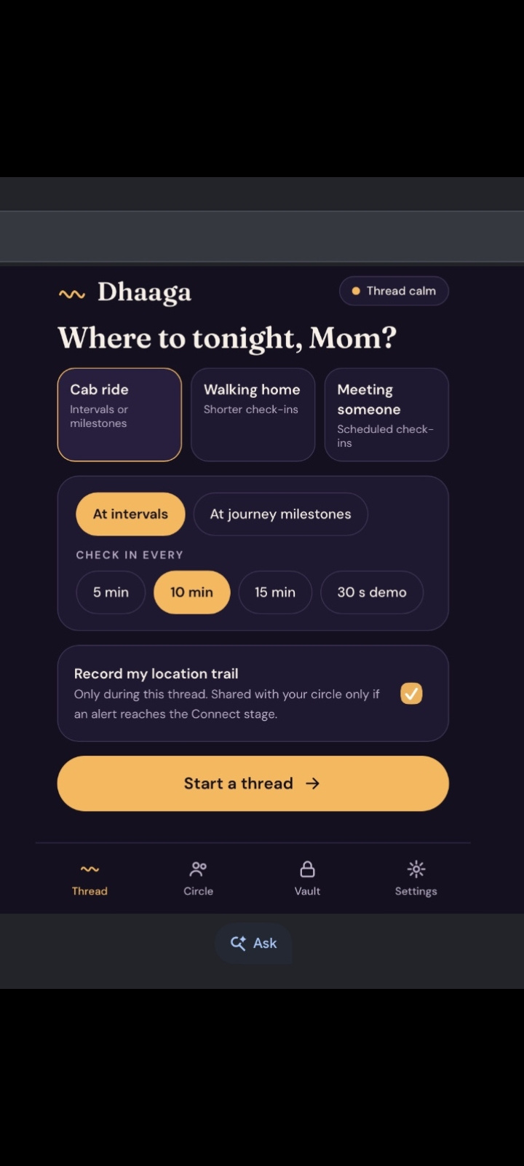
THE RESPONSE LOOP · 1 OF 5
Start a Thread
Choose Cab ride, Walking home, or Meeting someone.
Set the check-in rhythm and trusted contacts.
Notes:
Start by choosing the journey context, then set the check-in rhythm and trusted contacts.
2

Slide 4
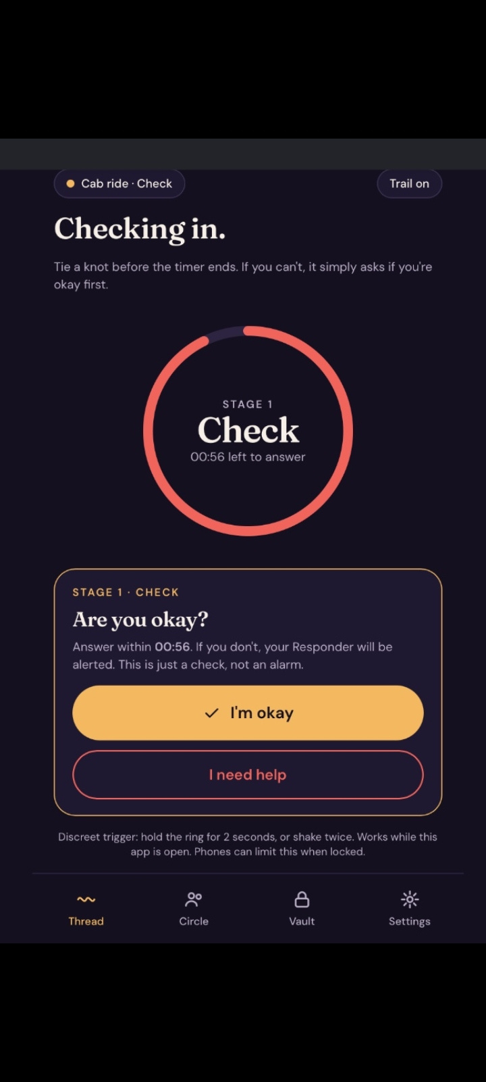
THE RESPONSE LOOP · 2 OF 5
Check In, Discreetly
A discreet “Are you okay?” prompt appears within the configured response window.
Notes:
CHECK is discreet and time-bound. The prompt appears only within the response window the user configured.
3

Slide 5
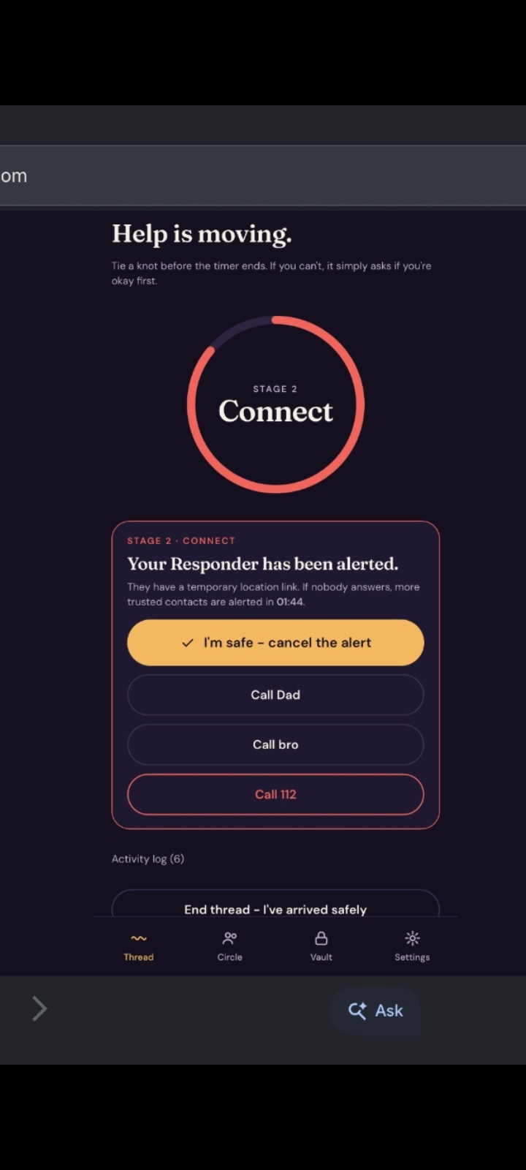
THE RESPONSE LOOP · 3 OF 5
Connect the Responder
If a check-in is missed, the designated Responder receives an alert.
A temporary location link is shared when enabled.
Notes:
CONNECT moves the first alert to the designated Responder. A temporary link is included only when the user has enabled it.
4

Slide 6
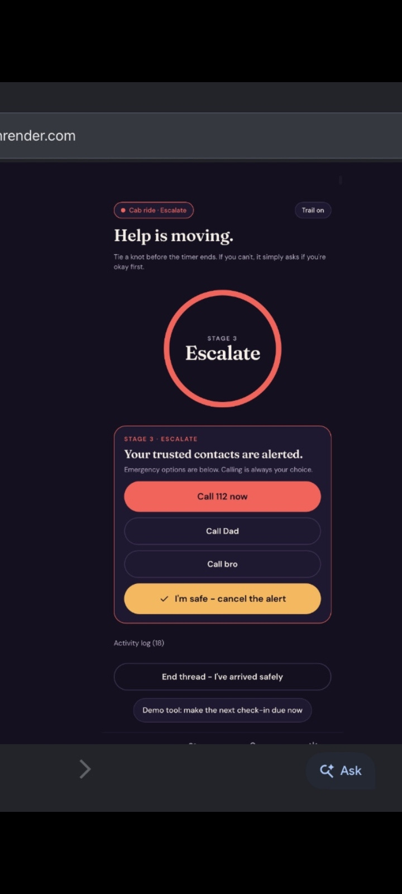
THE RESPONSE LOOP · 4 OF 5
Widen the Circle
Wider trusted contacts are alerted.
Emergency-call options appear.
Notes:
ESCALATE only happens when needed. It widens the circle to trusted contacts and shows emergency-call options.
5

Slide 7
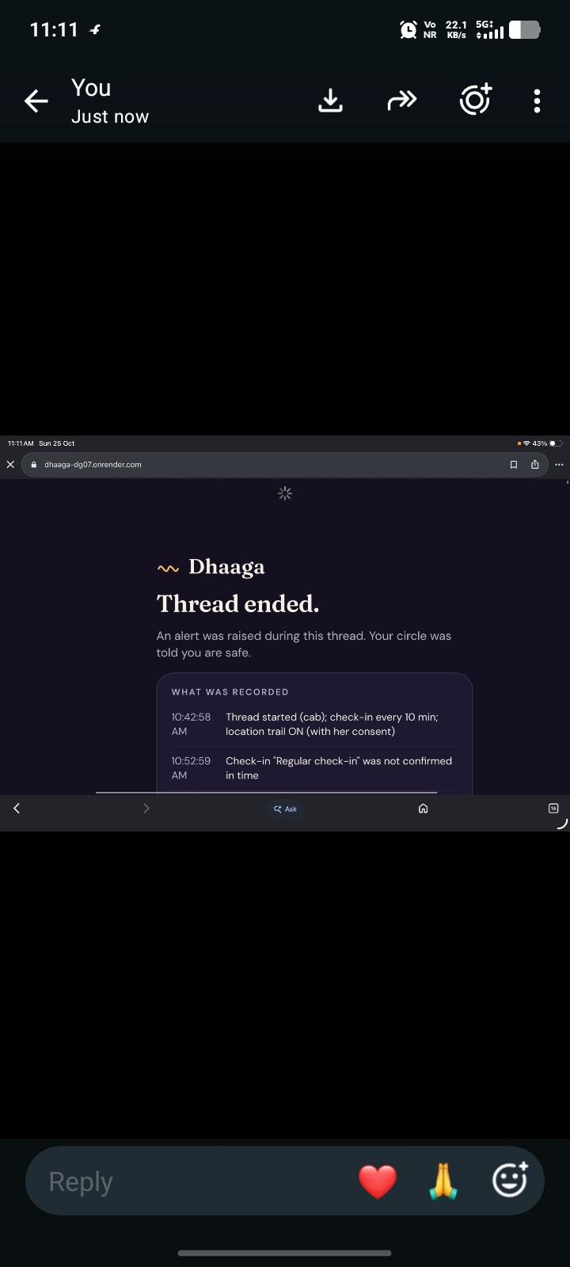
THE RESPONSE LOOP · 5 OF 5
You Stop the Sequence
The user confirms safety, and escalation stops.
Notes:
I'M SAFE gives the user control. Confirming safety stops the escalation sequence.
6

Slide 8
WHERE DHAAGA FITS
Where DHAAGA Fits
  Emergency services (112): Dhaaga does not replace them. Call options appear at Stage 3, and official helplines stay the fallback.
  Friends and family: Her own circle acts first: one Responder, then wider trusted contacts, in an order she sets.
  Typical SOS-button apps: They need a press, or alert everyone at once. Dhaaga checks on her first and widens only when needed.
Notes:
7

Slide 9
WHAT MAKES DHAAGA UNIQUE
What Makes DHAAGA Unique?
  Staged escalation: Check, Connect, Escalate. A missed check-in is not treated as proof of an attack.
  Server-driven: the escalation timer runs on the server, so it continues if her phone dies.
  No install for contacts: they just open a link in any browser.
  Location only when it matters: shared once an alert reaches Stage 2, and dark again when she is safe.
  Privacy-first vault: encrypted on her device, consent-based, deletable, with a verifiable time seal.
  Emergency services stay the fallback: call options appear at Stage 3, and calling is her choice.
Notes:
8

Slide 10







TECHNICAL APPROACH · FEATURES + STACK
Beyond a Panic Button
STACK
HTML · CSS · JavaScript · Node.js · Express · Web Crypto API · AES-GCM · PBKDF2 · Leaflet · OpenStreetMap · Telegram Bot API · Render · GitHub · automated smoke tests
Staged escalation: check-in → Responder → trusted circle.
Context-aware check-ins: rhythms adapt to the journey.
Discreet trigger: hold or shake gesture requests help while the app is open.
Optional duress PIN: calculator-style disguise for a discreet interaction.
Privacy-first evidence vault: client-side encryption, time-seal verification, and deletion controls.
Complaint draft: user-selected facts become an editable draft for review.
Temporary location sharing: consent-based support for the trusted-contact workflow.
ARCHITECTURE
User Interface → Express Backend → Escalation Engine → Trusted-Contact Alert Workflow.
Evidence Vault → Client-Side Encryption → Record Storage → Integrity Verification → Complaint Draft.
Notes:
This is the product beyond a single panic button. The system is staged, context-aware, discreet, privacy-first and user-controlled. Then ground the concept in the implementation: the stack is explicit, and the architecture separates escalation from evidence handling while keeping both workflows connected.
11

Slide 11
SYSTEM ARCHITECTURE
How the Pieces Fit
HER PHONE
EXPRESS SERVER
ALERTS
CIRCLE PAGE
Mobile web app (PWA): thread, check-ins, discreet trigger, location with consent.
API and escalation engine on a 1-second timer: Held, Check, Connect, Escalate.
Telegram bot, or an in-app outbox. Responder first, then trusted contacts.
Link in any browser: temporary map (Leaflet, OpenStreetMap) and role actions.
AFTER THE JOURNEY · THE RECORD IS HERS
EVIDENCE VAULT
TIME SEAL
COMPLAINT DRAFT
Encrypted on her device (AES-GCM, key from her passphrase via PBKDF2).
The server stores only ciphertext, plus a hash-chained seal she can verify and delete.
Built from facts she selects. Editable, and copy unlocks after she confirms review.
Notes:
Escalation runs on the server, not the phone, so it continues if her phone dies. Contacts open a link in any browser. The vault is separate: records are encrypted on her device before upload, so the server only holds ciphertext and a time seal.

Slide 12
FEASIBILITY
Built, Tested, Deployable
ALREADY WORKING
LOW COST TO ADOPT
PATH TO SCALE
A live prototype
Free-tier friendly
Clear next steps
• Deployed on Render, with the source on GitHub.
• Automated end-to-end test of the full escalation flow.
• Runs in a phone browser. Nothing to install.
• Express, Telegram bot and OpenStreetMap need no paid plan.
• Contacts only open a link, so there is no adoption barrier.
• A college or neighbourhood can pilot it first.
• Phone-number verification for accounts.
• SMS and WhatsApp alerts, and a managed database.
• Partnerships with NGOs and local authorities.
Notes:
Feasibility: the prototype is already deployed and tested end to end. It uses free-tier services, and contacts need no app, which removes the biggest adoption barrier. Scaling needs phone verification, a database and partnerships, all of which are listed on the roadmap.

Slide 13
IMPACT AND BENEFITS
Who Benefits, and How
FOR HER
FOR HER CIRCLE
Help can start without a button press, and alerts widen only as far as needed. Her location, record and data stay under her control.
Clear roles: a Responder acts first, trusted contacts follow. A calm message and a link, with nothing to install.
FOR CAMPUSES AND COMMUNITIES
FOR THE SAFETY ECOSYSTEM
Simple to pilot with a small group. Fewer false alarms means alerts keep being taken seriously.
Complements emergency services rather than replacing them, and gives her an organised draft if she chooses to report.
Notes:
Impact is stated carefully: Dhaaga makes it easier for help to start and keeps her in control. It does not promise rescue. Useful metrics for a pilot would be time to first response and the false-alarm rate.

Slide 14
RESPONSIBLE DESIGN
Limitations & Restrictions
Responsible-use boundaries for the current working prototype.
  Browsers can't guarantee the discreet trigger or background location on a locked phone. Escalation itself runs on the server.
  The vault time seal is a technical record, not a promise that any authority will accept it as evidence.
  Alerts travel by Telegram or a shared link. Dhaaga does not promise rescue or a guaranteed response time.
  Accounts are device-bound in this prototype. Phone-number verification is planned.
  Clearly distinguish what the working prototype does from what is only planned.
Notes:
9

Slide 15
ROADMAP
Future Improvements
  Verified partnerships with NGOs, women's support centres and local authorities.
  Multilingual support for regional languages.
  Improved accessibility for users with disabilities.
  Better location accuracy and low-connectivity support.
  Phone-number verification, SMS and WhatsApp alerts, and a production database.
  Stronger privacy controls and independent security testing.
Notes:
10

Slide 16
REFERENCES AND ACKNOWLEDGEMENTS
References & Credits
  Express (MIT): web server and API.
  Leaflet (BSD-2) and OpenStreetMap: circle map, with tiles © OpenStreetMap contributors.
  Telegram Bot API: optional alert delivery.
  Web Crypto API (W3C): on-device AES-GCM and PBKDF2 encryption.
  Render and GitHub: hosting and source code.
Problem statement: recHERsion 2026, PS2: Women's Safety.
Typography: Inter, Fraunces and DM Sans (SIL Open Font License).
AI assistance: design and code developed with Claude (Anthropic). Team AUREX reviewed and can explain the implementation.
Notes:
All libraries, services, fonts and AI assistance are acknowledged, as the hackathon rules require.

Slide 17

LIVE BUILD · OPEN SOURCE
Connecting Women to Help, One Knot at a Time.
WHY IT MATTERS
IMPLEMENTATION HIGHLIGHTS
Structured responses, journey-based check-ins, user-controlled documentation, and one cohesive safety workflow.
Public deployment, tested escalation workflow, trusted-contact roles, alert outbox, configurable stages, evidence vault, complaint drafting, and public source code.
Live Demo: https://dhaaga-dg07.onrender.com
Repository: https://github.com/IqraSanadi22/Dhaaga
Video demo: https://drive.google.com/file/d/1COMCP0ay0-Kvlr7AqIfTPVeVXM3c-_BA/view?usp=sharing
“Safety should not depend on finding the right button at the right moment. DHAAGA helps the circle respond when a knot is missed.”
Notes:
Close on the product's promise and the fact that it is live and inspectable. Point to both links. Then return to the language of the Thread: the user does not have to find the right button at the right moment. When a Knot is missed, the circle can respond.

