Slide 1
Hello Python!
INTRODUCTION TO PYTHON

Slide 2
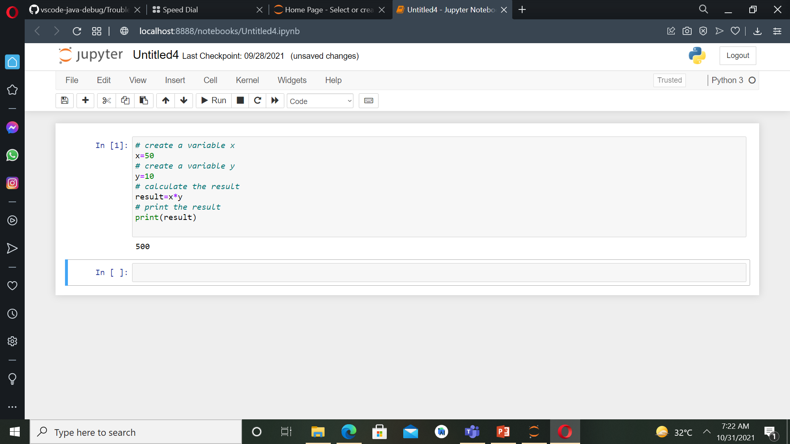
How you will learn?
Calculation with variables

Slide 3
Python Script
Text files - .py
List of python commands.
Similar to typing in python commands.
Use print() to generate output from script.

Slide 4
Variables and Types

Slide 5
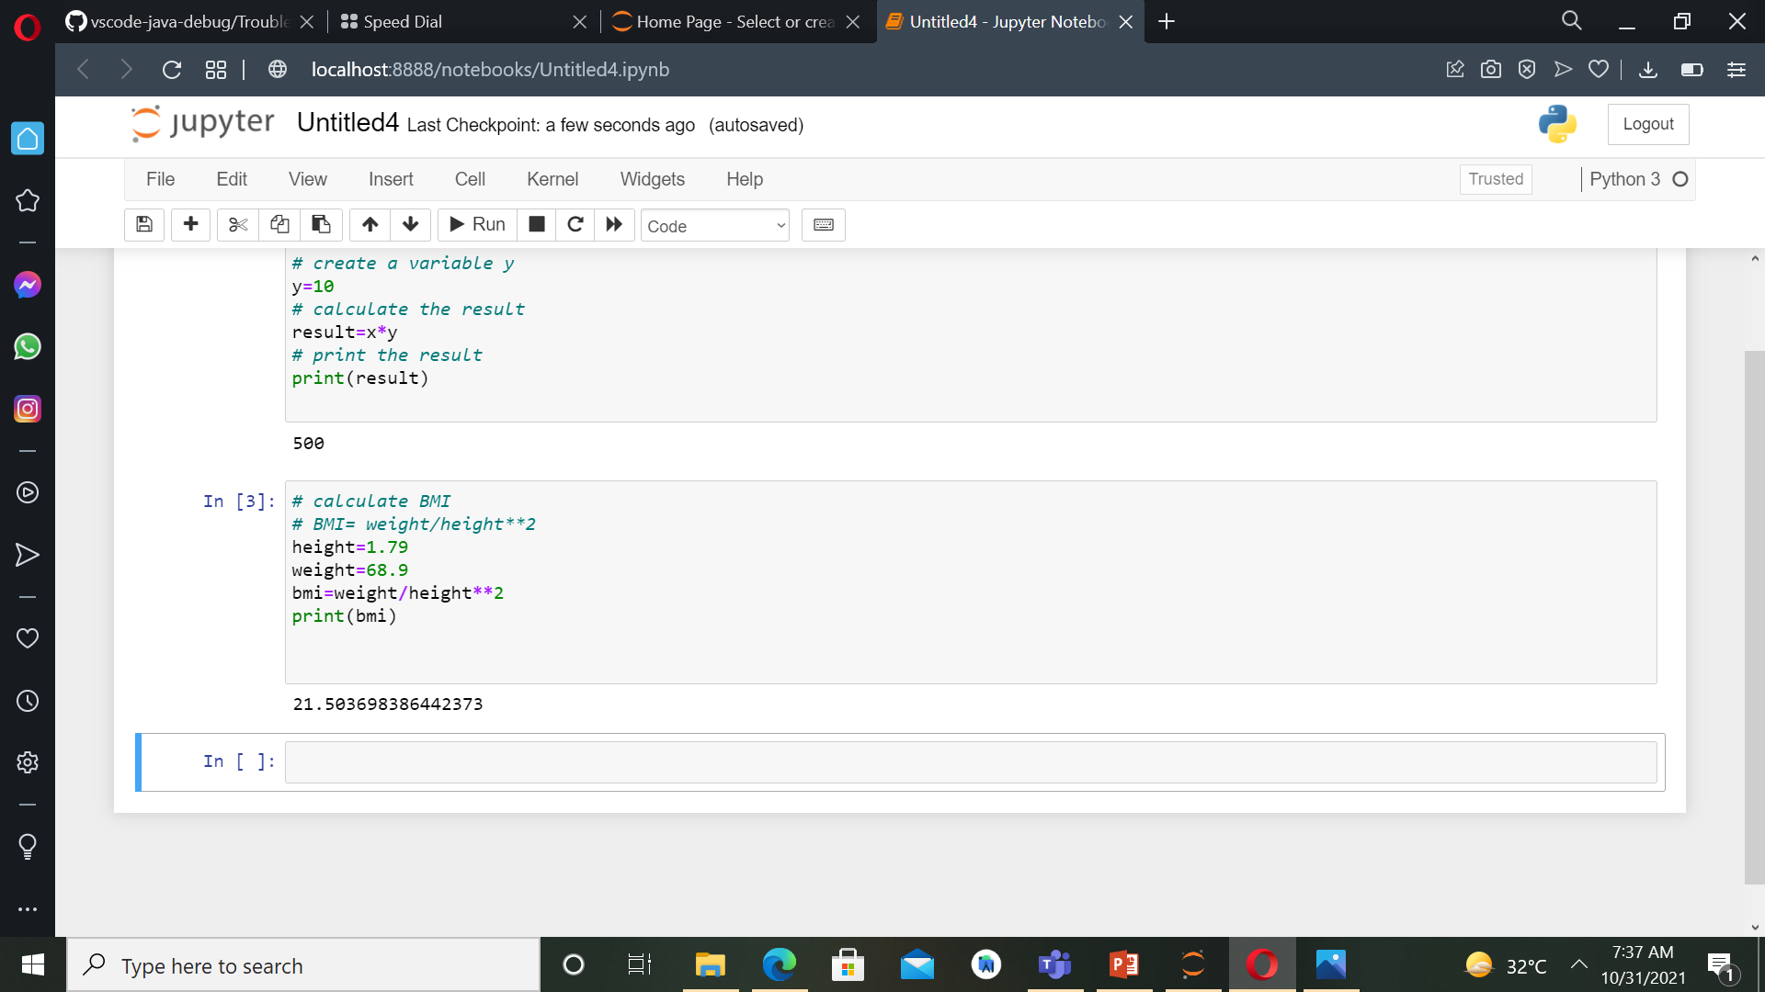
Variables
Specific, case-sensitive name
Call up value through variable name.
Like:
height=1.79
weight=68.9

Slide 6
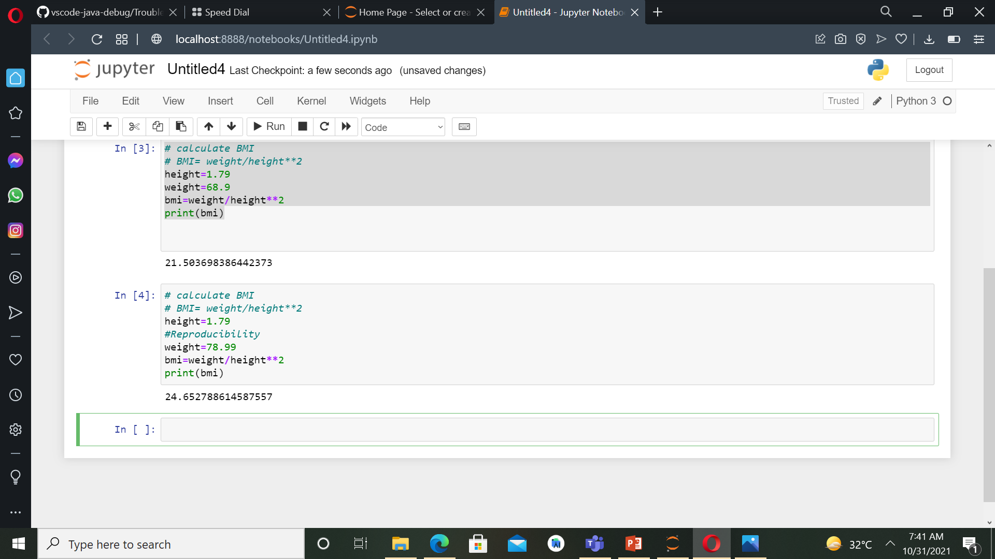
Reproducibility

Slide 7
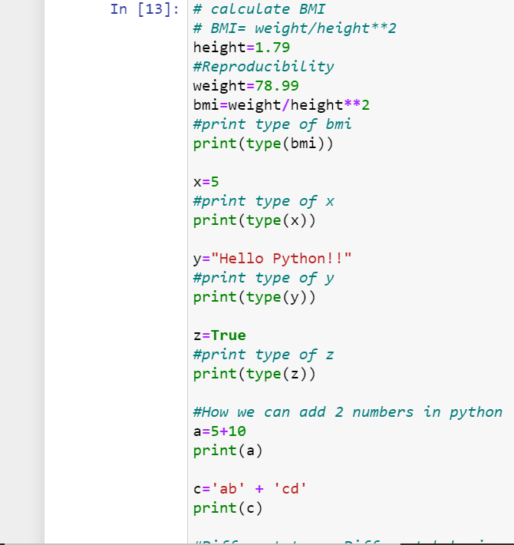
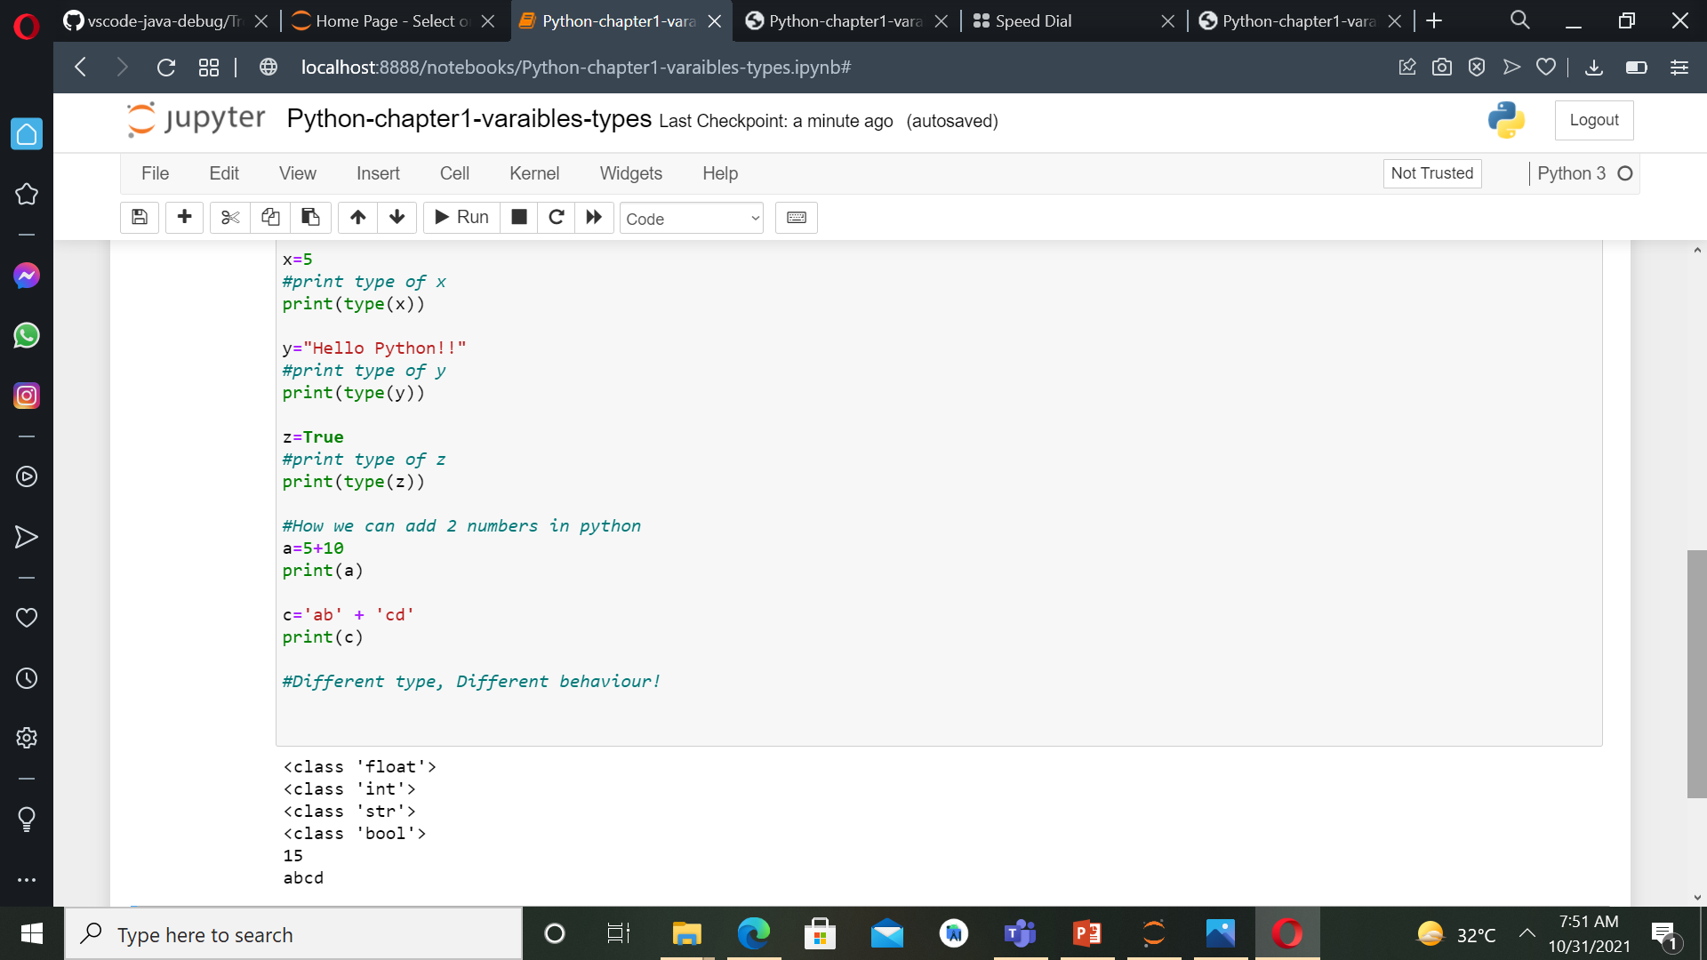
Python Types

