Slide 1

Hawk Finance

Slide 2
Class L05B: Budget Management Dashboard – P33 Project
Team Members
JPMorgan Chase Mentor
Lucas Ferguson
Achraf Kamni
Damian Samano
Vishnu Thampuran
Iqtedar Uddin
Jason Zheng
Diana Dang
Notes:
Welcome everyone, my name is damian.
This is our project Hawk Finance with help from our mentor Diana from JP Morgan Chase.
These are our team members, [everyone introduce themselves]
Today we will show you a budget management dashboard, [pause] our project developed over the last 9 weeks.

Slide 3
Problem Statement
College students
- Saving money
- Busy schedules
- New to budgeting
Notes:
As young adults, no one has ever taught us how to manage our finances and it’s a challenge to do so being a full-time student. With our app, we are trying to help college students by making it easier to track their expenses.

Slide 4
Project Planning
Our team worked on building mock-ups for a financial budgeting app that lets users track, analyze and enhance their spending habits.
Guiding Values: Scrum and Agile frameworks
Progression of product development:
Design
Implementation
Testing
Technologies Used:
Miro
Figma
Zoom, Discord
Trello
Notes:
Vishnu
Tackling the problem statement, th team worked on building mock-ups for a financial budgeting app that lets users track, analyze and enhance their spending habits.
Together, we have developed an aesthetically pleasing and functionally designed dashboard and its accompanying features for better visualizations, comprehension and more!
Guiding values: SCRUM and AGILE frameworks of management and development
Technologies Used:
Google Docs and Miro (Ideation and Diagrams)
Figma (Platform Design and Development)
Gmail, Zoom, Discord (Communication and Coordination)
Trello (Management, Peer Review and Progress Tracking)
The team went through multiple iterations of designing, implementing, and
testing of our product to arrive at our final Minimum Viable Product.
Hawk Finance is a culmination of our purposeful design,
functional adaptability, and exquisite user experience.

Slide 5
Minimum Viable Product (M.V.P)
Inputting data
Categorize data
Recurring payments/income
List of transactions
Filtering
Organization
Analytics
Visualizes information
Different Time periods
Goals/Budgeting
Notes:
Inputting Data
Different categories for each expenses to organize expenses
Option to repeat payments(monthly/weekly)
Option to input Income
Summary
Lists transactions In order with different filters(Date,Category, Amount)
Includes all income and expenses
Different periods to organize transactions(Weekly,Monthly,Quarterly)
Analysis
Shows different ways to analyse budgeting(Heat maps, Pie charts, Graphs)
Can make different graphs and charts for different time periods
Shows if you are meeting your budget over different time periods

Slide 6
Design Process
Notes:
"And now i'm going to hand it over to Achraf“
For the design phase of the project, the team spent quite some time on development a logically sound structure since everything we design afterward will build on top of that. This slide shows the flowchart that we came up with.

Slide 7
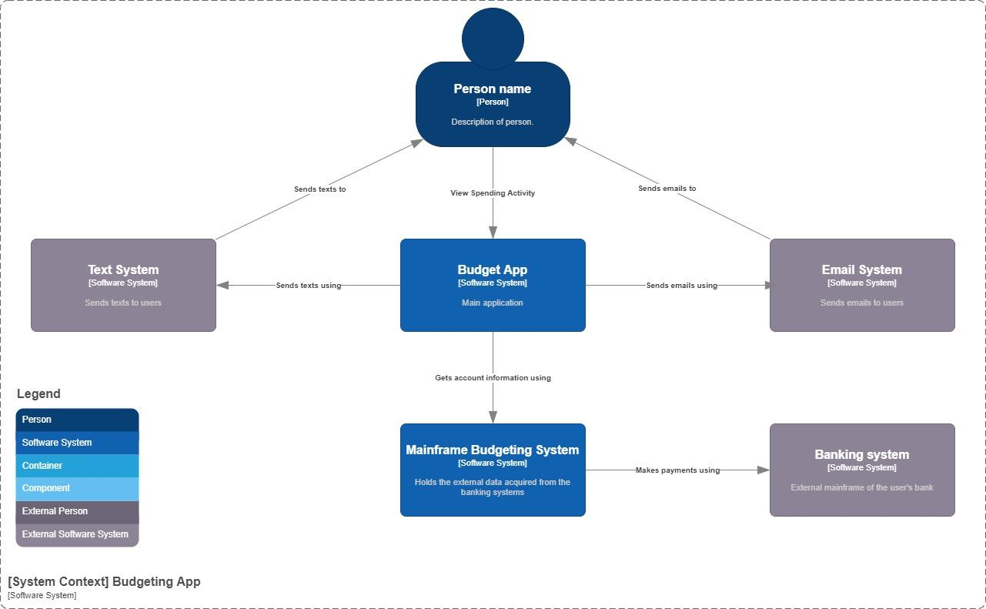
Design Process
System
Context
Diagram
Notes:
Explain the process your team went through to develop your solution. Context, Containers, Components, and Code.

Slide 8
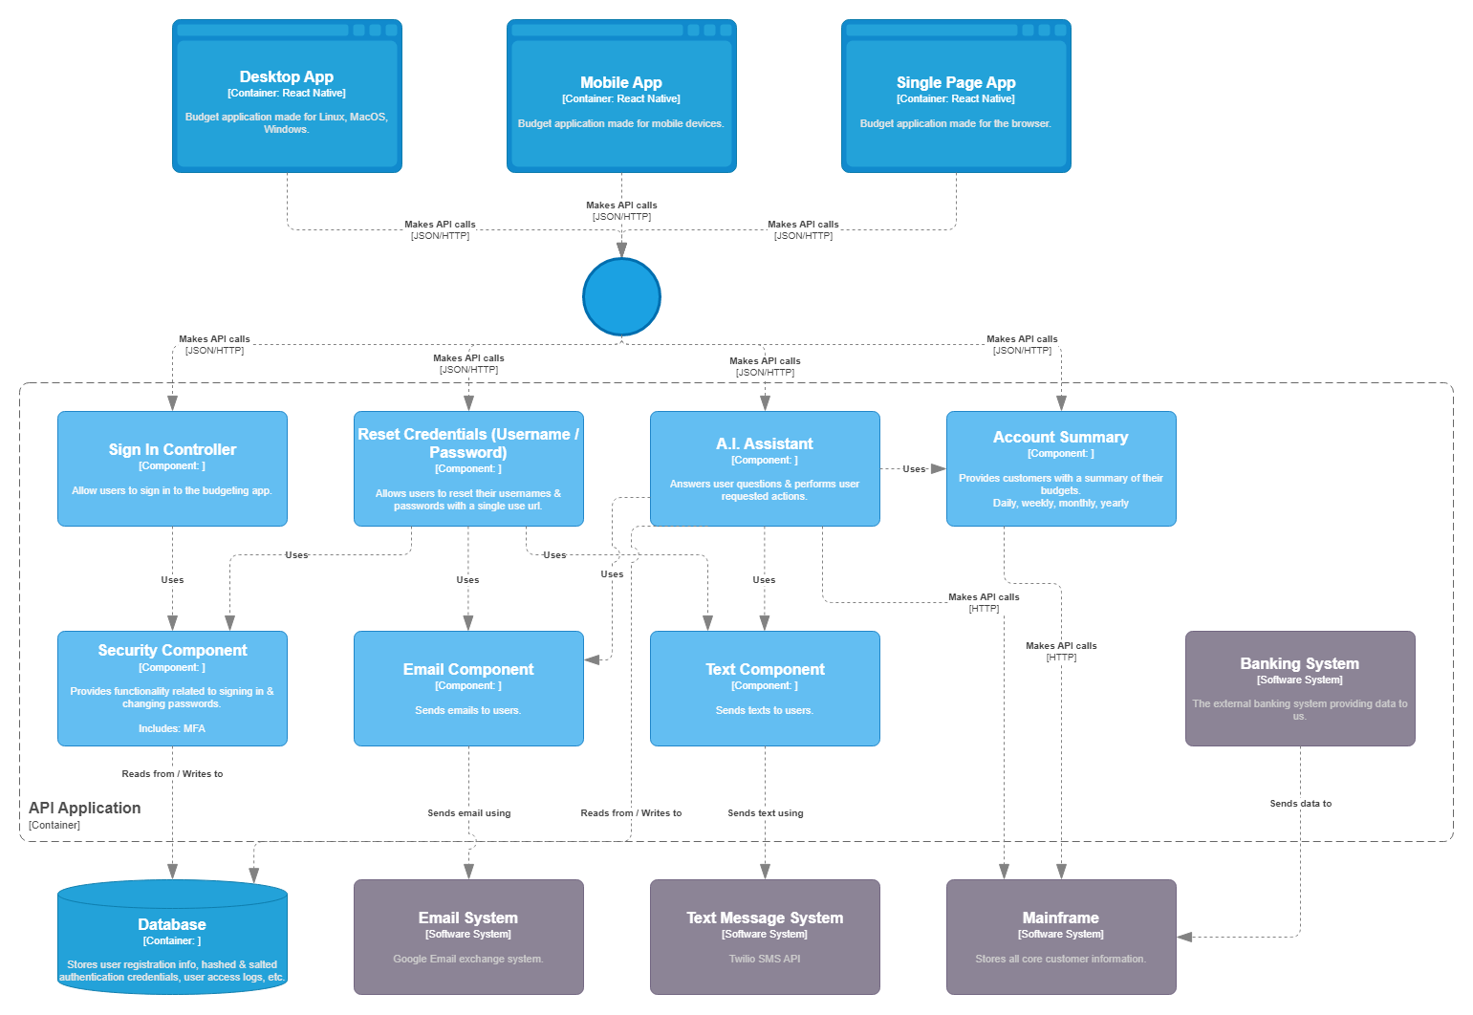
Design Process
Component
Diagram
Notes:
Explain the process your team went through to develop your solution.

Slide 9
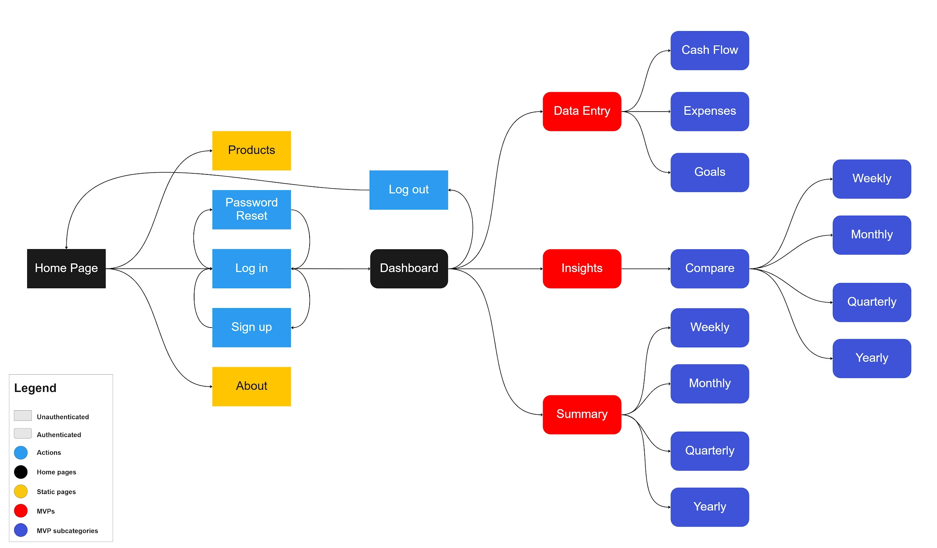
Website Flowchart
Notes:
the arrows show how the user can navigate from one page to the next.
The squared boxes are pages that the user have access to before logging in
The rounded boxes are pages that the user has access to after logging in.
Black: These are our main pages before/after logging in.
Light Blue: Pages related to the Authentication process.
Yellow: Pages that have public information.
Red: main pages for our MVPs.
Dark Blue: Subcategories for our MVPs.

Slide 10
Implementation
Notes:
"And now i'm going to hand it over to Lucas"

Slide 11
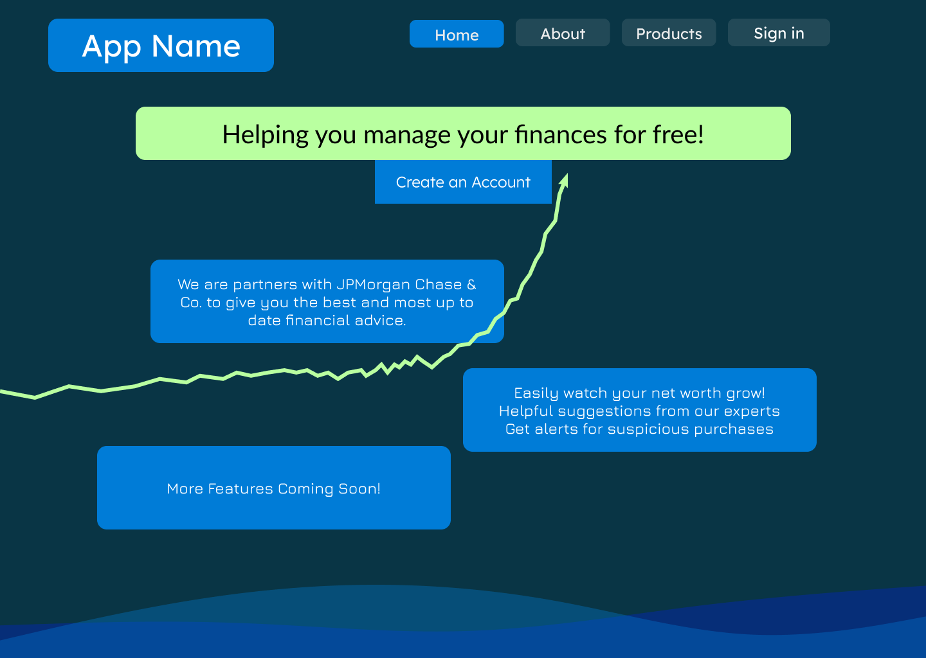
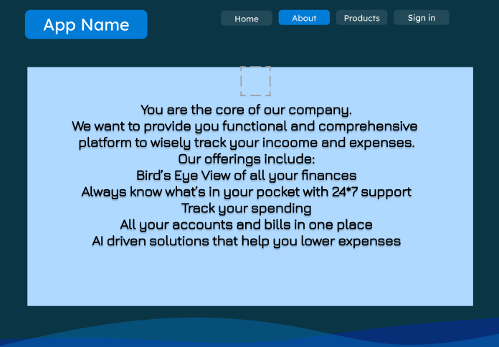
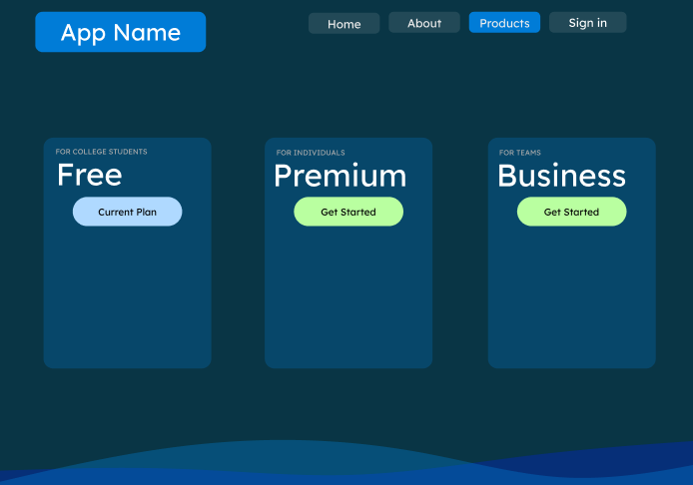
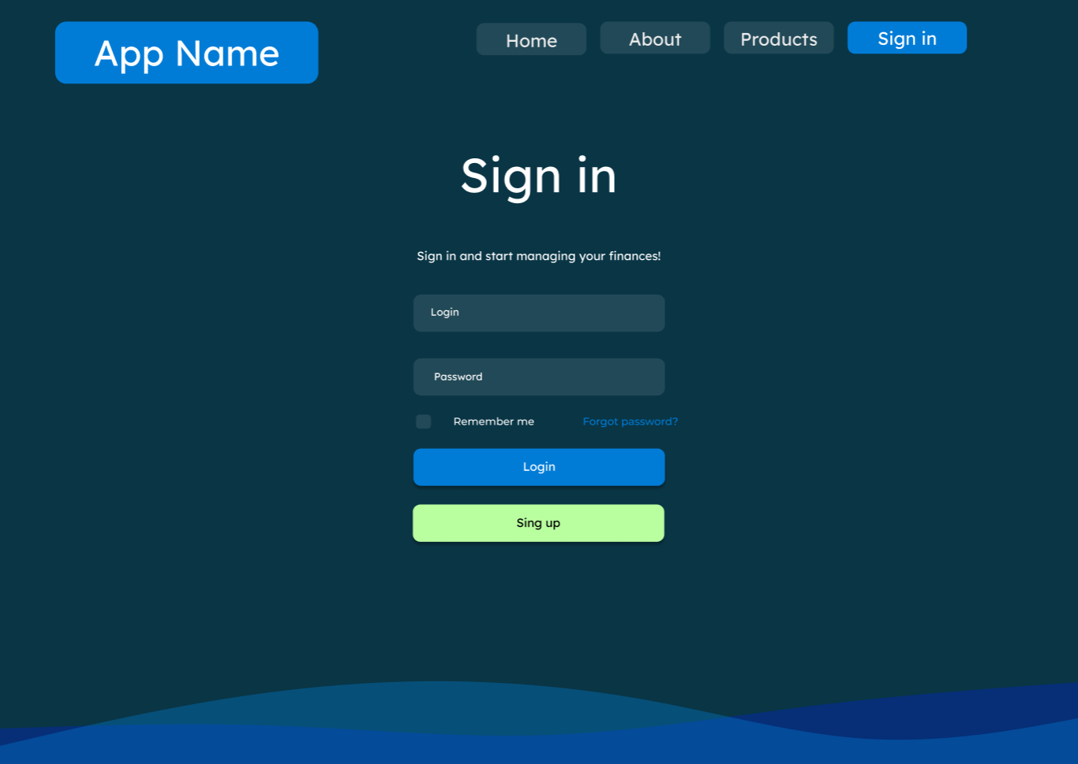
Version 1
Notes:
Lucas script:
As Vishnu mentioned we used Figma to create our project. In version 1, our color scheme consisted of blues and greens but our fonts were inconsistent.
We learned how to use the design tools.

Slide 12
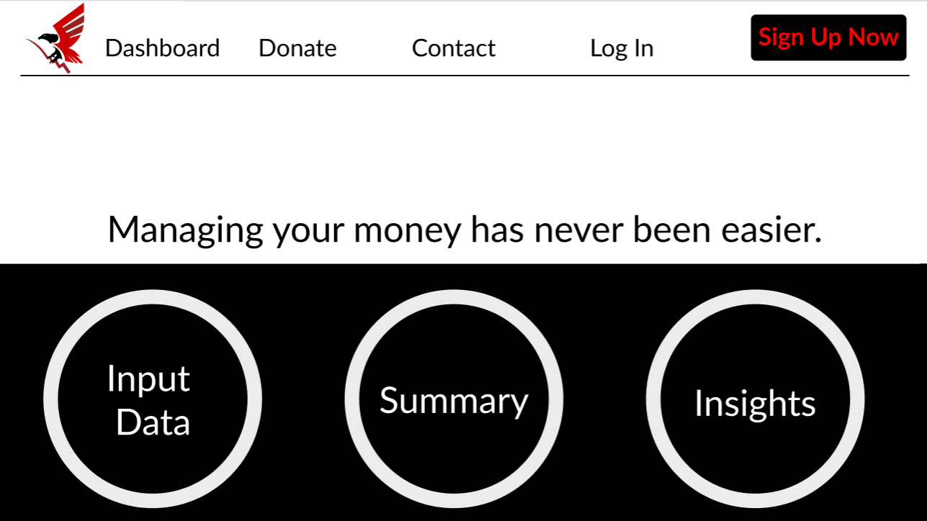
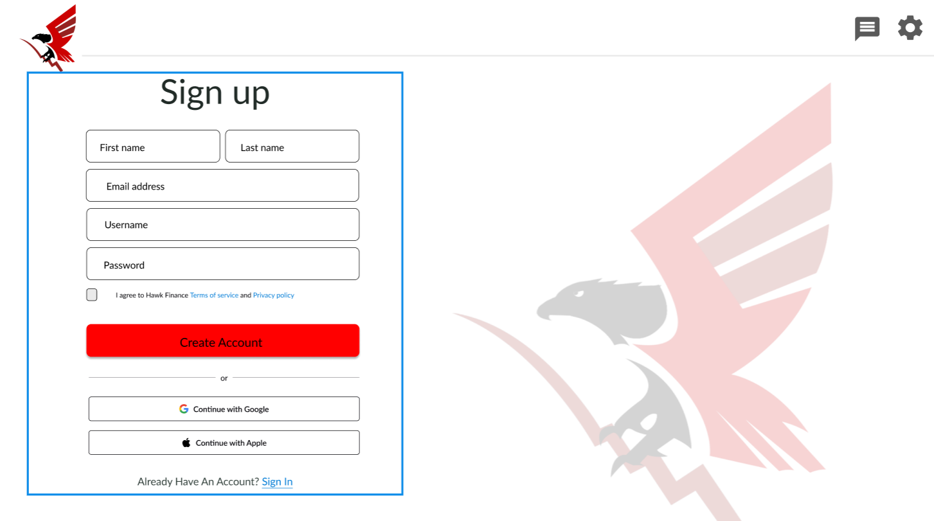
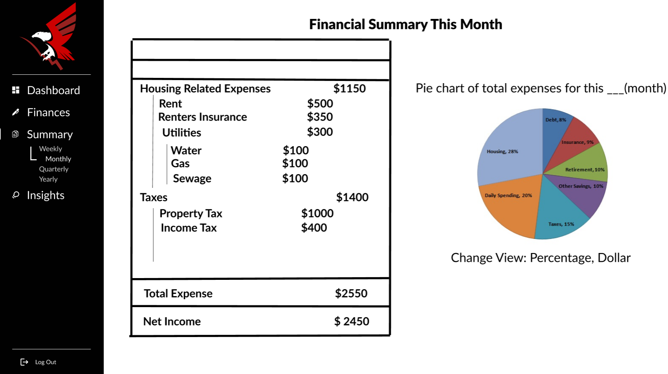
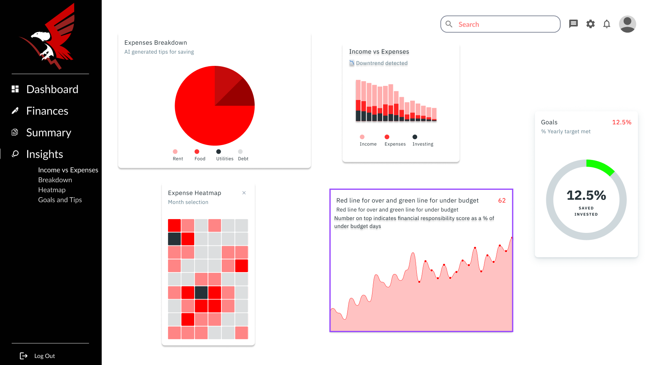
Version 2
Notes:
Lucas script:
Our color theme changed to black, white, red, and green
Logo was made

Slide 13
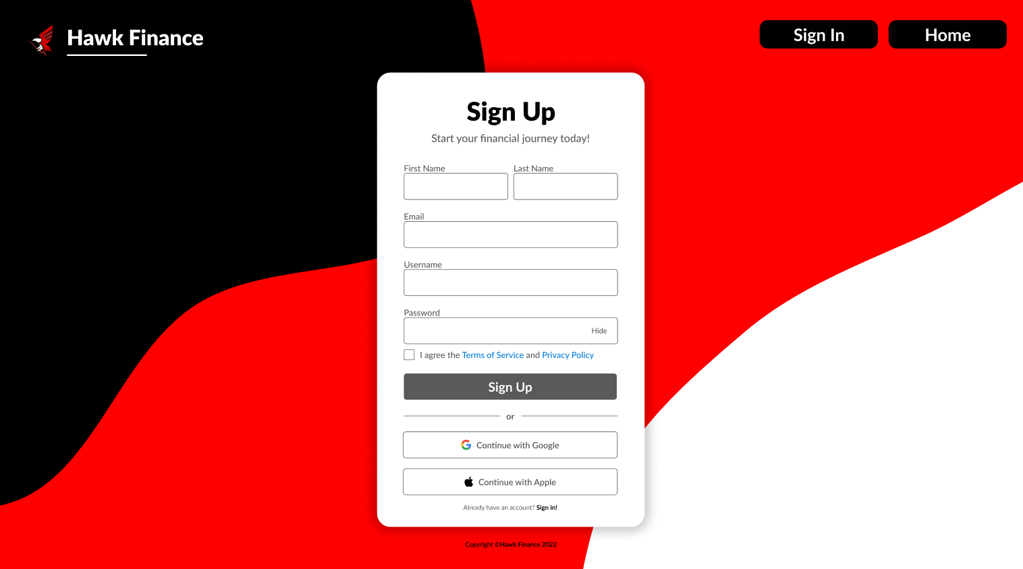
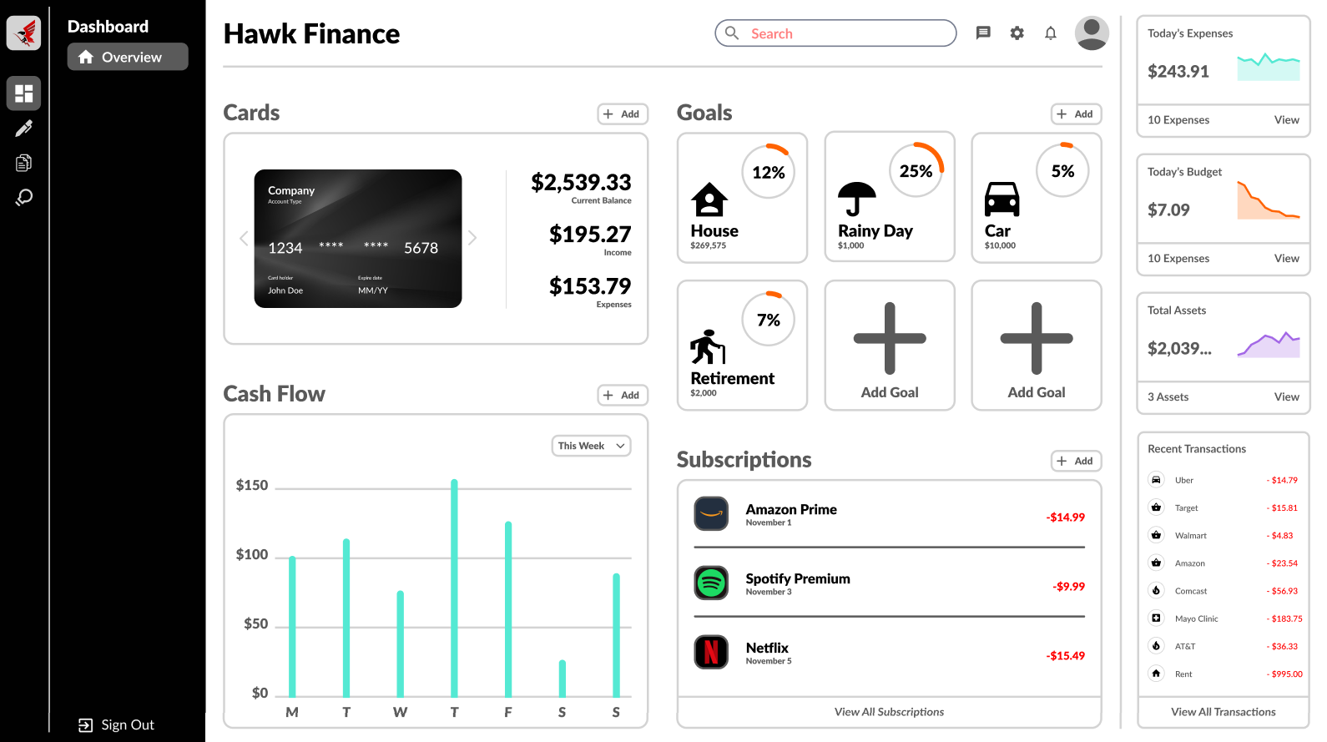
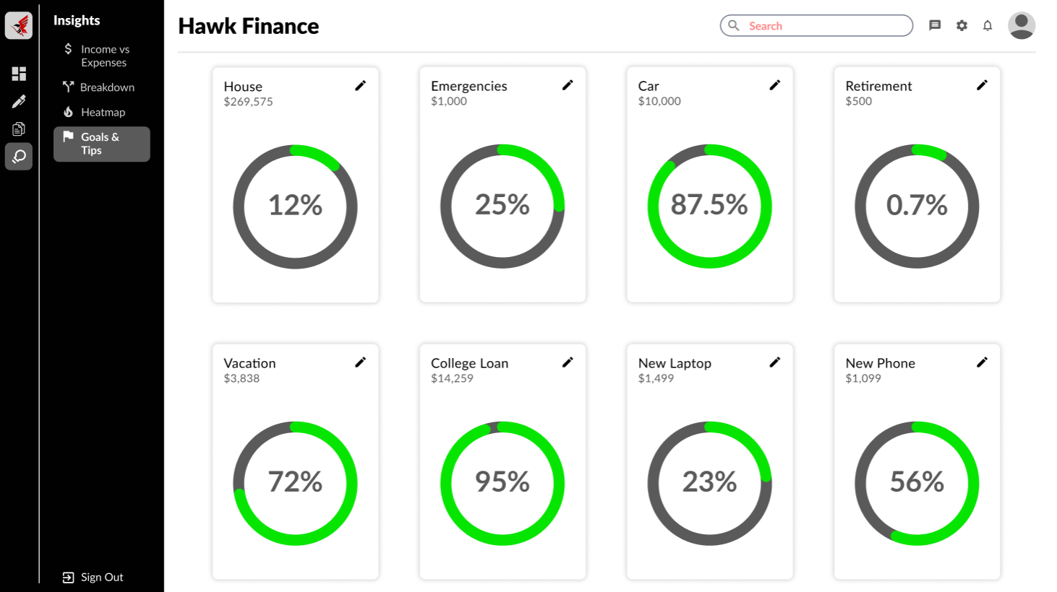
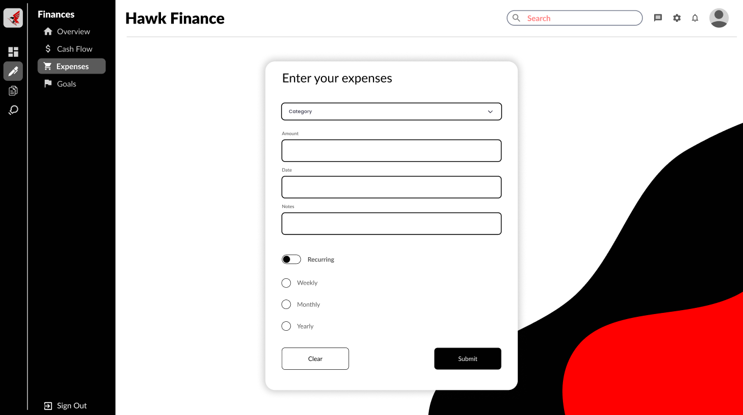
Version 3

Slide 14
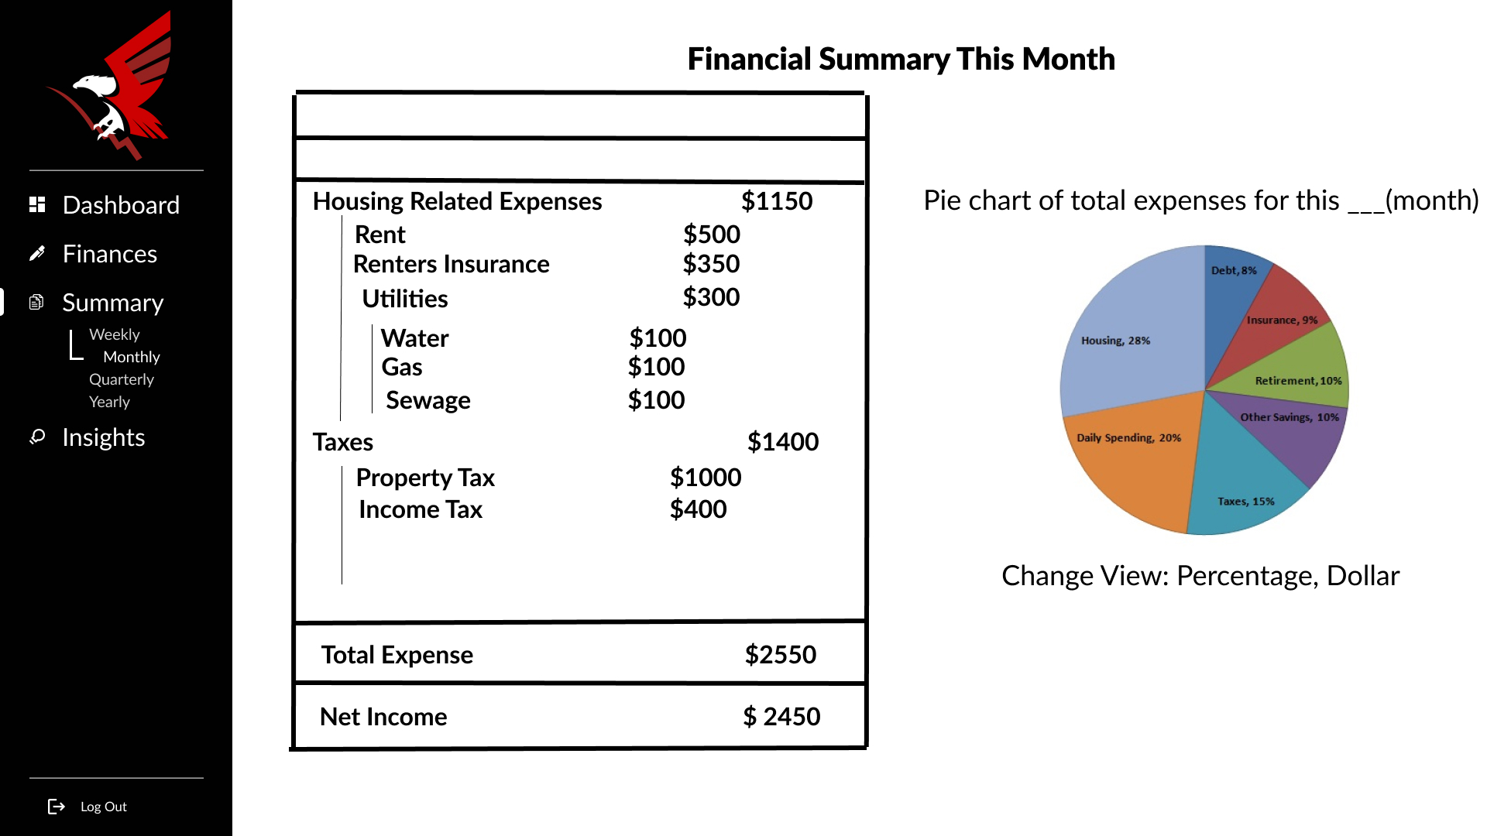
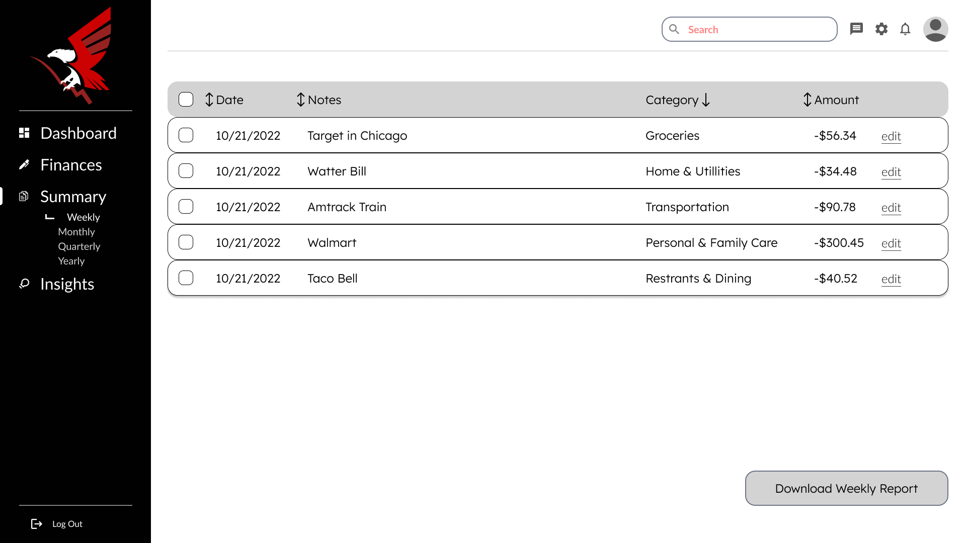
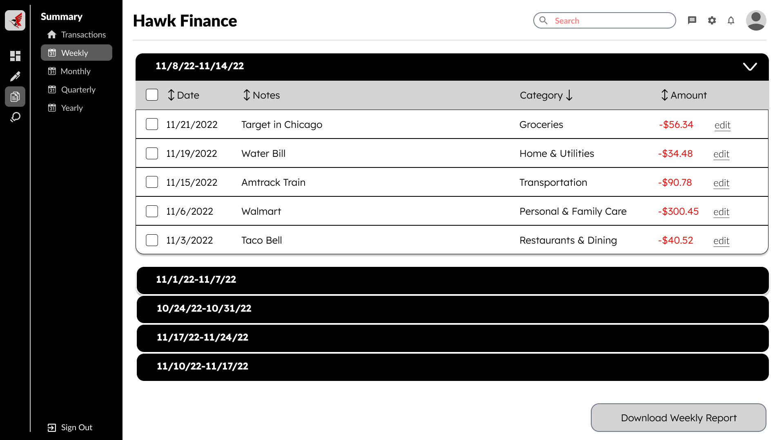
Version 1
Version 2
Version 3
Notes:
Lucas script:
Slides Highlighted in blue outline
Progress made over 4 versions for the same slide

Slide 15

Testing

Slide 16
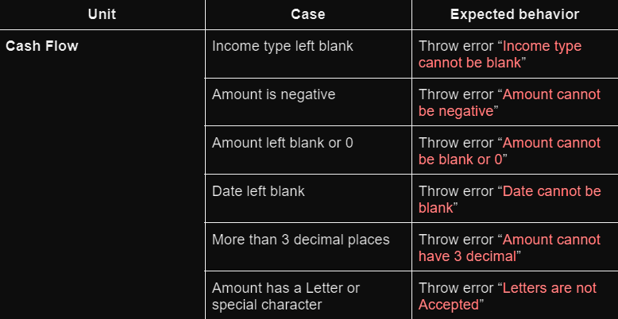
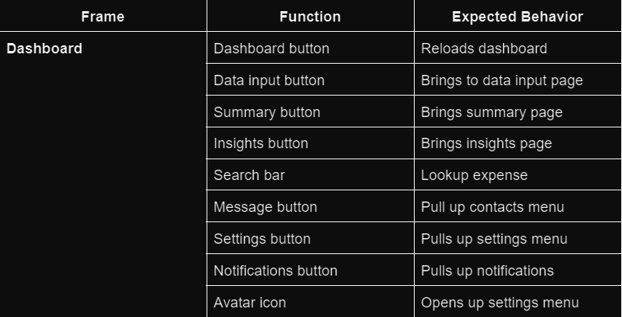
Unit Testing
Functional Testing
Notes:
For testing, we did unit and functional testing for our ui and prototyping, which helped us identify bugs.
Since we were creating our project using figma and not a full blown website, we were limited to these 2 types of testing.
An example of a test we did was for our buttons on our dashboard page. We had to test these to make sure they connected us to the right pages.

Slide 17
Team Dynamics
Research
Time commitment
Meetings
What We Learned
Agile Framework
Different testing methods
Collaboration
Notes:
Overall as a team, we did a good job collaborating with each other and being open to each others opinions.
If we were to do this project again, we could spend more time researching layouts and designs, which would help us be more efficient.
We would also look into committing more time into the project as individuals and have more meetings together as a group.
With that being said, we have also learned a lot throughout this project, such as how to manage our project under the AGILE framework, using test cases to identify bugs, and work together as a group.

Slide 18
Demo

