Slide 1
Cu-DNA based nanowires memory as a Memcomputing motion-pattern recognition device for blind people/fatigued drivers to avoid accidents
INUP-NANOHECKATHON-2023
IRA RAI,
B. Tech 2025 Batch
AE21B024
Department of Aerospace Engineering
IIT Madras, India
Mentors
Prof Udayan Ganguly and Paritosh Meihar
IIT Bombay, India

Slide 2
OBJECTIVES
I. In biological neural network (BNN’s) (Hasson, Nastase et al. 2020), wherein neurons communicate via spikes. The membrane potential, in a biological neuron, is produced by various electrochemical mechanisms across the insulating lipid bilayer cell membrane which acts as a leaky capacitor.
II. Nanowires have great potential in integrated circuits, DNA molecules being natural nanowires have been applied for the fabrication of multiple-state memory nanoelectronic devices which work on Redox-based resistive systems are one of the most promising emerging non-volatile memory technologies (Friedman, McAlpine et al. 2005).
III. The redox state of Cu ions in the Cu–DNA nanowire is switchable using the external biases. The ratio of redox species of Cu ions (Cu1+/Cu2+) can be changed when the external biases exceed the threshold of redox potential of Cu ions, indicating that the Cu–DNA nanowire may exhibit a capacitive effect. Also Cu is most conductive as well as economical, Cu–DNA molecule exhibit negative differential resistance as a dual memory circuit element (memelement) (Gloystein, Möller et al. 2019).
IV. Mimicking BNN’s, memristive systems can be used in digital logic as programmable switches in switching blocks. Herein, we demonstrate that the resistance of Cu-DNA depends on the “history” of applied voltage or currents; that is, Cu-DNA behaves as a memristive computing system.
Background study:
(Among other metals ions, such as Co and Zn ions, nickel ions provide efficient capacity for DNA to pass electrons through its core. Nickel ion (II) is stable in solution and is able to resist changes in environmental condition. As reported previously, nickel ions can be chelated between paired bases in duplex DNA by replacing imino protons of G and T bases and form stable structures under alkali conditions (pH ≥ 8.5))(Chu, Lai et al. 2017)

Slide 3
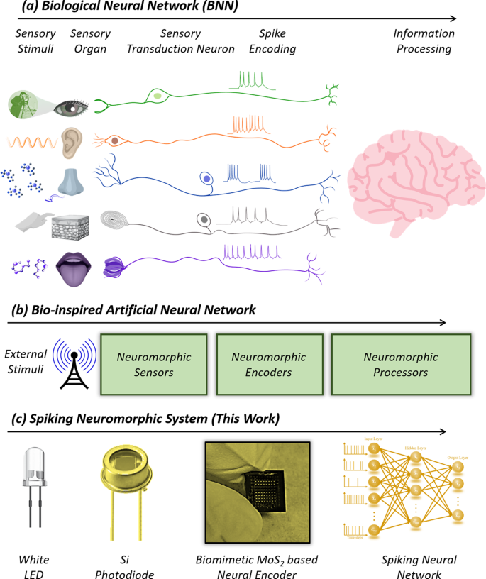
BNN to SNN
a Schematic of biological neural network (BNN). Specialized neurons convert analog external/internal stimuli into corresponding spike trains by a process called sensory transduction and subsequent relay the information to the central nervous system for further processing. Various encoding algorithms are found in sensory neurobiology such as spike rate-based, spike count-based, and spike timing-based encoding.
b Schematic of bio-inspired artificial neural network comprising of neuromorphic sensors, neuromorphic encoders, and neuromorphic processors.
c Schematic of our spiking neuromorphic system consisting of a white light emitting diode (LED) as the visual stimulus, a silicon (Si) photodiode (PD) as the sensor, a dual gated MoS₂ based field effect transistors (FETs) with a stochastic terminal as the neuromorphic encoder, and a trained spiking neural network (SNN) as the neuromorphic processor. (Subbulakshmi Radhakrishnan, Sebastian et al. 2021)
“Subbulakshmi Radhakrishnan S, Sebastian A, Oberoi A, Das S, Das S. A biomimetic neural encoder for spiking neural network. Nature communications. 2021 Apr 9;12(1):2143.”

Slide 4
APPLICATIONS
Big Data and big data storage: The amount of big data generated all over the world in a single day, from scientific research, and numerous businesses and industries, consists of over 2.5 quintillion bytes (Panwar, Rajendran et al. 2017).
Memory computing devices can significantly accelerate Artificial intelligence and machine learning tasks. This enables real-time processing, faster training of deep neural networks, and more efficient inference. (Dutta, Kumar et al. 2017)(Uddin, Bende et al. 2022)(Sakhuja, Rowtu et al. 2023)
Memory computing devices can enhance the capabilities of IoT devices. Their low power consumption, fast data access, and high-density storage make them suitable for edge computing and real-time analytics in IoT applications (Lashkare, Uddin et al. 2023). This allows for faster decision-making, reduced data transfer requirements, and improved energy efficiency in IoT systems such as voice-activity detection (Zhao, Gao et al. 2021)(Singh, Saraswat et al. 2022), speech classification (Shukla, Kumar et al. 2017), fatigue testing in drivers thus preventing accidents, motion-pattern recognition (Dhoble, Nuntalid et al. 2012)(Sarbishei 2019), navigation, odor recognition (Xiong, Chen et al. 2021), biomedical signals (Tsai, Hsieh et al. 2014)etc
Here: As per previous experience and member of Team Sahay at IIT Madras for constructing electric belt for blind people, the nanoelectronic device can be a part of waist belt for blind people to understand the motion pattern recognition in blind people, as well as it would be of great use to detect fatigue like closing of eyes, tilting or dropping of head at different angles while driving to prevent accidents.

Slide 5


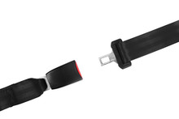


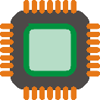
NOVELTY
DNA combined with nanowires can potentially enable a novel approach to memory storage. Traditional memory storage technologies, such as silicon-based transistors, are limited by physical constraints and face challenges in terms of scalability and density. DNA, on the other hand, offers exceptional data storage capacity and long-term stability.
Moreover, DNA-based memory storage could have significant advantages in terms of longevity. DNA has an inherent stability that allows it to persist for long periods under proper conditions. This characteristic makes DNA-based memory attractive for long-term archival applications.
Earlier studies have shown cloud computing and machine learning to demonstrate their application in motion pattern recognition and driver fatigueless to avoid road accidents but no study has shown metal-DNA nanowires and their use as memecomputing devices in diagnosing motion pattern recognition for blind people or to diagnose the driver fatigueless in road drived vehicles, wherein the person anyways has his eyes closed simulating blind behavior only.
Some of the challenges include improving read and write speeds, reducing error rates, and developing efficient encoding and decoding techniques. Nevertheless, the combination of DNA and nanowires holds promise for novel memory storage solutions in the future.
I
II
Driver fatigue recognizing car screen
Motion recognizing blind belt
Memristive recognizing motion patterns
Memristive recognizing motion patterns
II. Improvisation of work done at IIT-Madras which faced limitations

Slide 6
INTRODUCTION
To fabricate the Cu-DNA memristor device, linear DNA strands would be obtained on request from either IIT Bombay or IIT Madras Biosciences department.
The nanogold electrodes were fabricated using a standard procedure (Letchumanan, Md Arshad et al. 2020).
The Cu-DNA molecules were linked on two gold electrodes through the Cu ions chelated BamHI and EcoRI linkers (Chu, Chiu et al. 2014) those were self-assembled on the gold electrodes. The residue water on the Cu-DNA device was removed by baking at 80 °C for 15 min following protocol of (Chang, Chang et al. 2019).
The electrical properties of the electrodes were measured via a high-impedance electrometer (Keithley).
Two probes were utilized to acquire data for the current−voltage (I−V) curves and to monitor the device performance of the Cu-DNA memristor. The current flowing through the Cu-DNA could be measured when bias voltage was supplied.
Chang, P.C., Chang, C.Y., Jian, W.B., Yuan, C.J., Chen, Y.C. and Chang, C.C., 2019. The fabrication and application of Ni-DNA nanowire-based nanoelectronic devices. Nano Research, 12, pp.1293-1300.

Slide 7
PROCESS FLOW…
The silicon (2 inch) wafer undergoes to RCA 1 and RCA 2 cleaning for the removal of insoluble contaminants and ionic, heavy metal atomic contaminants respectively, following by wet oxidation process at about 1150°C to deposit the 300 nm thick of oxygen layer of SiO₂ and characterization of the SiO₂ wafer would be done by spectroscopic ellipsometer.
Deposit a Seed Layer: To promote adhesion and enhance the uniformity of the gold layer, deposit a thin seed layer of a suitable metal, such as titanium or chromium, onto the cleaned silicon wafer surface. The seed layer can be deposited using techniques like physical vapor deposition (PVD) or sputtering.
Deposit the Gold Layer: After depositing the seed layer, coat the wafer with a layer of gold. This can be done using techniques like evaporation, sputtering, or electroplating. The thickness of the gold layer will depend on the desired application and can typically range from a few nanometers to micrometers.
Define the Electrode Patterns: Use standard photolithography techniques to define the desired electrode patterns on the gold-coated wafer. This involves applying a photosensitive resist material, exposing it to ultraviolet (UV) light through a photomask with the desired electrode pattern, developing the resist to remove the exposed areas, and etching the underlying gold layer using an appropriate etchant (such as a gold etchant or a combination of acids) to define the electrode shapes.
Remove the Resist: After defining the electrode patterns, remove the remaining resist material from the wafer surface. This can be done using resist stripping techniques, such as immersion in a resist stripper solution or plasma ashing.
Clean and Inspect: Clean the wafer again to remove any residues or particles resulting from the fabrication process. Inspect the fabricated gold electrodes using microscopy or other characterization techniques to ensure the desired electrode quality and integrity.

Slide 8
PROCESS FLOW
The size of the nanogap in the paired finger electrodes was near 100nm, depending on the length of the DNA nanowires.
The Cu -DNA molecules were linked on two gold electrodes through the Cu ions chelated (BamHI and EcoRI ) linkers following the standard protocol of Chu, Chiu et al. 2014; those were self-assembled on the gold electrodes. The residue water on the Cu-DNA device was removed by baking at 80 °C for 15 min The nanogold electrodes were fabricated using a standard lithography procedure.
The Cu-DNA nanowire devices were then treated with UV light at 0.25 J/cm² for crosslinking. Then, the devices were annealed at 80 °C for 15 min to remove residual water. To enhance binding and integration between the Cu-DNA nanowires and the paired electrodes, the paired electrodes were treated with ozone at 300 °C prior to the integration of the Cu-DNA nanowires.
The ozone treatment resulted in a high surface roughness of the gold electrodes, increasing the binding capability of Cu-DNA to the gold and thereby boosting the yield of Cu-DNA nanowire devices.

Slide 9
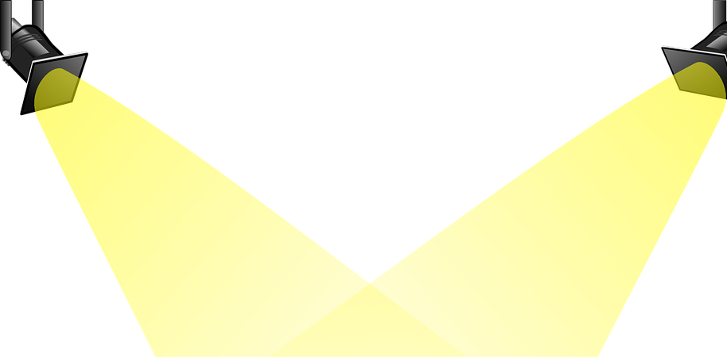
PROCESS FLOW…
Photoresist development
2” Si wafer
v
i
UV exposure
SiO₂ 300nm
ii
Al 200nm
iii
DNA Linkers deposited
Thermal evaporator (PVD) vacuum coater
vi
Au
100nm
Au
Au 100nm
iv
Standard electron beam lithography
and thermal evaporation

Slide 10



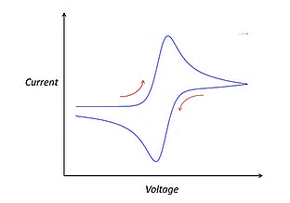
Cu-DNA based nanowire
e^{_-}
vii
Cu⁺
+
Cu⁺
Cu⁺
-
I
Au 100nm
Au
100nm
Au
Cyclic sweeping of current-voltage
Al 200nm
SiO₂ 300nm
Driver fatigue recognizing car screen
Memristive recognizing motion patterns
e^{_-}
+
Cu⁺
-
II
viii
Cu⁺
Cu⁺
Au 100nm
100nm
Au
Au
Al 200nm
SiO₂ 300nm
Motion recognizing blind belt
Memristive recognizing motion patterns

Slide 11
COST EFFECTIVENESS
Copper possesses the highest electrical conductivity among common metals after silver, making it an attractive choice for conducting electricity efficiently. It has a low resistivity, allowing for the smooth flow of electrical current with minimal losses.
Copper is also abundant in nature and has a relatively low cost compared to precious metals like silver or gold, making it a cost-effective option for many applications.
Although the fabrication of DNA-based nanoelectronic devices is similar to that of organic nanowire devices, their functions and properties are significantly different.
The organic nanowire devices are operated under the same schema as the inorganic semiconductor technology, using the mechanism of the field-effect transistor. However, the DNA-based devices are operated as multiple-state memory devices. In particular, the metal ion-chelated DNA or polymer nanowire has been demonstrated to exhibit a unique reduction–oxidation (redox) reaction that leads to a negative differential resistance (NDR).
On the other hand, information can be stored as different redox states of the DNA nanowires by setting with high voltages and read out by a small bias.
Several novel applications in the fields of memristor, memcapacitors, and artificial neural network may evolve with the integration of metal-DNA nanowire devices

Slide 12
Infrastructure required from IITBNF
Mention all fabrication and the characterization tools required (Details of R&D infrastructure available at the IITBNF may be found on http://www.iitbnf.iitb.ac.in/iitbnf/index.php/infrastructure?layout=edit&id=18 )
For example :
RCA cleaning
Sputter
Oxidation Furnace
Thermal Evaporator
Double sided wafer Aligner equipment
MJB4 lithography
Profilometer
SEM
Electrometer
I-V analysis

Slide 13
Electrical Characterization of DNA templated Cu wire
Qualitative Evaluation: To understand their electrical properties, the study will begin by qualitatively assessing individual DNA/Cu structures using scanning conductance microscopy (SCM).
Microscopy Image: An atomic force microscopy (AFM) height image will have three DNA-templated Cu structures immobilized on a modified silicon wafer with a silicon dioxide layer. The main DNA/Cu structure is indicated by a white arrow and has an average diameter of 5.5 nm. There are two additional structures marked by green arrows, with mean diameters of 2.8 nm and 4.2 nm, respectively.
SCM Phase Map: A scanning conductance microscopy (SCM) phase map will be obtained by applying a direct current (dc) bias of -10 V. Dark areas in the phase map correspond to the positions of all three DNA/Cu structures on the wafer surface.

Slide 14
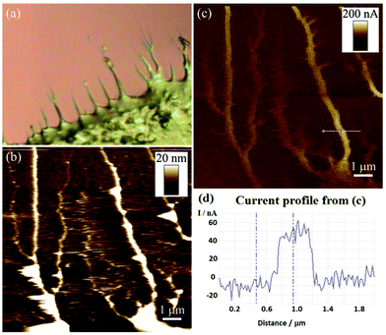
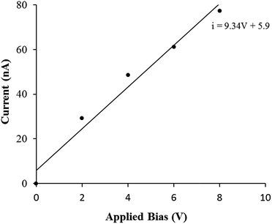
Conductive Observation: The dark phase contrast observed across the entire range of bias potentials (-10 V to +10 V) will indicate that all three DNA/Cu structures are conductive. The magnitude of phase shifts is proportional to V^2.
Confirmation of Conductivity: In previous SCM experiments, it has been established that negative phase shifts like those observed in this study can only occur if the analyzed object is electrically conducting. This confirms that the DNA-templated Cu structures in this study will exhibit electrical conductivity.
Conductivity of Thin Coatings: Even the smallest of the examined DNA/Cu structures (with a diameter of 2.8 nm) is shown to be conductive according to previously done experiments. This suggests that, through the solution-based synthetic approach used in this study, even relatively thin Cu coatings on the DNA molecules can create a continuous electrical conducting pathway along the structure.

Slide 15
Other Method to Obtain Cu-DNA
Different Templating Method: Unlike previous methods that involved templating DNA immobilized on a support surface, this approach starts by mixing aqueous solutions of duplex DNA and Cu(NO3)2. The aim was to introduce Cu(ii) cations into the DNA structure.
Cu Cation Association with DNA: Divalent metal cations, such as Cu(ii), can interact with DNA duplexes by binding to phosphate groups in the DNA backbone or donor sites in the DNA bases.
Formation of DNA-Templated Cu Structures: The addition of ascorbic acid initiated the formation of DNA-templated Cu structures by reducing Cu(ii) cations to Cu(0). This reduction process not only involved the initially added Cu(ii) cations but also additional Cu(0) deposition from the solution.
Isolation of Product Material: To analyze the product using AFM, the reaction mixture was centrifuged to separate the DNA-templated Cu structures from non-templated Cu material in the solution. The isolated structures were then immobilized on a silicon wafer modified with a TMS monolayer using molecular combing methods.
Effect of Cu Concentration: The concentration of Cu(ii) in the templating solution influenced the structural characteristics of the resulting product material. Higher Cu(ii) concentrations (25-500 mM) led to the formation of dense network structures.

Slide 16
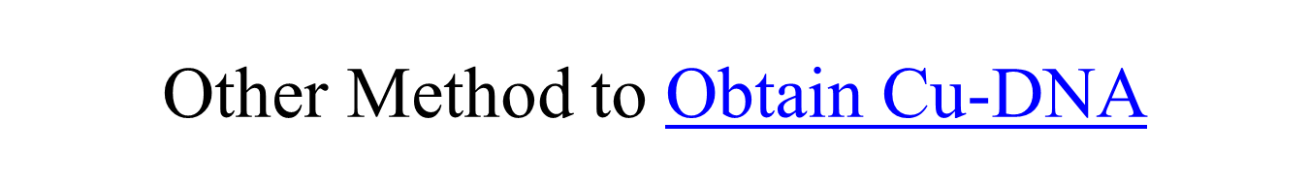
Charge Neutralization: The introduction of Cu(ii) cations into the DNA helped neutralize the repulsive electrostatic forces between DNA molecules. This neutralization allowed DNA to aggregate into dense networks, as observed through AFM imaging.
Cu Concentration Impact: Lower Cu(ii) concentrations in the templating solutions (10-50 μM) were insufficient to induce significant aggregation. As a result, the resulting DNA/Cu product material appeared as distinct 1D structures.
Optimal Reaction Conditions: After initial studies, specific reaction conditions were established to produce uniform DNA-templated Cu nanowires. These conditions included λ-DNA (300 μg mL−1), Cu(NO3)2 (50 μM), and ascorbic acid (2 mM) mixed in a 1 : 1 : 1 (v/v/v) ratio, incubated at room temperature for 3 hours.
Structural Characteristics: DNA-templated Cu structures prepared under these conditions appeared as distinct nanowires with a height of approximately 4.7 nm, indicating successful metallization of the DNA. The Cu coating was smooth and continuous without visible breaks.
Comparison to Surface-Bound DNA: Importantly, the structures formed in bulk solution differed from the more granular structures observed in templating reactions involving surface-bound DNA.

Slide 17
I-V Characterization Study in IITBNF LAB
Sample Preparation: DNA/Cu nanowires were densely deposited onto a silicon wafer with a 200 nm SiO2 layer, modified with TMS. Small bundles of these nanowires were observed protruding radially at the periphery of the dense deposit (see Fig. 5(a)).
Electrical Contact: The dense nanowire deposit served as an electrical contact between the sample material and a metallic chuck.
Probe Setup: cAFM was performed on the DNA/Cu structures located at the edge of the dense nanowire deposits. The Ga–In eutectic/nanowire network acted as one electrical contact, and a conductive AFM tip served as the second contact.
Measurement Location: The areas of the sample surface scanned during cAFM measurements were typically within a distance of ≤1 mm from the eutectic contact.
Contact Mode Image: A contact mode height image was captured at the edge of a dense DNA/Cu nanowire deposit, revealing multiple DNA/Cu structures on the Si/SiO2 wafer surface. These structures had heights typically ranging from 11 to 20 nm, indicating they were bundles of multiple DNA/Cu nanowires, forming thicker rope-like structures.
Importance of Nanoropes: These thicker nanoropes were necessary for reliable imaging in contact mode during cAFM experiments.

Slide 18

Current Map: A current map was simultaneously acquired with the height data at +8 V bias, confirming the conductive nature of the DNA/Cu structures. Current signals, on the order of tens of nanoamps, correlated with the positions of these DNA/Cu nanoropes
No Current on Dielectric Surface: No current signal was detected in areas where the AFM tip was in contact with the dielectric SiO2 surface, confirming that the conductivity was specific to the DNA/Cu structures.
Current-Voltage Plot: A current-voltage (I-V) plot for an individual DNA/Cu nanorope was generated by recording a series of current maps at different applied biases. Line profile measurements were used to estimate the current passing through the nanorope. The plot displayed a linear relationship between current and applied bias.
Resistance Estimation: The slope of the regression line in the I-V plot provided an estimated resistance of approximately 10^7 megaohms (MΩ) for the nanorope.
Resistivity Calculation: To calculate resistivity, the nanorope was assumed to have a diameter of about 20 nm (based on AFM measurements) and a length of approximately 1.5 micrometers (representing the distance between the edge of the nanowire network and the measurement point). Using these dimensions, a resistivity value of approximately 2 ohm-centimeters (Ω cm) was determined.
Comparative Resistivity: This resistivity value is significantly higher than that reported for Pd-seeded DNA-templated Cu nanostructures (3.6 × 10^-2 Ω cm) and much higher than the resistivity of pure bulk Cu (1.7 × 10^-6 Ω cm).

Slide 19
Market Analysis (Current Status in Market)
The global memristor market was valued at US$ 190 Million in 2022.
Expected global memristor market to exhibit a CAGR of 51.4% during 2023-2028.
The rising utilization of memristors for enabling modern computing and memory device technologies, including nanoelectronic memories and neuromorphic computing architectures, as they are stable, fast, and reliable, is primarily driving the global memristor market.
Based on the type, the global memristor market has been segmented into molecular and ionic film memristor and spin-based and magnetic memristor. Currently, molecular and ionic film memristor holds the majority of the global market share.
Some of the major players in the global memristor market include Avalanche Technology, Crossbar Inc., Everspin Technologies Inc., Fujitsu Semiconductor Memory Solution (Fujitsu Limited), Honeywell International Inc., Known Inc., Renesas Electronics Corporation, STMicroelectronics, and Weebit Nano.

Slide 20
Market Analysis
The dna template and the Cu-dna can be obtained from DNA lab.
The fabrication of Cu-DNA with the device will be done in Nanofabrication lab.
The I-V characteristics of the device will be studied.
The characteristics will be implemented to a pattern recognition based SNN framework (codes) for AI applications like autonomous driver sensors and object detection and the accuracy for effective implementation can be studied.

Slide 21
Study of Read & Write speeds
Writing Process: During the writing process, a voltage of 0.6 V is applied to the device for a specific period of time (tw). This process involves applying a voltage to the device to set its state.
Reading Process: The reading process is slightly different. Here, the supplied voltage is gradually increased from 0 V to 0.1 V over a ramp-up time (tr). Once this voltage is reached, the device's current is continuously monitored at the same reading voltage. This process is used to measure the device's resistance state.
Change in Current States: By altering the duration of the writing period (tw), the current states of the Cu-DNA nanowire device can be changed. However, an interesting observation is made that after 300 seconds of current reading, the current states derived from different writing times converge to the same level.
Resistance States: The different current states, achieved through varying writing periods, correspond to different levels of resistance in the Cu-DNA nanowire device. This means that the resistance state of the device can be controlled by adjusting the duration of the applied voltage during the writing process.

Slide 22
Questions posed
In what form the Cu will be made to react with DNA?
Cu is made to go through an ionic reaction with DNA, In metal ion-chelated DNA (M-DNA), metal ions are involved in the formation of a coordinate complex.
The metal ions specifically interact with the N3 position of thymine and the N1 position of guanine.
This interaction occurs by replacing the imino protons at these positions .
To facilitate this coordination between metal ions and DNA bases, M-DNA synthesis is carried out under an alkaline environment, typically around pH 9.
The alkaline environment is necessary to deprotonate the thymine and guanine bases, making them available for coordination with the metal ions.
Can we directly obtain Cu-DNA outside lab?
Yes, it can be procured from DNA labs.

Slide 23
DNA linkers
DNA Sequences: Three single-stranded DNA sequences were synthesized for the purpose of immobilizing a double-stranded DNA between gold electrodes. These sequences were named T5, T3, and T53.
Thiol Group Labeling: T5 and T3 oligonucleotides were labeled with thiol groups on opposite ends using specific chemical methods.
Complementary Sequences: T5 is complementary to one end of T53, while T3 is complementary to the other end of T53. When mixed in equimolar ratios with T53 in a sodium chloride (NaCl) solution, they form an 18-base double-stranded DNA.
Immobilization Process: Double-stranded DNA was immobilized in the break junction by reacting the T3-T5-T53 complex with the gold electrodes. This reaction occurred at a 5 micromolar concentration in a phosphate buffer solution at room temperature for 2 hours.
Use of 6-Mercapto-1-Hexanol (MCH): The surface was further treated with a 1-millimolar solution of 6-mercapto-1-hexanol (MCH). MCH is known to react with gold surfaces to form a self-assembled monolayer. This treatment helps minimize nonspecific DNA-gold interactions and removes non-covalently bound DNA.
XPS Analysis: X-ray photoelectron spectroscopy (XPS) was used to determine the relative grafting density of the oligonucleotides on the gold surfaces. The table summarizes the atomic composition of gold surfaces exposed to T3 alone (DNA) and T3 followed by MCH (DNA+MCH). The decrease in nitrogen and phosphate composition after MCH treatment confirmed the displacement of non-covalently bound DNA.
In essence, the text describes the synthesis and immobilization of DNA sequences on gold electrodes, the use of 6-mercapto-1-hexanol to enhance the bonding and minimize non-specific interactions, and the characterization of the DNA monolayers on the gold surfaces using XPS analysis.

Slide 24
Specific Application Process
Our device excels for the following reasons:
Bio-compatibility: It's made from organic molecules, ensuring bio-compatibility.
DNA Template: Utilizes DNA as a template, offering immense storage potential (1 gm of DNA equals millions of gigabytes).
Industry Revolution: Has the potential to revolutionize nanofabricated devices, enabling vast data storage in a tiny space.
Additionally, in areas like pattern recognition, failure tolerance, and cognitive tasks, simple organisms outperform supercomputers. A Cu-DNA-based SNN framework can enhance energy efficiency and provide extensive storage space.

Slide 25
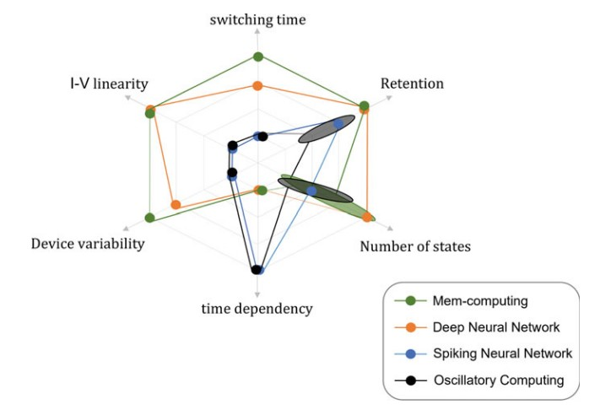
Testing for AI Applications involving Pattern recognition
Most to the AI applications need huge amount of training data, large storage space will boom the productivity of all AI applications, for testing pattern based AI applications using CU-DNA following can be done:
Fabricate the Cu-DNA chip
Study the I-V characteristics of the chip in IITBNF lab.
Implement the characteristic parameters to pattern recognition - Spiking neural Networks based computational architecture to study its implementation to check the requirements on particular memristive device properties, such as I-V linearity, switching time, retention, number of states, time-dependency, and device variability.
Conclude the implementation of Cu-DNA based SNN framework on pattern recognition AI applications like Driver sensor, object detection.

Slide 26
References (Maximum 10)
Chang PC, Chang CY, Jian WB, Yuan CJ, Chen YC, Chang CC. The fabrication and application of Ni-DNA nanowire-based nanoelectronic devices. Nano Research. 2019 Jun;12:1293-300.
Subbulakshmi Radhakrishnan S, Sebastian A, Oberoi A, Das S, Das S. A biomimetic neural encoder for spiking neural network. Nature communications. 2021 Apr 9;12(1):2143.
Kim, Youngeun, and Priyadarshini Panda. "Visual explanations from spiking neural networks using inter-spike intervals." Scientific reports 11, no. 1 (2021): 19037.
Phadke, O., Saraswat, V. and Ganguly, U., 2022. Highly Deterministic One-Shot Set–Reset Programming Scheme in PCMO Resistive Random-Access Memory. ACS Applied Electronic Materials, 4(10), pp.4921-4928.
Shukla, Aditya, and Udayan Ganguly. "An on-chip trainable and the clock-less spiking neural network with 1R memristive synapses." IEEE transactions on biomedical circuits and systems 12, no. 4 (2018): 884-893.
Shukla, S., Pathak, R., Saraswat, V., & Ganguly, U. (2020). Adaptive chemotaxis for improved contour tracking using spiking neural networks. In Artificial Neural Networks and Machine Learning–ICANN 2020: 29th International Conference on Artificial Neural Networks, Bratislava, Slovakia, September 15–18, 2020, Proceedings, Part II 29 (pp. 681-692). Springer International Publishing.
Kotariya, Vineet, and Udayan Ganguly. "Spiking-GAN: A spiking generative adversarial network using time-to-first-spike coding." In 2022 International Joint Conference on Neural Networks (IJCNN), pp. 1-7. IEEE, 2022.
Singh, A.K., Saraswat, V., Baghini, M.S. and Ganguly, U., 2022. Quantum tunneling based ultra-compact and energy efficient spiking neuron enables hardware SNN. IEEE Transactions on Circuits and Systems I: Regular Papers, 69(8), pp.3212-3224.
Lashkare, Sandip, Wasi Uddin, Kumar Priyadarshi, and Udayan Ganguly. "Emerging Memory Technologies for Data Storage and Brain-Inspired Computation: A Global View with Indian Research Insights with a Focus on Resistive Memories." Proceedings of the National Academy of Sciences, India Section A: Physical Sciences (2023): 1-18.
Kasabov N, Dhoble K, Nuntalid N, Indiveri G. Dynamic evolving spiking neural networks for on-line spatio-and spectro-temporal pattern recognition. Neural Networks. 2013 May 1;41:188-201.

