Slide 1

DOX Project – Eliminate NDF From ECAT RMA
Innovation
Teamwork
Inspiration
Title slide

Slide 2
Contents
Team Structure Page 3
Business Problem & Background Page 4
Scope Page 5
Objective Page 6
Motivation Page 6
DEFINE
Project Plan Page 8
Project Charter Page 9
SIPOC Page 10
MEASURE
Process Mapping Page 12
Value Stream Mapping Page 13
Identify Improvement Areas Page 14
Data Collection Plan Page 15
Gage R&R Study Page 16
Attribute Agreement Analysis Result Page 17
ANALYZE
Identify opportunities for improvement at FCT Page 19
Identify potential cause for FCT low FPY Page 20
Fishbone diagram Page 22
Validate potential causes Page 23
Develop problem statement Page 24

Slide 3
IMPROVE
Evaluate and select solutions Page 28
Design of Experiments Summary. Page 29
Verify effectiveness of solution Page 34
CONTROL
Implementation Plan Page 37
Process Control System Page 38
Control Result Page 40
Cost Saving Page 41
Project Status

Slide 4
Team Structure
Name (s) | Role
Jason Miller/Chin Meng Tan/Casey Ng | Project Sponsor
IBM MFG | Process Owner
PQE & MFG TEST ENGINEERING | Key Stakeholders
Ceriawati Ng | Finance Analyst
Celine Chong | MBB/BB Coach
Isaias Rafael Jr Burao Angeles | Project Lead / GB
Ireneo Delco Quesea, Thanabal Krishnan, Kumar Thirumalai, Christian Nugraha | Core Team
MFG Test, PQE, RCH ECAT Test | SME

Slide 5
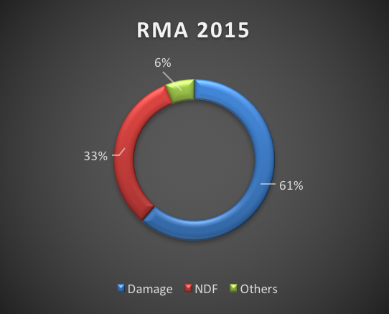
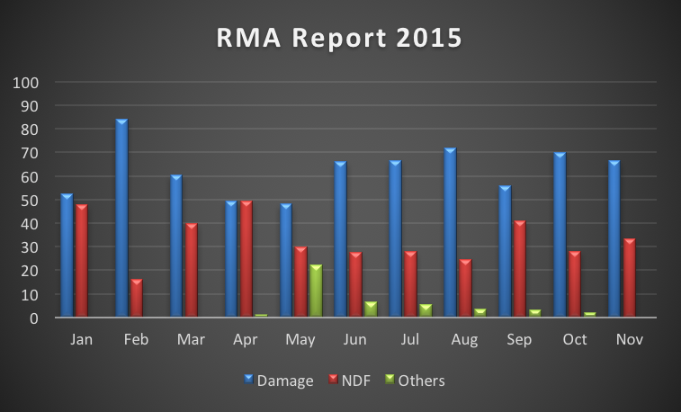
Business Problem & Background
In the ECAT RMA Analysis report on Power System in 2015, the top defects are damage and NDF. NDF parts contributes 33% to the total defective parts found in supplier
Picture 1 – Top three (3) Defects
Picture 2 – RMA Report for year 2015
Agenda slide

