Slide 1
Review: Chips – Snack Foods
June 2020
Retail Analytics
analysis was made by Ira Safonik
Data Analyst
Brand note: If client logo is not required, use alternate title page layout right click slide thumbnail > Layout > Title

Slide 2
Notes:
To view Privacy video explaining how important data privacy is to Quantium, please click here: https://www.youtube.com/watch?v=Zq1QDAkoRzU
or here Q:\Company Reference\Brand & Design\Brand videos\Q Privacy.mp4
At Quantium, we believe that data is the behavioural footprint of humanity and that it has to be treated with the utmost care and responsibility.
Histories, attitudes, indeed lives are stored within it in ways that aren’t always apparent – and that’s what makes its potential so powerful.
To work with it responsibly, sensitively, we set ourselves the highest data privacy protection and governance standards.
We have spent 17 years perfecting privacy-by-design and secure-by-design principles. Central to this is not holding any personally identifiable information about people –
we neither receive it, and put the necessary protections in place to be unable to decipher it.
Every aspect of handling data is safeguarded: from its de-identification, to its encryption – data security is paramount and of the highest grade.
We pride ourselves on gaining the trust of iconic organisations around the world through years of securely working with their data,
and in turn the trust that builds with their stakeholders.

Slide 3
Executive summary
01
Chips Category Review
Top contributing customer segments: Budget - Older Families, Mainstream - Young Singles/Couples, Mainstream - Retirees
Mainstream, Midage and Young Singles/Couples exhibited more impulse purchasing behavior, paying higher prices per unit
Mainstream - Young Singles/Couples 23% more likely to buy premium Tyrrells brand chips
For trial store 77, there was a statistically significant increase in sales during 2 of the 3 trial months compared to the control store.
For trial store 86, there was no statistically significant difference in sales compared to the control store during the trial period. However, the number of customers increased significantly.
For trial store 88, there was a statistically significant increase in both sales and number of customers during 2 of the 3 trial months compared to the control store.
02
Trial Store Analysis

Slide 4
01
Chips Category Review

Slide 5
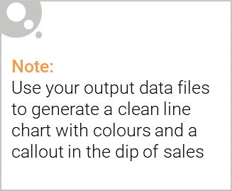
Overview: your key callout for the category should be included here
Key Callouts:
Optimize product assortment and placement to drive impulse purchases from valuable Mainstream - Young Singles/Couples segment
Increase visibility and off-locate Tyrrells chips and smaller pack sizes near areas they frequent
Target and retain top contributing customer segments with tailored marketing and promotions
In summary, adjusting assortment and strategic product placement, especially of premium and impulse options like Tyrrells and small packs, can capitalize on the high-value Mainstream Young Singles/Couples segment. Combined with targeted promotions for the top segments, this can unlock further chip category growth.

Slide 6

This slide will be commentary on affluence and its effect on consumer buying for the category of chips
Affluent mainstream customers (Midage/Young Singles/Couples) paid higher avg. price per unit => willing to buy premium/indulgent varieties
Mainstream Young Singles/Couples 23% higher affinity for premium Tyrrells brand
Higher disposable income enables impulse purchases of premium/gourmet chips
Budget segments (e.g. Older Families) prioritized more economical options over premium
Premium customers did not exhibit same impulse premium chip purchases
Greater affluence drove discretionary indulgences in mainstream middle-class
Opportunity to tailor strategies for these higher-value affluent mainstream segments

Slide 7
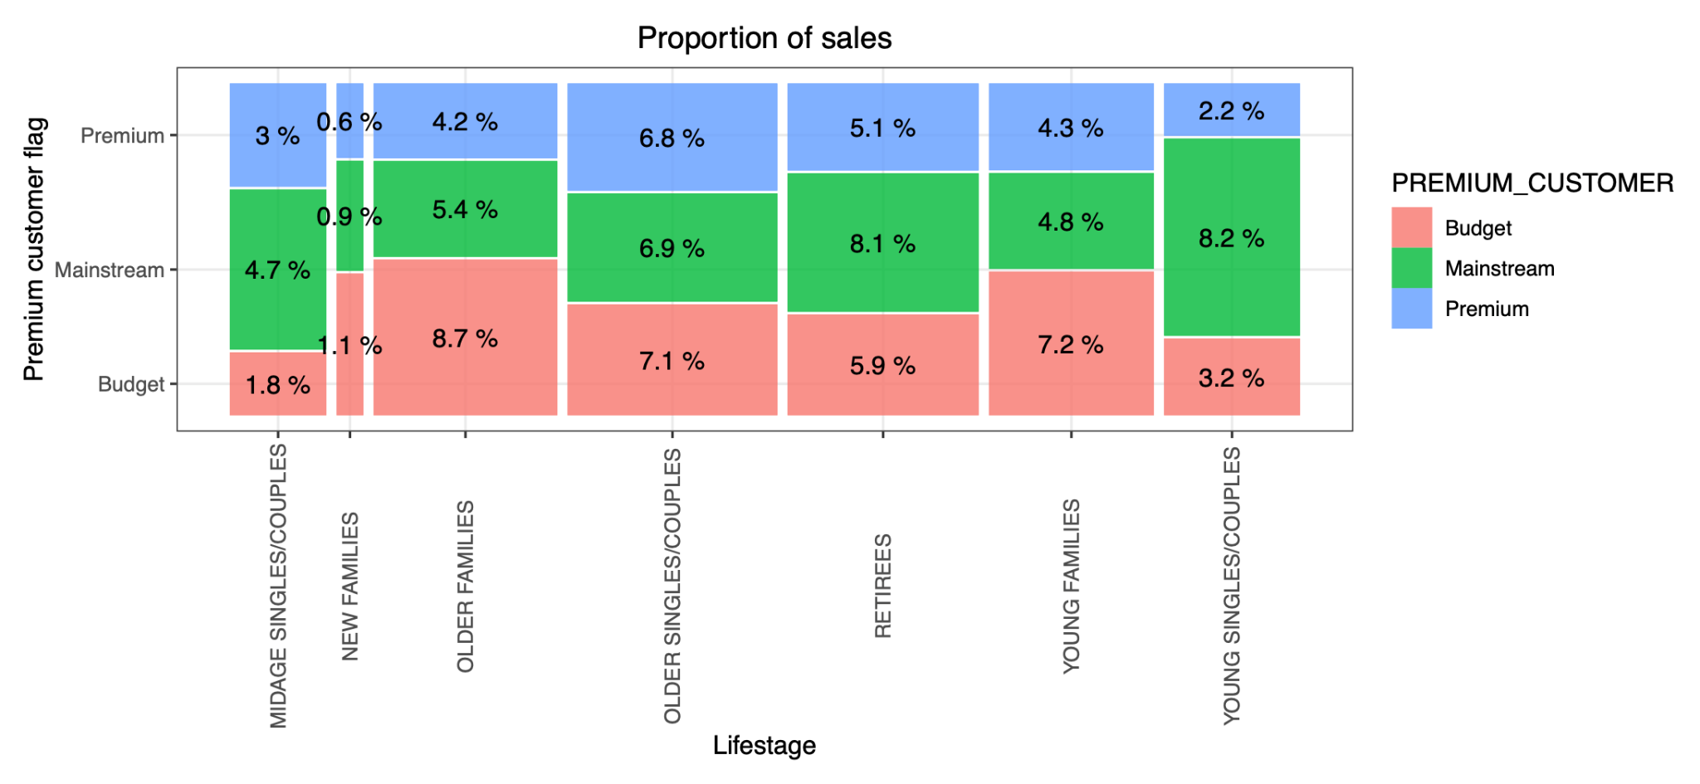
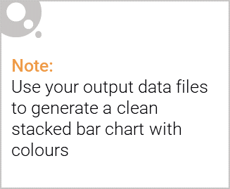
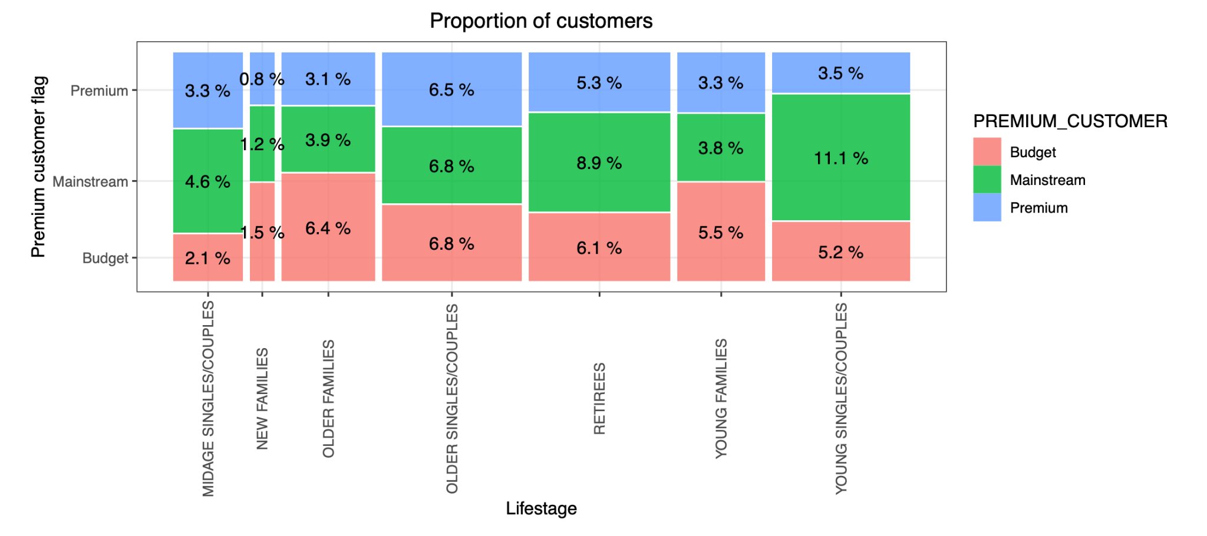
Editable (delete this)
Sales are coming mainly from Budget - older families,
Mainstream - young singles/couples,
and Mainstream - retirees
There are more Mainstream - young singles/couples and Mainstream - retirees who buy chips.
This contributes to there being more sales to these customer segments but this is not a major driver for the Budget - Older families segment.

Slide 8
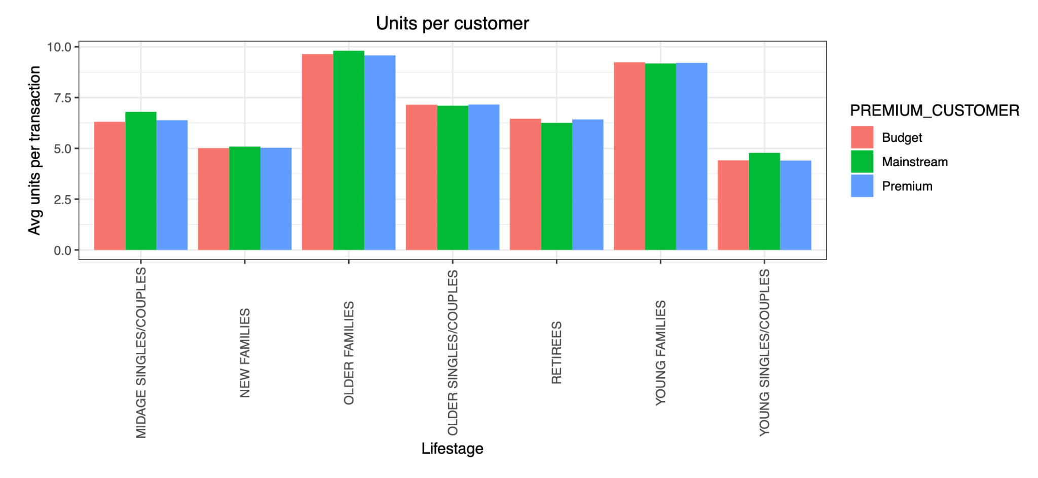
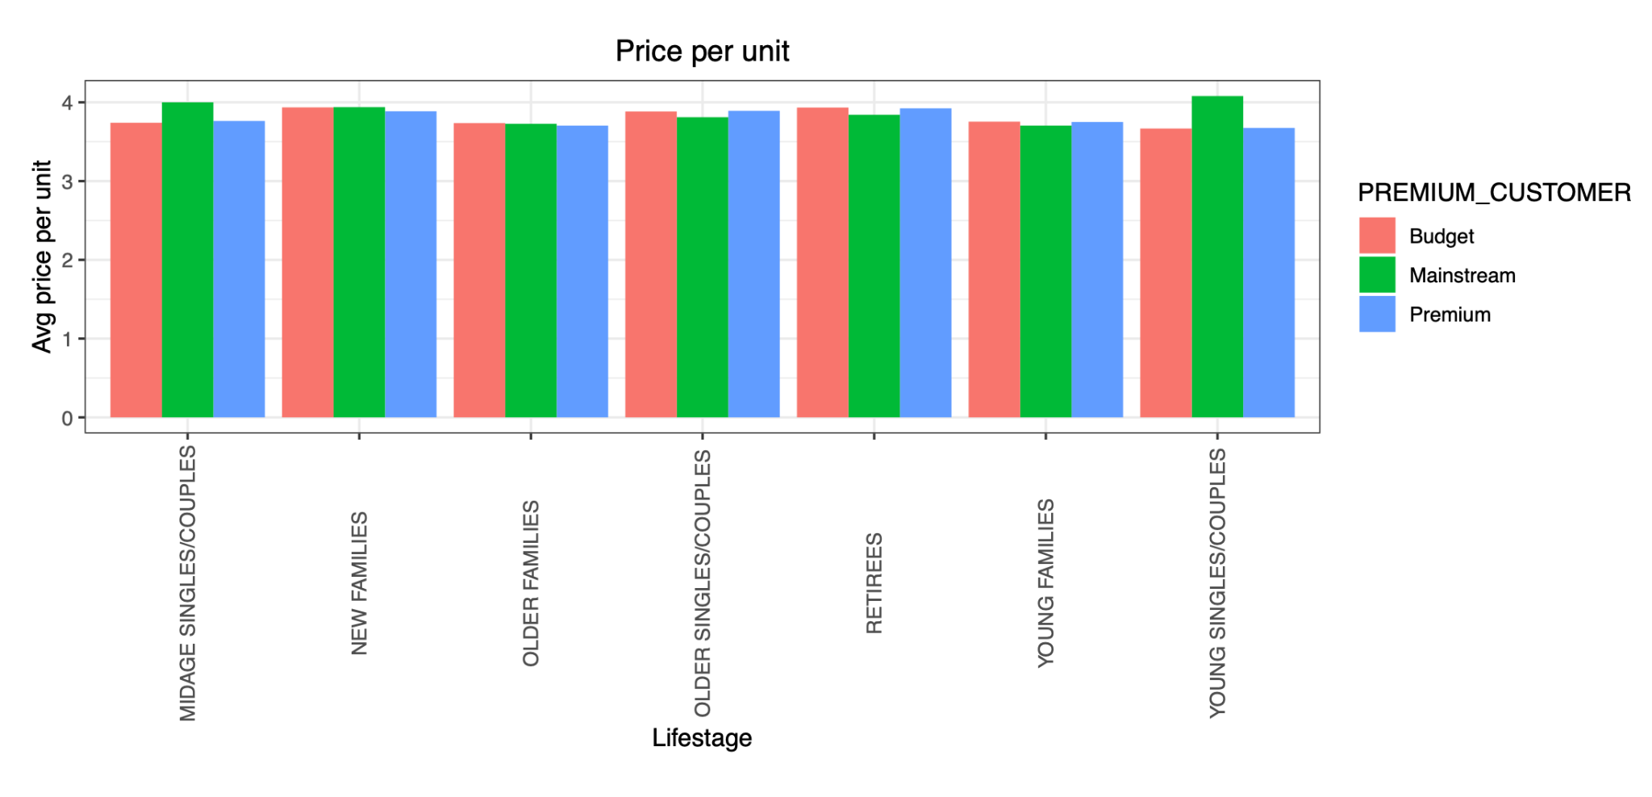
Editable (delete this)
Older families and young families in general buy more chips per customer.
Mainstream midage and young singles and couples are more willing to pay more per packet of chips compared to their budget and premium counterparts.
This is also supported by there being fewer premium midage and young singles and couples buying chips compared to their mainstream counterparts.

Slide 9
02
Trial store performance

Slide 10
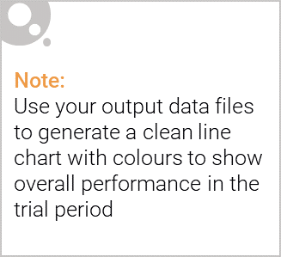
Explanation of the control store vs other stores
Control stores were identified for each of the 3 trial stores (77, 86, 88) by finding stores with similar sales and customer trends prior to the trial period.
Key Callouts:
The trial appears to have had a positive impact on increasing sales for stores 77 and 88, but not for store 86. Further investigation may be needed for store 86.
The increase in number of customers for store 86 despite no sales increase could indicate promotional pricing that impacted revenues.
Overall, the trial seemed successful in driving higher sales/customers for 2 out of the 3 stores, indicating it may be worthwhile to broadly implement the changes tested.
These findings suggest valuable insights for strategic planning and decision-making, emphasizing the importance of understanding individual store dynamics and tailoring strategies accordingly.

Slide 11
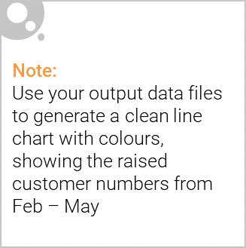
Call out of the performance in the trial store
The performance analysis of the trial store revealed varying outcomes across the three stores (77, 86, 88) during the trial period. Here's a summary of the findings:
Trial Store 77:
Experienced a statistically significant increase in sales during two out of the three trial months compared to the control store.
The trial period demonstrated a positive impact on sales performance, indicating successful implementation of the trial initiatives.
Trial Store 86:
Did not exhibit a statistically significant difference in sales compared to the control store during the trial period.
Despite this, there was a notable increase in the number of customers.
Further investigation is warranted to understand the discrepancy between sales and customer count, potentially due to promotional strategies or other factors.
Trial Store 88:
Demonstrated a statistically significant increase in both sales and the number of customers during two out of the three trial months compared to the control store.
The trial period showcased a successful performance, with positive impacts on both sales revenue and customer engagement.
Overall, while Trial Store 77 and Trial Store 88 saw favorable outcomes, Trial Store 86 exhibited mixed results. Success in the trial stores was primarily determined by the increase in sales and customer metrics compared to the control stores. The analysis underscores the importance of evaluating both sales and customer behavior to gauge the effectiveness of trial initiatives.

Slide 12
Thank you for your attention !

