Slide 1
DABDA Model
-Dr.IM, PgM, 9880.IM.0868

Slide 2
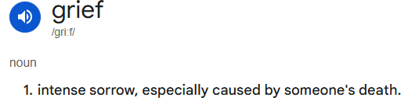

Grief?
Grief is a natural response to loss, particularly the loss of someone or something to which a person has formed a bond.
It is a complex emotional experience that can affect individuals in various ways, encompassing a range of emotions from deep sadness to anger.
Understanding grief and its stages can help individuals navigate through their emotions and find ways to cope with their loss.
The book "On Death and Dying“ – 1969, by Elisabeth Kübler-Ross, defines a model DABDA.
This model outlines five stages that people typically go through when dealing with grief and loss.
These stages are not necessarily experienced in a linear order, and individuals may move back and forth between stages or experience multiple stages simultaneously.

Slide 3
Denial
  Denial is the first stage of grief. It helps us to survive the loss. In this stage, the world becomes meaningless and overwhelming. Life makes no sense.
  Key Points:
    Shock and disbelief
    Numbness
    Avoidance of reality

Slide 4
Anger
  Anger is a necessary stage of the healing process. Be willing to feel your anger, even though it may seem endless. The more you truly feel it, the more it will begin to dissipate and the more you will heal.
  Key Points:
    Frustration and irritation
    Blaming others
    Feeling abandoned

Slide 5
Bargaining
  Before a loss, it seems like you will do anything if only your loved one would be spared. After a loss, bargaining may take the form of a temporary truce. We become lost in a maze of 'If only...' or 'What if...' statements.
  Key Points:
    Guilt and regret
    Making deals with a higher power
    Dwelling on what could have been done differently

Slide 6
Depression
  After bargaining, our attention moves squarely into the present. Empty feelings present themselves, and grief enters our lives on a deeper level, deeper than we ever imagined.
  Key Points:
    Deep sadness and despair
    Withdrawal from life
    Feeling overwhelmed

Slide 7
Acceptance
  Acceptance is often confused with the notion of being 'all right' or 'OK' with what has happened. This is not the case. Most people don't ever feel OK or all right about the loss. This stage is about accepting the reality that our loved one is physically gone and recognizing that this new reality is the permanent reality.
  Key Points:
    Coming to terms with the loss
    Finding ways to move forward
    Adjusting to a new reality

Slide 8
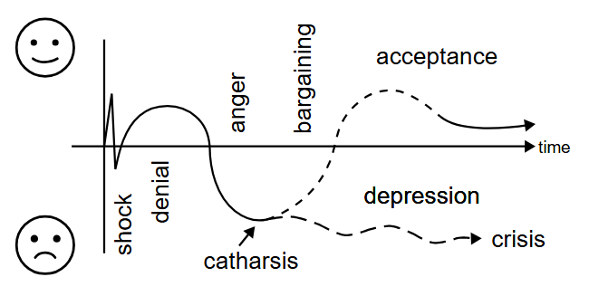
Catharsis
Catharsis is a term derived from the Greek word "katharsis," which means "purification" or "cleansing."
In psychological and emotional contexts, catharsis refers to the process of releasing, and thereby providing relief from, strong or repressed emotions.
This concept is often associated with therapeutic practices and the arts, where expressing emotions can lead to a sense of emotional liberation and healing.

Slide 9
Conclusion
Understanding these stages can provide a framework for recognizing and processing the emotions associated with grief. It's important to remember that everyone's grief journey is unique, and there is no right or wrong way to grieve.
Key Takeaways:
The stages are a framework for understanding the emotional responses to loss.
Not everyone will go through all the stages, and the order can vary.
The model helps in recognizing and validating the emotions experienced during grief.
DABDA theory can provide valuable insights into the grieving process and help individuals, and their loved ones navigate through the difficult emotions associated with loss.

Slide 10

Thank You

