Slide 1

Monkey Mind to
Monk Mind
Mental Discipline for Inner Peace
- Dr.IM, 9880.IM.0868

Slide 2
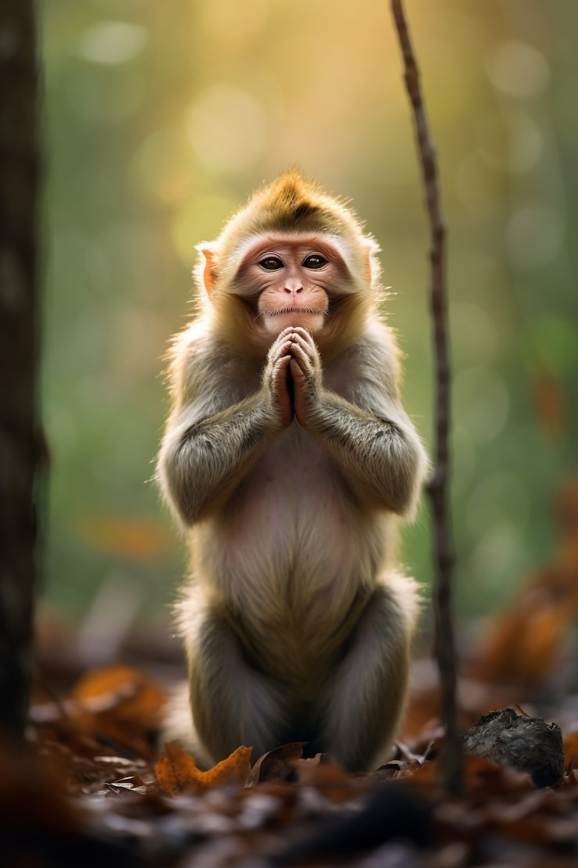
What is the 'Monkey Mind'?
Restless, random thoughts
Constant distractions and impulses
Irrational thinking and emotional reactivity

Slide 3
Symptoms of Monkey Mind
Difficulty in focusing
Anxiety or stress
Impulsive decision-making
Overconsumption of information

Slide 4
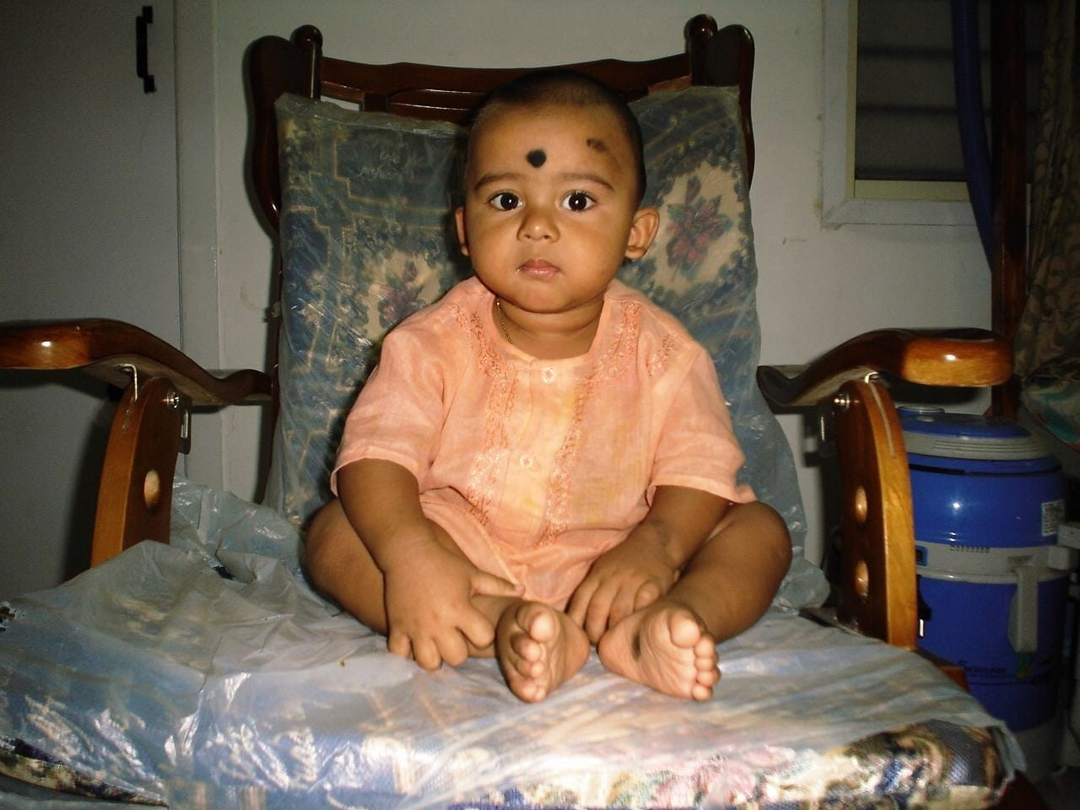
What is the 'Monk Mind'?
Calm and focused
Present in the moment
Guided by awareness and wisdom
Emotionally balanced

Slide 5
Why Shift from Monkey to Monk Mind?
Greater emotional intelligence
Improved concentration
Better decision-making
Enhanced well-being and peace

Slide 6
Cultivating Monk Mind
Mindfulness Practice
  Daily meditation, conscious breathing
Minimalism
  Reduce mental and physical clutter
Journaling
  Reflect to understand your thought patterns
Digital Detox
  Limit distractions and overstimulation
Intentional Living
  Align actions with values

Slide 7
Tools & Techniques
Meditation apps (multiple apps available for this)
Pomodoro technique for structured work model
Gratitude journaling
Nature walks or tech-free time
Jacobson deep relaxation technique (PMR)

Slide 8
Challenges in the Transition
Restlessness in early practice
Social pressure to stay constantly “busy”
Requires patience and consistency

Slide 9
Summary
Monkey Mind is reactive and chaotic
Monk Mind is intentional and calm
Mind training transforms perception, behavior, and emotional health

Slide 10
Final Thought
“You don’t have to control your thoughts. You must stop letting them to control you.”
  Dan Millman

