Slide 3

Outline
Parallelism Motivation, Concepts, serial vs parallel, parallelization strategies
Finisterrae III
Computer architecture
Optimization
Introduction to parallelism
Vectorization
Shared Memory vs. Distributed Memory
Parallel programing (OpenMP y MPI)
Hybrid Programing

Slide 4
Optimization
Compilation:
GNU: gfortran, gcc
Intel: ifort, icc
Options:
-o name : output executable name (a.out)
-O[0-3] : optimization level (-O2)
-g : for debugging
-pg : generate profiling report
Intel-specific options (equivalents available in GNU):
-x<code>:sse, avx, core-avx2, etc.
-xhost: optimize for the current processor (-march=native)
-fast: -ipo, -O3, -no-prec-div,-static, -fp-model fast=2, and –xhost (-Ofast)
-qopt-report-phase[=list]: loop, par, vec, openmp, all, etc.
-qopt-report[=N] -> N (0-5) report level (.optrpt) Optimization: The higher the level

Slide 5
Parallelism
Levels of Parallelism:
Instruction-level parallelism
Scalar processors, superscalar processors, and MT
Out-of-order execution and speculative execution

Slide 6
Parallelism
How to be faster?
Three methods (Pfister, 1998):
Work harder
Work smarter
Get help
Equivalent in computing:
Using faster hardware (higher clock frequency)
Optimizing algorithms
Utilizing multiple resources -> parallel computing

Slide 7
Parallelism
Levels of Parallelism:
Hardware Parallelism
Temporal parallelism (pipelining)
Spatial parallelism (replication)
Functional parallelism (multicore)
Software Parallelism
Instruction-level (vectorization)
Thread or task level
Process level
Evolution of processors:
Scalar -> Temporal parallelism
Superscalar -> Temporal and spatial parallelism
Multithread -> Temporal, spatial, and functional parallelism
Multicore -> …

Slide 8
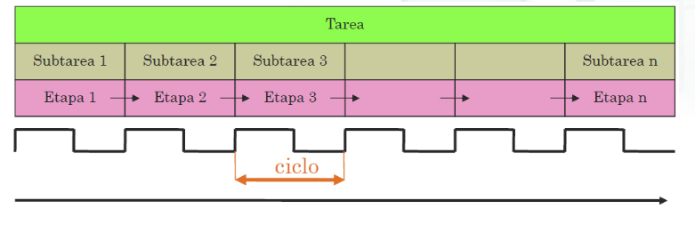
Parallelism
Scalar Processors - Superscalar Processors
Subdivision of execution into phases (of equal duration), synchronized with the clock
Each phase is assigned to a different hardware stage
One stage receives its inputs from the previous stage and provides inputs to the next stage
Segmentation
Task
Subtask 1
Subtask 2
Subtask 3
Subtask n
Stage 1
Stage 2
Stage n
Cycle

Slide 9
Parallelism
To maximize the utilization of all resources:
Out-of-order execution
Reordering instructions to avoid dependencies
add $t3, $t3, $t4
add $t5, $t3, $t6
Speculative
Execution In sequential programs, it's easy to launch several instructions and reorder them if necessary.
What happens when there is a branch instruction?
The CPU tries to predict and starts executing speculatively.
If the prediction fails, it discards the speculatively executed instructions.

Slide 10
Parallelism
Seeking more parallelism:
Superscalar Processors Increasing performance by finding independent instructions in a single thread.
Multithreaded Processors
Increasing performance by finding independent instructions in multiple threads.
Currently:
Multiple threads per processor (Hyper-Threading).
Multiple processors per chip (Multicore).
Multiple chips per node (Servers).
And of course, the combination of all the above.

Slide 11
Parallelism
Dependencias
Rendimiento de un computador
Speedup o aceleración y eficiencia
Escalabilidad
• Fuerte y débil
Ovehead, sincronización
Granularidad
Ley de Amdahl

Slide 12
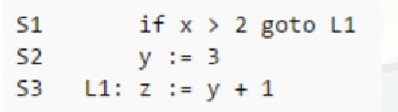
Parallelism
Control Dependencies
The execution of an instruction is conditioned by a previous one.
Data Dependencies
Instructions in a program refer to results that have not yet been completed.
Solutions:
Hardware (out-of-order and speculative execution)
Compiler (NOPs) Manual code reordering

Slide 13
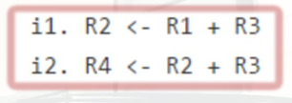
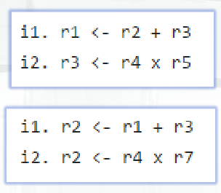
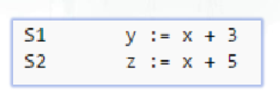
Parallelism
Types of Data Dependencies
RAW (True dependencies)
A needed data has not been calculated yet.
WAR (Antidependencies)
Concurrency or out-of-order execution issue.
WAW (Output dependencies)
Concurrency or out-of-order execution issue.
RAR (Input dependencies)
Not really a dependency

Slide 14
Parallelism
Computer Performance:
Number of instructions per unit of time.
FLOPS Theoretical Performance:
Maximum performance that can be achieved (peak)
Actual Performance:
The one obtained during the execution of a program
Sustained Performance:
Average performance for various tasks

Slide 15


Parallelism
Basic Concepts:
Speedup:
The acceleration experienced by a program when using N computing units.
Efficiency:
The achieved speedup compared to the ideal case.
Superlinear Speedup:
Speedup greater than N or efficiency greater than 1.
Parallel efficiency

Slide 16
Parallelism
Scalability:
The evolution of performance with the number of resources.
Strong Scalability:
The evolution of speedup with the number of computing units for a given problem size.
Weak Scalability:
The evolution of performance by increasing the number of processors and the size of the problem, trying to keep the workload of each processor constant.

Slide 17
Parallelism
Wall clock time:
The time required by a program to complete its execution.
CPU time:
Sum of time consumed on each of the CPUs.
Approximately Wall clock x N.
Parallel overhead:
The extra cost due to the parallel execution of a program.
Due to synchronization, message passing, task or thread creation and destruction, etc.

Slide 18
Parallelism
Process:
A copy of a program. Communicates with other processes through message passing.
Task (thread):
Part of a program.
Communicates via shared memory.
Synchronization:
Synchronizing two or more processes or tasks running in parallel.
Thread safe:
Capability of a library to be used simultaneously and independently by multiple tasks running in parallel.

Slide 19
Parallelism
Communications:
The action of sending data between processes within the same program.
Latency:
The time required by the network to send the smallest data.
Primarily time due to initialization.
Bandwidth:
The amount of data that can be sent per unit of time.

Slide 20

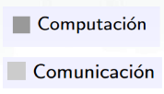

Parallelism
Granularity in communication:
A qualitative measure of the ratio between time spent on communication and computation.
Fine granularity: Little computation between successive communications.
Coarse granularity: Much computation between successive communications.
time
computation
Communication
time

Slide 21
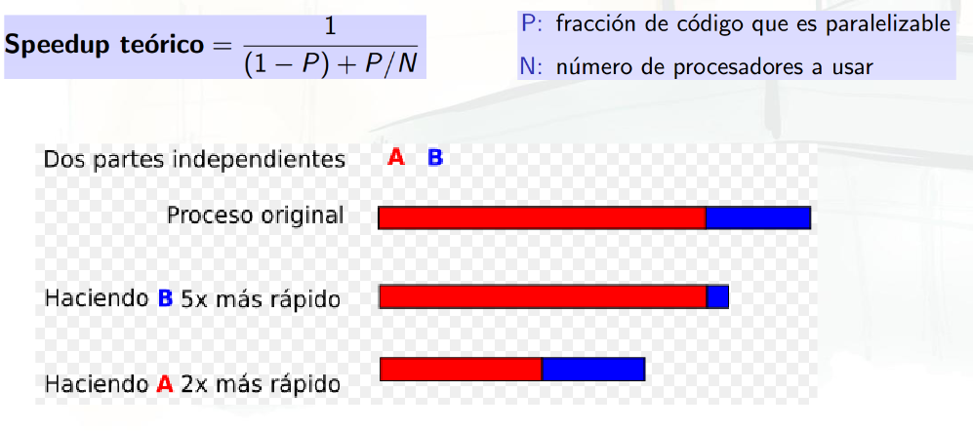
Parallelism
The Amdahl's Law, formulated in the 1960s, states that the performance improvement of a system is limited by the fraction of time that can be improved or parallelized. In other words, if a portion of a program or process cannot be parallelized, then the overall performance of the system will be limited by that non-parallelizable portion.
Theoretical speedup
Parallelized Fraction of the code
Number pf processors used
2 independent parts
Original process
Making B 5x more faster
Making A 2x more faster

Slide 22
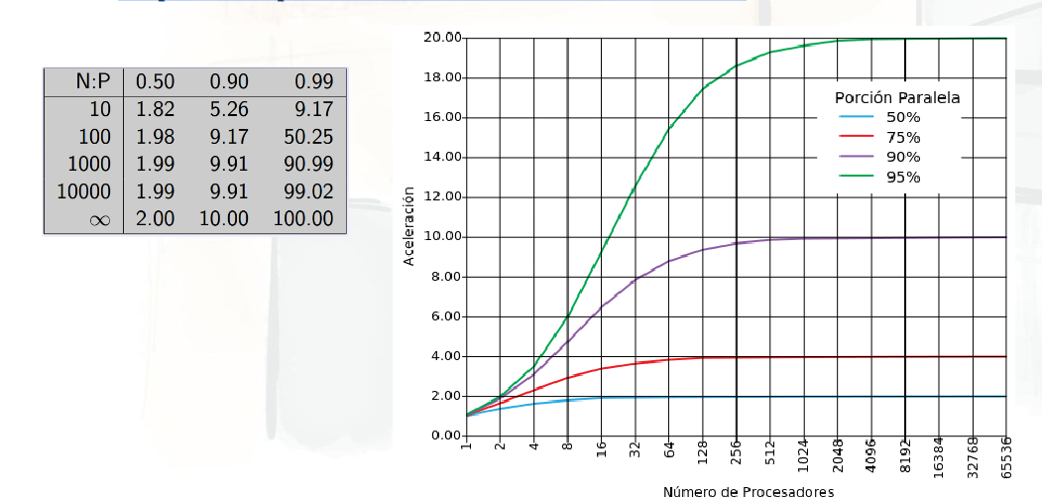
Parallelism
Amdahl's Law
The non-parallelizable part limits scalability.

Slide 23
Parallelism
Classification
There are different criteria for classification.
Flynn's Taxonomy
System memory organization
Scalability
Performance/cost ratio
Levels of utilized parallelism
etc.

Slide 24
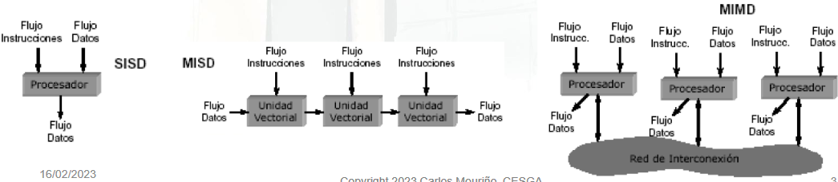
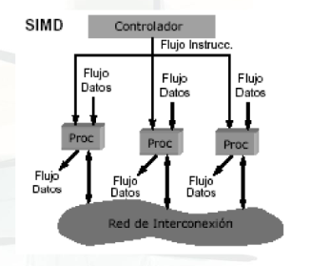
Types of Parallelism
Flynn's Taxonomy (1966)
Based on the flow of instructions and data
SISD: Single Instruction Single Data -> Uniprocessors
MISD: Multiple Instruction Single Data -> Not Used
SIMD: Single Instruction Multiple Data -> SPMD
MIMD: Multiple Instruction Multiple Data

Slide 25
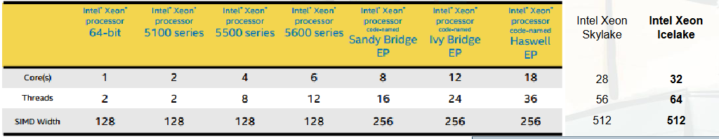
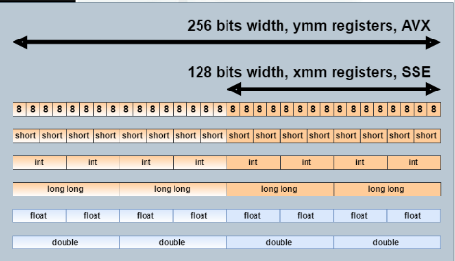
Vectorization
Current processors have vector units.
FMA: D = A*B + C (in one cycle)
Several ways to program:
Multimedia instructions (SSE/AVX Intrinsics)
Compilation directives
OpenMP 4.0, OpenACC

Slide 26
Vectorization
Requirements:
Absence of dependencies (or eliminable dependencies)
Regular access to data (without indirections)
Sufficiently long vectors
Aligned data
Recommendations:
Code as "flat" as possible (without jumps or function calls)
Avoid dependencies between iterations
Static arrays preferred over dynamic arrays with pointers "Efficient" memory access (contiguous and aligned data)

Slide 27
Vectorization
Compilation:
-x<code>: sse, avx, core-avx2, etc.
-ax<code>,<code>
-xhost: maximum for the current processor (-march=native)
Default is SSE2, with optimization level -O2 or higher
-qopt-report[=N] -> N report level (.optrpt) (-fopt-info-vec)
Level 0: No report
Level 1: When vectorizing
Level 2: Why it has not been vectorized
Level 3: Summary diagnostic of vectorization
Level 4: Additional details (such as data alignment)
Level 5: Adds details about dependency analysis

Slide 28

Vectorization
OpenMP SIMD Directives:
Portable:
-qopenmp, -simd, -qopenp-simd (-ftree-vectorize)
Allows vectorization of more complex loops than vector instructions
They are instructions, not indications (responsibility of the programmer)
Recognizes matrix notation: a = b * c
Syntax:
Clauses: Private, Firsprivate, Lastprivate, reduction, collapse, linear, safelen, aligned
Allows declaring and calling functions: !$omp declare SIMD

Slide 29
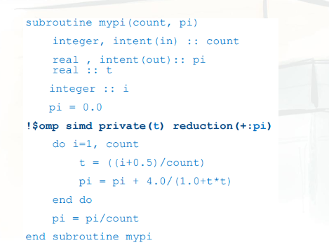
Vectorization
Example

Slide 30
Parallel Programming Environments:
Implicit parallelism:
The compiler handles parallelization
Shared memory only Usually achieves low performance
Less work for the programmer
Already parallel libraries can be used: BLAS, LAPACK, etc.
Explicit parallelism:
The programmer parallelizes the application
Directives or extensions of conventional languages are used
If done well, performance is very high
Quite costly for the programmer

Slide 31
Parallel Programming Environments:
Implicit parallelism:
The compiler handles parallelization
Shared memory only Usually achieves low performance
Less work for the programmer
Already parallel libraries can be used: BLAS, LAPACK, etc.
Explicit parallelism:
The programmer parallelizes the application
Directives or extensions of conventional languages are used
If done well, performance is very high
Quite costly for the programmer

Slide 32
Parallel Programming Paradigms:
Message Passing
Shared Memory
Tasks
Data Parallelism (SIMD).
Vectorial Remote Memory Operations
They are not mutually exclusive
They are independent of the underlying hardware

Slide 33
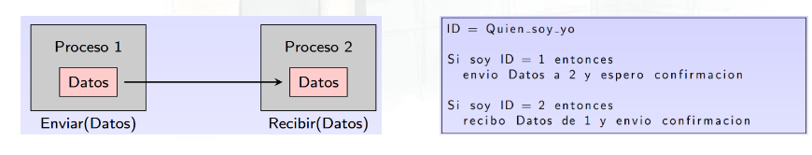
Parallel Programming Paradigms:
Message Passing Models
Each process has its own local memory
Processes exchange data through messages
The programmer is responsible for sending and receiving messages, typically done through calls to a library
Standard: MPI
ID= Who I’m I
If I ID=1 then
Send data to 2 and wait for confirmation
If I’m ID=2 then
Receive data of 1 and send confirmation
Process 1
Process 2
Data
Data
Send data
Receive data

Slide 34
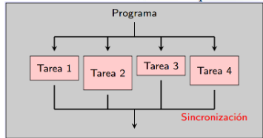
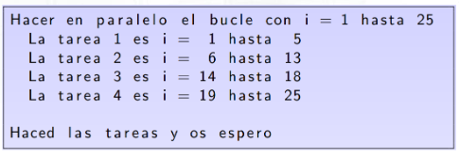
Parallel Programming Paradigms:
Task Model
The serial program defines a set of tasks
Each task has local memory but "has" access to shared memory
Tasks are executed simultaneously (Dependencies?)
The programmer is responsible for synchronization
Standard: OpenMP
Do in parallel the loop with i=1 to 25
The task 1 is i=1 to 5
The task 2 is i=6 to 13
The task 3 is i=14 to 18
The task 4 is i=19 to 25
Do the task I wait

Slide 35
Decomposition Techniques:
Decompose the problem into smaller problems, which will be assigned to processors to be solved simultaneously
Domain Decomposition:
Data Parallelism (SPMD)
Chunks of similar size and each part is assigned to a processor
Processors may need communication Functional
Decomposition: Task
Parallelism Very small chunks (>> processors)
Master - Slave: The master assigns subtasks to the slaves
Good when domain partitioning can be highly unbalanced

Slide 36
Implementations of parallel programming:
Fork-join in C
Use of threads (pthread)
OpenMP
MPI
CUDA (Only for NVIDIA)
Dask and other Python packages
Global Arrays, OpenACC, Map Reduce, Spark, ...

Slide 37
OpenMP:
De facto standard for shared memory systems
Basically 3 elements:
Parallelism control:
Parallel directive
Work control directives (do directive)
Data control and communications:
Private and shared variables
Synchronization:
Barriers
Critical sections and atomic instructions..

Slide 38
OpenMP:
De facto standard for shared memory systems
Basically 3 elements:
Parallelism control:
Parallel directive
Work control directives (do directive)
Data control and communications:
Private and shared variables
Synchronization:
Barriers
Critical sections and atomic instructions..

Slide 39
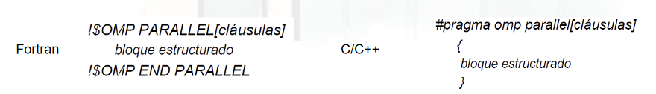
OpenMP: PARALLEL
Directive:
Defines a parallel region, which is a block of structured code executed in parallel by multiple threads
When a thread of execution encounters a parallel region:
It creates a team of threads (OMP_NUM_THREADS)
It becomes the master (id=0)
There is an implicit barrier at the end of the parallel region (NO_WAIT) Upon finishing the region, only the master thread continues
Structured block
Structured block

Slide 40
OpenMP:
PRIVATE(variable list)
Each thread has a local copy of the variables
A local variable is invisible to the rest
They are not defined outside the parallel region
SHARED(variable list)
Variables are seen and shared by all threads
The variable can be accessed concurrently
Mutual exclusion is not guaranteed (programmer's responsibility)
Accessible outside the parallel region
DEFAULT(PRIVATE|SHARED|NONE)
By default shared, except local variables and loop indices.
FIRSTPRIVATE and LASTPRIVATE

Slide 41
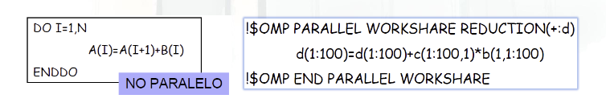
OpenMP:
Work-sharing Directives:
DO/for, Sections, Single, Workshare These directives distribute the workload of a block among the threads
They must be within a parallel region
They do not spawn new threads
There is no barrier on entry, but there is on exit
A loop is parallel if its instructions can be executed in any order

Slide 42
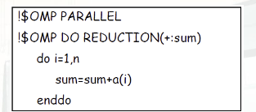
OpenMP:
REDUCTION(operator: list)
Applies a commutative and associative binary operator
As the order of operations changes, the result can be different.
SCHEDULE(static | dynamic | guided | auto | runtime), chunk
Distribution of iterations among the threads Important in case of imbalance
The default depends on the implementation

Slide 43
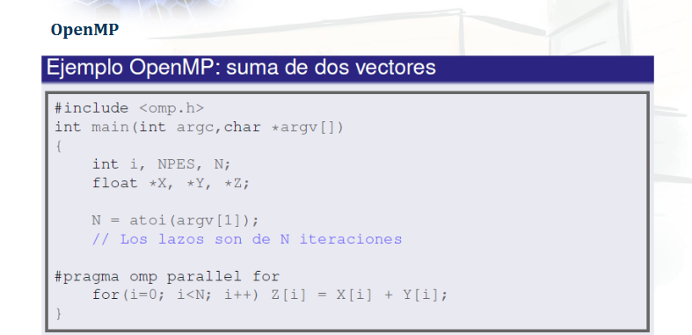
Example OpenMPI: sum of vectors

Slide 44
OpenMP:
MASTER Only the master thread executes the block
CRITICAL All threads execute the block, but only one at a time
BARRIER Synchronizes all threads
ATOMIC Similar to CRITICAL but for a single instruction
ORDERED Ensures ordered execution

Slide 45
OpenMP:
Library Functions
void omp_set_num_threads(int num_threads); Sets the number of threads to use in the next parallel region.
int omp_get_num_threads(void); Gets the number of threads being used in a parallel region.
int omp_get_thread_num(void); Returns the thread number.
int omp_in_parallel(void); Returns a nonzero value if executed within a parallel region. Parallel Program Design
Include: #include <omp.h>

Slide 46
OpenMP:
Library Functions
void omp_set_num_threads(int num_threads); Sets the number of threads to use in the next parallel region.
int omp_get_num_threads(void); Gets the number of threads being used in a parallel region.
int omp_get_thread_num(void); Returns the thread number.
int omp_in_parallel(void); Returns a nonzero value if executed within a parallel region. Parallel Program Design
Include: #include <omp.h>

Slide 47
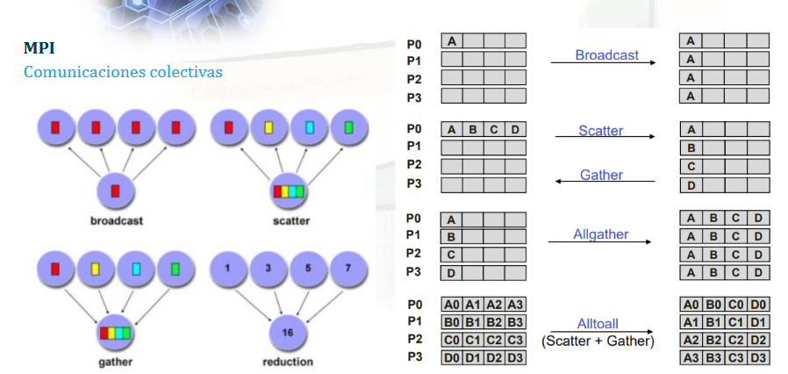

Slide 48
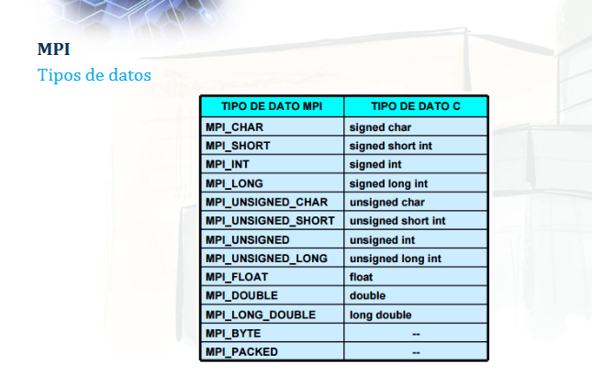

Slide 49
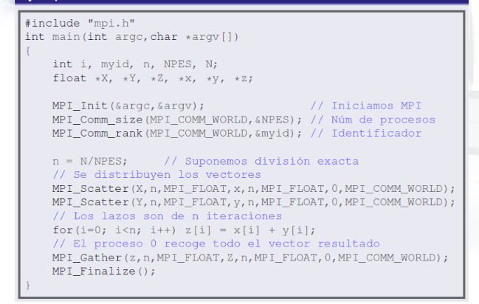

Slide 50
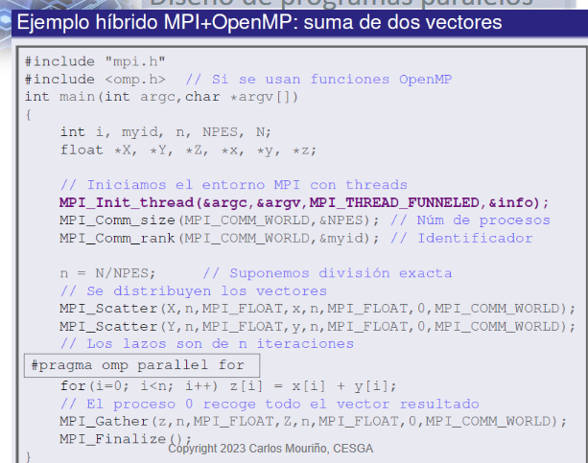

Slide 51
