Slide 1

FINAL YEAR PROJECT
MemoryCare
A smart assistant for dementia and Alzheimer's care
Supporting patients and caregivers, every single day

Slide 2
INTRODUCTION
Project Details
Presented by: Iraj Shahzad
Registration no: 41207223026
Domain: Healthcare and Artificial Intelligence
MemoryCare | Final Year Project
2

Slide 3
INTRODUCTION
Presentation Outline
What we will cover today
The problem and why it matters
Our solution and its main features
System analysis: use cases, domain model and system sequence
System design: database, architecture and process flows
Implementation, testing and results
MemoryCare | Final Year Project
3

Slide 4
01
Problem and Solution
Understanding the need and our approach

Slide 5
PROBLEM AND SOLUTION
Problem Statement
Daily life becomes difficult for both the patient and the family
Patients forget their medicines and daily routines
Familiar faces become hard to recognise
Caregivers cannot watch over the patient all day
Missed doses often go completely unnoticed
MemoryCare | Final Year Project
4

Slide 6
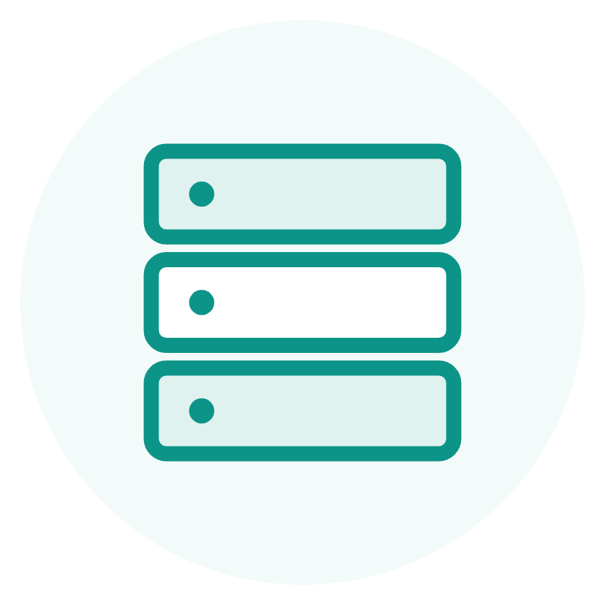
PROBLEM AND SOLUTION
Existing Systems
Why current tools are not enough
Reminder apps only show a basic alert and never involve the caregiver.
Voice assistants cannot recognise faces or use the patient's care data.
Each tool solves one task, so families end up using many apps.
None of them keep a record that a doctor or caregiver can review.
MemoryCare | Final Year Project
5

Slide 7

PROBLEM AND SOLUTION
Proposed Solution
One simple app for the patient and the caregiver
Medicine and routine reminders with a clear voice alert.
Face recognition that tells the patient who a person is.
A friendly assistant that answers in easy words.
Instant alerts to the caregiver when something is missed.
Reports that show how well the care plan is followed.
MemoryCare | Final Year Project
6

Slide 8
PROBLEM AND SOLUTION
System Features
Eight features that work together as one care system
Medicine reminders with voice
Daily routine tracking
Face recognition of loved ones
Memory gallery of people and moments
Friendly chat assistant
Real time caregiver alerts
Reports and compliance tracking
Roles for patient, caregiver and admin
MemoryCare | Final Year Project
7

Slide 9

PROBLEM AND SOLUTION
Objectives
What the project set out to achieve
Help patients remember medicines and daily routines.
Help patients recognise the people around them.
Give patients a simple assistant they can talk to.
Keep caregivers informed through live alerts and reports.
Give admins the tools to manage users and monitor the system.
MemoryCare | Final Year Project
8

Slide 10

PROBLEM AND SOLUTION
Scope
The boundaries we set for this project
Three user roles: patient, caregiver and admin.
Seven modules covering medicines, routines, faces, memories, chat, reports and alerts.
Runs in a normal web browser, so no special hardware is needed.
MemoryCare | Final Year Project
9

Slide 11

PROBLEM AND SOLUTION
Methodology
An iterative and incremental process
Phase 1: requirements gathering and system design.
Phase 2: core modules for medicines, routines and users.
Phase 3: face recognition and the chat assistant.
Every module was built, tested with real data and then improved.
Frontend and backend were joined through a REST API and Socket.io.
MemoryCare | Final Year Project
10

Slide 12
02
System Analysis
Understanding what the system must do

Slide 13
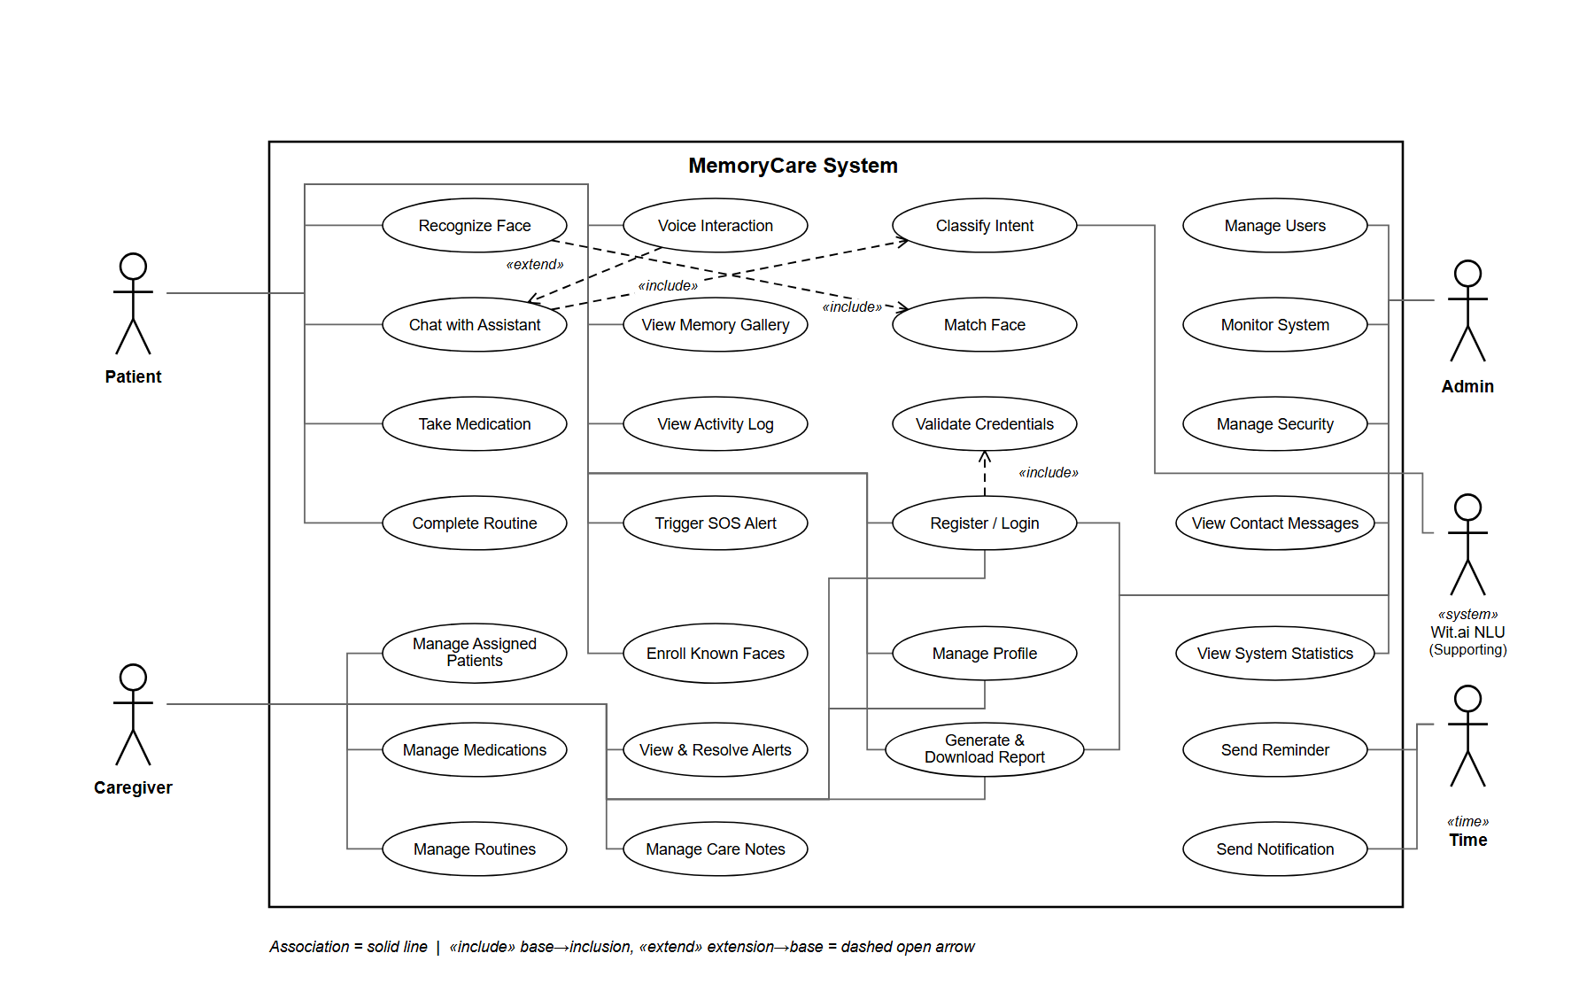
SYSTEM ANALYSIS
Use Case Diagram
WHAT IT SHOWS
Purpose: what each user is able to do in the system.
On the left: Patient and Caregiver, our primary actors.
On the right: Admin, plus Wit.ai and Time as supporting actors.
Inside the box: the use cases, grouped by role.
Notation: include is a step that always runs, extend is optional.
MemoryCare | Final Year Project
11

Slide 14
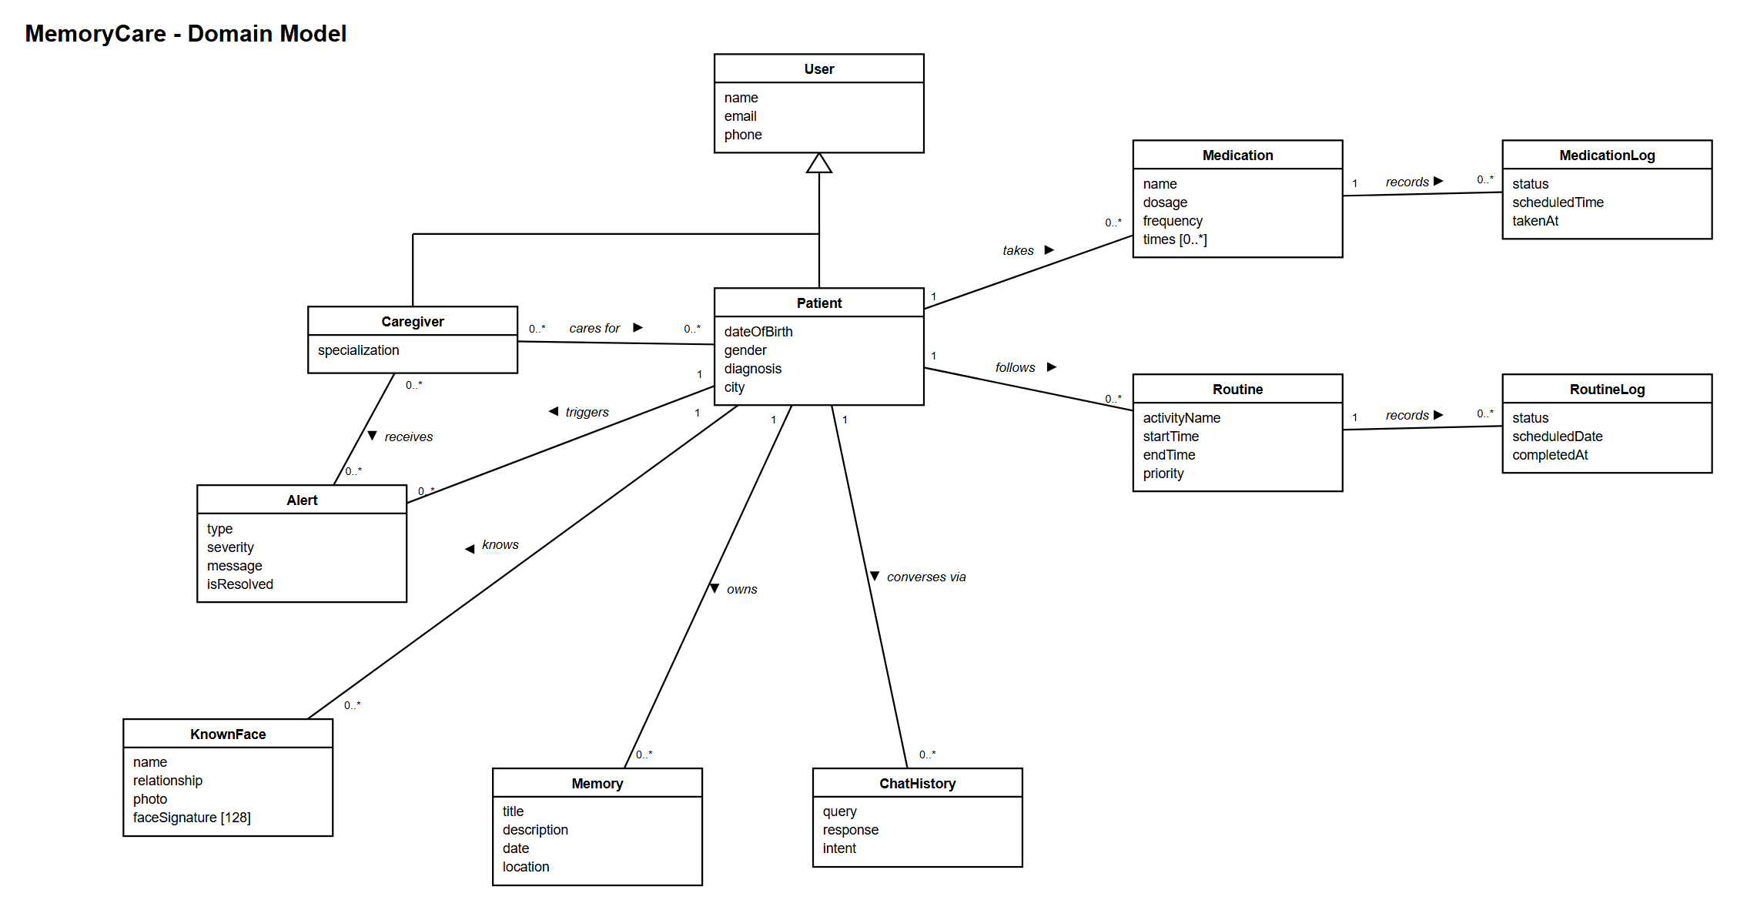
SYSTEM ANALYSIS
Domain Model
WHAT IT SHOWS
Purpose: the real world ideas behind the system.
The Patient sits at the centre of everything.
A patient takes medicines, follows routines and knows faces.
Every dose and every activity is written into a log.
A caregiver cares for one or more patients.
Only ideas and data here, no methods, because this is analysis.
MemoryCare | Final Year Project
12

Slide 15
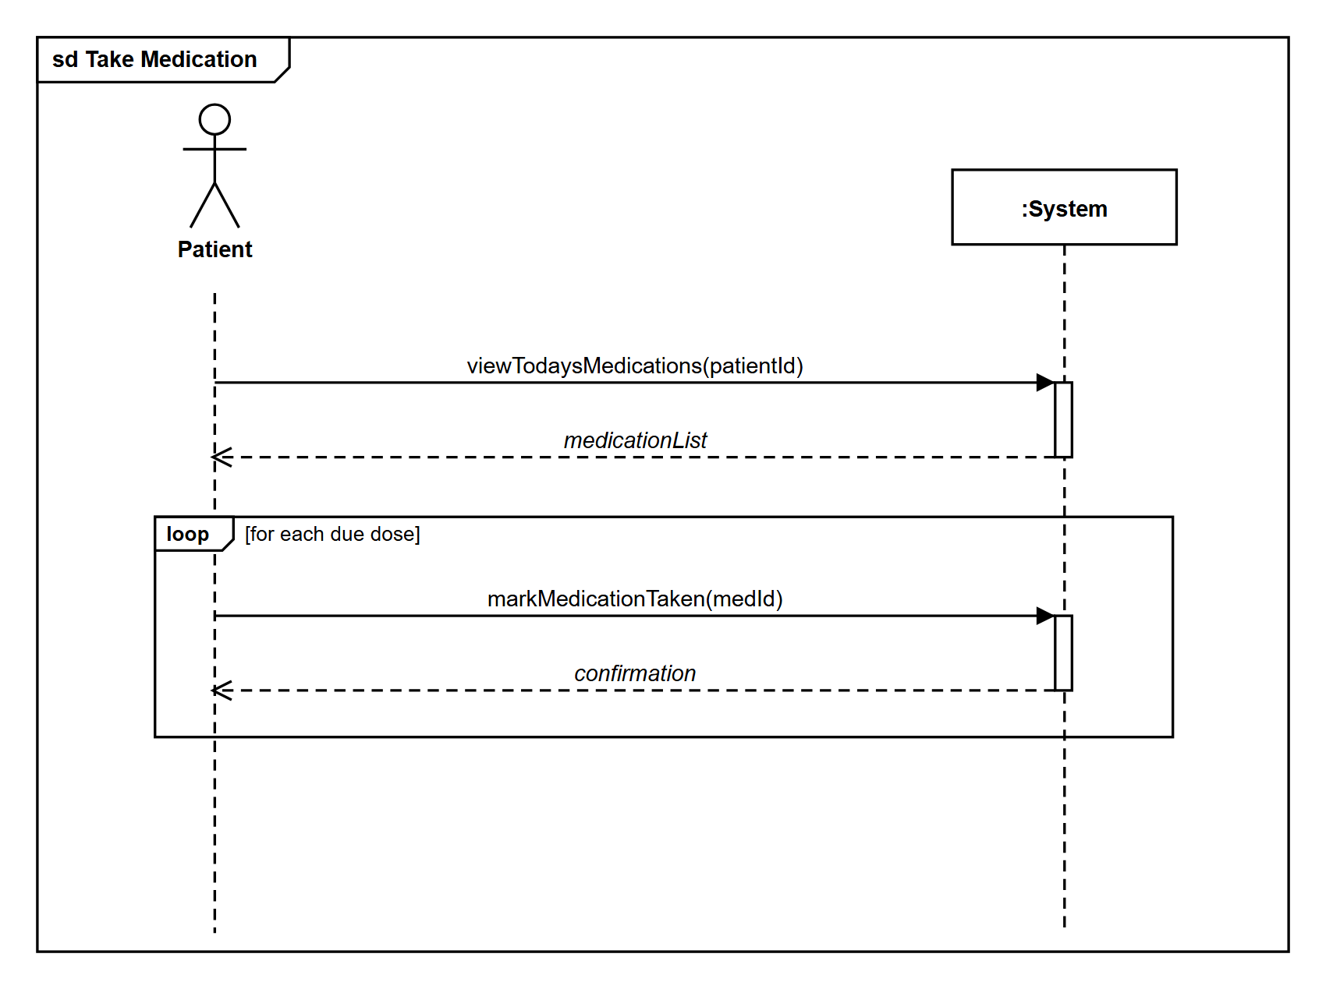
SYSTEM ANALYSIS
SSD: Take Medication
WHAT IT SHOWS
Purpose: the Take Medication scenario, step by step.
The patient asks for today's medicines and the system returns the list.
Then each dose that is due is marked as taken.
The loop frame means this repeats for every dose.
Every call returns a confirmation back to the patient.
MemoryCare | Final Year Project
13

Slide 16
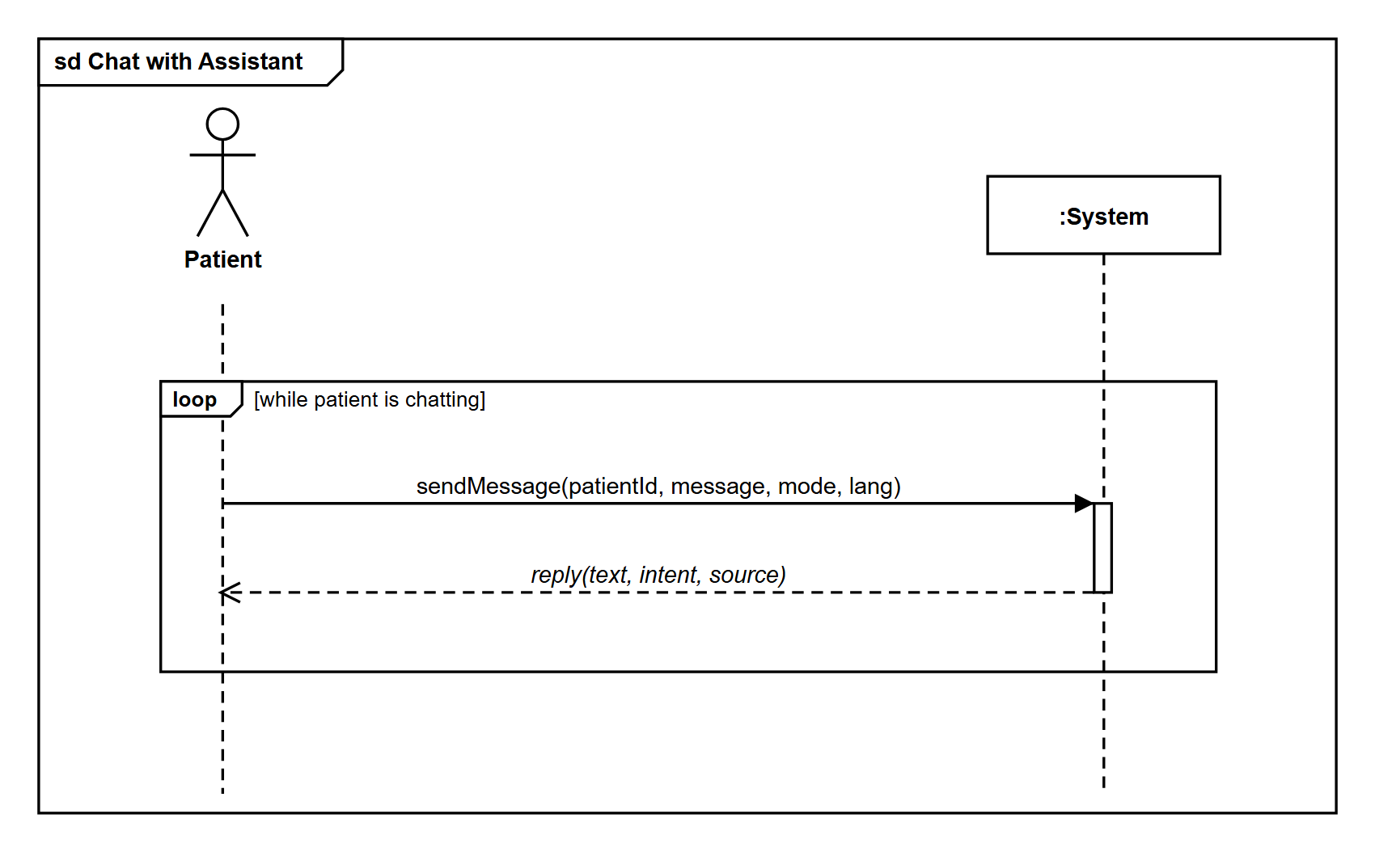
SYSTEM ANALYSIS
SSD: Chat with Assistant
WHAT IT SHOWS
Purpose: the chat scenario between the patient and the assistant.
One call carries the patient, the message, the mode and the language.
The system returns a reply written in simple words.
The loop frame runs for as long as the patient keeps chatting.
MemoryCare | Final Year Project
14

Slide 17
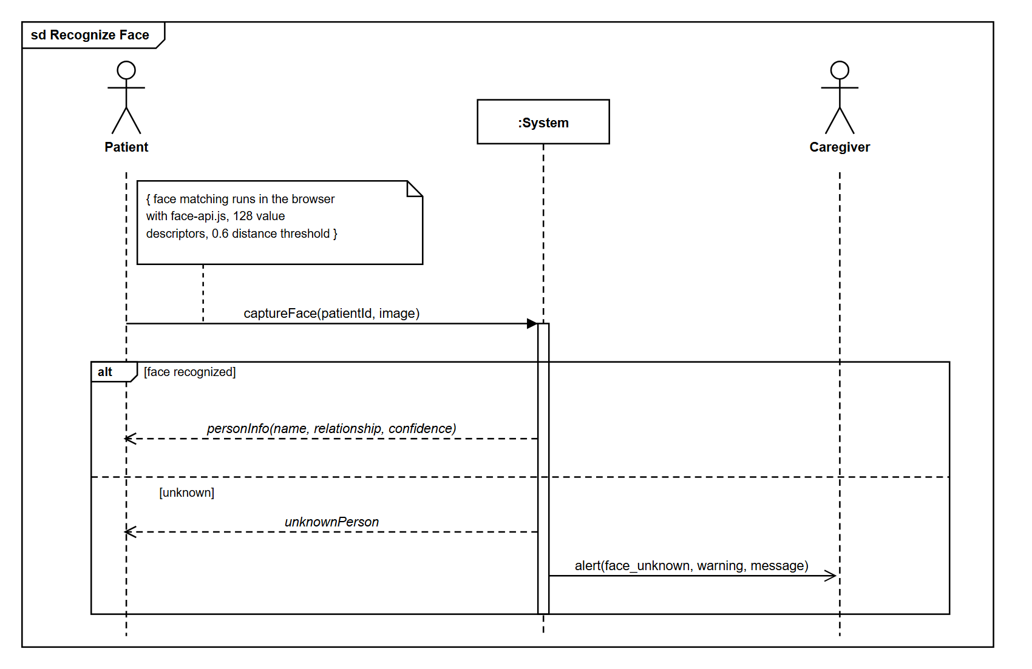
SYSTEM ANALYSIS
SSD: Recognize Face
WHAT IT SHOWS
Purpose: the face recognition scenario from camera to result.
The patient captures a face and it goes in with their id.
The alt frame gives us two possible outcomes.
A known face returns the name and the relationship.
An unknown face returns unknown and alerts the caregiver.
MemoryCare | Final Year Project
15

Slide 18
03
System Design
How the system is structured

Slide 19
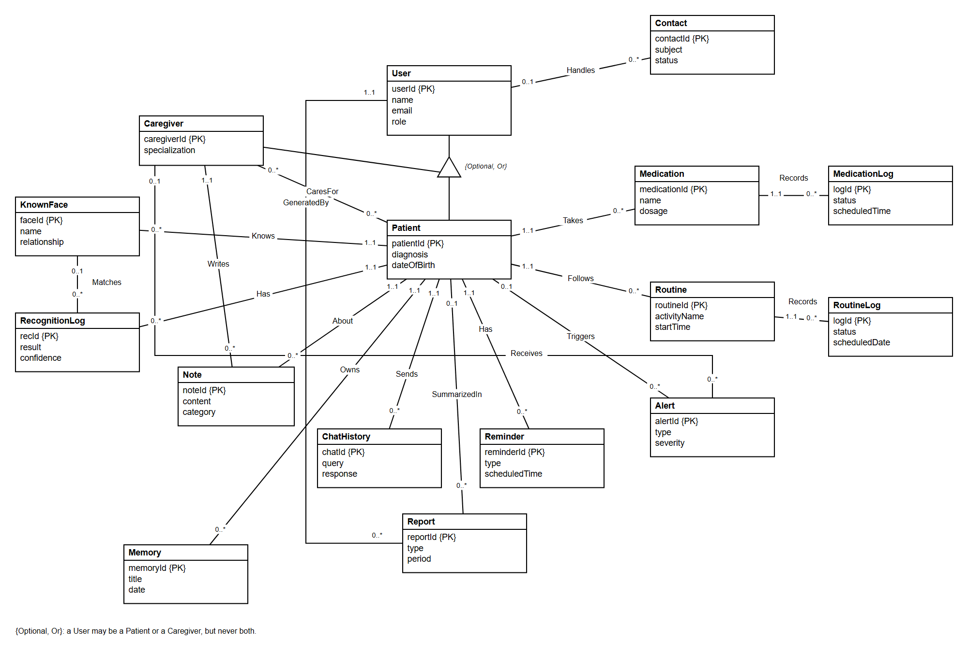
SYSTEM DESIGN
Entity Relationship Diagram
WHAT IT SHOWS
Purpose: how our data is actually stored in the database.
Sixteen entities, each one a rectangle with its attributes.
PK marks the primary key, the unique identity of that entity.
The verb on each line names the relationship, for example Takes or Records.
1 to 0..* reads as one patient can have many medicines.
Optional, Or means a user is either a patient or a caregiver.
MemoryCare | Final Year Project
16

Slide 20
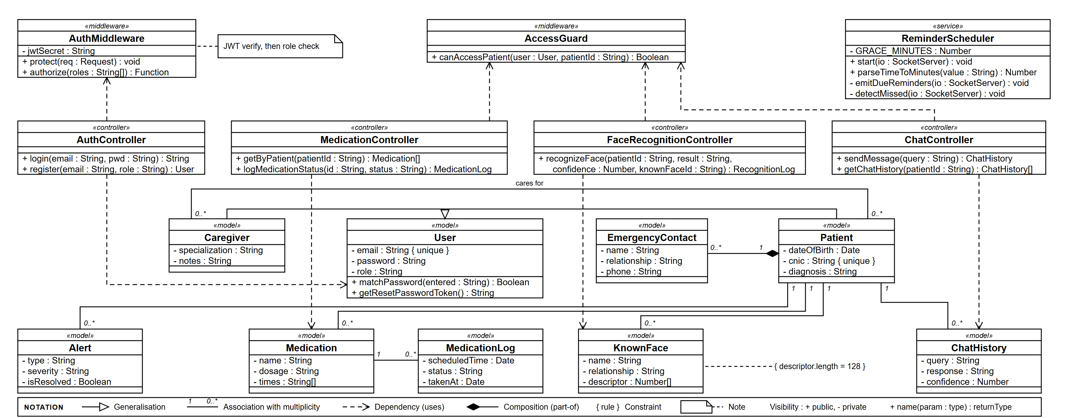
SYSTEM DESIGN
Class Diagram
Purpose: the software design, so unlike the domain model this one also shows operations.
Top band: the security checks and the reminder scheduler.
Middle band: the controllers, one for each main feature.
Bottom bands: the models, which map onto the database collections.
The IntentClassifier holds our three tier chat cascade.
Notation: hollow triangle is inheritance, filled diamond is composition, curly braces are a rule.
MemoryCare | Final Year Project
17

Slide 21
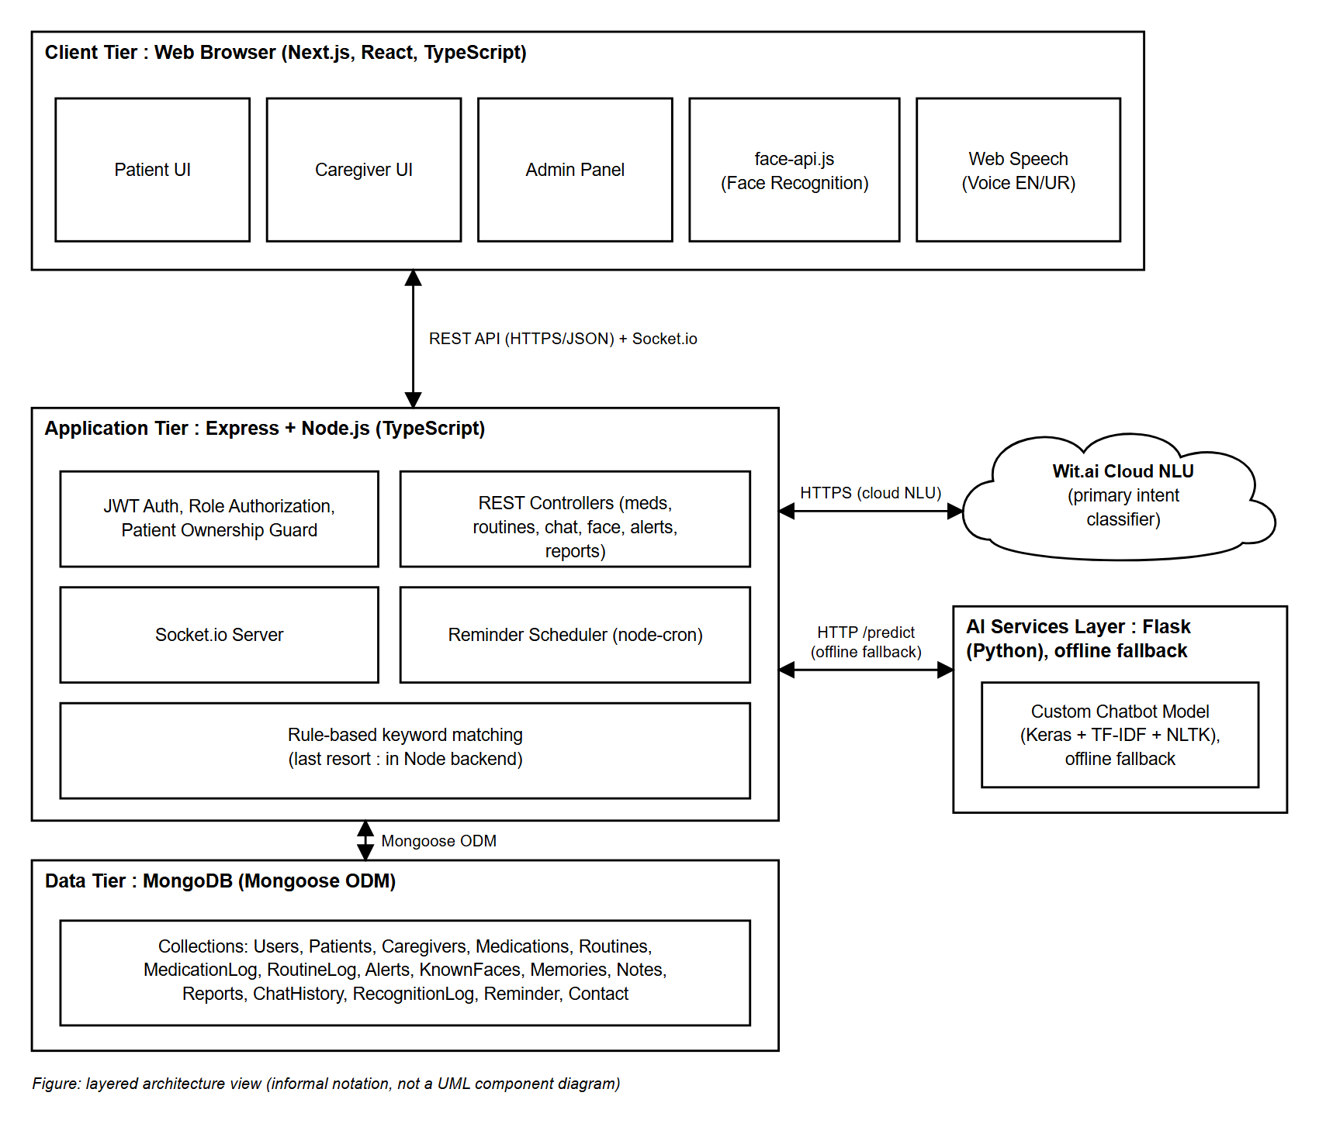
SYSTEM DESIGN
System Architecture
WHAT IT SHOWS
Purpose: how the whole system is put together, layer by layer.
Browser layer: the user interface and the face matching.
Server layer: controllers, security and the reminder scheduler.
AI layer: Wit.ai understands the chat, an offline model is the backup.
Data layer: MongoDB stores every collection.
MemoryCare | Final Year Project
18

Slide 22
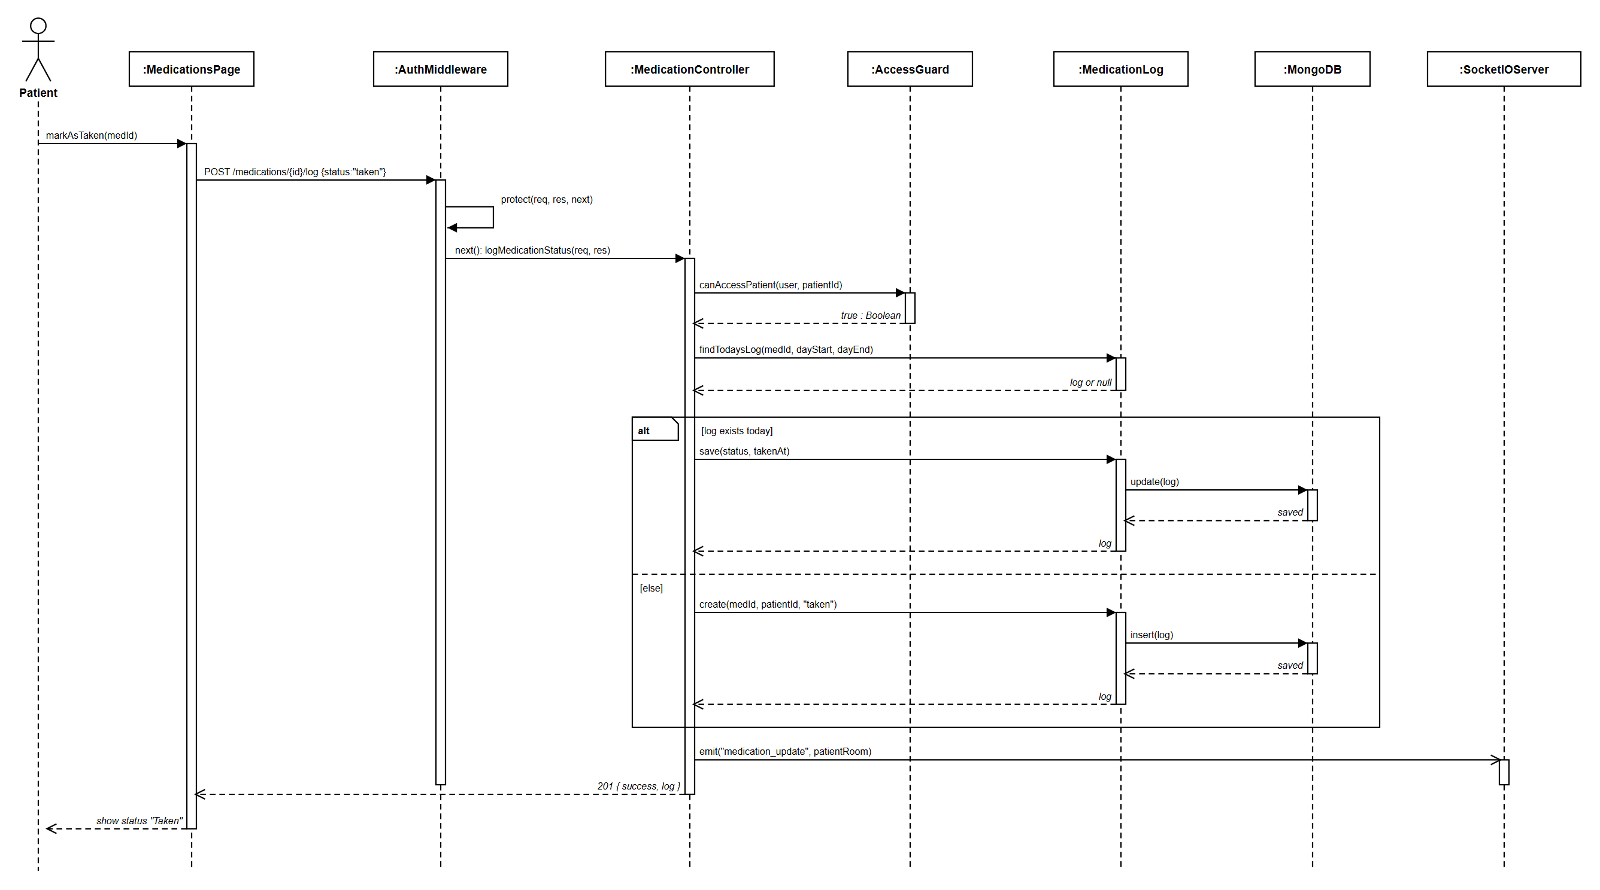
SYSTEM DESIGN
Sequence Diagram: Take Medication
WHAT IT SHOWS
Purpose: what happens inside the system when a dose is marked taken.
The page sends the request, and the login check runs first.
A separate guard then checks this patient really belongs to this user.
The alt frame is the important part: if today's log already exists we update it, otherwise we create a new one.
That is why pressing the button twice cannot create two records.
Finally a live update is pushed and the screen shows Taken.
MemoryCare | Final Year Project
19

Slide 23
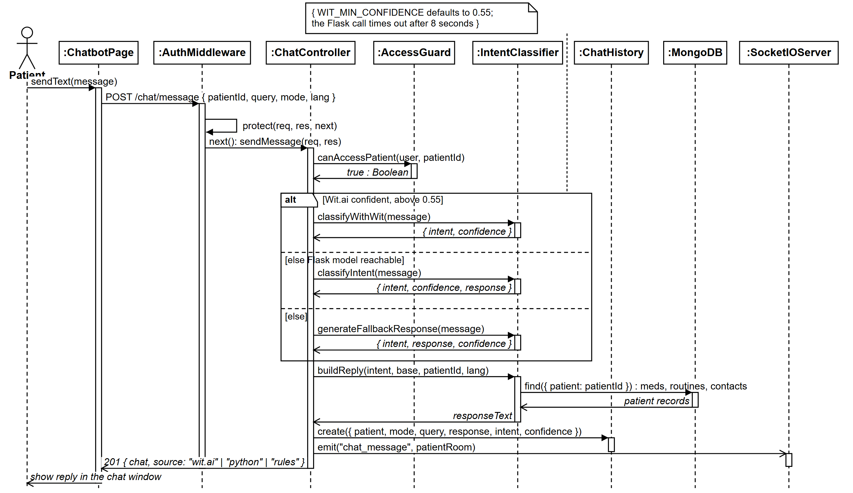
SYSTEM DESIGN
Sequence Diagram: Chat with Assistant
WHAT IT SHOWS
Purpose: what happens inside when a patient sends a message.
This is the same flow as the SSD, but now the box is open.
The alt frame shows our three tier cascade in order.
Tier one Wit.ai, tier two our offline model, tier three keyword rules.
Then the reply is filled with the patient's own records and saved.
MemoryCare | Final Year Project
20

Slide 24
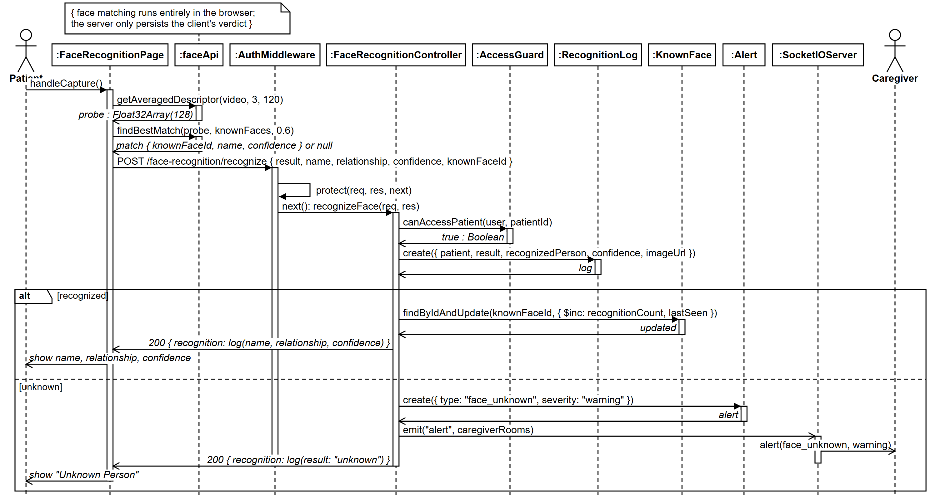
SYSTEM DESIGN
Sequence Diagram: Recognize Face
WHAT IT SHOWS
Purpose: what happens inside when a face is captured.
The first two steps run in the browser, not on the server.
The browser makes the 128 value descriptor and finds the best match.
Only the result is sent to the server, never the descriptor.
The alt frame splits a known face from an unknown one.
An unknown face creates an alert and pushes it to the caregiver.
MemoryCare | Final Year Project
21

Slide 25
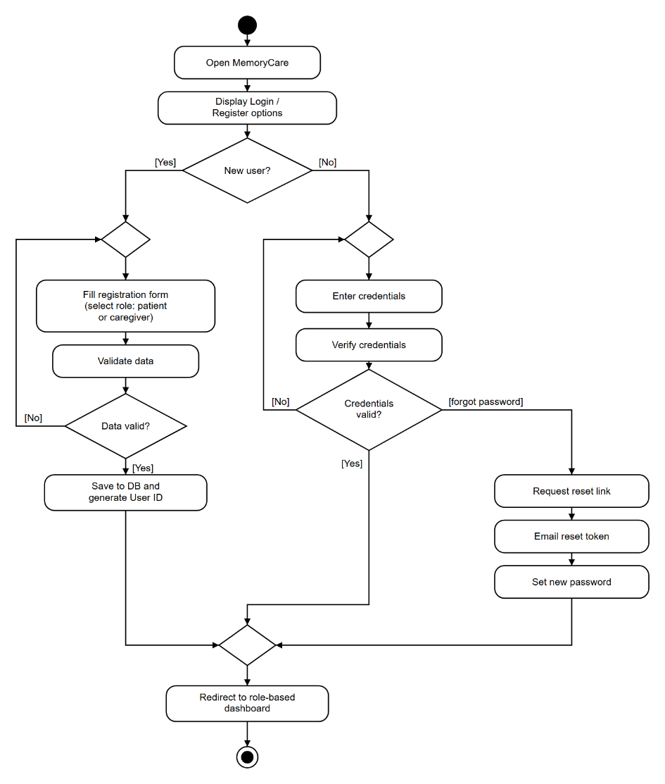
SYSTEM DESIGN
Activity: Register and Login
WHAT IT SHOWS
Purpose: how a user signs up or signs in.
The first diamond asks: is this a new user or an existing one.
Wrong or missing details loop back to the same form.
Forgot the password? A reset link is sent and a new one is set.
A valid login opens the dashboard made for that role.
Notation: filled circle starts, diamond decides, ringed circle ends.
MemoryCare | Final Year Project
22

Slide 26
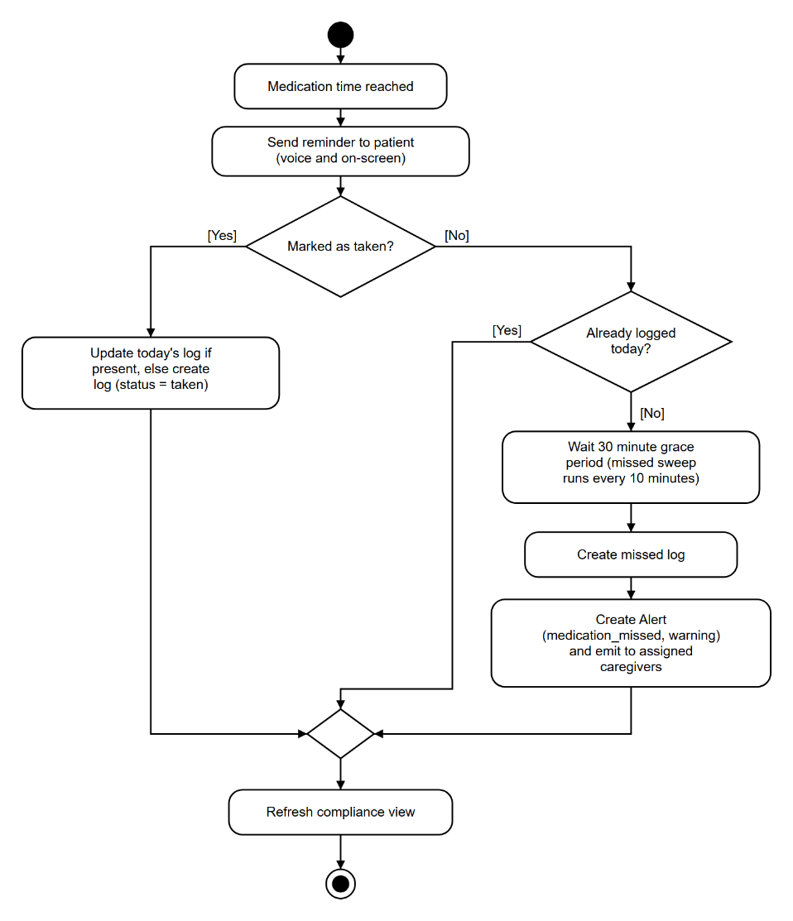
SYSTEM DESIGN
Activity: Take Medication
WHAT IT SHOWS
Purpose: what the system does at medicine time.
It starts on its own when the scheduled time arrives.
The decision asks: did the patient mark the dose as taken.
If yes, it is logged as taken straight away.
If not, the system waits 30 minutes, then logs it as missed.
A missed dose sends an alert to the caregiver.
MemoryCare | Final Year Project
23

Slide 27
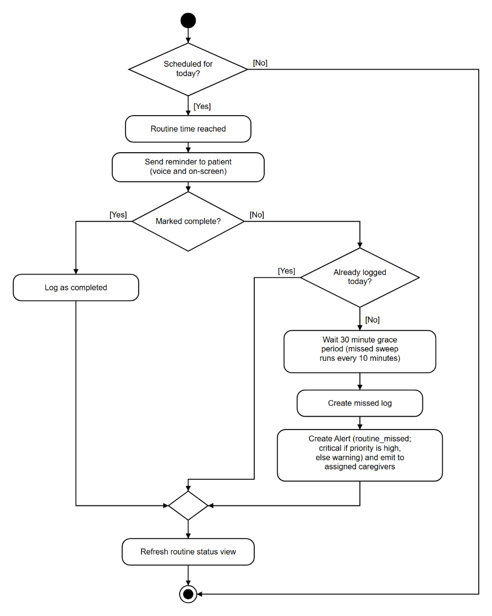
SYSTEM DESIGN
Activity: Daily Routine
WHAT IT SHOWS
Purpose: the same idea, but for a daily activity instead of a dose.
First check: is this activity even scheduled for today.
Then: was it completed on time.
Completed and missed are both recorded in the log.
A missed activity alerts the caregiver, and a high priority one is marked critical.
MemoryCare | Final Year Project
24

Slide 28
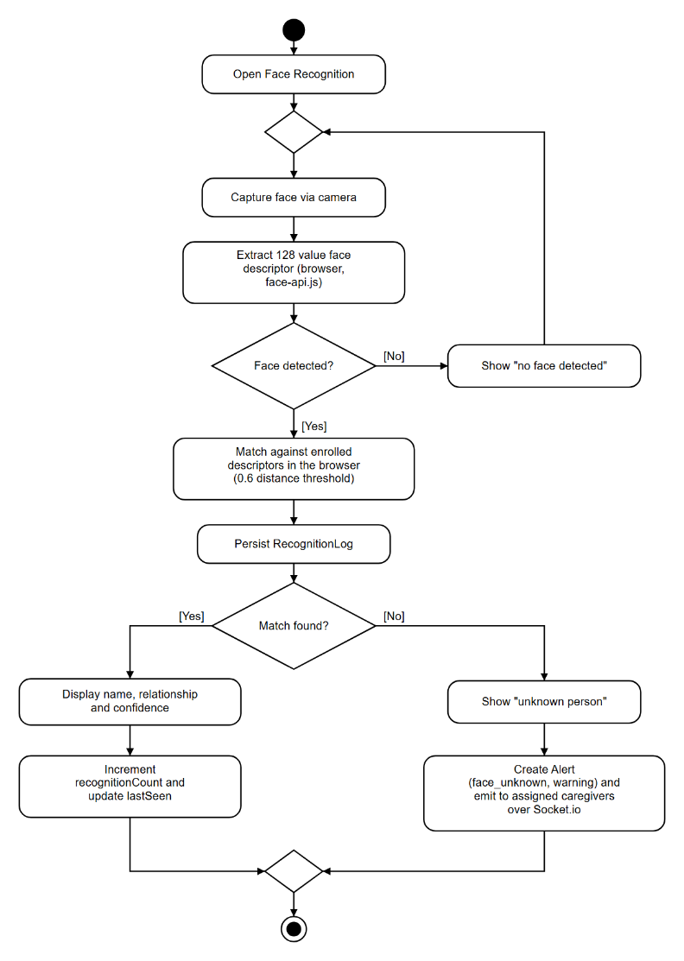
SYSTEM DESIGN
Activity: Face Recognition
WHAT IT SHOWS
Purpose: the journey from a camera frame to a name on screen.
First check: was a face found in the picture at all.
The matching happens in the browser itself, not on the server.
A match shows the person's name and how they are related.
An unknown face alerts the caregiver, and every attempt is logged.
MemoryCare | Final Year Project
25

Slide 29
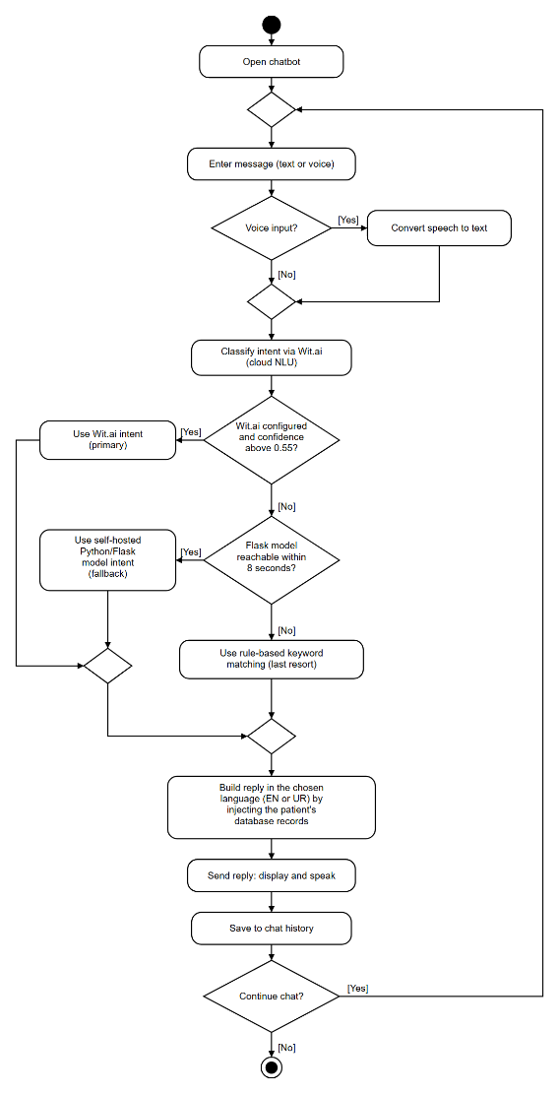
SYSTEM DESIGN
Activity: AI Chatbot
WHAT IT SHOWS
Purpose: how a patient's message becomes a useful reply.
This is our three tier cascade, and it is the heart of the chatbot.
Tier one: the message goes to Wit.ai in the cloud.
Tier two: if Wit.ai is not confident, our offline model runs instead.
Tier three: if that is unavailable, simple keyword rules still answer.
Finally the reply is filled in with the patient's own real data.
MemoryCare | Final Year Project
26

Slide 30
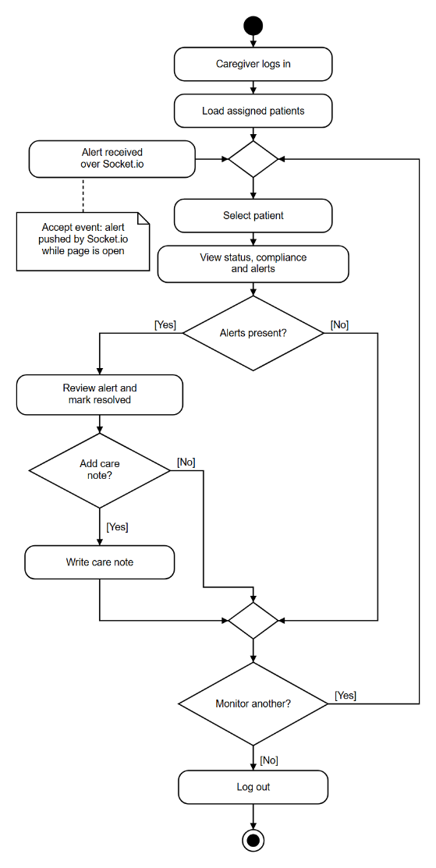
SYSTEM DESIGN
Activity: Caregiver Dashboard
WHAT IT SHOWS
Purpose: the caregiver's daily routine inside the app.
After login, the patients assigned to them load first.
They review each patient's status and compliance.
New alerts also arrive on their own, pushed live to the page.
They resolve an alert, write a care note, or move to another patient.
MemoryCare | Final Year Project
27

Slide 31
04
Implementation
Building and testing the system

Slide 32
IMPLEMENTATION
Technology Stack
Modern web technologies chosen for reliability
Frontend: Next.js, React, TypeScript
Backend: Node.js, Express, TypeScript
Database: MongoDB with Mongoose
Face recognition: face-api.js in the browser
Chat assistant: Wit.ai with an offline model
Live updates: Socket.io
MemoryCare | Final Year Project
28

Slide 33
IMPLEMENTATION
Main Modules
Each role sees only what it needs
Patient: dashboard, medicines, routines, face recognition, memory gallery, chat and reports.
Caregiver: assigned patients, medicines, routines, alerts, care notes and reports.
Admin: user management, system monitoring, security and system reports.
MemoryCare | Final Year Project
29

Slide 34
05
User Interfaces
A walk through the working screens

Slide 35
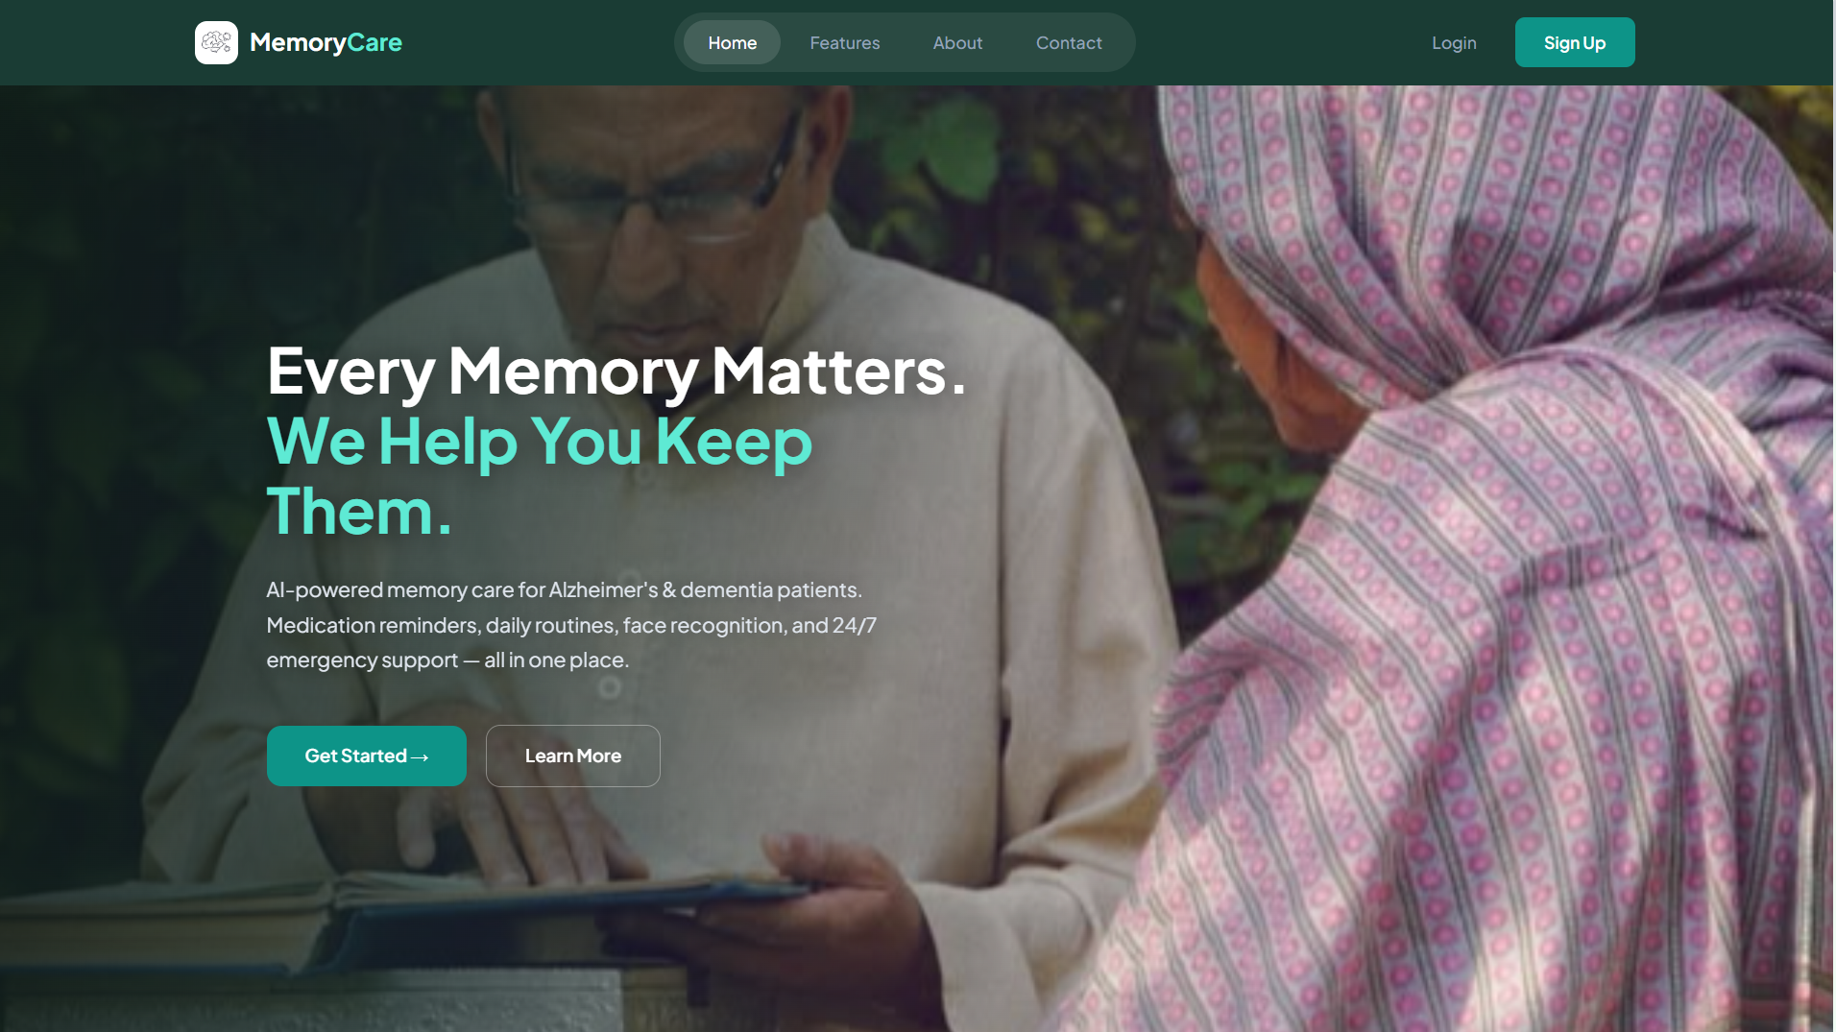
USER INTERFACES
Home Page
MemoryCare | Final Year Project
30

Slide 36
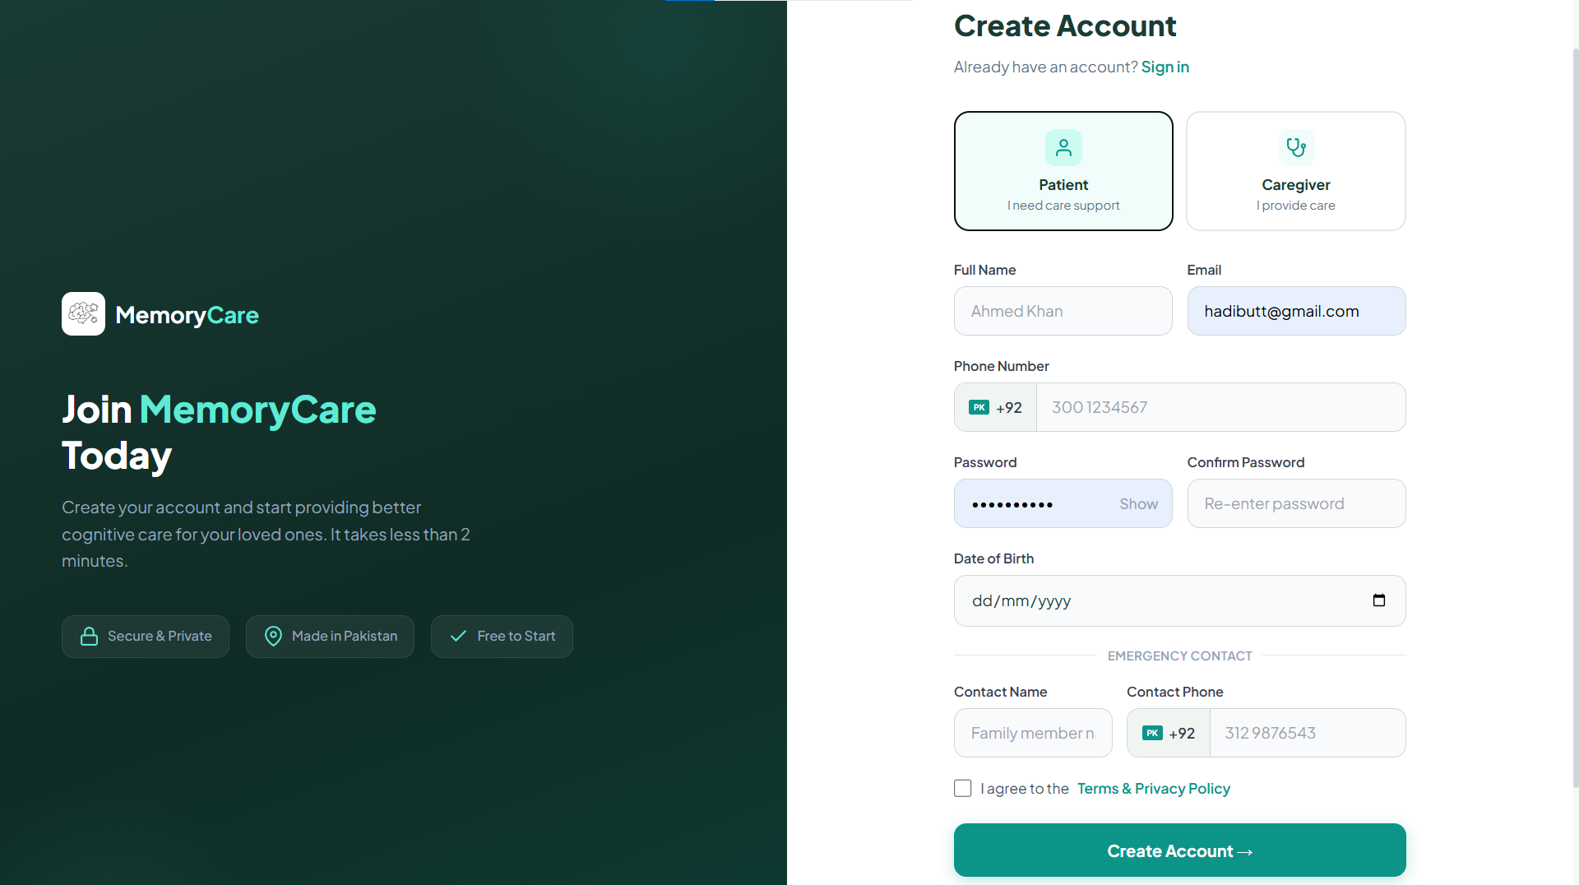
USER INTERFACES
Register and Login
MemoryCare | Final Year Project
31

Slide 37
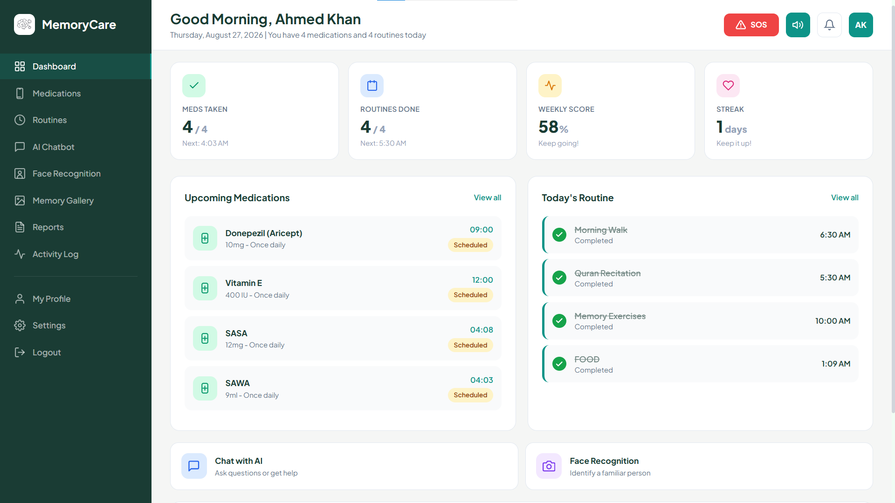
USER INTERFACES
Patient Dashboard
MemoryCare | Final Year Project
32

Slide 38
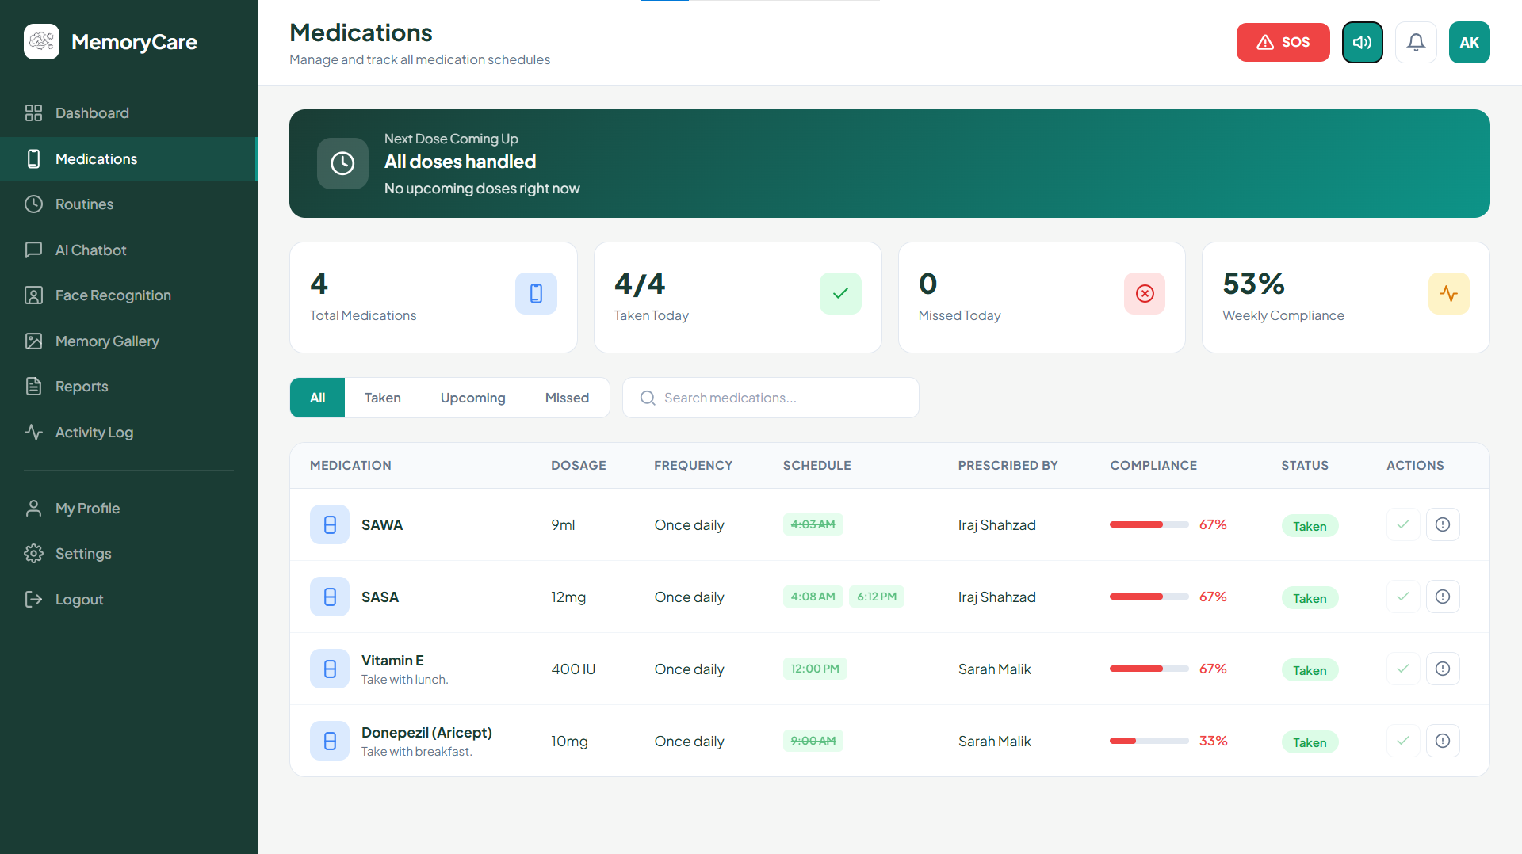
USER INTERFACES
Patient: Medications
MemoryCare | Final Year Project
33

Slide 39
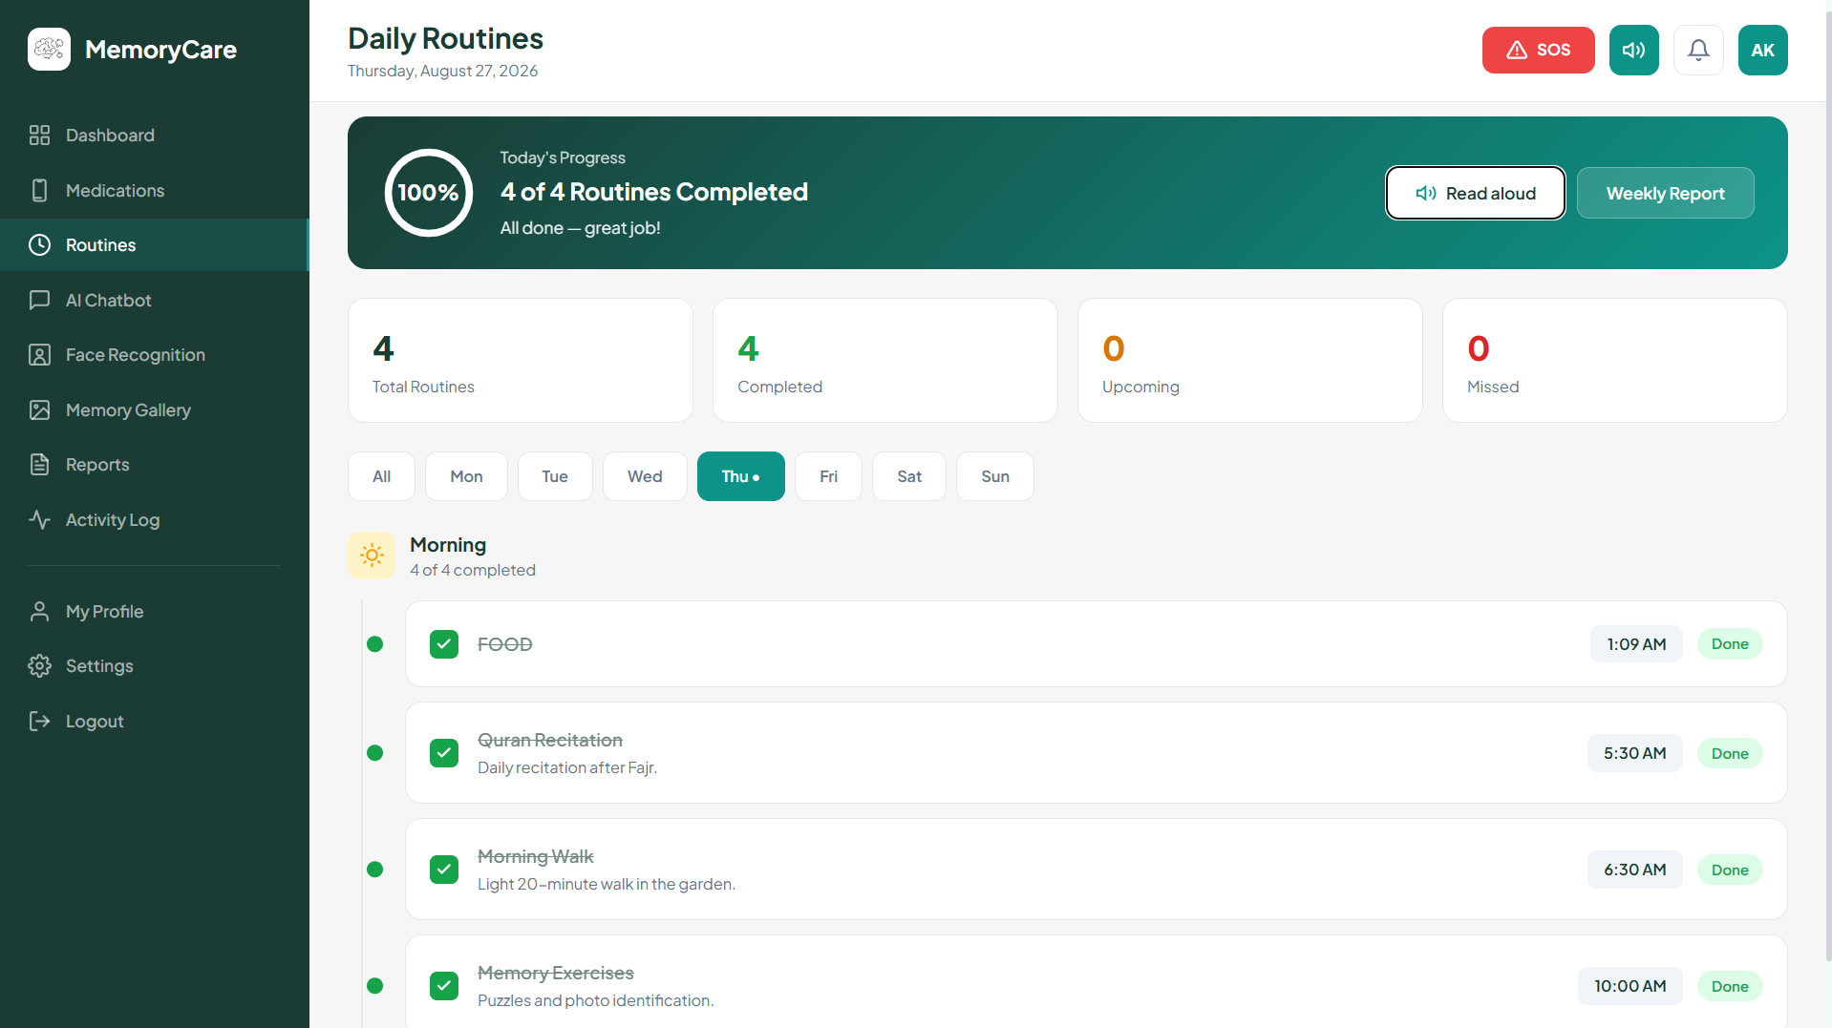
USER INTERFACES
Patient: Daily Routines
MemoryCare | Final Year Project
34

Slide 40
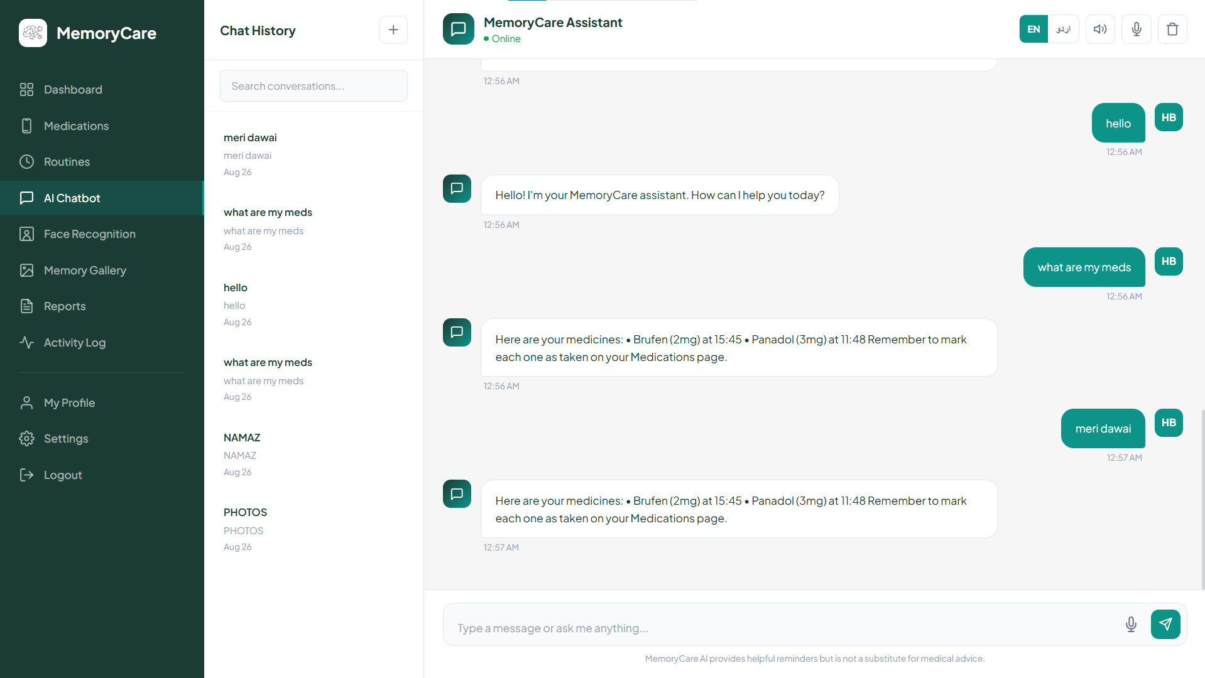
USER INTERFACES
Patient: Chat Assistant
MemoryCare | Final Year Project
37

Slide 41
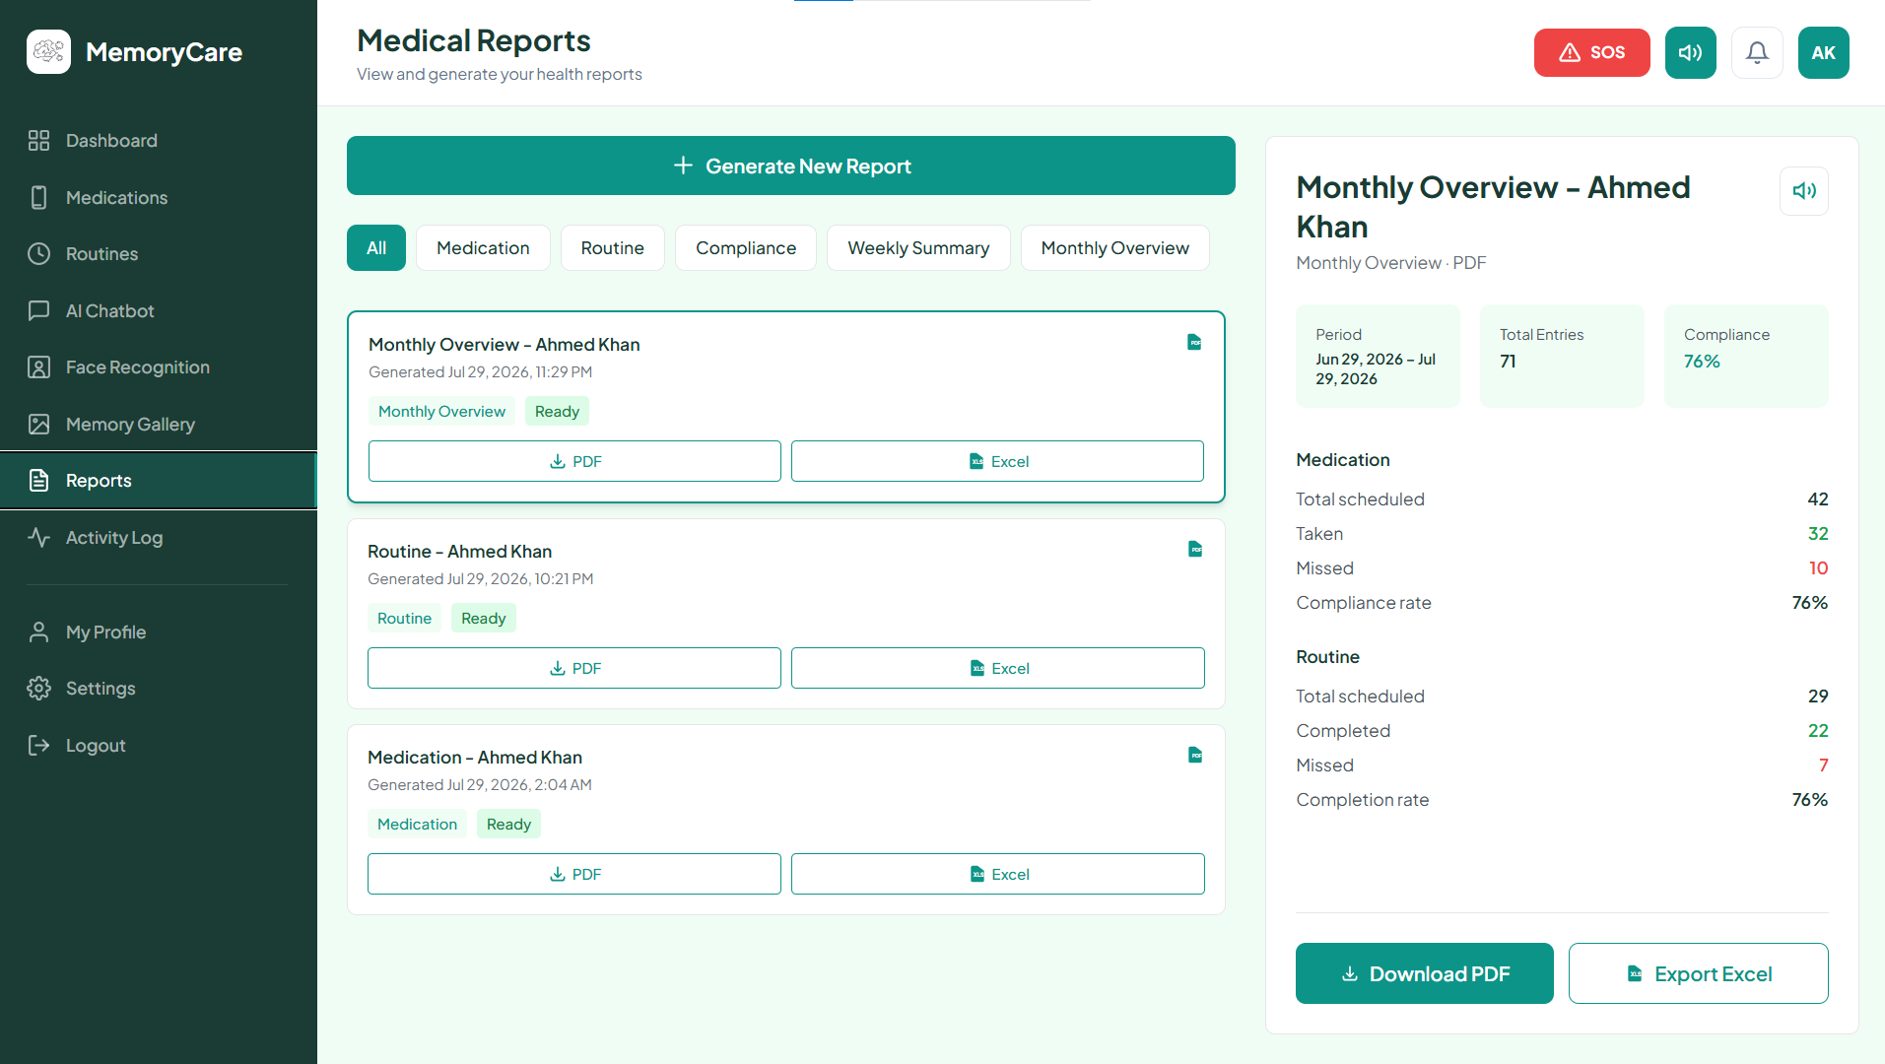
USER INTERFACES
Patient: Reports
MemoryCare | Final Year Project
38

Slide 42
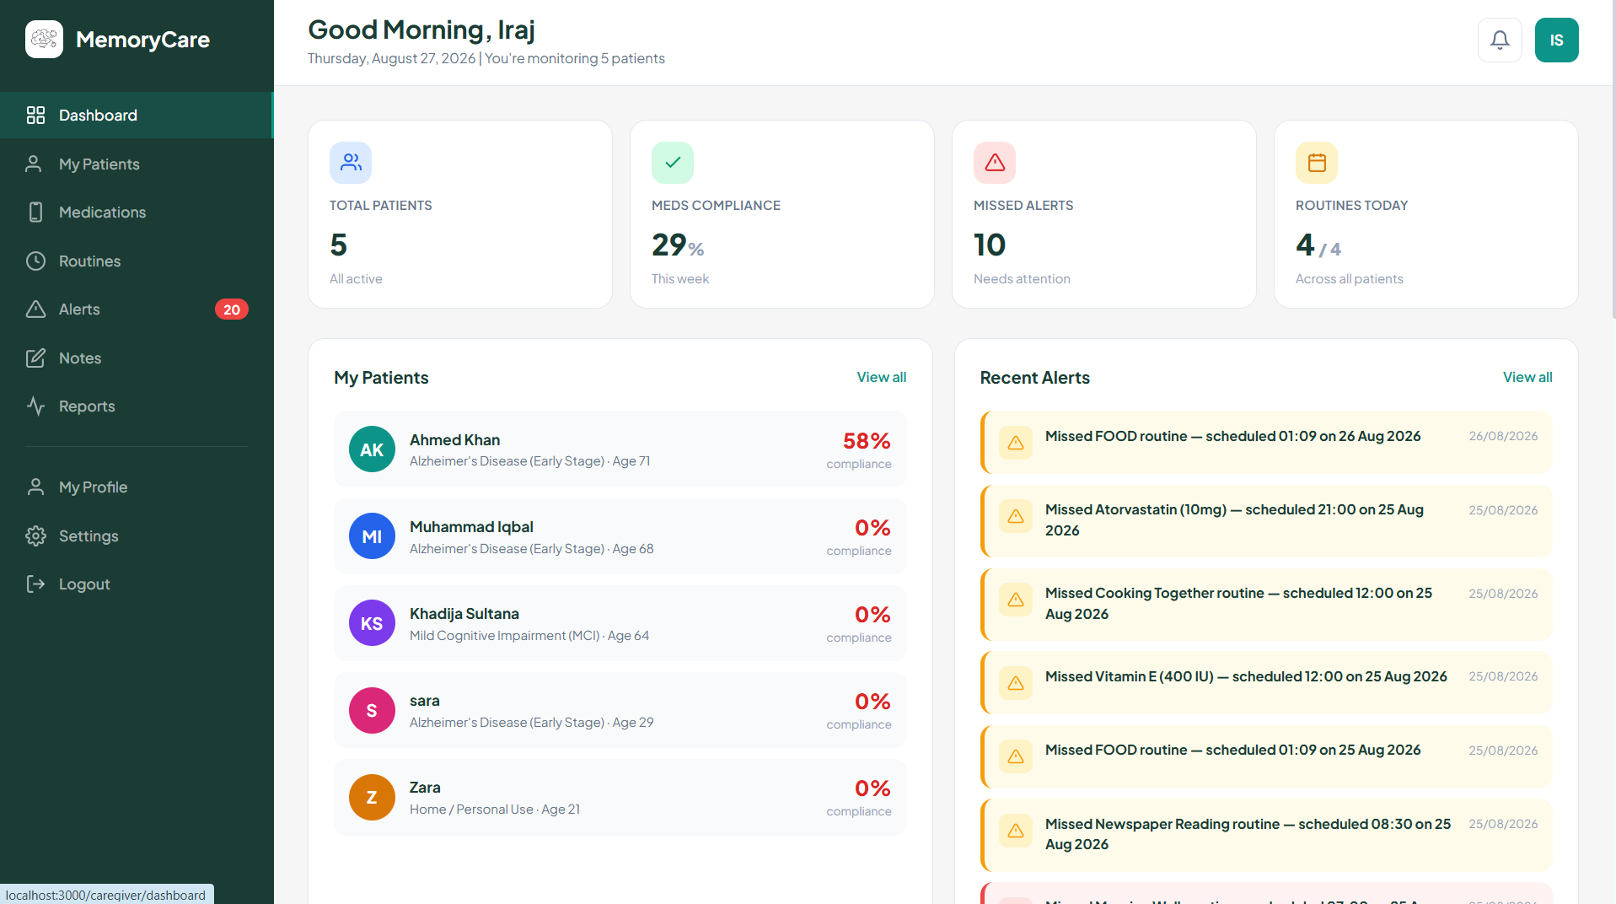
USER INTERFACES
Caregiver Dashboard
MemoryCare | Final Year Project
39

Slide 43
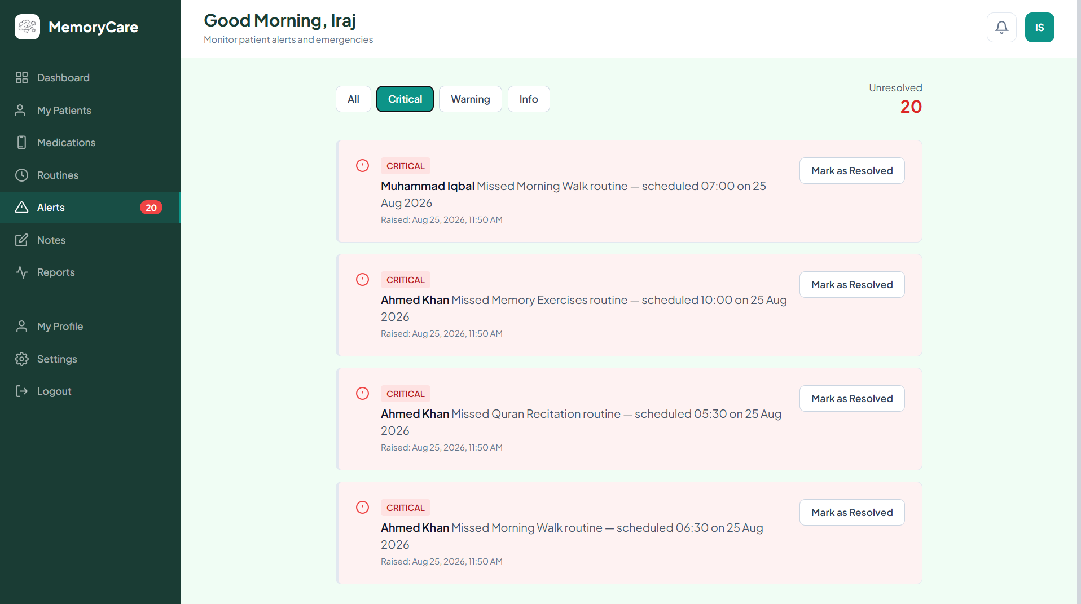
USER INTERFACES
Caregiver: Alerts and Care Notes
MemoryCare | Final Year Project
40

Slide 44
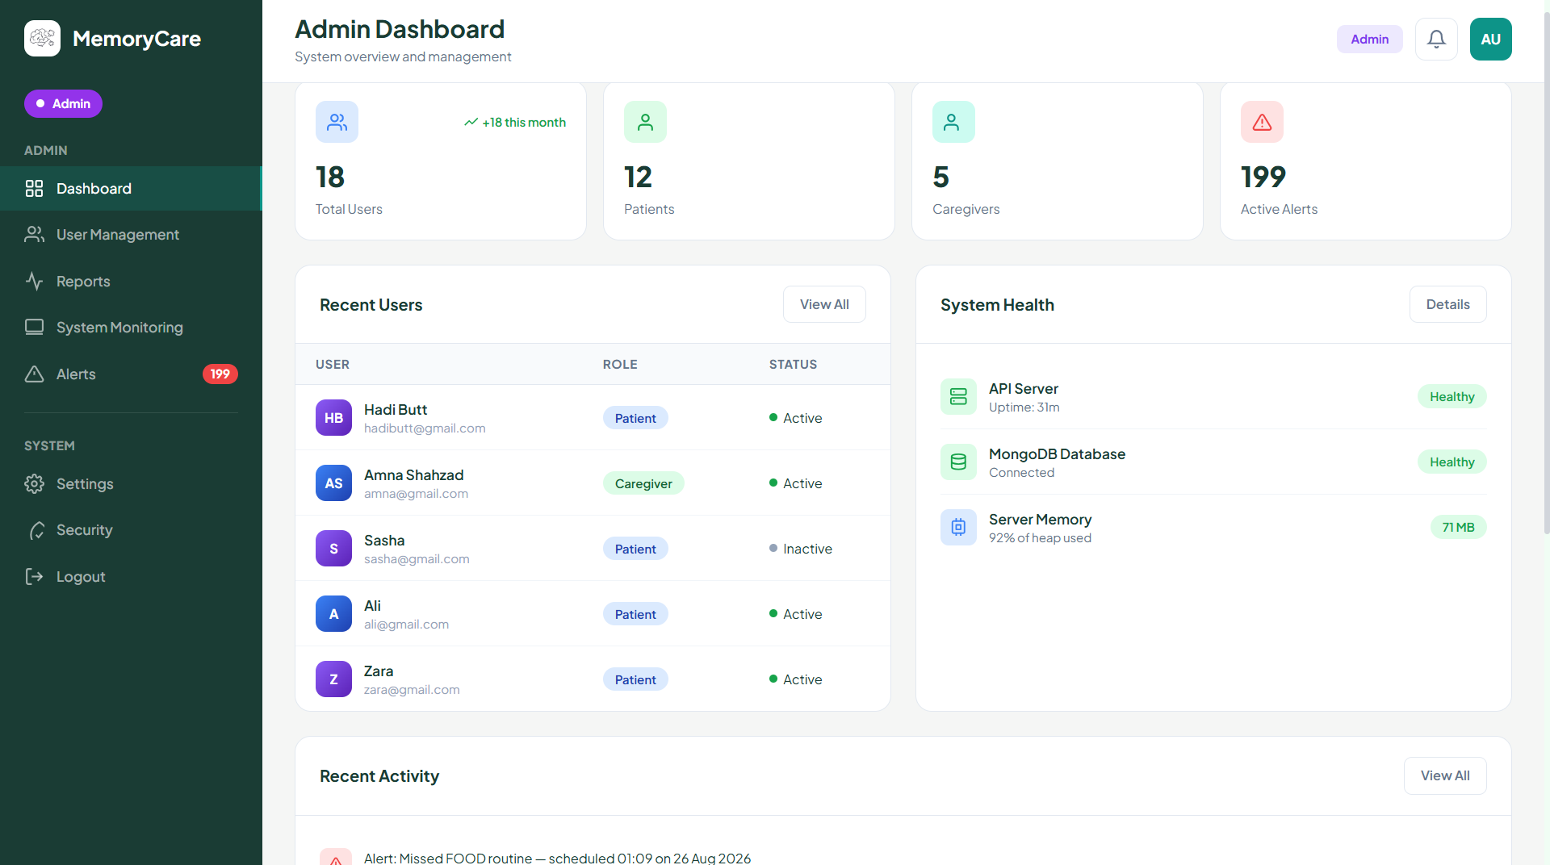
USER INTERFACES
Admin Panel
MemoryCare | Final Year Project
41

Slide 45

IMPLEMENTATION
Testing
Verified with real data from start to finish
Every module was tested with real records, never with dummy data.
Reminders, alerts, reports and chat were checked end to end.
Access rules were tested so each role sees only its own data.
The system also works for any new data added later.
MemoryCare | Final Year Project
42

Slide 46
IMPLEMENTATION
Results
What the finished system delivers
All seven modules are complete and working
Reminders reach the patient by screen and voice
Faces are recognised and logged for review
Caregivers receive alerts in real time
Reports are generated from live records
The assistant answers in English and Urdu
MemoryCare | Final Year Project
43

Slide 47
IMPLEMENTATION
Conclusion and Future Work
Where the project stands and where it can go
MemoryCare brings the patient and the caregiver together in one simple app.
It supports memory, medicine, daily routines and everyday communication.
Future work: a mobile application for easier daily use.
Future work: support for more regional languages.
Future work: a smarter assistant with wider understanding.
MemoryCare | Final Year Project
44

Slide 48
IMPLEMENTATION
References
Larman, C. Applying UML and Patterns. Third Edition.
Connolly, T. and Begg, C. Database Systems: A Practical Approach.
Official documentation: Next.js, Express, MongoDB, face-api.js and Wit.ai.
The complete reference list is given in the thesis document.
MemoryCare | Final Year Project
45

Slide 49
Thank You

