Slide 1
Data Separation
A recent study “The spectrum of cluster headache: A case report of 4600 attacks “ has been published by International Headache Society. Some of the findings concluded that the condition of each patient is very individual.
User 36 has been chosen with 9 years (10.000 data entries) data.
The dataset has been split into 2 parts:
1) symptoms information such as intensity, duration, time of day and how a person feels.
2) medical treatment information, such as treatment type and time at which it was taken.

Slide 2
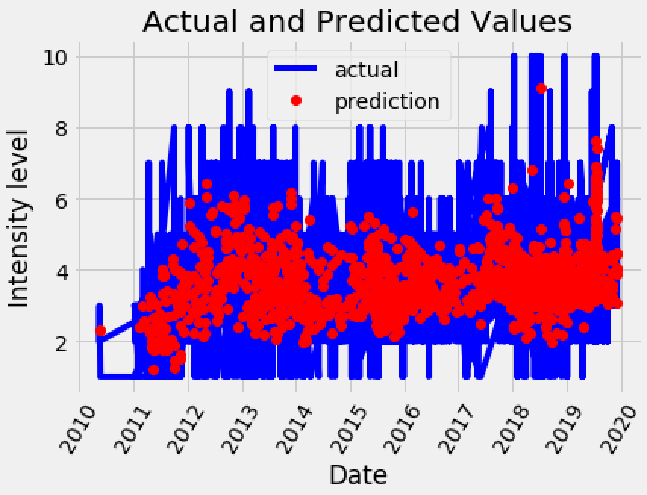
Modeling / Analysis
Since the relationships between symptoms, when they occur and how long they last are expected to be highly non linear, we have decided to go for a Random Forest model.
After selecting appropriate variables to try and ‘predict’ the intensity level, we have produced a model that has overall accuracy of 78.52% and MAE = 0.72. The following graph shows the importance of each variable with respect to the Intensity of an attack.

Slide 3
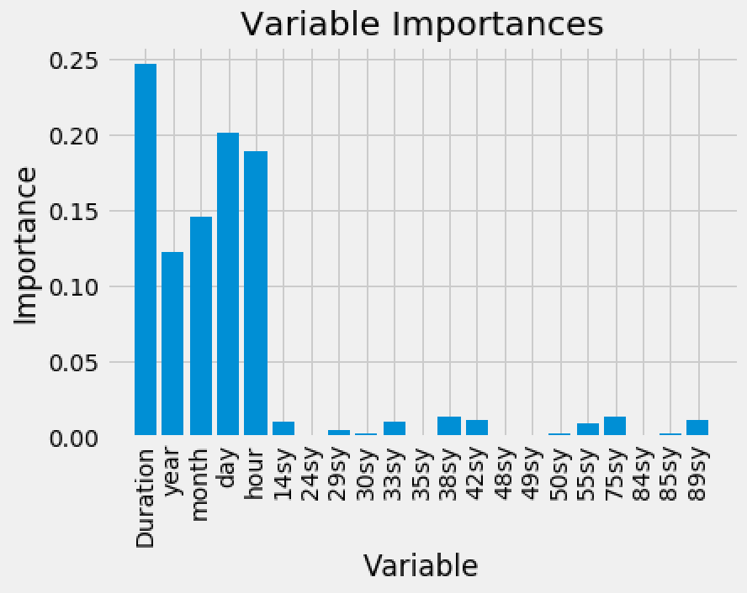
Modeling / Analysis
Once the most important variables have been identified, we removed the ones that don’t really affect our model’s understanding of the relationships between Intensity level and other variables, which improved the model even further.
Duration and date/time of the attacks has the most effect on their intensity, hence, this has to be investigated further for more insights.
This information supports the findings about a relationship between the number of attacks and their occurrence during the day.

Slide 4
Conclusions / Future Work
We have identified that there is some clear relationship between intensity of attacks and at what time of the day / week they occur.
Medical treatments data needs to be merged with symptoms dataset in order to see how it impacts the intensity levels of attacks.
New variables could be created in order to produce even more information about each patient’s condition, for example number of attacks per day or the time difference between a medical treatment and an occurrence of a symptom.
Each user could be classified by their symptoms, for example a cluster headache patient or migraine patient. This will allow us to analyze bigger datasets.

