Slide 1
Sovereign: AI Stock Market Assistant
● LIVE DEMO · US STOCKS
Market data, company research and Python-powered analysis in one conversational interface
Iram Shahzadi
React · FastAPI · Gemini · MCP · Celery + Redis · Docker sandbox
Notes:
Assalam-o-Alaikum. Today I am presenting Sovereign, an AI stock market assistant. It brings market data, company research and analysis into one chat interface. I will cover the problem, the product features, the architecture, and then show a live demo.

Slide 2



Too many tools, too little trust
Scattered tools
Chatbots without data
No sources, no assumptions
Charts on one site, statements on another, calculations in a spreadsheet.
General AI has no live prices and can invent numbers.
Answers rarely say where numbers came from or what was assumed.
Goal: one conversational interface with live data, clear explanations, and sources + assumptions on every answer.
Notes:
The problem: a beginner or a student today opens a charting website, a finance portal and a spreadsheet, and maybe a chatbot that has no live data. Nothing shows where numbers come from. Our goal is one interface that does all of this and always shows sources and assumptions.

Slide 3
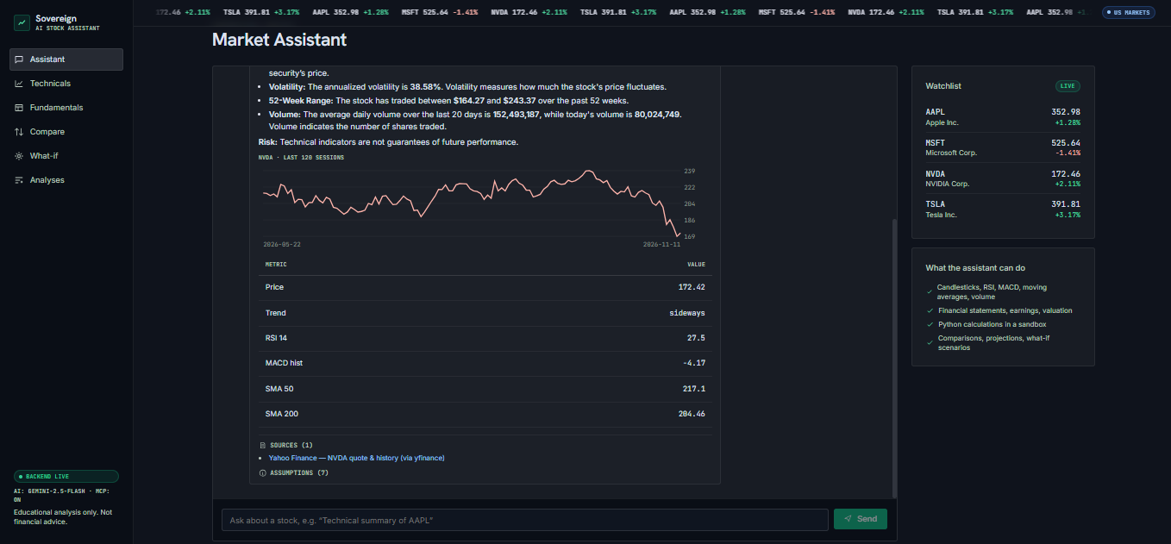




Four capabilities in one chat
Technical analysis
Candlesticks, volume, SMA 20/50/200, RSI, MACD, trend
Fundamental analysis
Income statements, earnings vs estimates, valuation, margins
Python calculations
Comparisons, Monte Carlo projections, what-if, backtests
Live answer for NVDA: Gemini called the MCP data tool, then returned a chart, a metrics table and its source.
Clear explanations
Interactive charts and tables with sources and assumptions
Notes:
These are the four features from the brief. Technical analysis with candlesticks and indicators. Fundamental analysis with statements, earnings and valuation. Python-powered calculations for comparisons, projections and what-if. And clear explanations: every answer has a chart, a table, sources and assumptions. The screenshot is a real answer from our app with live Yahoo data.

Slide 4
How one question becomes an answer
1
2
3
4
5
6
Context
Plan
Permission
Fetch
Compute
Explain
System prompt + last 10 messages
Gemini picks tools (function calling)
Harness checks read / compute, max 6 calls
MCP server → Yahoo Finance data
Python sandbox runs the maths
Answer + chart + table + sources
If there is no API key or the model fails, a rule-based fallback answers from the same tools, so the demo never breaks.
Notes:
This is the AI harness, the brain that coordinates the model, context, permissions and workflow. First it builds context. Gemini then plans which tools to call. Before each call the harness checks permissions: read tools for data, compute tools for code. Data comes through our MCP server from Yahoo Finance. Calculations run in the Python sandbox. Finally the harness attaches sources, assumptions, a table and a chart.

Slide 5
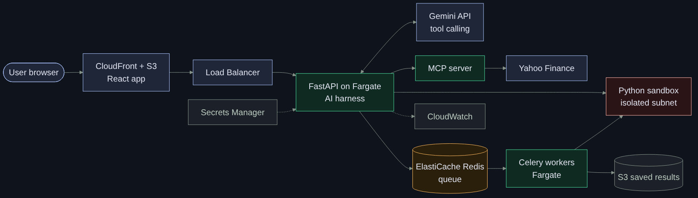
AWS-style architecture
Full diagram with VPC and subnets: docs/architecture/architecture.drawio
Notes:
Here is the AWS-style deployment. The React app is served from S3 through CloudFront. API calls go through a load balancer to the FastAPI service on ECS Fargate, with the MCP server as a sidecar. Long jobs go to ElastiCache Redis and are picked up by Celery workers. The Python sandbox runs in an isolated subnet with no internet. Results are saved to S3, the Gemini key is in Secrets Manager, and logs go to CloudWatch. Locally the same design runs with docker compose.

Slide 6
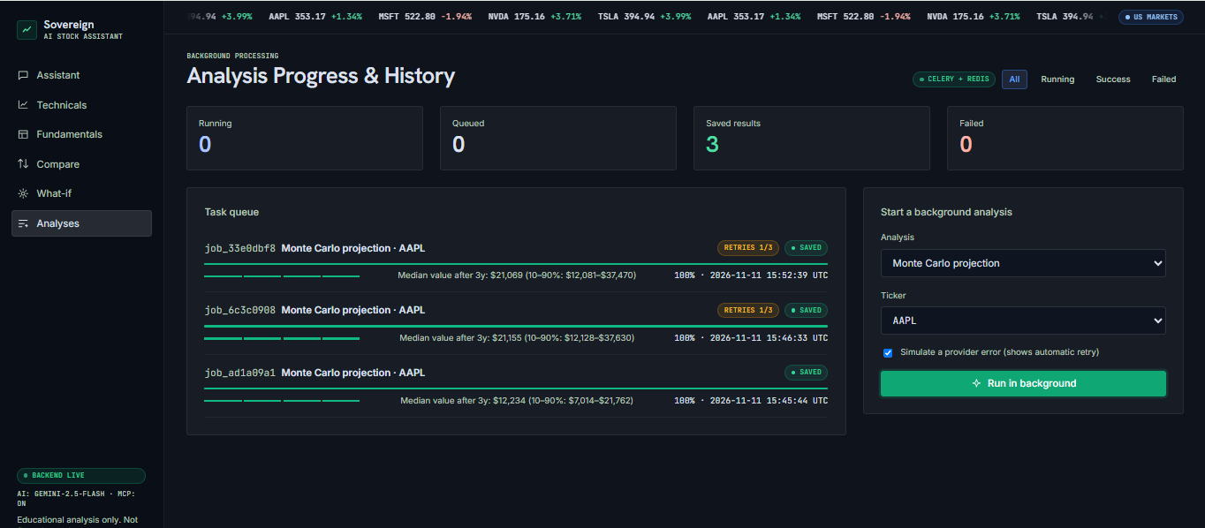
Safe maths, reliable background jobs
5,000
Monte Carlo paths per projection
3×
automatic retries with backoff
Celery + Redis queue: the job failed once, retried automatically (RETRIES 1/3), ran in the sandbox and saved its result.
0
internet access inside the sandbox
Notes:
Two engineering pieces from the brief. The Python sandbox runs every script in a separate process with a timeout; in Docker it has no internet, a read-only file system, a non-root user and memory and CPU limits, and unsafe code like importing os is blocked. Longer analyses run as background jobs: Redis is the queue, Celery workers do the work, the UI shows progress, failed jobs retry three times with backoff, and results are saved. In the screenshot the job failed once on purpose and recovered.

Slide 7

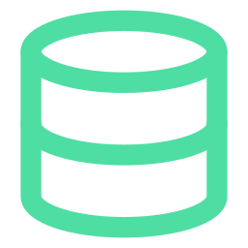
Delivered with a real engineering workflow
GitHub
Automated checks
Feature branches, pull requests, CONTRIBUTING guide
GitHub Actions: lint, 16 tests, build, Docker images
Miro board
Jira board
Research, journeys, wireframes, system flow
8 epics, 18 stories, 20 tasks with acceptance criteria
Notes:
All deliverables from the brief are ready. The GitHub repository has feature branches merged through pull requests and a contributing guide. GitHub Actions runs lint, 16 backend tests, the frontend build and Docker image builds on every pull request. The Miro board has research, user journeys, wireframes and the system flow. The Jira board has 8 epics, 18 stories and 20 tasks, each with an owner and acceptance criteria.

Slide 8
Live demo: five minutes
1
Assistant
“Give me a technical summary of NVDA”: tool badges, chart, sources
2
Technicals
Candles, SMA toggles, RSI and MACD panels
3
Fundamentals + Compare
Statements, valuation; AAPL vs MSFT vs NVDA
4
What-if
Run Monte Carlo in sandbox, watch progress
5
Analyses
Simulated provider error → automatic retry → saved
Notes:
Demo order. One: ask the assistant for a technical summary of NVDA and point out the tool badges, chart, table and sources. Two: the Technicals page with candlesticks and indicators. Three: Fundamentals and Compare. Four: the What-if page, run Monte Carlo in the sandbox. Five: the Analyses page, start a job with a simulated error and show the automatic retry and the saved result. Backup: if the internet fails, the app switches to demo data and shows a DEMO DATA badge.

Slide 9
Thank you: questions?
Next steps: more markets (PSX), news sentiment, user accounts and watchlists, deployment on AWS
Educational analysis only, not financial advice.
Notes:
To summarise: one chat interface with live data, technical and fundamental analysis, safe Python calculations and reliable background jobs, with sources and assumptions everywhere. Next steps could be Pakistani PSX data, news sentiment, user accounts and a real AWS deployment. Thank you, I am happy to take questions.

