Slide 1
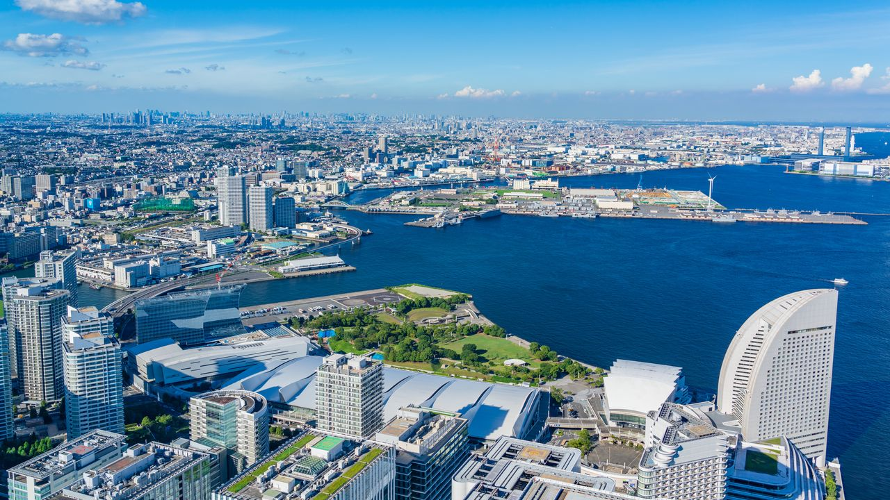
JAPAN
Japan is an archipelago, or string of islands, on the eastern edge of Asia. There are four main islands: Hokkaido, Honshu, Shikoku, and Kyushu. There are also nearly 4,000 smaller islands! Japan's nearest mainland neighbors are the Siberian region of Russia in the north and Korea and China farther south.

Slide 2
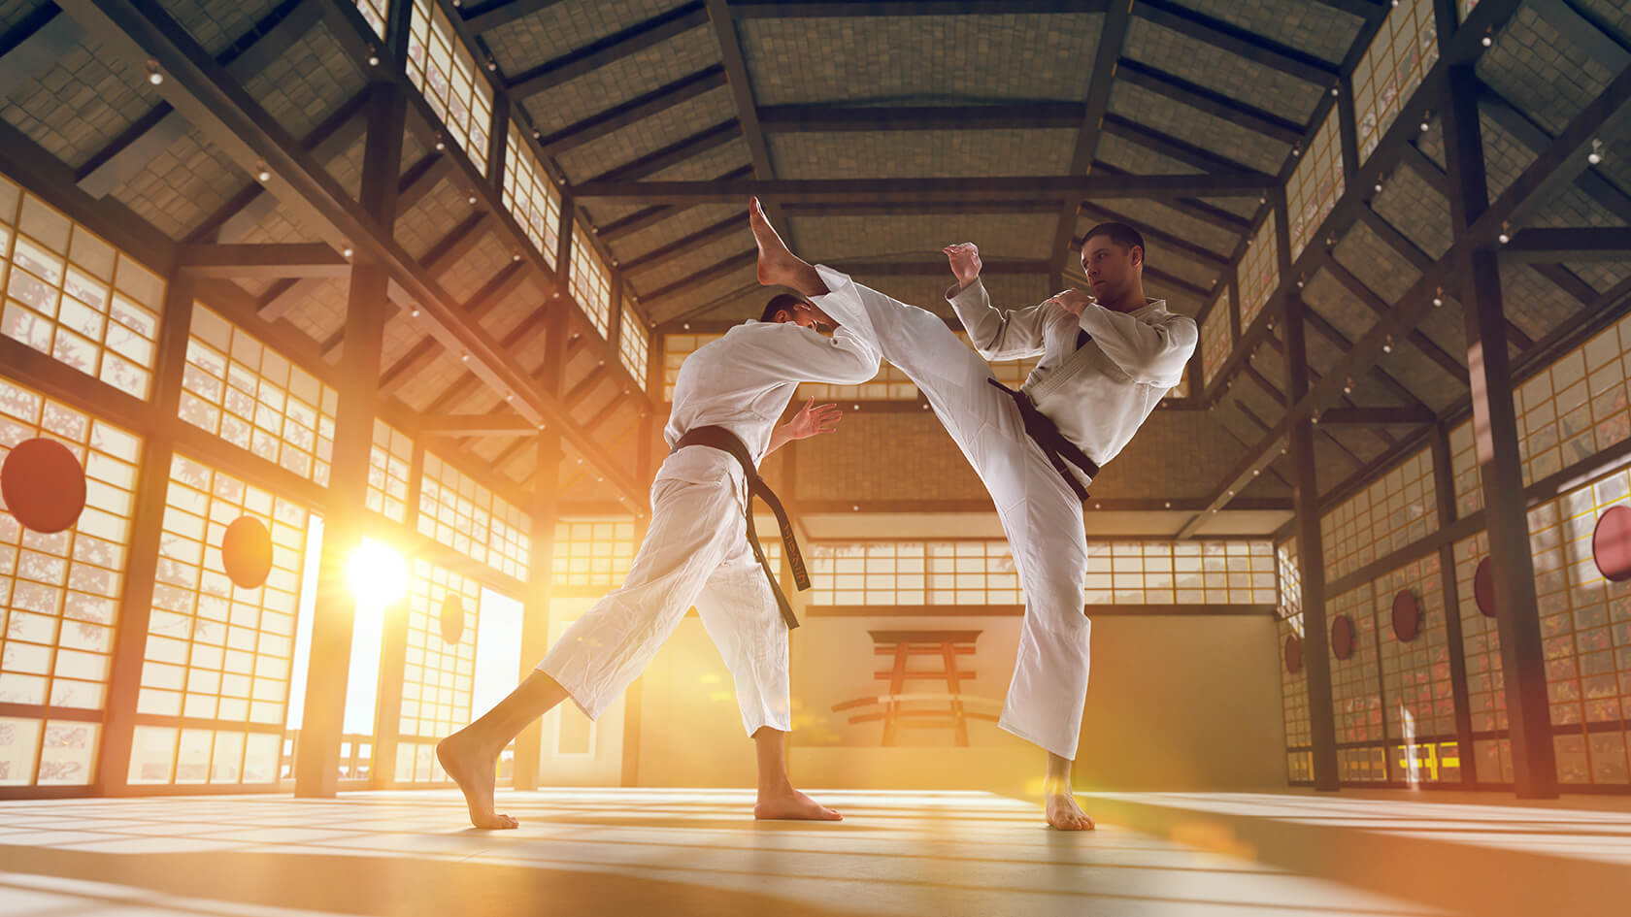
Karatedo, which means “the way of the empty hand,” developed over 1,000 years ago in China. It was introduced to the island of Okinawa (formerly an independent kingdom) many centuries ago as a form of weaponless self defense. The art was a late-comer into Japan proper, having been introduced by Funakoshi Gichin in the 1920s. In karate, every part of the body can be turned into a fighting weapon. But equally important are defensive techniques used to sidestep or block an opponent’s thrusts and kicks
In Japanese, karate is known as heiwa no bu, the “martial art of peace,” and around the world it is practiced by more than 130 million enthusiasts. What many people may not realize is that Okinawa is the birthplace of karate, and that the martial art is deeply rooted in the history and culture of the islands.

