Slide 1

AI-BASED DROP-OUT PREDICTION AND COUNCELLING SYSTEM
Title: AI-based Drop-out Prediction and Counseling System
Theme: Smart Automation
Category: Software
Team ID:
Team Name: Syntax Solvers

Slide 2
OVERVIEW
Who are we?
We are Team Syntax Solvers, a passionate group of innovators focused on solving real-world education challenges using Artificial Intelligence, Data Analytics, and Smart Automation.
Why are we here?
We are here at IDE 2026 to present AI Guardian — an AI-powered Dropout Prediction & Counseling System designed to identify at-risk students early and enable timely intervention to protect their academic future.

Slide 3
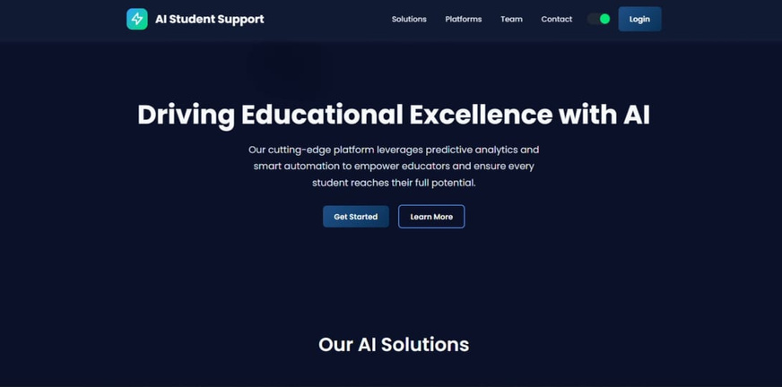
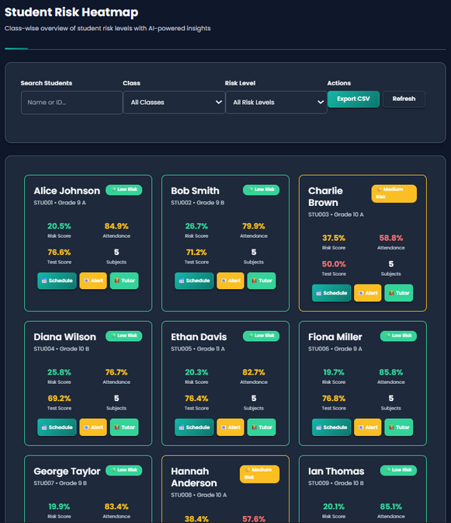
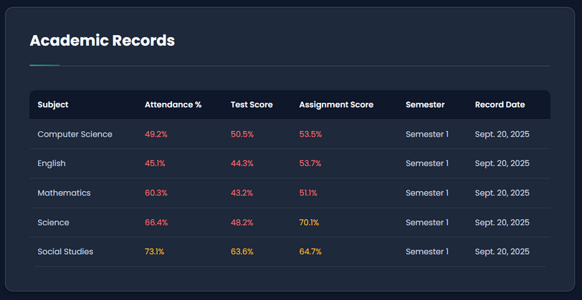
AI GUARDIAN:
PREVENTING DROPOUTS, PROTECTING FUTURES
Syntax Solvers
Problem:
Scattered student records across attendance, tests, and fees prevent early identification of struggling learners, often revealing issues only after it’s too late.
Solution:
Build a digital dashboard to unify attendance,
test, and fee data.
Apply simple ML/rule-based logic to
detect at-risk students.
Use color-coded visuals to highlight
risk levels.
Send timely alerts to mentors and
parents for intervention.
Prototype Link

Slide 4
MARKET AND OPPORTUNITY
Total Addressable Market (TAM): The global education technology market is projected to reach $404 billion by 2028, driven by rising digital adoption in schools globally.
Target Market : Our focus is on the Indian K-12 education sector, where over 260 million students are enrolled, and dropout rates are a critical challenge.
Primary Research: We conducted interviews with 50 school administrators and 200 students, revealing that 35% of students face challenges in staying engaged, leading to early dropouts.
Serviceable Addressable Market:
We aim to initially serve 5,000 private and public schools in India, with a potential expansion to Southeast Asia within five years.
Secondary Research: According to a 2025 study by the Ministry of Education, dropout rates in rural areas are 2.5 times higher, creating a significant need for predictive interventions.

Slide 5
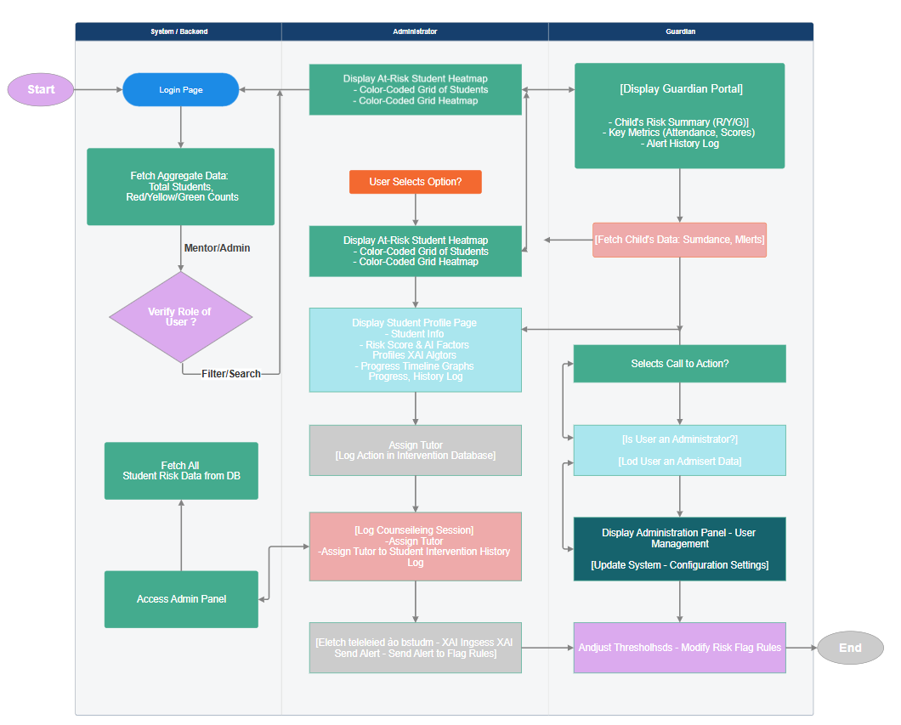

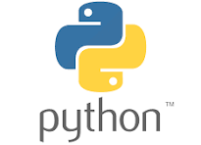

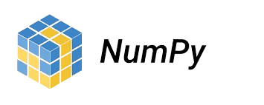

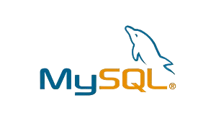
TECHNICAL APPROACH
Syntax Solvers

Slide 6
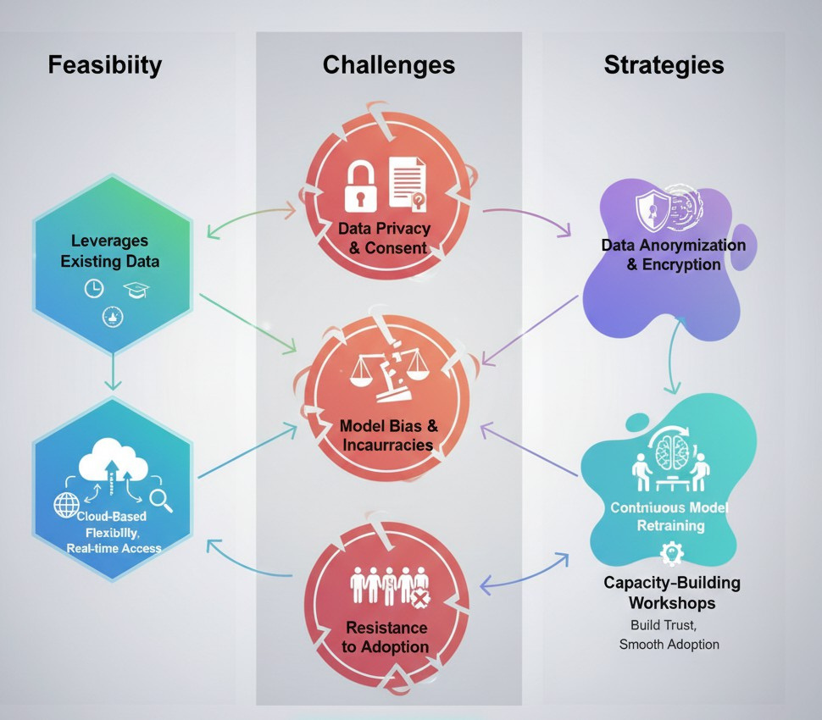
FEASIBILITY AND VIABILITY
Syntax Solvers
Feasibility:
Strategies:
The solution leverages existing student data sources such as attendance records, academic performance, and demographic details, reducing the need for new infrastructure.
Implement data anonymization, encryption, and strict security protocols to safeguard student information while maintaining compliance with privacy regulations.
A cloud-based architecture ensures scalability, flexibility, and real-time accessibility across institutions, making it easier to handle large datasets and multiple users simultaneously.
Conduct capacity-building workshops, training sessions, and awareness programs for teachers, mentors, and students to build trust, ensure smooth adoption, and highlight the system’s value.

Slide 7





Syntax Solvers
IMPACT AND BENEFITS
Early Support
Identify weak students
for timely intervention.
Unified Data
All student info in one platform.
Error Reduction
Minimizes mistakes and delays.
Teacher-Friendly Simple UI with easy training.
Efficiency & Collaboration
Saves time and improves
coordination.

Slide 8
RESEARCH AND REFERENCES
Syntax Solvers
Key Academic Papers
Seo, E.Y., Predictive modelling of student dropout risk — practical study analysing time-series student data and offering modelling guidance for education deployments (experiment + reproducible results) LINK
Kim, S., Student Dropout Prediction for University with High … (Applied Sciences / MDPI, 2023) — hybrid model and evaluation on university data; useful baseline models and feature engineering ideas. LINK
Rabelo, A.M., “A model for predicting dropout of higher education students” (ScienceDirect, 2025) — recent applied study that reports operational accuracy and highlights actionable features (attendance, attempts, grades). LINK
Data ingestion & spreadsheet
Google Data Fusion / CData guide LINK
Community notes / experience threads LINK
Practical guide: If You Must Use A Spreadsheet As A Database LINK
Dashboard & educational
Empowering Schools with Data — Inter-American Development Bank (IDB) study: LINK
Mass notification guide for schools — evaluation checklist and channel recommendations (email, SMS, push): LINK
Demo Video

Slide 9
THE TEAM
• We combine AI skills with real student perspective.
• Being students ourselves, we understand the real challenges behind dropouts and build solutions that are practical, scalable, and human-centric.
•We turn complex data into simple insights that drive timely action.
• This project comes from real experiences.
•We have seen talented students struggle silently and miss opportunities due to lack of timely support
•Through AI Guardian, we want to use technology to give every student the chance to succeed.
•Our goal is simple — ensure help reaches students before it’s too late.
Project Mentor – Dr. Ruchi Jain Assistant Professor, CSE (AI & DS), SISTec Bhopal Expertise: Machine Learning • Python • Deep Learning • Data Analytics Contribution: Guided the team in research, model development, and system design, helping us shape AI Guardian into a practical and scalable solution.
Team Members A passionate team of B.Tech students dedicated to building AI-driven solutions for real-world education challenges. Members: Iram khan
Ilya Ali
Hifza Hasan
Kehkasha Begum
Shahroz Khan

Slide 10
THANK YOU

