Slide 1

University Library Analytics Data Warehouse
Consolidating Legacy Systems for Real-Time Decision Making
Group X: [insert names of 3 team members]
Data Mining and Data Warehousing | 6 November 2026
Notes:
Good morning/afternoon. We are Group X, and today we are presenting our Data Warehouse solution for the University Library. Our system replaces their manual, 15-hour monthly reporting process with a fully automated, interactive dashboard.

Slide 2



Why a Data Warehouse?
3 disconnected systems
Manual and slow
Books (MySQL), Digital (Excel) and Rooms (CSV) never talk to each other.
The director spends 15+ hours a month combining reports by hand.
Inconsistent data
No historical trends
“CS” vs “CompSci”, mixed date formats, missing IDs.
Impossible to see how library usage changes over time.
Notes:
Currently, the library runs on three legacy systems that don't talk to each other. The director manually combines CSV and Excel files, which takes weeks and leads to contradictory reports. They can't answer basic questions like 'Which department uses the library most?' because the data is too messy.

Slide 3
Solution Architecture: ETL + Star Schema
3 Sources
Python Staging
MySQL Warehouse
Streamlit Dashboard
Books: MySQL
Digital: Excel
Rooms: CSV
Extract
Clean with Pandas
Transform
Star schema
Central, clean
history
Real-time KPIs
OLAP explorer
Role-based access
Bottom-up (Kimball) approach
Dimensional modeling
Built for speed and business usability.
One centralized star schema serves all three sources.
Notes:
To solve this, we built a Bottom-Up Kimball architecture. We extract raw data into a Python staging area, clean it, and load it into a MySQL Star Schema. Finally, we connected a Streamlit web app for real-time visualization.

Slide 4
The Star Schema
dim_date
Year · Quarter · Month
dim_student
Department · User Type
dim_resource
Books · E-books · Journals
Why a star schema?
Denormalized for faster OLAP queries
Fewer joins, so the dashboard loads instantly
Easy for non-technical users to understand
library_usage_fact
Downloads · Loan Days · Room Hours
dim_room
Room number
dim_time
Time slot
Notes:
We chose a Star Schema instead of a Snowflake because it reduces the number of joins required for complex queries, making our dashboard load instantly. The central fact table links to 5 dimensions.

Slide 5
Cleaning the Data (ETL)
Standardized formats
“ENG/Engr” → Engineering; “Room101/R-101” → R101
1
Date parsing
3 different date formats → ISO 8601 (YYYY-MM-DD)
2
Deduplication
50 duplicate records removed across the 3 systems
3
Handling nulls
Missing ReturnDate → “Not Returned”; missing room StudentID → “UNKNOWN” (walk-ins)
4
Notes:
We spent significant time cleaning the data. For example, the room booking system had three different ways of writing 'Room 101'. We used Python Regex to standardize all of them. We also removed exactly 50 duplicate records across the three systems.

Slide 6
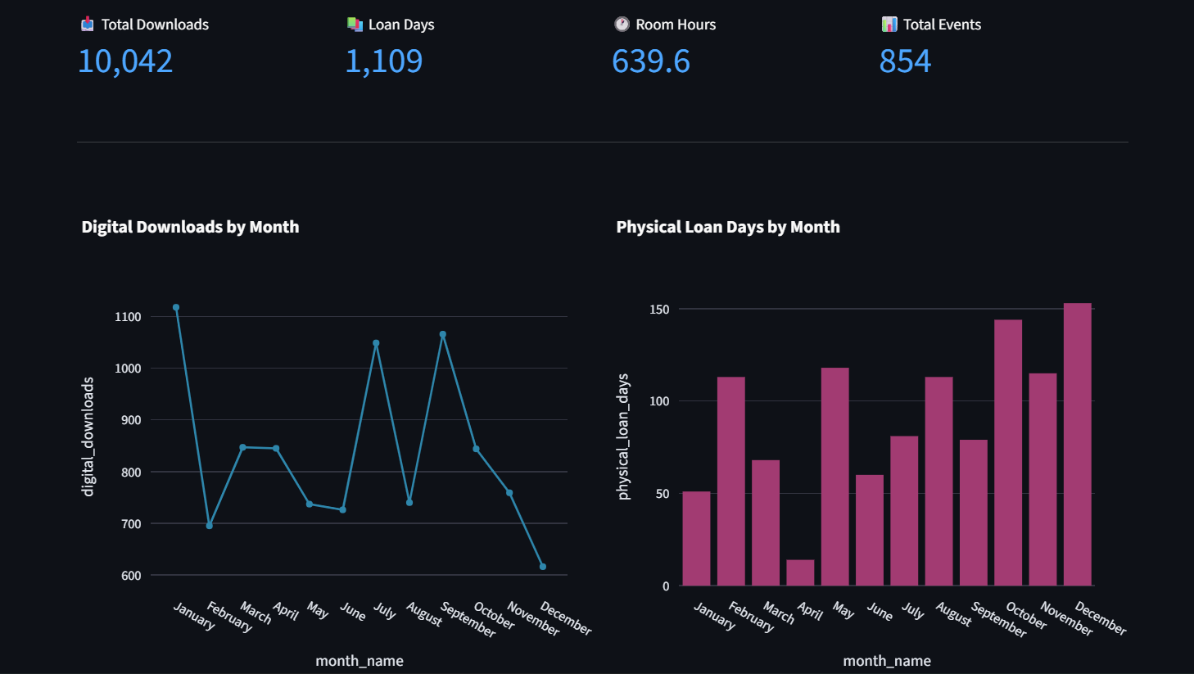
Live Demo: Executive Overview
10,042
1,109
639.6
Total downloads
Total loan days
Total room hours
Live demo: Streamlit Overview page (line and bar charts, monthly trends)
Notes:
Now, let's look at the live system. Here is the Executive Dashboard. The Library Director can instantly see high-level KPIs. Instead of waiting 3 weeks, they can see monthly trends of physical books vs digital downloads in real-time.

Slide 7
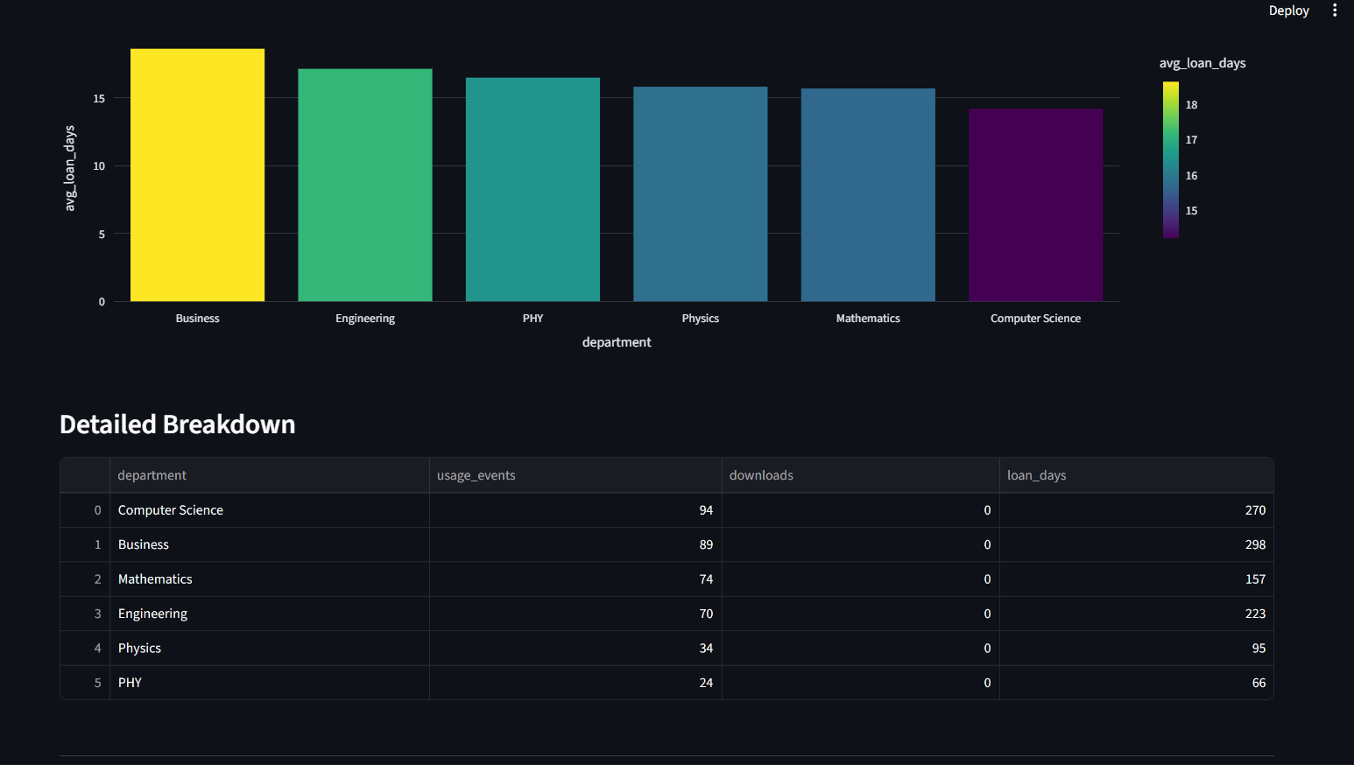
Live Demo: Department Usage
Live demo: Streamlit Departments tab (bar chart and pie chart)
Top users
Computer Science and Business are the heaviest users.
Also shown
Departments ranked by usage events, plus average loan duration.
Notes:
Here we can answer the question: 'Which departments use the library most?' We can see Computer Science and Business are the heaviest users. We can also see the average loan duration per department.

Slide 8
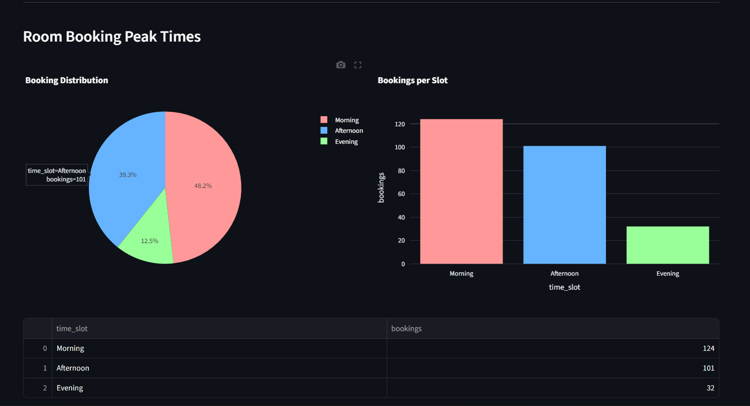
Live Demo: Peak Times & Rooms
Live demo: Streamlit Peak Times page (pie chart of room bookings)
124
room bookings in the morning slot, the busiest time of day
Helps schedule cleaning and staff shifts
Notes:
For the operational staff, we built the Peak Times dashboard. We can clearly see that mornings are the busiest time for room bookings, which helps management decide when to schedule cleaning or staff shifts.

Slide 9
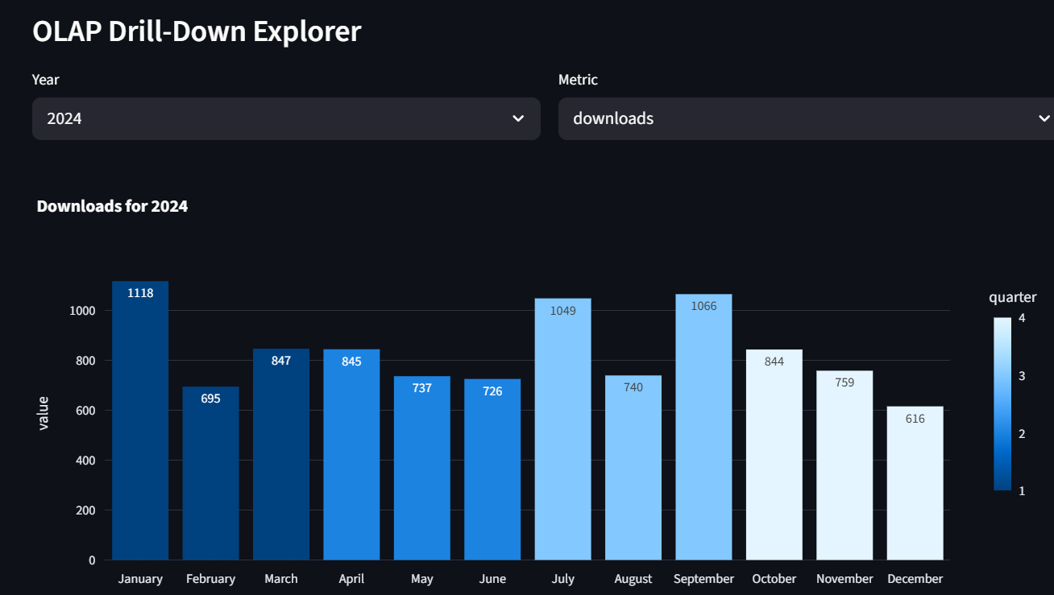
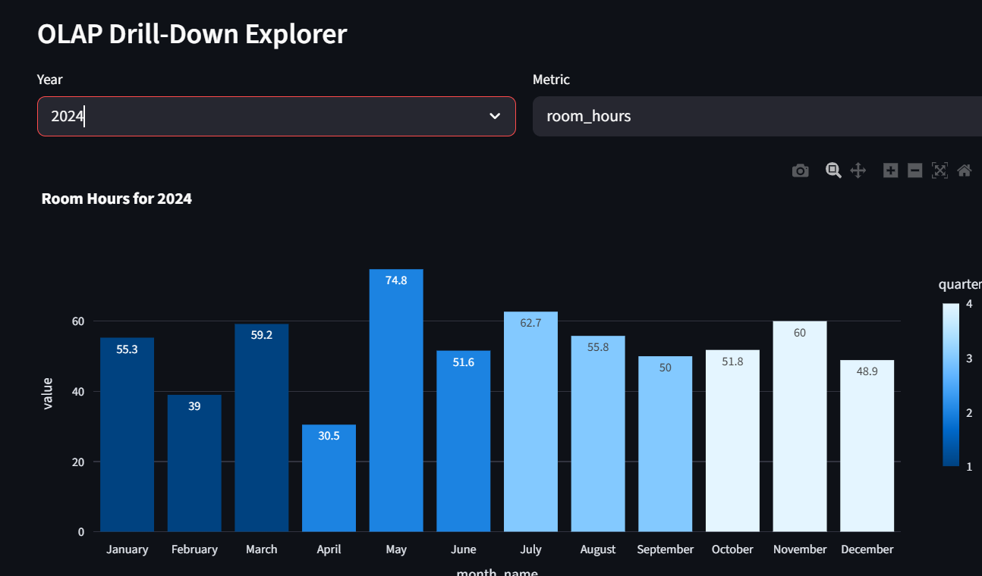
OLAP: Drill-Down & Roll-Up
Year
Quarter
Month
Day
Drill-down: Year → Day Roll-up: Day → Year
Live demo: Streamlit Explorer tab
Example
Notes:
Our system supports full OLAP operations. In the Explorer tab, we can drill down from a whole year, into a specific quarter, and look at monthly patterns. This is powered by complex SQL Group By queries with ROLLUP.

Slide 10




Security: Role-Based Access Control
Admin
Analyst
Department Head
Full access to every dashboard and all department data.
Read-only access to the Overview and Monthly Trends.
Restricted to their own department's data.
Demo: log in as “Dept Head”
The SQL query is rewritten on the fly, so only that department's data appears.
Notes:
Security was a major requirement. We implemented Role-Based Access Control. If the Head of the Engineering department logs in, the dashboard automatically updates its SQL queries to only show Engineering data, protecting other departments' privacy.

Slide 11



Backup & Recovery Plan
Full backup
Incremental backup
Recovery
mysqldump of the whole warehouse every Sunday at 2:00 AM.
Binary logs saved daily to capture every change.
Restore the last full backup, then replay the binary logs.
Result: zero data loss, restored up to the minute of failure
Notes:
To ensure business continuity, we designed a backup plan. We run full database dumps weekly, and incremental backups daily. If the system crashes, we can restore everything up to the minute of failure.

Slide 12
How We Handle Growth
New branch opening?
The schema already supports it: add a row to dim_room or create a dim_branch table.
Tracking reading time?
Add a reading_time column to the library_usage_fact table.
Data source changes?
The Python ETL is modular: update the extraction logic, not the warehouse.
Notes:
A mock stakeholder asked: 'What if we open a new branch next year?' Because we used a scalable Star Schema, we don't need to rebuild the database. We just add the new branch to our dimension tables.

Slide 13



What Surprised Us in the Data
Digital vs physical
Room bookings
Data quality
Digital downloads stay high; physical loans spike in October and December (likely exams).
Evening bookings are surprisingly low compared with mornings.
Exact duplicates (system errors) were more common than we expected.
Takeaway: stock up on textbooks right before exam season
Notes:
One of the most surprising insights was the physical book loan spike in October and December. This tells the library they need to stock up on textbooks right before exam season.

Slide 14
Lessons Learned
01
Handling mixed dates
Python format='mixed' in pd.to_datetime was a lifesaver for the three inconsistent date formats.
02
Git & GitHub
We learned to manage branches and resolve merge conflicts as a team.
03
Streamlit deprecation
Updated use_container_width to width='stretch' for the latest Streamlit versions.
Notes:
Our biggest technical challenge was dealing with the completely inconsistent date formats across the three systems. We also learned a lot about Git version control and resolving conflicts.

Slide 15

Thank You
Questions?
3 wks → live
100%
Ready
Reports now in real time
Deduplicated and standardized
Actionable insights for the Library Director
Notes:
In conclusion, we transformed the library's messy, disconnected data into a fast, secure, and interactive dashboard. We cut reporting time from weeks to seconds. Thank you for listening. We are now open to your questions.

