Slide 1
Music-JEPA
Learning a world model of sound from action
Ziyu Wang, Kun Fang, Yann LeCun · arXiv, July 2026
IRCAM Machine Learning Reading Group · presented by Luke Dzwonczyk

Slide 2
A world model predicts how the world responds to an action
next state = f(current state, action)
Notes:
A world model is a model of how an environment changes over time in response to actions. next state = f(current state, action). In current context, it’s helpful as it can allow an agent to simulate an action and see a predicted response before acting in the world
A generative model learns what piano music sounds like
A world model learns what happens to the music when you perform an action (like pressing keys)
JEPA does prediction in the latent space instead of raw audio (actually, pixel) space

Slide 3
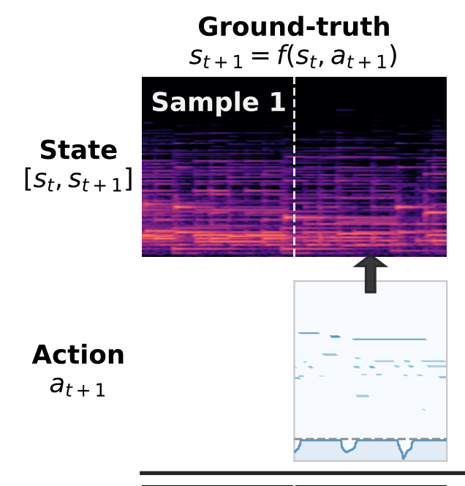
Music-JEPA learns to predict (embedded) piano sounds by predicting what MIDI will sound like
State: 2 seconds of audio
Action: 2 seconds of MIDI
next audio = f(current audio, next action)
Notes:
JEPA: prediction is done in the embedding space, so audio does not need to be generated during training and you can have a smaller model

Slide 4
Data
Dataset: MAESTRO v3, about 200 h of Disklavier piano with aligned MIDI, mostly classical.
State: 2 seconds of audio
Log-mel spectrogram
200 frames × 229 mel bins
Patch and embed
16 × 16 patches, each embedded (256-dim)
256 tokens × 256 dims
conv projection + positions

Slide 5
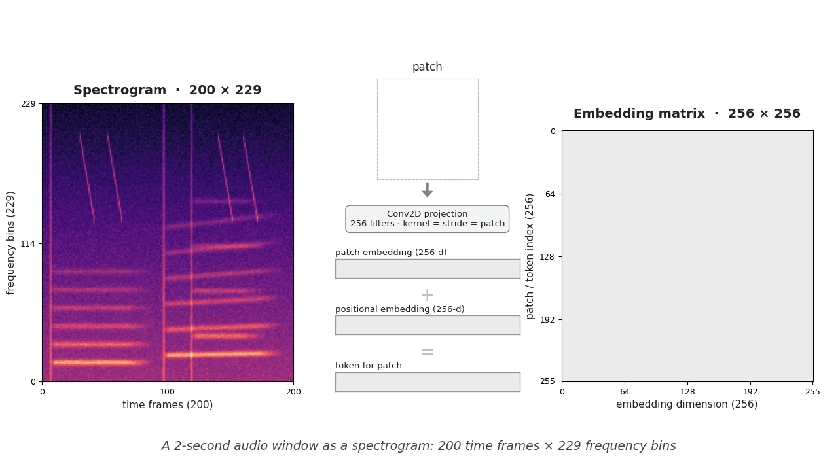
Data preparation
Notes:
The 256x256 embedding matrix is passed to the Transformer

Slide 6
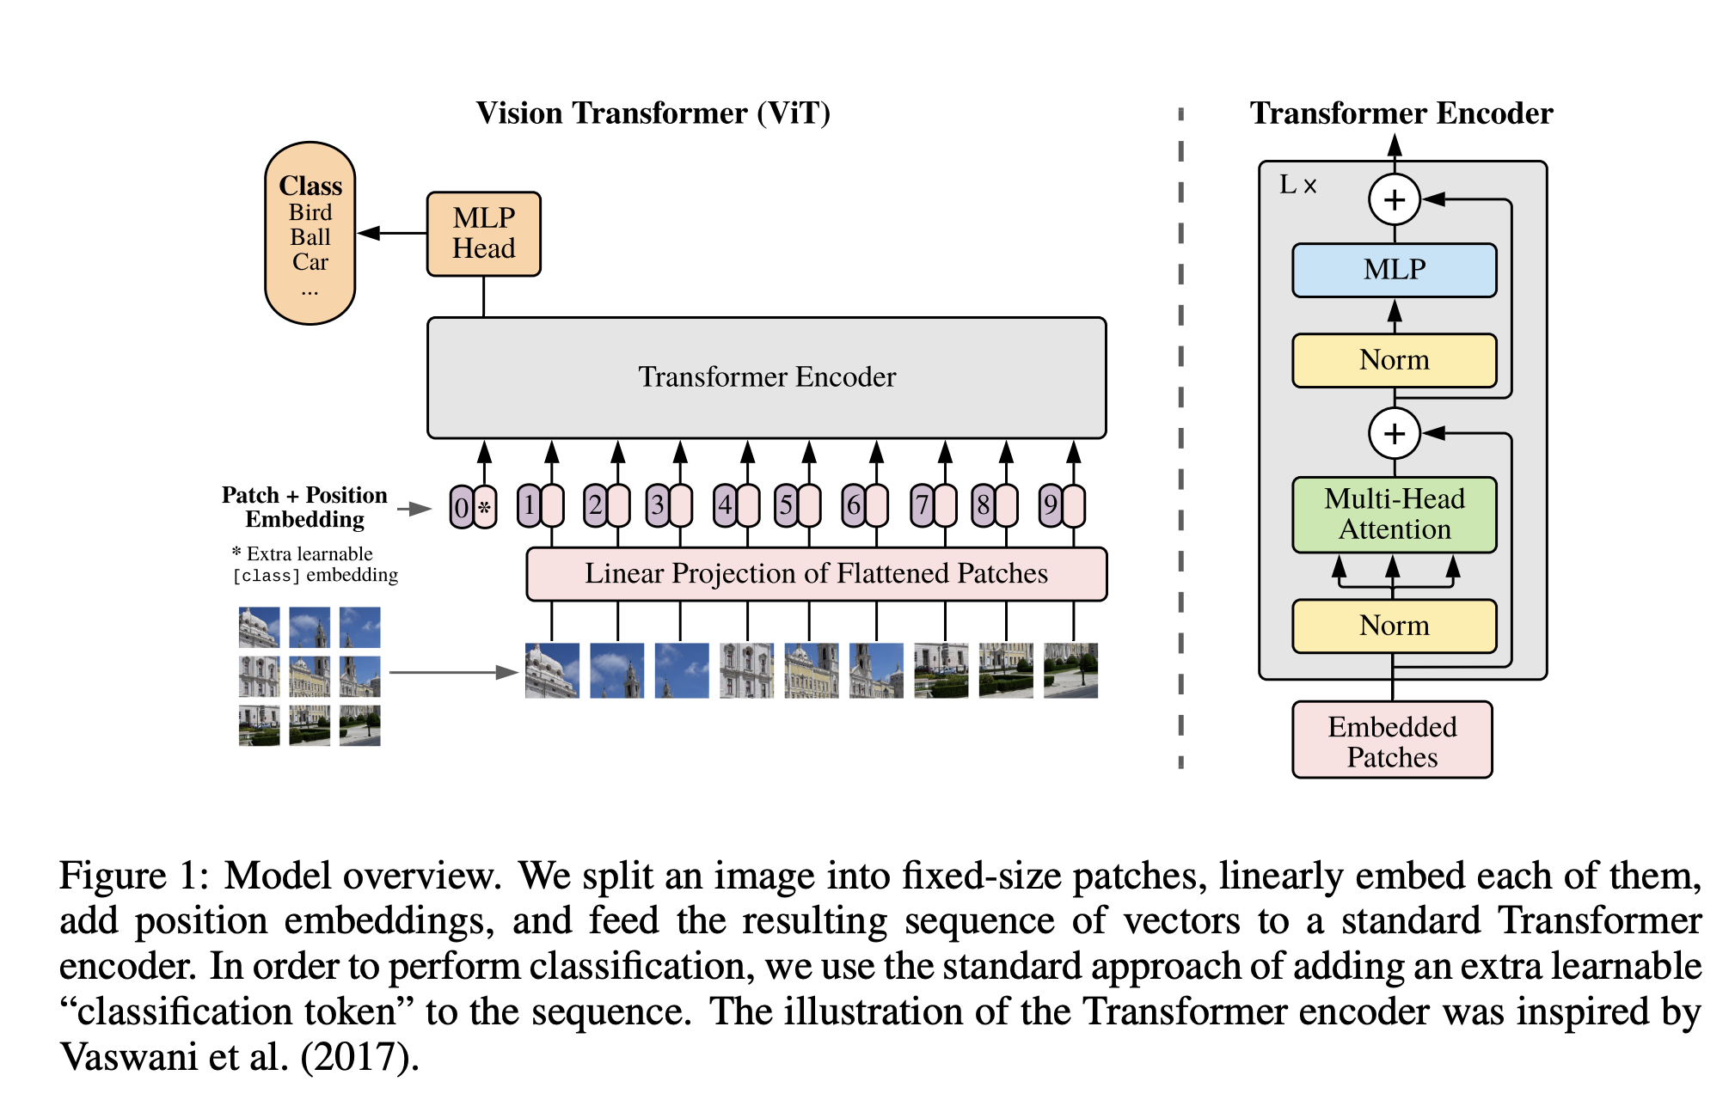
Architecture (19M parameters)
A. Dosovitskiy, et al. “An image is worth 16x16 words: Transformers for image recognition at scale,” in ICLR 2021,https://openreview.net/forum?id=YicbFdNTTy

Slide 7
JEPA predicts embeddings, so it never reconstructs audio in training
Joint-embedding prediction (JEPA)
Encode context and target separately, predict the target's embedding, compare in latent space.
Fine detail, such as noise or room tone, can be left out of the latent
New here: the predictor is conditioned on what the player did
A decoder is trained only afterwards, to listen to predictions

Slide 8
A student–teacher EMA keeps the embeddings from collapsing
Student encoders
Trained by backprop on the prediction loss
Collapse: an encoder that maps every input to one vector drives the latent MSE to zero
Targets come from a slow-moving, stop-gradient copy, so the student cannot chase them to a constant
LayerNorm on both outputs stops the loss dropping by just rescaling embeddings
Loss does not track convergence, so they train a fixed 15–25 epochs
EMA after every step
θ̄ ← 0.95·θ̄ + 0.05·θ
Teacher encoders
No gradients; produces the target embeddings

Slide 9
Actions let the model pick the true next state over nearby ones
Perturbation | Music-JEPA | AO-JEPA
Input state, nearby segment | 0.93 | 0.79
Target state, nearby segment | 0.99 | 0.58
Input state, random segment | 1.00 | 0.99
Target state, random segment | 0.99 | 0.98
Pitch-shifting the MIDI hurts most, especially by a tritone
Shifts under 50 ms and 10% velocity or pedal changes barely register
Decoded predictions follow counterfactual MIDI such as scales
Win rate: share of test cases where the perturbed input gives higher prediction error than the correct one (0.5 = chance). AO-JEPA: audio-only JEPA trained on MAESTRO.

Slide 10
Downstream classification tasks:
competitive with MERT at 7% of its size
Task (metric) | Music-JEPA | AO-JEPA | MERT
Beat tracking (F1 at 70 ms) | 0.62 | 0.60 | 0.58
Composer ID (top-1 accuracy) | 0.35 | 0.33 | 0.41
Composer ID (top-3 accuracy) | 0.70 | 0.66 | 0.65
Key recognition (weighted F1) | 0.76 | 0.76 | 0.65
Encoder parameters | 6M | 6M | 95M

Slide 11
Running the model backwards gives transcription: weak on notes, best on pedal
Model | Onset F1 | Pedal MAE ↓
Music-JEPA | 0.73 | 0.122
Kong et al. | 0.97 | 0.147
Yan et al. | 0.98 | 0.141
Zhang et al. | — | 0.134
(sₜ, sₜ₊₁, aₜ)
current + next audio, previous MIDI
h
inverse predictor; the JEPA stays frozen
âₜ₊₁
predicted next MIDI
Far behind supervised transcription on notes, but best on continuous pedal, which has a large, direct effect on the sound.

Slide 12
Takeaways
Learning audio and MIDI together improves performance compared to an audio-only model
Similar performance on downstream classification tasks compared to MERT, with only 7% of the parameters
More efficient training (less epochs required)

Slide 13
My Questions
Why use image ViTs rather than an audio encoder? Would we get better results with an audio encoder?
How is this similar or different to a semantic autoencoder? (What is a semantic autoencoder?)
The main advantage is a smaller model and efficiency in training, how could this be useful in audio generation?

