Slide 1

Three ways to learn from unlabeled images
I-JEPA, ANIMATED · FIGURE 2
Joint-embedding
Two edited copies of a photo must get matching embeddings. People have to choose the edits.
Generative
Hide patches and repaint every pixel. No edits needed, but effort goes into tiny details.
JEPA
Hide patches and predict their embedding. No edits and no pixels, just the meaning.
Notes:
This animates Figure 2. Every method gets two related inputs, x and y, and a loss D that scores how well they fit together. Joint-embedding methods like DINO and iBOT feed two hand-edited views of the same photo (cropped, recoloured) through two encoders and pull the embeddings together; they work well, but the edits bake in human assumptions. Generative methods like MAE hide patches and use a decoder to repaint the missing pixels, so the loss is in pixel space and the model spends effort on fine detail. JEPA keeps the masking idea but makes the prediction in embedding space: a predictor, told where the hidden block is (z), guesses what the y-encoder would output for it. I-JEPA is the image version of this third design.

Slide 2
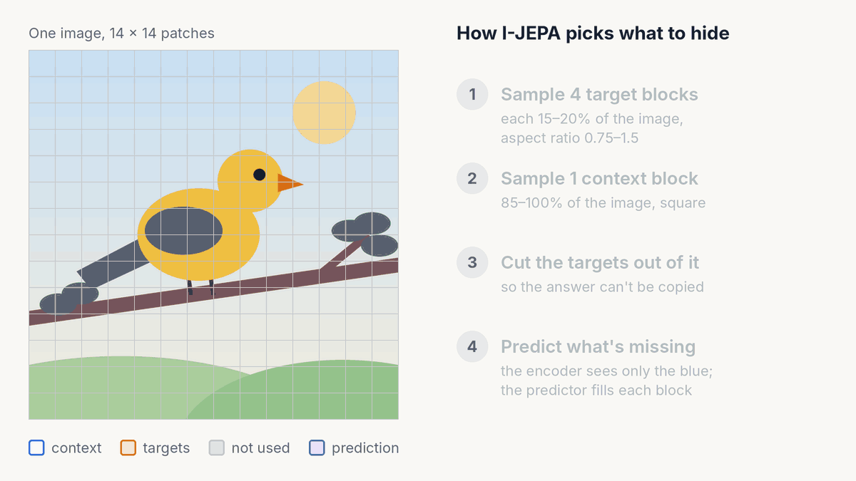
What gets hidden, and why it matters
FIGURE 4 · MULTI-BLOCK MASKING
Hide big chunks
Targets of 15–20% cover whole object parts. Let them shrink to 7.5% and accuracy falls from 54.2% to 19.2%.
Keep a wide context
A context of 85–100% scores 54.2%; 40–100% scores 31.2%.
Blocks beat random patches
Multi-block 54.2% vs. random patches 17.6%.
1% of ImageNet labels, linear probe, ViT-B/16, 300 epochs (Tables 6, 8, 9).
Notes:
This animates Figure 4 with the paper's actual sampler on a 14 by 14 patch grid. Step 1: four target blocks, each covering 15 to 20 percent of the image with an aspect ratio between 0.75 and 1.5; they may overlap. Step 2: one square context block covering 85 to 100 percent. Step 3: any part of the context that overlaps a target is removed, so the model can't just copy the answer. What's left is informative but sparse, about a quarter of the patches on average. Step 4: the context encoder sees only the blue patches and the predictor has to produce an embedding for every patch in each orange block. The second loop shows a fresh random draw. The ablations on the right are why these settings were chosen: small targets or a narrow context make the task too local or too hard, and random-patch masking (the MAE style) gives far weaker features here.

Slide 3
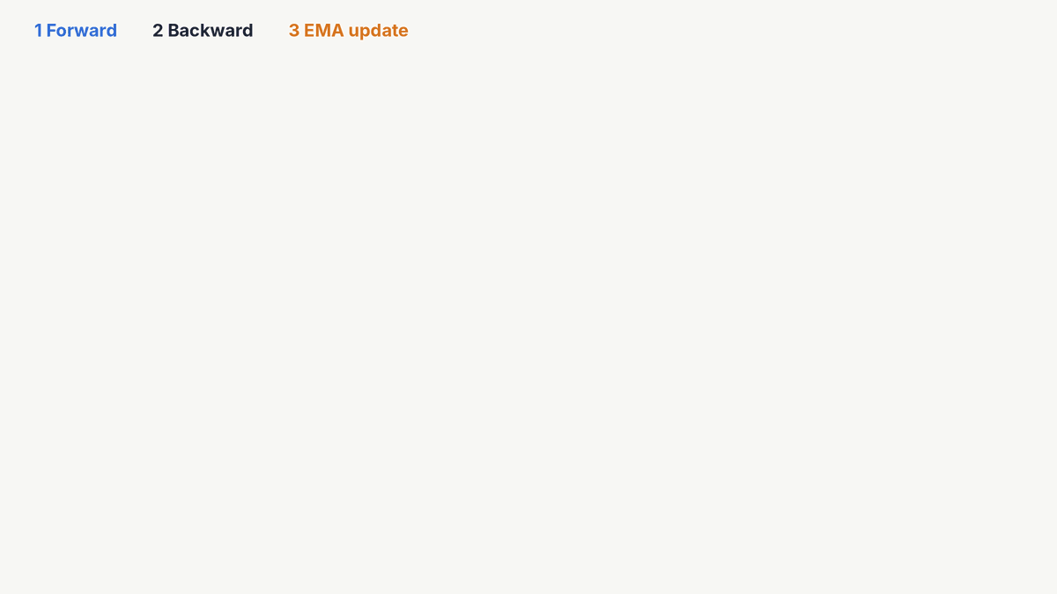
One training step, start to finish
FIGURE 3 · THE TRAINING LOOP
1 · Forward
The context encoder sees only the visible patches. The target encoder sees the whole image; targets are cut from its output.
2 · Backward
An L2 loss compares predictions with targets. Only the context encoder and predictor get gradients.
3 · EMA update
The target encoder follows the context encoder as a slow moving average.
Notes:
This animates Figure 3, one step of training. Forward: the same image goes two ways. The context encoder, a Vision Transformer, only processes the visible context patches. The target encoder processes the full image and outputs an embedding for every patch; the target blocks are then selected from that output. Masking the output rather than the input matters: it gives 67.3 versus 56.1 on the 1%-label test (Table 11), because each target embedding already carries information from the whole image. The predictor, a narrow ViT, takes the context embeddings plus one mask token per hidden patch (a shared learned vector plus that patch's position) and predicts the embeddings. It runs once per target block, four times per image. Backward: the loss is the average squared distance between predicted and target embeddings, and only the context encoder and predictor are trained by it. EMA update: the target encoder receives no gradients; its weights become 0.996 times their old value plus 0.004 times the context encoder's, with the 0.996 rising to 1.0 over training. This asymmetry is what stops the system from collapsing to a constant output.

Slide 4

Using the trained encoder
AFTER PRE-TRAINING · INFERENCE
Keep one encoder, frozen
The target encoder is kept. The context encoder and predictor are dropped.
Pool, then one linear layer
Average the patch embeddings into one vector. Only a linear layer on top is trained.
One model, many tasks
On Clevr depth, I-JEPA scores 72.4 vs. 53.4 for DINO and 62.8 for iBOT (Table 4).
Notes:
After pre-training, the predictor and the context encoder have done their job and are dropped. The paper evaluates with the target encoder: it is frozen, a new image goes through it, and its patch embeddings are average-pooled into a single vector (I-JEPA uses no class token). A linear layer, the only part trained at this stage, maps that vector to the answer. Swapping only the linear head lets the same frozen features do different jobs: ImageNet classification, and low-level tasks on the Clevr dataset such as counting objects (86.7) and estimating depth (72.4), where I-JEPA beats DINO and iBOT, the augmentation-based methods. The pictures in the animation are illustrations, not dataset images.

Slide 5

Better features for less compute
FIGURE 1 · TABLE 1 · RESULTS
+2.1
points over MAE at the same size (ViT-H/14), after 300 epochs instead of 1,600.
81.1
top-1 at 448 px, level with iBOT's 81.0, without hand-made views.
< 72 h
to pre-train a ViT-H/14 on 16 A100 GPUs.
Notes:
Left chart: ImageNet-1K linear evaluation from Table 1, for methods that, like I-JEPA, use no hand-made view augmentations. The encoder is frozen and only a linear classifier is trained. I-JEPA ViT-H/14 reaches 79.3 after 300 epochs, against 77.2 for MAE ViT-H/14 after 1,600; at 448-pixel resolution it reaches 81.1, level with iBOT ViT-L/16 (81.0), which does rely on augmentations. Right chart: compute. The paper says a ViT-H/14 trains in under 72 hours on 16 A100s (under 1,200 GPU-hours), over 2.5 times faster than a small ViT-S/16 trained with iBOT and over 10 times more efficient than a ViT-H/14 with MAE; those are stated as lower bounds, so the bars carry arrows. Predicting embeddings costs about 7% more per iteration than predicting pixels, but I-JEPA converges in roughly 5 times fewer iterations. Fine-tuned on full ImageNet it reaches 87.1 versus MAE's 87.8, so MAE still edges ahead when the whole network is fine-tuned.

Slide 6
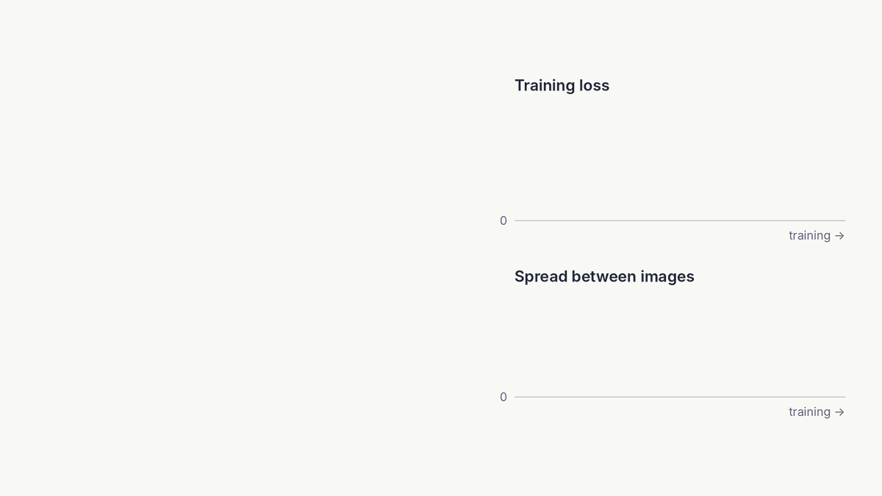
The loss alone does not rule out collapse
A CRITICAL READING · 1 OF 3
From reviews and follow-up papers
“JEPA’s prediction task admits failure modes, such as representation collapse”
Balestriero & LeCun (an I-JEPA author), LeJEPA, 2025
“the inefficacy of Exponential Moving Average (EMA) from I-JEPA in preventing entire collapse”
C-JEPA paper, NeurIPS 2024 (spotlight)
Notes:
The animation is a schematic, not data from the paper. I-JEPA's loss is the distance between predicted and target embeddings. If both encoders output the same vector for every image, every prediction matches its target and the loss is zero, so a falling loss on its own can't distinguish learning from collapse. The objective has no term against this (no contrastive loss, no variance penalty); the I-JEPA paper relies on an asymmetric design, an EMA target encoder with a stop-gradient plus a predictor, and says the EMA is essential without reporting runs that leave it out. Quotes: LeJEPA (Balestriero and LeCun, 2025): "Alas, JEPA's prediction task admits failure modes, such as representation collapse". It also describes its own loss as "the first practical loss for model selection without supervised probing". C-JEPA (NeurIPS 2024 spotlight) names as one of two limitations "the inefficacy of Exponential Moving Average (EMA) from I-JEPA in preventing entire collapse", and one of its reviewers (rating 7) wrote that "I-JEPA has room for improvement regarding the risk of model collapse." Fair to add: the runs reported in the I-JEPA paper train without collapsing; the point is that the protection comes from architecture choices, not from the objective.

Slide 7

Accuracy depends on hand-set mask choices
A CRITICAL READING · 2 OF 3
From reviews and follow-up papers
“A key component that determines the success of [V-JEPA] is multiblock design.”
ICLR 2024 reviewer of V-JEPA
“a delicate balance of hyperparameters. As a result, today’s JEPA training is brittle”
Balestriero & LeCun (an I-JEPA author), LeJEPA, 2025
Notes:
Data from I-JEPA's Tables 8, 9 and 10 (1% of ImageNet labels, linear probe, ViT-B/16, 300 epochs). The chosen settings score 54.2. Every other target size tried scores 19.2 to 42.4; a 40 to 100 percent context scores 31.2; one target block scores 9.0. Table 6 adds random-patch masking at 17.6, and Table 7 shows predicting pixels instead of embeddings drops 66.9 to 40.7. Other values are also set by hand: the EMA momentum schedule, predictor depth and width, a weight-decay ramp and a learning-rate warm-up. No error bars are reported. Quotes: an ICLR 2024 reviewer of V-JEPA (rating 6): "A key component that determines the success of VJPEA [sic] is multiblock design. I would have liked to have seen careful ablation of the design choices of this block including the scale factors and also aspect ratios used to design the mask". LeJEPA (2025): state-of-the-art recipes "rely on heuristics", including "teacher–student networks with carefully tuned EMA schedules", "and a delicate balance of hyperparameters. As a result, today's JEPA training is brittle." A TMLR reviewer of the revised V-JEPA: "relatively light on elaborating and expanding on hyperparameters". Fair to add: other methods tune settings too (MAE's mask ratio, DINO's augmentations), and I-JEPA uses the same masking settings unchanged from ViT-B up to ViT-G.

Slide 8
The gains depend on how you evaluate
A CRITICAL READING · 3 OF 3
From reviews and follow-up papers
“the evaluation is focused on linear probing, which … is usually inferior to fine-tuning”
ICLR 2024 meta-review of V-JEPA
“such models do not have the best performance when frozen, but even finetuning 1 or a small number of layers makes a large difference”
ICLR 2024 reviewer of V-JEPA, on MAE-style models
Notes:
Data from I-JEPA's Tables 1, 2, 3, 4 and 15, comparing I-JEPA with the best other method in each table. I-JEPA leads where the encoder stays frozen and only a linear layer is trained on ImageNet (+0.1 over iBOT, +1.6 over MSN with 1% of labels). It trails when the whole network is fine-tuned (87.1 vs MAE's 87.8), on transfer probes (CIFAR-100, Places205, and iNaturalist by 9.7 points behind iBOT) and on Clevr counting (MAE 90.5 vs 86.7), and ties MAE on depth. Quotes: the ICLR 2024 meta-review of V-JEPA (rejected; scores 3, 3, 5, 5, 6): "the evaluation is focused on linear probing, which despite being important, isn't always the way how these models are used and is usually inferior to fine-tuning." The same meta-review: "all reviewers find that the propose extension is a straightforward application of I-JEPA to video and lacks novelty." Reviewer HoWZ (rating 3): "It is well known since even the original MAE work that such models do not have the best performance when frozen, but even finetuning 1 or a small number of layers makes a large difference". I-JEPA's own CVPR 2023 reviews are not public; OpenReview lists only the paper record. The other side: a revised V-JEPA was accepted at TMLR in 2024 with all reviewers recommending acceptance. Training on ImageNet-22K narrows the iNaturalist gap (55.3 with ViT-G). C-JEPA and LeJEPA keep the JEPA idea and add a regulariser rather than abandon it, and I-JEPA's compute savings stand.

Slide 9
All eight animations, played once
I-JEPA, ANIMATED · OVERVIEW
1 · Architectures
2 · Masking
3 · Training step
4 · Inference
5 · Results
6 · Collapse
7 · Mask settings
8 · Gains
Notes:
All eight animations on one slide. Each plays once and stops on its final frame, which shows the finished diagram or chart. The full-size versions with explanations are on the slides before this one.

