Slide 1


DIGITAL EXPERIMENTS · GAME UX STUDIO
Your ship date isn't moving.
Your UX is the final boss.
Senior game UX, embedded in your team in days — not months.
Digital Experiments embeds senior designers inside game studios — the same team that shipped UX on Valorant, World of Warcraft, and Monopoly Go.
better design, better games
DXP

Slide 2
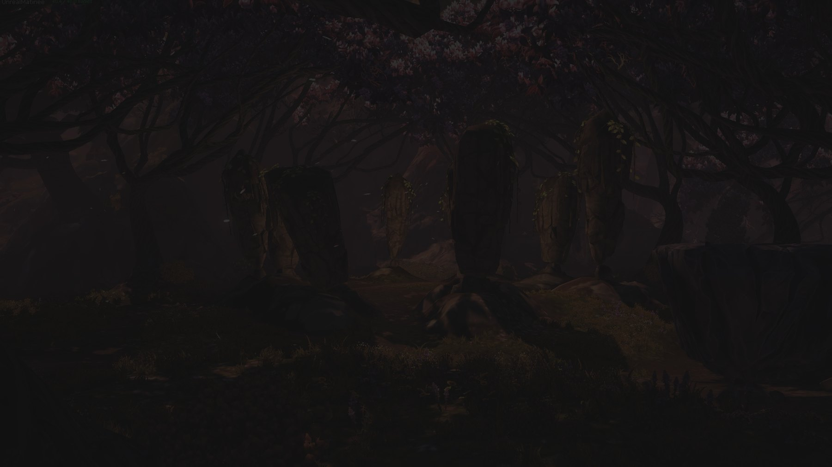
THE PROBLEM
The gap between your ship date and your UX bandwidth is real.
Your players decide in the first five minutes. Your team is already at capacity.
WHAT YOU ACTUALLY NEED
A senior team that has shipped this exact kind of problem before — and can be inside your workflow before your next standup.
Hiring a senior game UX designer takes three to six months — and one bad hire to regret. A freelancer gives you hands.
That is what Digital Experiments does.
DXP
02 / 14

Slide 3

WHO WE ARE
Led by Irena Pereira. 25+ years.
A hand in dozens of shipped titles.
A game UX studio founded by Irena Pereira — a UX lead with 25+ years of shipped experience across mobile, PC/console, and live-service games.
Valorant
World of Warcraft
UX contract engagement — director of a team of 5
in-house at Blizzard Entertainment
Monopoly Go
Blankos Block Party
in-house at Scopely — GTM, art overhaul, UA loop
Mythical Games
Game of Thrones: Conquest
Chief Puzzle Officer
game UX / UI
battle-screen clarity
Irena Pereira
FOUNDER & UX LEAD
Games are the only thing we do —
the ones you grew up on, and the ones you're grinding right now.
DXP
03 / 14

Slide 4

HOW WE WORK
In your team within 24 hours.
In your Figma files within the week.
We embed directly inside your studio — attending standups, working in your tools, delivering production-ready Figma files on your sprint cadence. No vendor onboarding tax. No handoff lag.
1
DAY 1
2
WEEK 1
3
WEEK 2+
Embedded
Shipping
Compounding
In your team and tools — standups, channels, sprint board.
Production-ready Figma files delivered on your cadence.
Embedded alongside your team, or scoped project-based — your call.
Tools Figma · your PM stack · your communication channels Working model embedded or project-based — your call
DXP
04 / 14

Slide 5
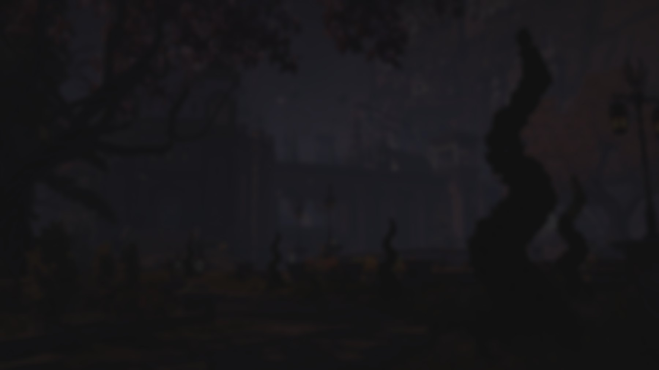
SERVICES
Four ways to engage
Execution, strategy, audits, or team capability — the same senior people either way.
Embedded UX & UI
UX Strategy
Your senior hands this sprint. UI design, UX flows, Figma handoff, player-facing interfaces — done while your permanent team keeps shipping.
Clarity before execution: product vision, research, design-system architecture, or a plan for your next title.
UI/UX Audits
Team Workshops & Training
A senior teardown of your existing game or build — onboarding, moment-to-moment play, readability, accessibility — with prioritized recommendations.
We level up the team you already have. UX process, player-centered design, research methods — taught by people who have shipped the work.
A GOOD PLACE TO START
Need hands this sprint or a UX strategy for your next title? Same team, same week.
DXP
05 / 14

Slide 6
LET'S TALK
Let's talk about your ship date.
30 minutes. No deck on our end — just your situation.
If anything in the first five slides sounds like your current quarter,
book time directly on Irena's calendar.
BOOK A CALL →
More case studies and capabilities follow — but this is a good moment to reach out.
DXP
06 / 14

Slide 7
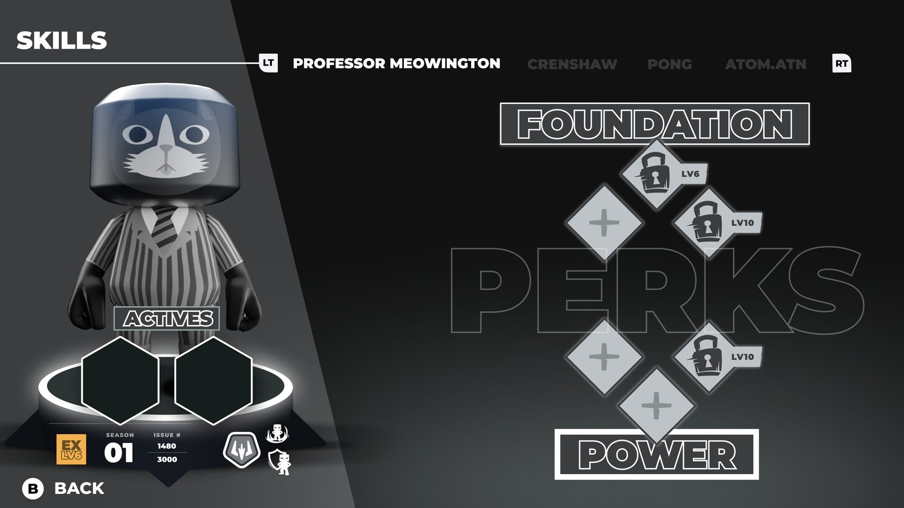
CASE STUDY · MYTHICAL GAMES
Embedded execution under crunch
In their team within 24 hours of first contact.
SITUATION
Mythical Games had features due on Blankos Block Party — and no UX bandwidth to execute them at the quality the game demanded.
WHAT WE DID
Embedded within 24 hours of first contact, delivered working Figma files within days, and redesigned the skills system — full UX and UI — inside their existing sprint structure without disrupting the team's cadence.
BLANKOS BLOCK PARTY — SKILLS SYSTEM
“From start to finish, the Digital Experiments team was impeccable.”
— Andrew Petrie, Mythical Games
RESULT
Skills feature redesigned end-to-end and delivered into their live sprint workflow.
DXP
07 / 14

Slide 8
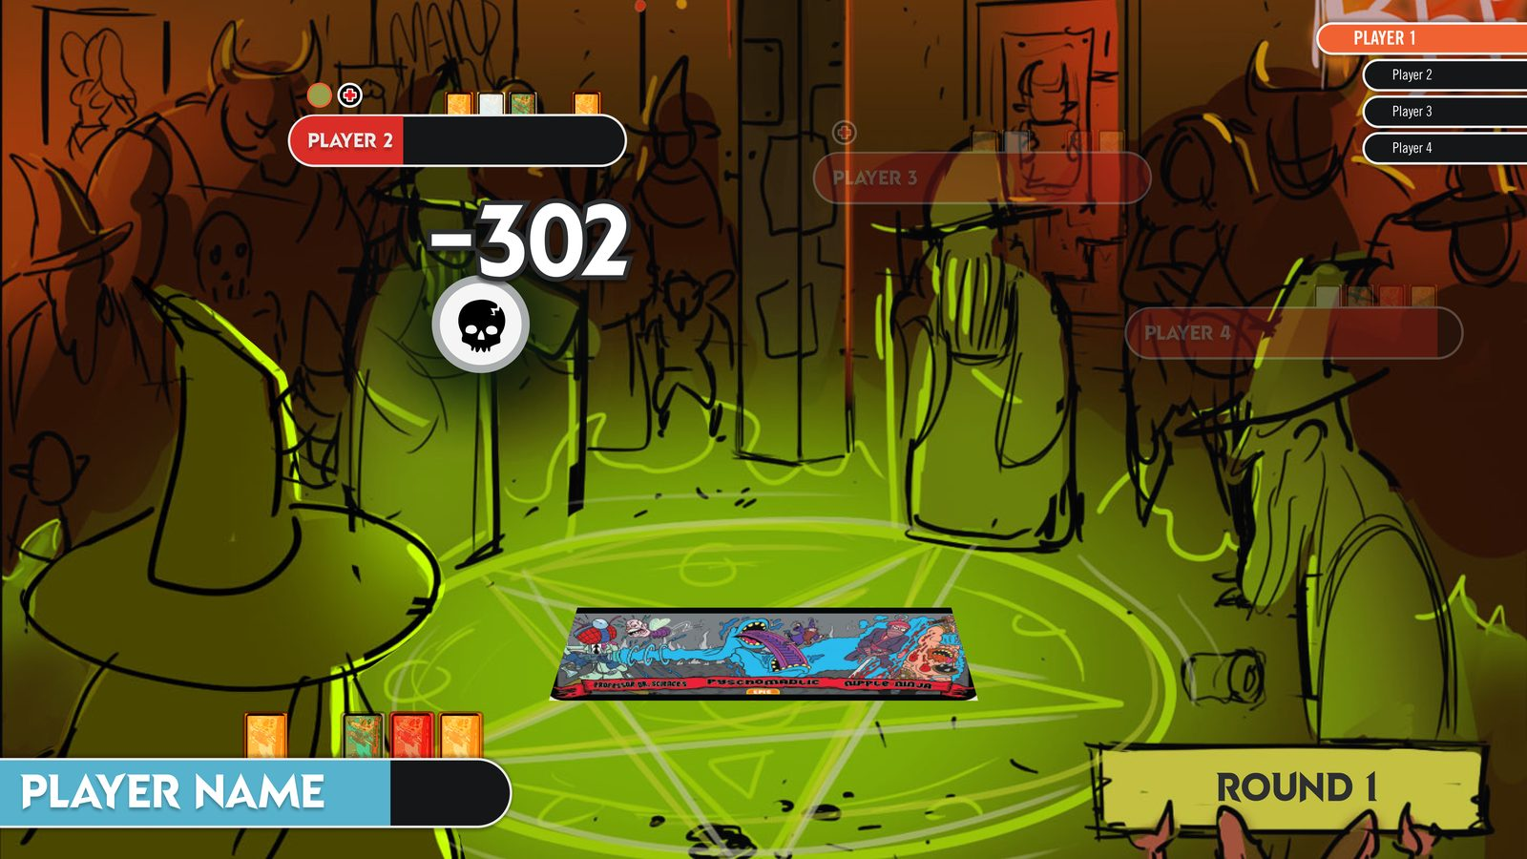
CASE STUDY · EPIC SPELL WARS
Combat prototype, lean budget, short timeline
Constraints didn't change what players needed to understand.
SITUATION
The team came in with a short timeline, a lean budget, and art that deserved better UX than the time would normally allow.
WHAT WE DID
Concepted the combat prototype and shipped the deck-builder UI — UX and UI execution together, scoped to what the timeline and budget could bear without cutting what players actually needed to play.
EPIC SPELL WARS — COMBAT / DECK-BUILDER UI
Constraints respected. No apology language.
RESULT
The game never made it to market — but the prototype proved the gameplay, which is exactly what a prototype is for.
DXP
08 / 14

Slide 9
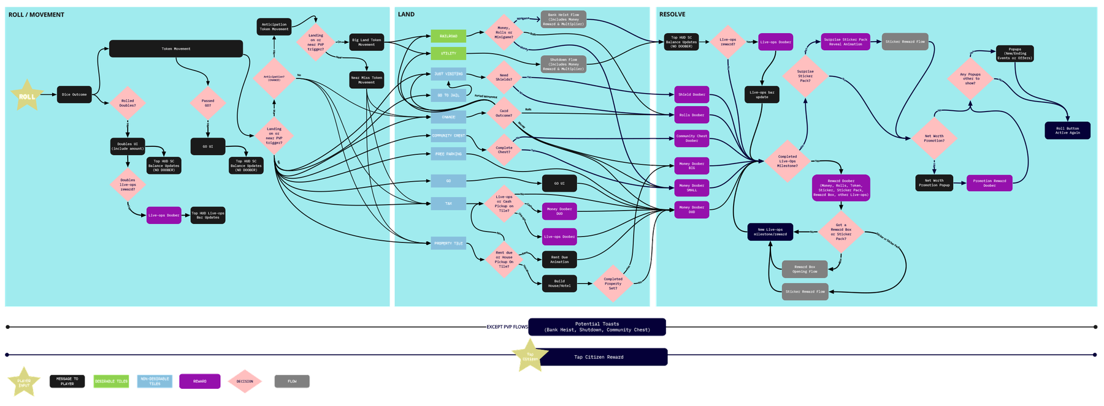
FOUNDER CREDIT · MONOPOLY GO
FOUNDER CREDIT — IRENA, IN-HOUSE AT SCOPELY (PRE-DXP)
From a misaligned team to an organic growth loop
SITUATION
Monopoly Go carried a brand players recognized, but the team behind it was struggling to align and communicate — and the product showed it.
WHAT IRENA DID
Led a GTM clarification built on an aligned player-persona strategy, then a full art overhaul — coordinated moment-to-moment with music, audio, animation, and VFX — so every beat of play landed as one experience.
MONOPOLY GO — BOARD / TURN MAP
RESULT
Gameplay changes that prioritized an organic UA loop through social design — the game grows because players bring their friends, not the UA budget. Validated week over week with playtests and post-play surveys.
Aligned player-persona strategy, end to end.
Before/after art-overhaul samples available in a live meeting.
DXP
09 / 14

Slide 10
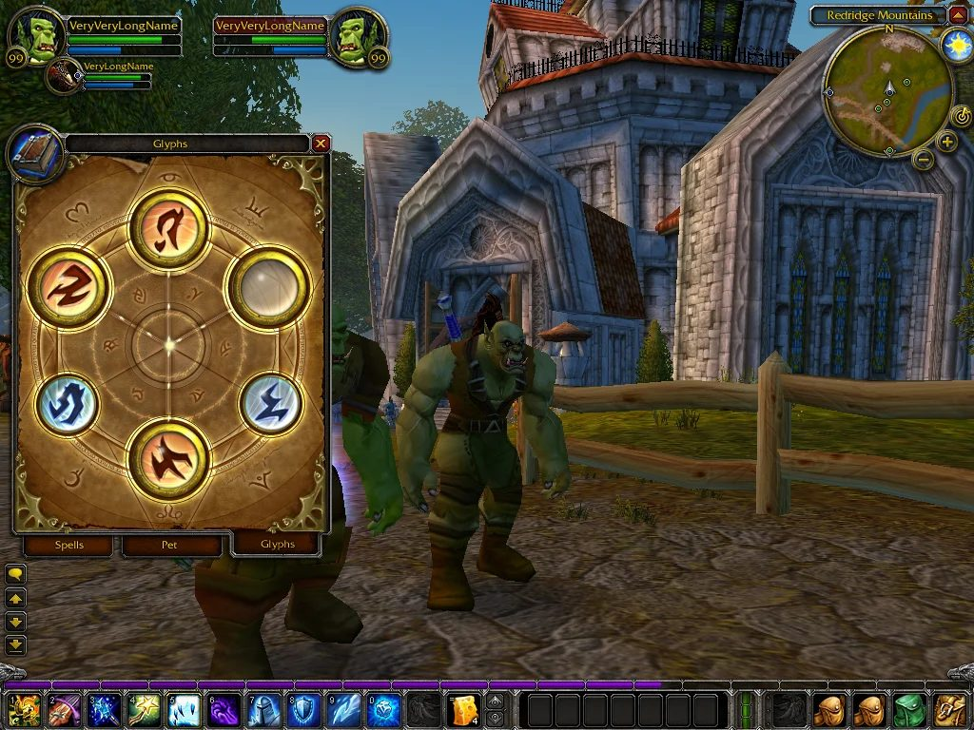
CASE STUDY · WORLD OF WARCRAFT
Blizzard-scale UI complexity
A new crafting interface for millions — without adding cognitive load to an already deep game.
SITUATION
WoW's inscription system needed a new interface that matched the game's visual language — a crafting loop players would use repeatedly — without adding confusion to a game that already asks a great deal.
WHAT WE DID
From a rudimentary design document to a fully functional inscription interface. We began with a summoning-circle motif and expanded it with glyphs, slots, and glowing geometry — new customization without breaking familiarity.
INSCRIPTION INTERFACE — WORLD OF WARCRAFT
RESULT
Shipped to the live game.
DXP
10 / 14

Slide 11
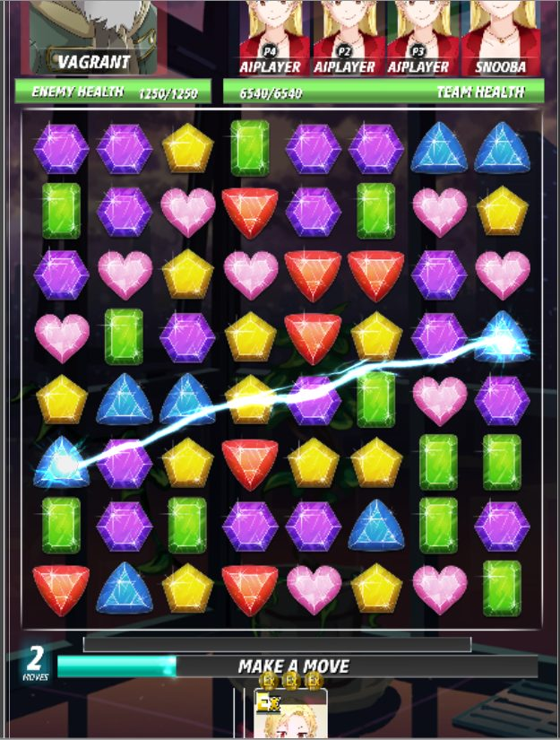
CASE STUDY · CHIEF PUZZLE OFFICER
Battle screen clarity
A dense real-time battle screen, made legible without losing the fun.
SITUATION
Chief Puzzle Officer — corporate espionage with anime wackiness, a real-time card-builder with multiplayer — needed a battle screen that communicated state without interrupting play.
WHAT WE DID
Brought AAA know-how to an indie mobile title: information hierarchy, state communication, and visual clarity within the game's art direction.
CHIEF PUZZLE OFFICER — BATTLE SCREEN
AAA clarity, indie budget.
DXP
11 / 14

Slide 12
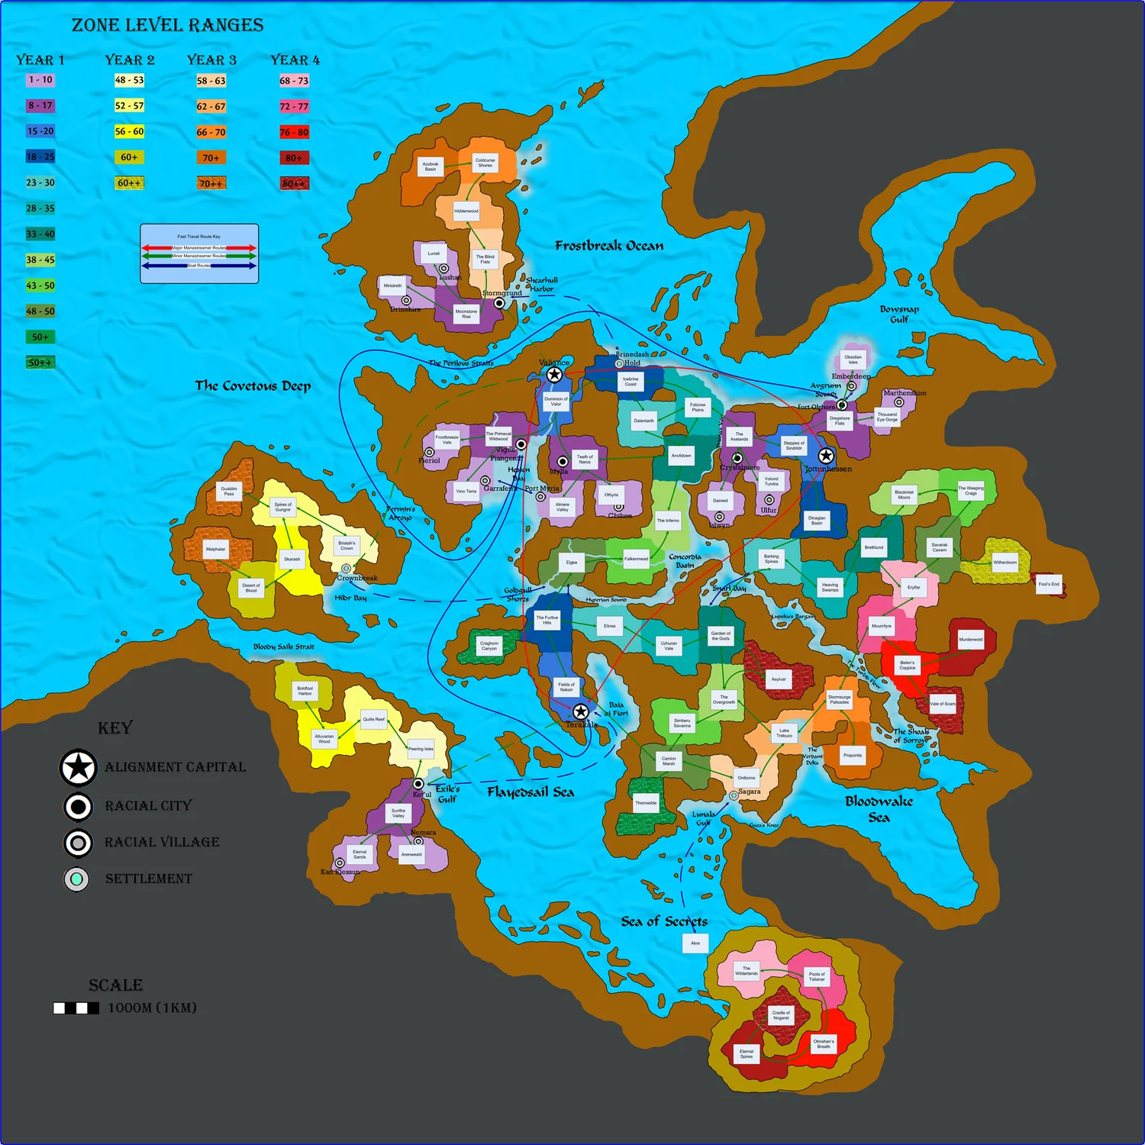
TEAM PEDIGREE · PROJECT COPERNICUS
Some of the best UX work ships on games the public never played.
LARGE-SCALE WORLD-NAVIGATION UX, FROM A CANCELLED MMO
The DXP team designed the fast-travel map system for Project Copernicus, the 38 Studios MMO that never shipped. Every open-world MMO needs fast travel; ours made the time investment legible and gave players logical breaks.
We include it because the quality of the work doesn't depend on whether the game shipped. It reflects the caliber of problems this team has solved.
PROJECT COPERNICUS — FAST-TRAVEL MAP (38 STUDIOS)
DXP
12 / 14

Slide 13
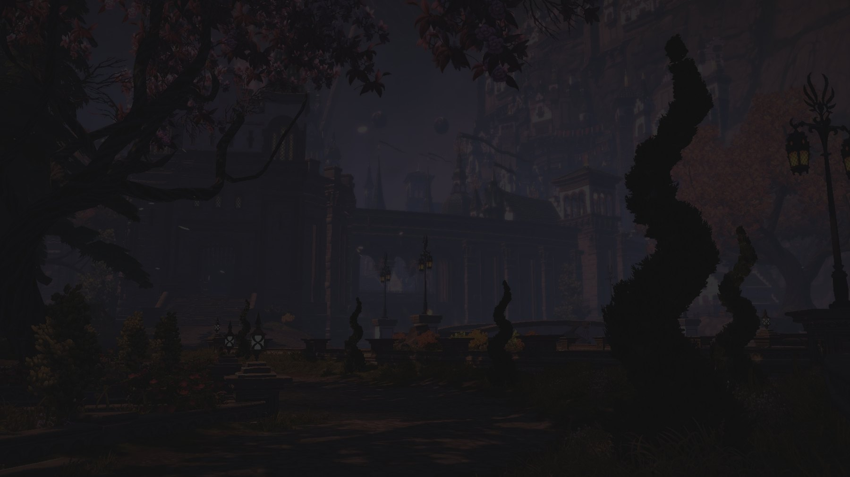
STRATEGIC CAPABILITIES
When you need more than hands
UX strategy and team training — from the same people who execute.
UX Strategy
Team Workshops & Training
Product-vision alignment, UX research, design-system planning, UX audits. The output is not a framework — it is a decision your team can act on by next sprint. Clear system architecture is what makes a 24-hour embed possible.
Working sessions that change how your team designs — hands-on process work tied to a real problem on your current project, not lecture-style training. Player-centered research, design-critique structure, and UX process for studios without a dedicated UX team.
DXP
13 / 14

Slide 14
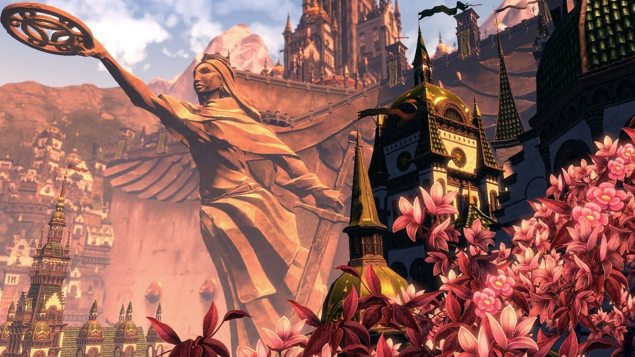
DIGITAL EXPERIMENTS
Let's talk about your next title —
or your current crunch.
Your ship date is not moving. Let's make sure your UX is ready for it.
We embed senior game UX designers in your team within days. We've shipped UX on Valorant, World of Warcraft, and Monopoly Go — and we know what crunch looks like from the inside.
BOOK A CALL →
EMAIL sayhi@digitalexperiments.com
DXP
better design, better games

